Slide 1
Waste Diversion at Southcoast Health
Nicole Rosa
Director SCM Logistics, PM & Sustainability

Slide 2
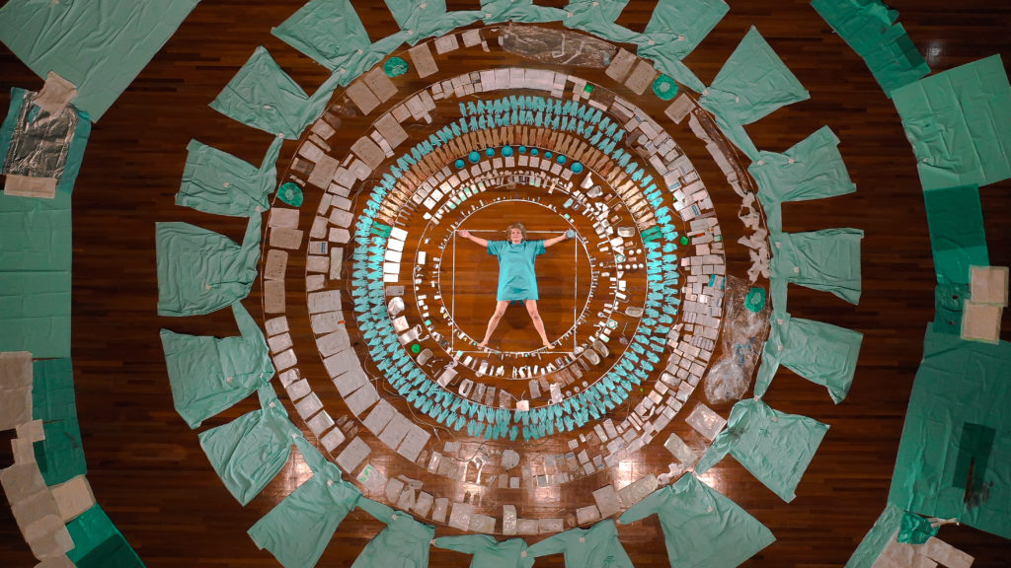
Source: Health Waste, Maria Koijck

Slide 3
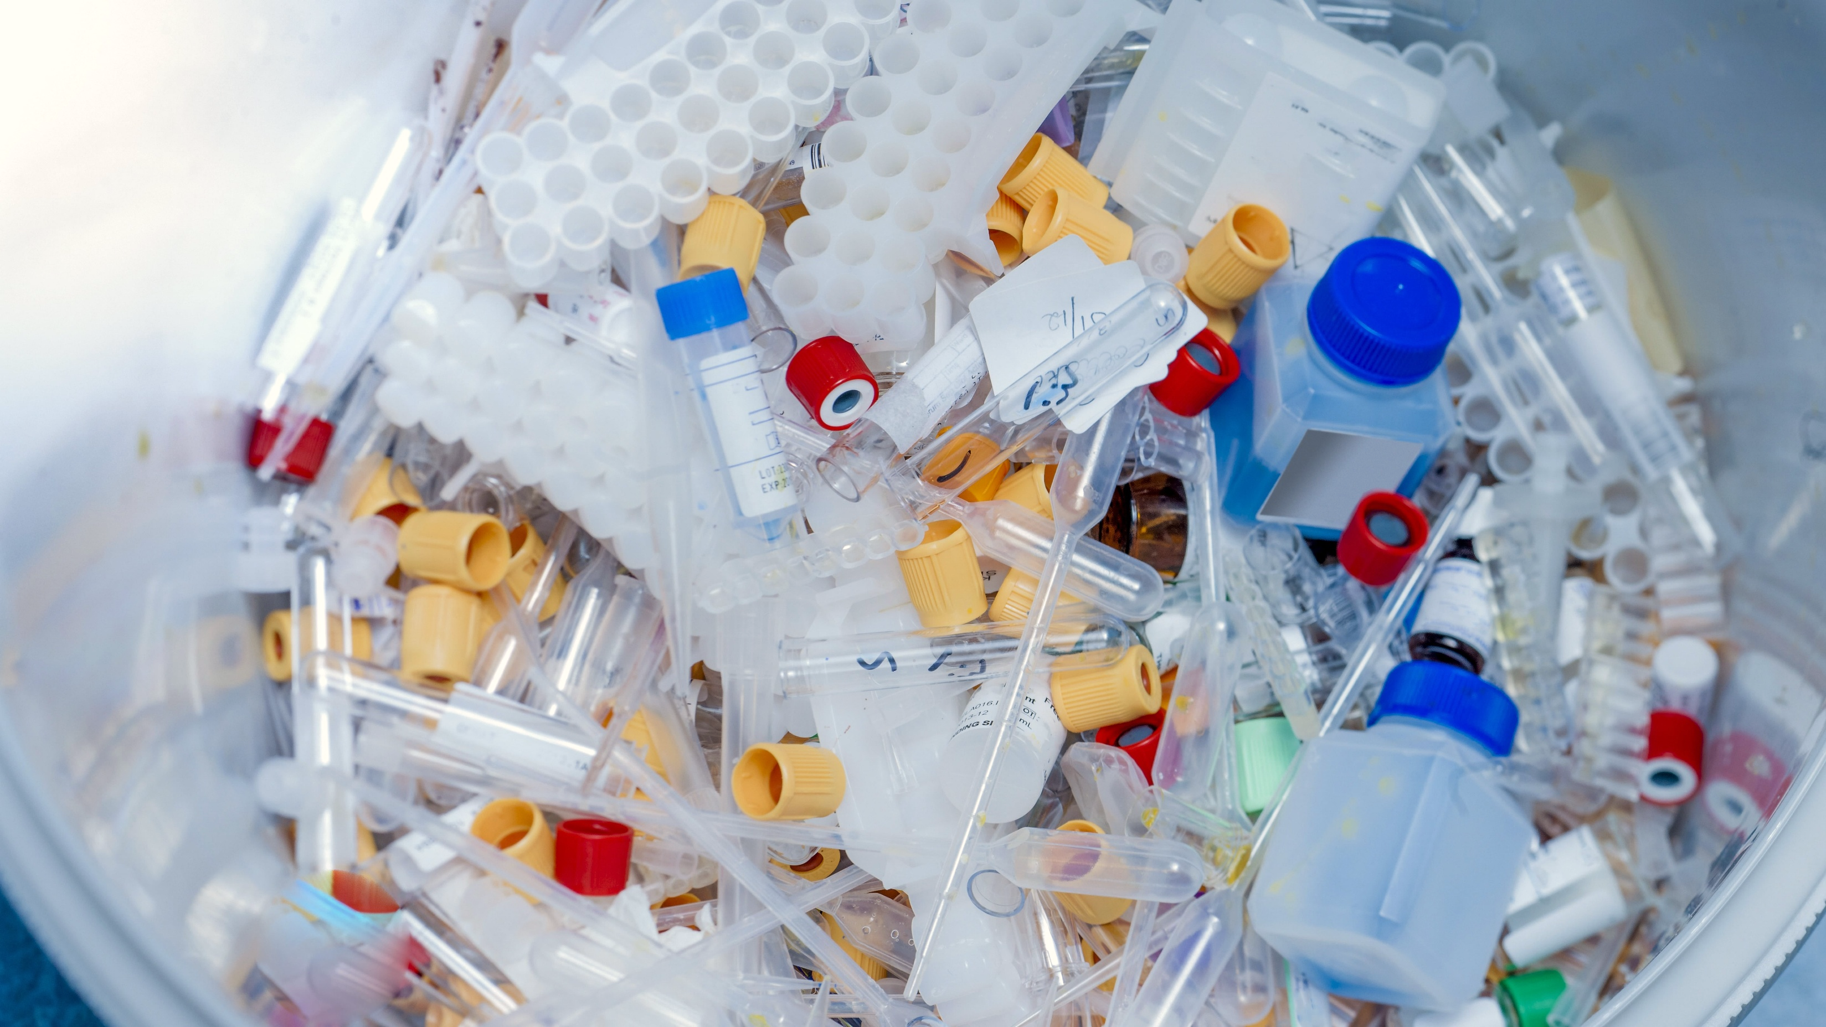
Healthcare’s Impact
According to Practice Greenhealth, hospitals generate more than
29 pounds of waste per staffed bed each day.
According to the American Hospital Association, there are approximately 907,000 staffed hospital beds in the United States.
This means U.S. hospitals generate approximately
26 million pounds of waste every day, or
~9.6 billion pounds each year
Sources:
Practice Greenhealth Waste Management Benchmark Data;
American Hospital Association Fast Facts on U.S. Hospitals

Slide 4
Designing Waste Out of the System
Optimize workflows
The most sustainable waste is the waste that is never created
Notes:
According to Practice Greenhealth, Hospitals generate over 29 pounds of waste per bed per day.
For Calendar Year 2025 Southcoast generated > 4 million pounds, ~ 3 million is trash
This upside down triangle is the strategy we use to reduce waste.
“The most sustainable waste is the waste that’s never created.”
We first look to optimize workflows, minimize packaging and reduce waste. Next, we look to reuse items where appropriate, then we move to Recycling and composting. After this, Waste-to-energy is what we would resort to and then the
Landfill is our last resort
Emphasize intention:
Landfill isn’t the goal — it’s what’s left after every better option has been exhausted.
Reducing reliance on single-use items supports both sustainability and budget resiliency.

Slide 5
Designing Waste Out of the System

Slide 6

consolidated shipments reduce packaging materials and save on freight costs.
Standardized digital processes have reduced redundant steps and paper waste

Slide 7
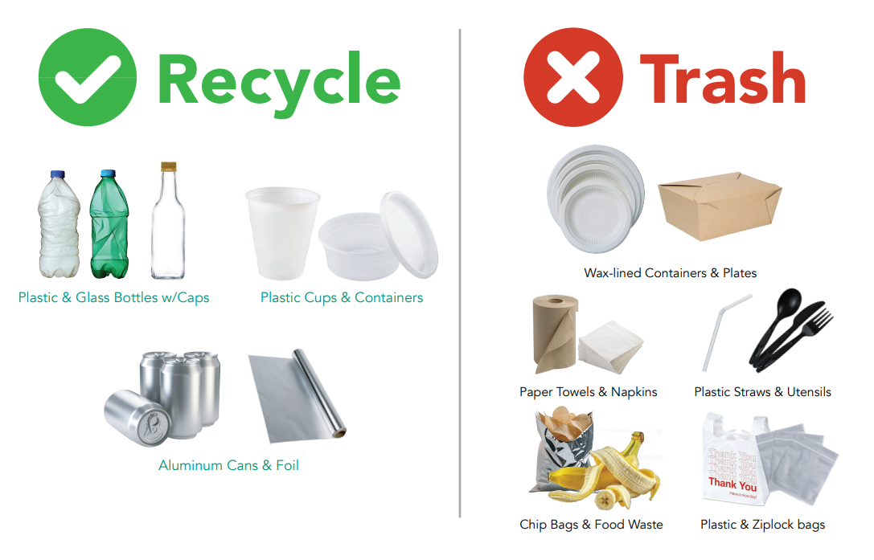
Improved Processes
Notes:
Expanded recycling access and implemented standardized signage across facilities to improve consistency, participation, and diversion accuracy.
standardization clarity at point of use behavior change enabling higher diversion

Slide 8
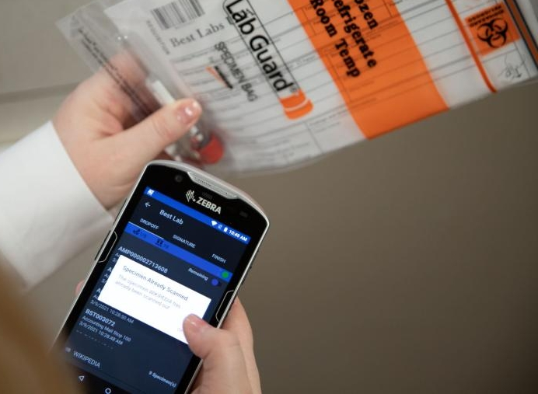
Improved Processes

Slide 9
Designing Waste Out of the System
Optimize workflows
Minimize Packaging
The most sustainable waste is the waste that is never created
Notes:
According to Practice Greenhealth, Hospitals generate over 29 pounds of waste per bed per day.
For Calendar Year 2025 Southcoast generated > 4 million pounds, ~ 3 million is trash
This upside down triangle is the strategy we use to reduce waste.
“The most sustainable waste is the waste that’s never created.”
We first look to optimize workflows, minimize packaging and reduce waste. Next, we look to reuse items where appropriate, then we move to Recycling and composting. After this, Waste-to-energy is what we would resort to and then the
Landfill is our last resort
Emphasize intention:
Landfill isn’t the goal — it’s what’s left after every better option has been exhausted.
Reducing reliance on single-use items supports both sustainability and budget resiliency.

Slide 10
Reducing Waste at the Source

Slide 11
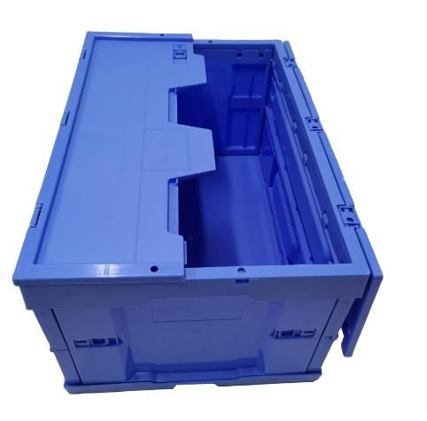
Reusable totes for direct hospital deliveries, reducing single-use packaging waste
Consolidated supply deliveries to reduce excess packaging materials
Notes:
Reusable totes for direct hospital deliveries, reducing single-use packaging waste
Consolidated supply deliveries to reduce excess packaging materials

Slide 12
Designing Waste Out of the System
Optimize workflows
Reduce Waste
Minimize Packaging
The most sustainable waste is the waste that is never created
Notes:
According to Practice Greenhealth, Hospitals generate over 29 pounds of waste per bed per day.
For Calendar Year 2025 Southcoast generated > 4 million pounds, ~ 3 million is trash
This upside down triangle is the strategy we use to reduce waste.
“The most sustainable waste is the waste that’s never created.”
We first look to optimize workflows, minimize packaging and reduce waste. Next, we look to reuse items where appropriate, then we move to Recycling and composting. After this, Waste-to-energy is what we would resort to and then the
Landfill is our last resort
Emphasize intention:
Landfill isn’t the goal — it’s what’s left after every better option has been exhausted.
Reducing reliance on single-use items supports both sustainability and budget resiliency.

Slide 13
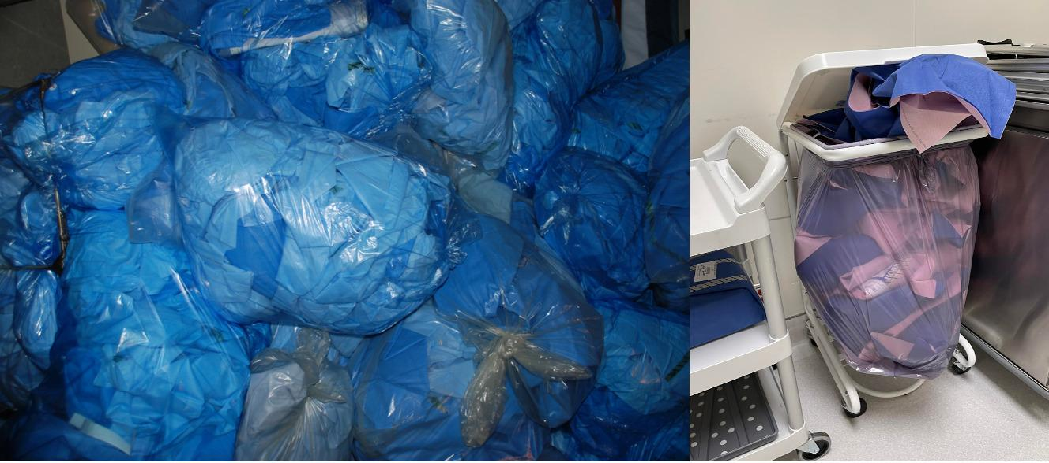
Blue Wrap: A High Volume OR Waste Stream

Slide 14
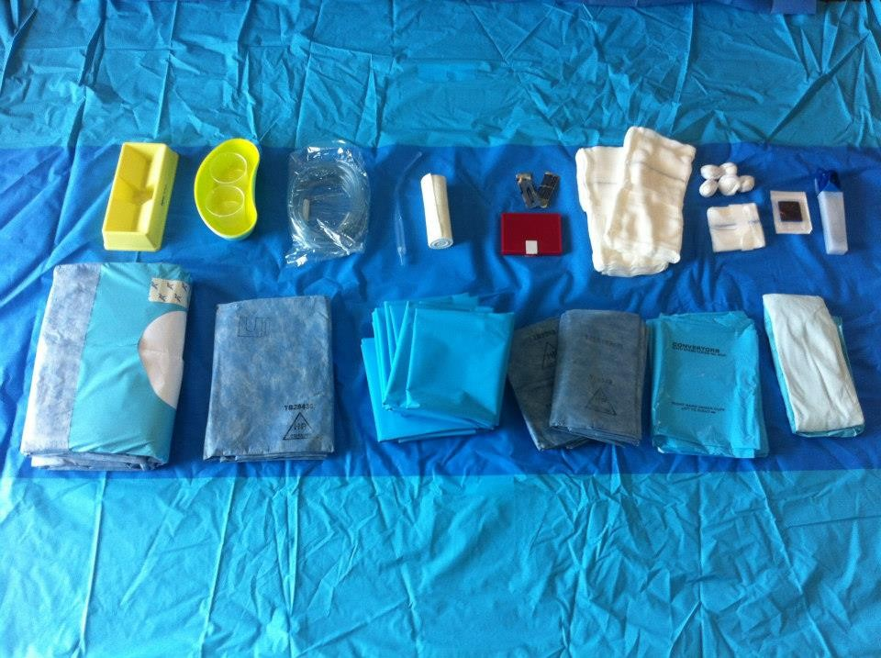
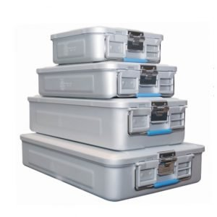
OR Waste Reduction

Slide 15
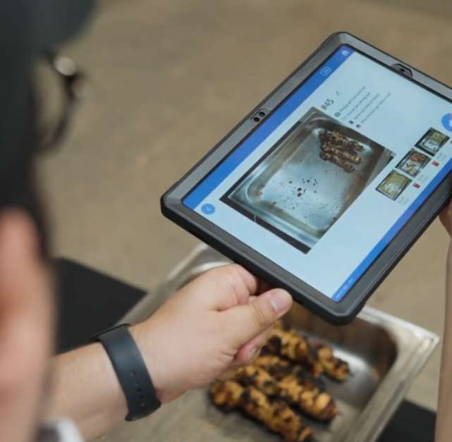
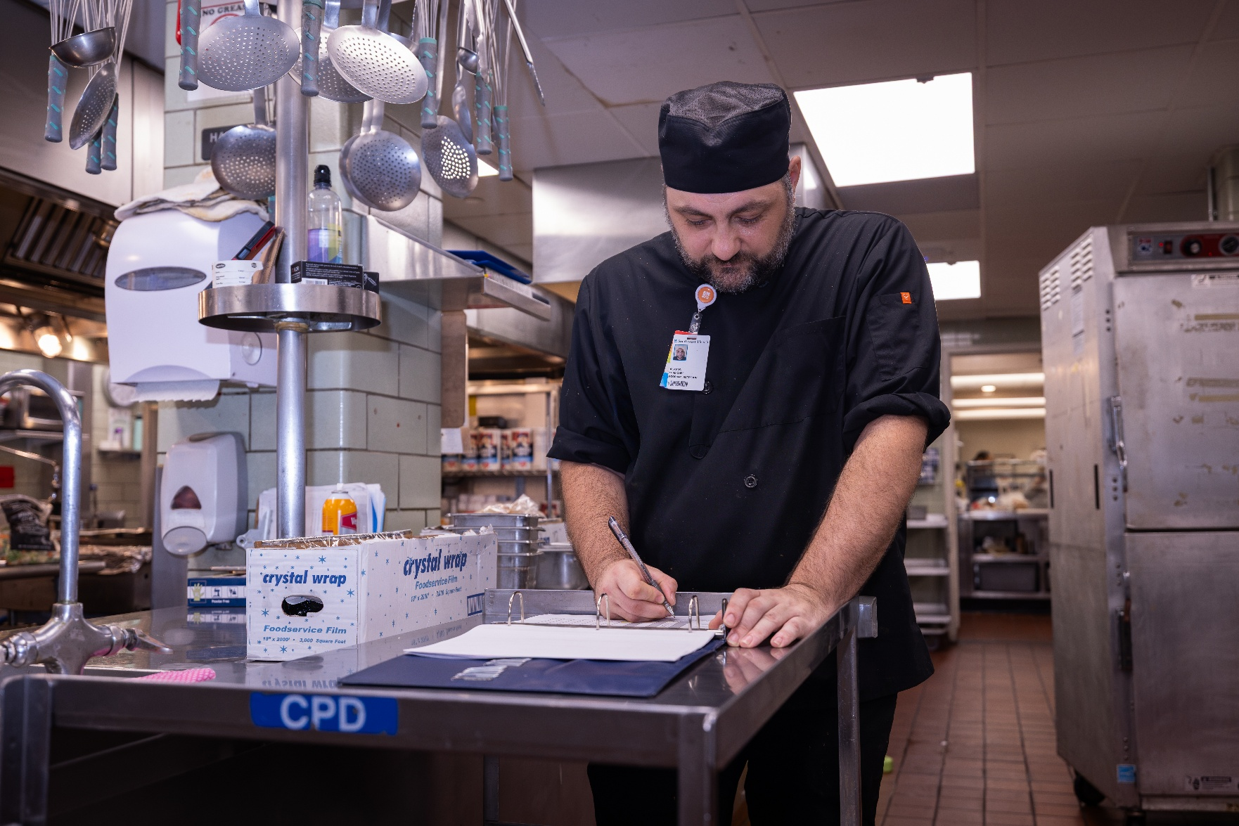
Food Waste Reduction
Notes:
Leanpath has helped us understand our waste and make informed decisions. It has led to a 55 percent reduction of food waste. Fo

Slide 16
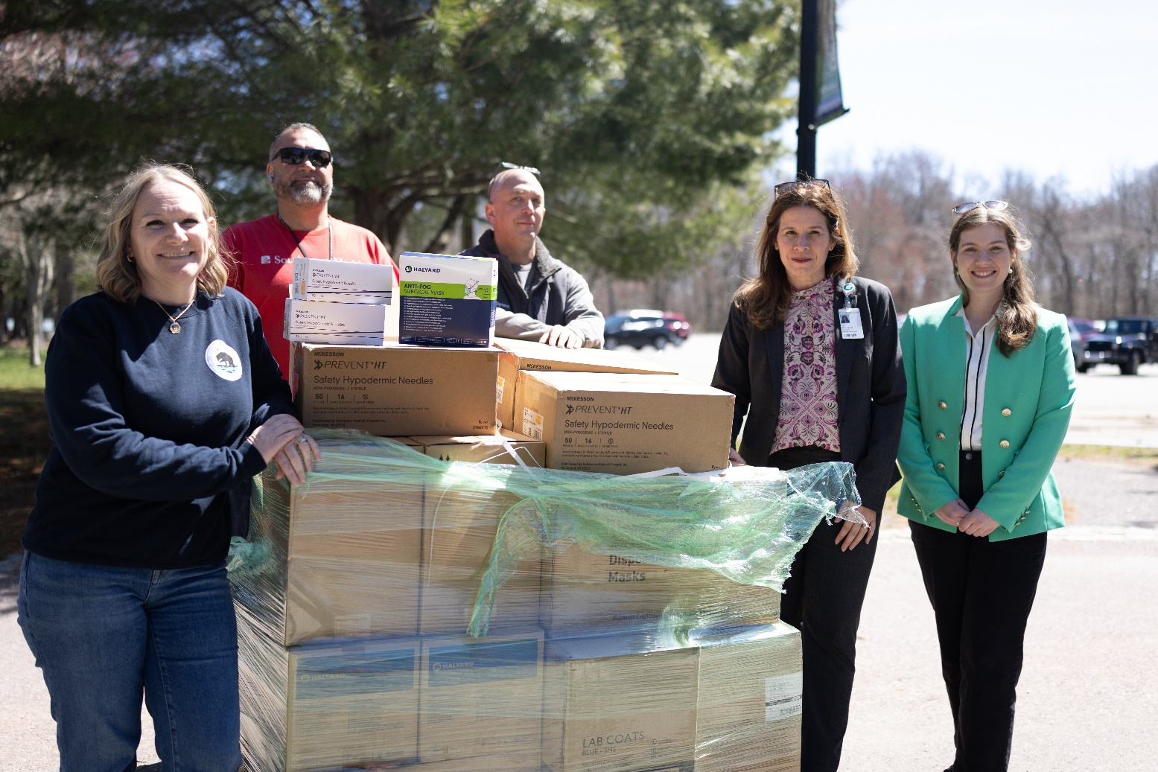
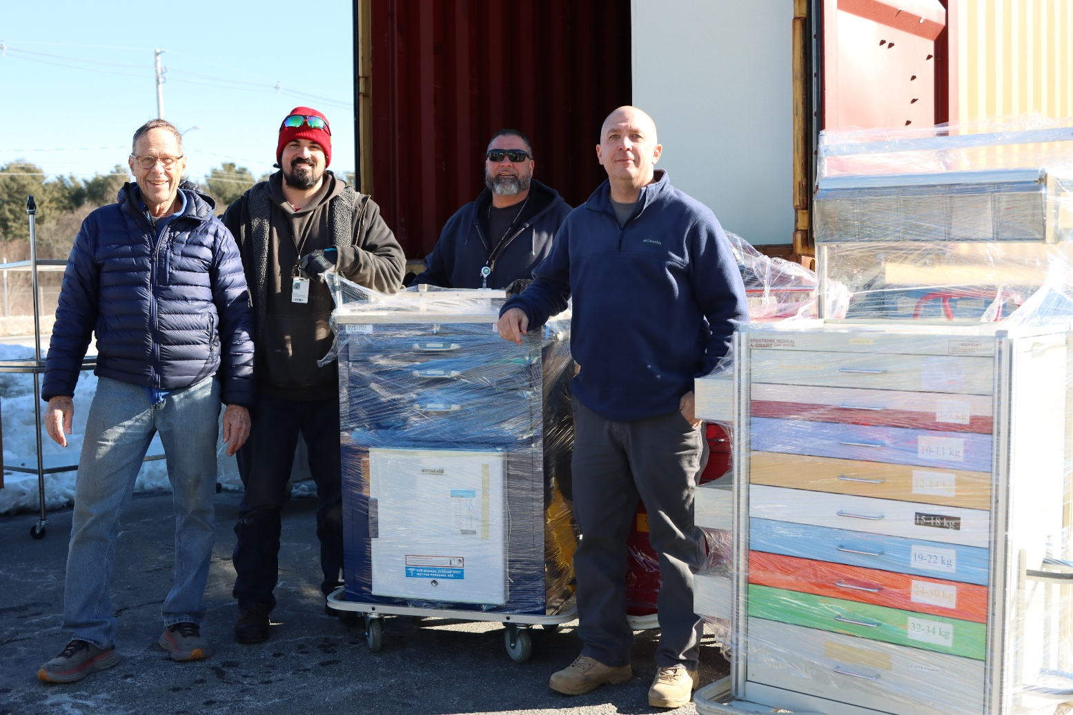
Recovery Pathways in Surplus Donation
Notes:
) Zoo = diversion (repurposed use)Honduras = circular system reuse (equivalent function)

Slide 17
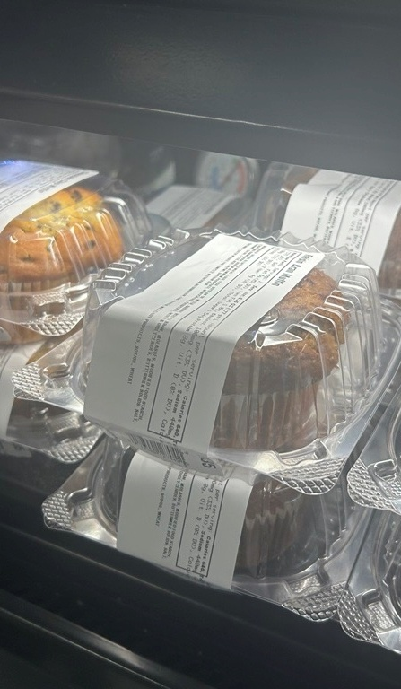
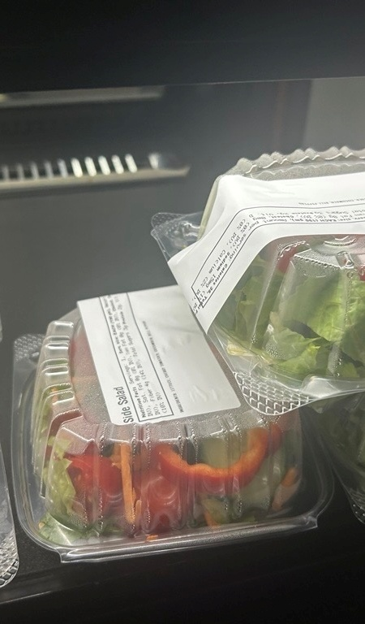
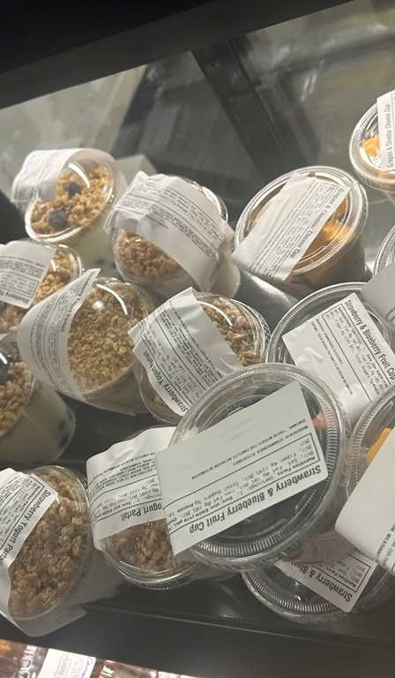
Food Donation

Slide 18
Circular Systems in Practice

Slide 19
Designing Waste Out of the System
Optimize workflows
Reduce Waste
Reuse of items (where appropriate)
Minimize Packaging
The most sustainable waste is the waste that is never created
Notes:
According to Practice Greenhealth, Hospitals generate over 29 pounds of waste per bed per day.
For Calendar Year 2025 Southcoast generated > 4 million pounds, ~ 3 million is trash
This upside down triangle is the strategy we use to reduce waste.
“The most sustainable waste is the waste that’s never created.”
We first look to optimize workflows, minimize packaging and reduce waste. Next, we look to reuse items where appropriate, then we move to Recycling and composting. After this, Waste-to-energy is what we would resort to and then the
Landfill is our last resort
Emphasize intention:
Landfill isn’t the goal — it’s what’s left after every better option has been exhausted.
Reducing reliance on single-use items supports both sustainability and budget resiliency.

Slide 20
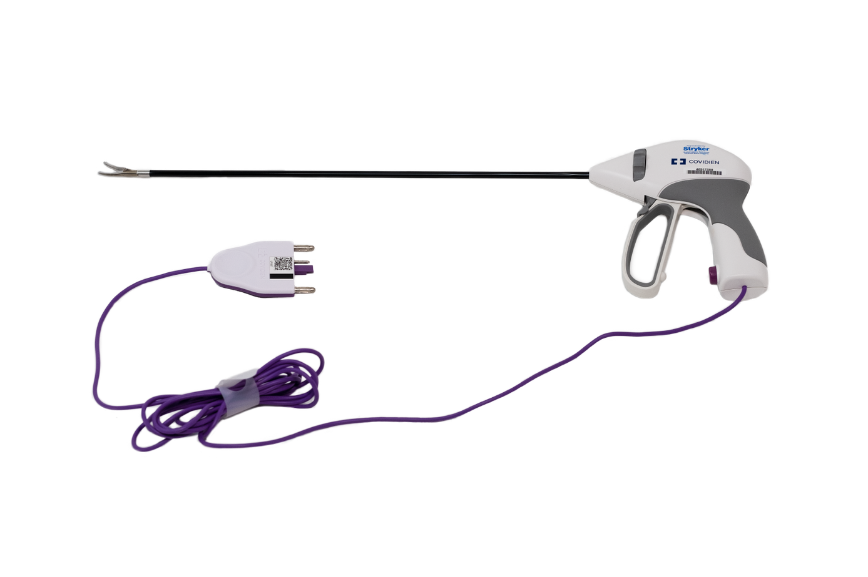
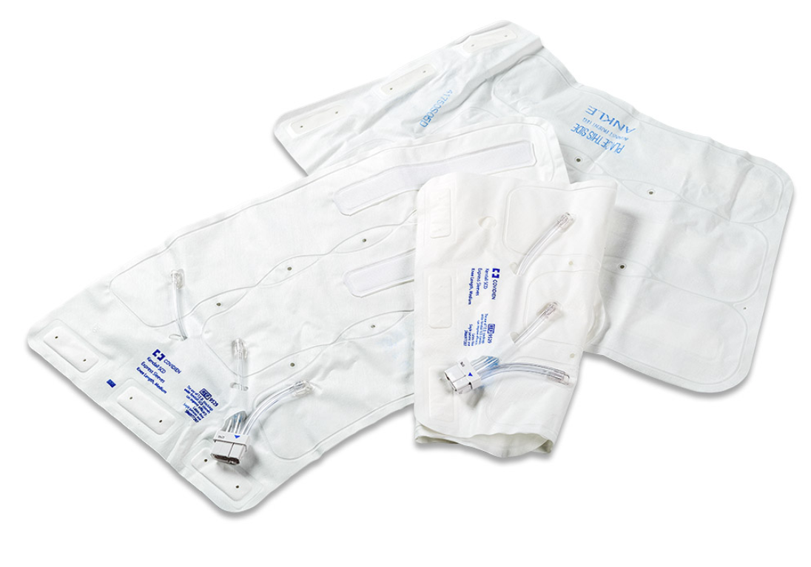
Reprocessing of eligible single-use medical devices
Notes:
Ligasure vascular sealer and compression sleeves

Slide 21
Designing Waste Out of the System
Optimize workflows
Reduce Waste
Reuse of items (where appropriate)
Recycle / Compost
Minimize Packaging
The most sustainable waste is the waste that is never created
Notes:
According to Practice Greenhealth, Hospitals generate over 29 pounds of waste per bed per day.
For Calendar Year 2025 Southcoast generated > 4 million pounds, ~ 3 million is trash
This upside down triangle is the strategy we use to reduce waste.
“The most sustainable waste is the waste that’s never created.”
We first look to optimize workflows, minimize packaging and reduce waste. Next, we look to reuse items where appropriate, then we move to Recycling and composting. After this, Waste-to-energy is what we would resort to and then the
Landfill is our last resort
Emphasize intention:
Landfill isn’t the goal — it’s what’s left after every better option has been exhausted.
Reducing reliance on single-use items supports both sustainability and budget resiliency.

Slide 22
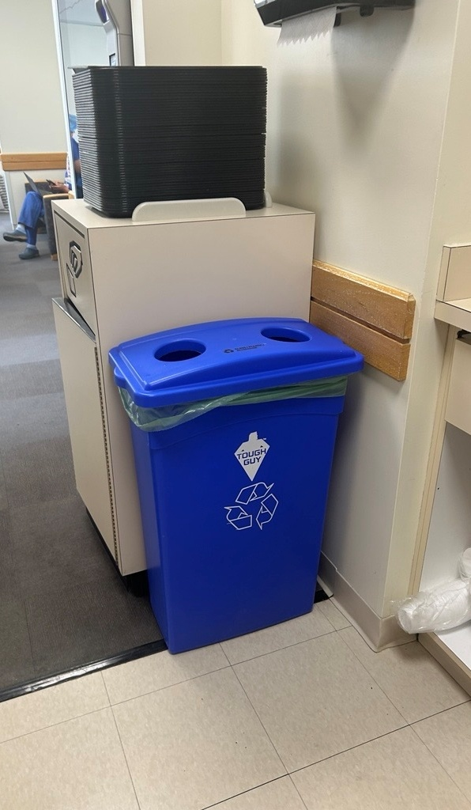
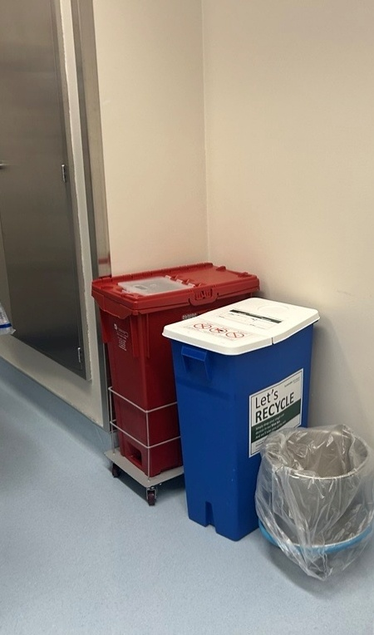
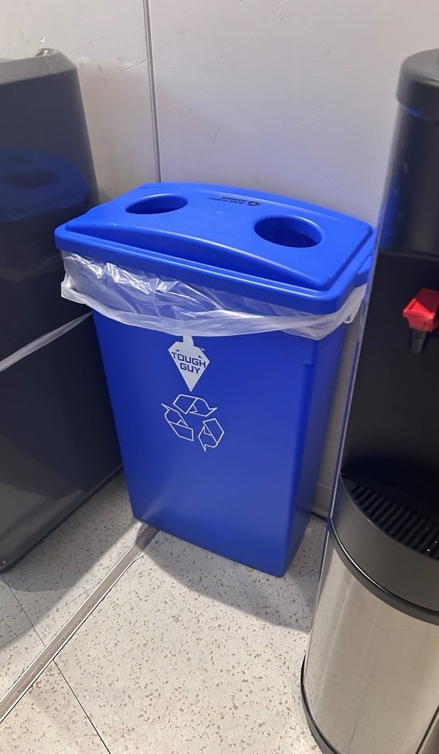
Recycling

Slide 23
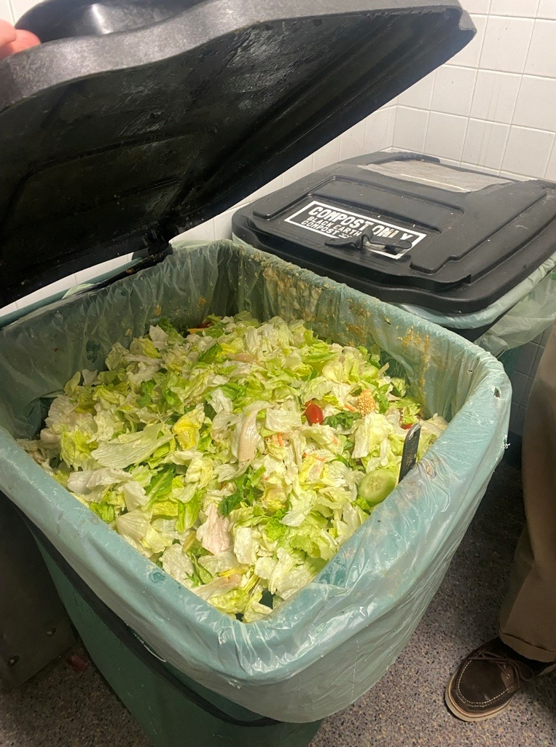
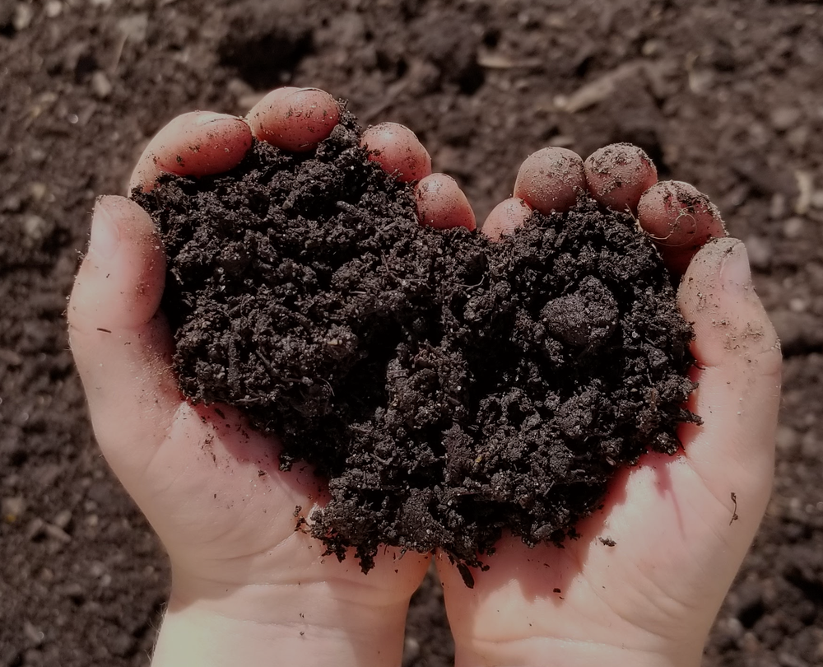
Compost

Slide 24
Designing Waste Out of the System
Optimize workflows
Reduce Waste
Reuse of items (where appropriate)
Recycle / Compost
Waste-Energy
Minimize Packaging
Landfill
The most sustainable waste is the waste that is never created
Last resort, minimized to the smallest possible volume
Notes:
According to Practice Greenhealth, Hospitals generate over 29 pounds of waste per bed per day.
For Calendar Year 2025 Southcoast generated > 4 million pounds, ~ 3 million is trash
This upside down triangle is the strategy we use to reduce waste.
“The most sustainable waste is the waste that’s never created.”
We first look to optimize workflows, minimize packaging and reduce waste. Next, we look to reuse items where appropriate, then we move to Recycling and composting. After this, Waste-to-energy is what we would resort to and then the
Landfill is our last resort
Emphasize intention:
Landfill isn’t the goal — it’s what’s left after every better option has been exhausted.
Reducing reliance on single-use items supports both sustainability and budget resiliency.

Slide 25
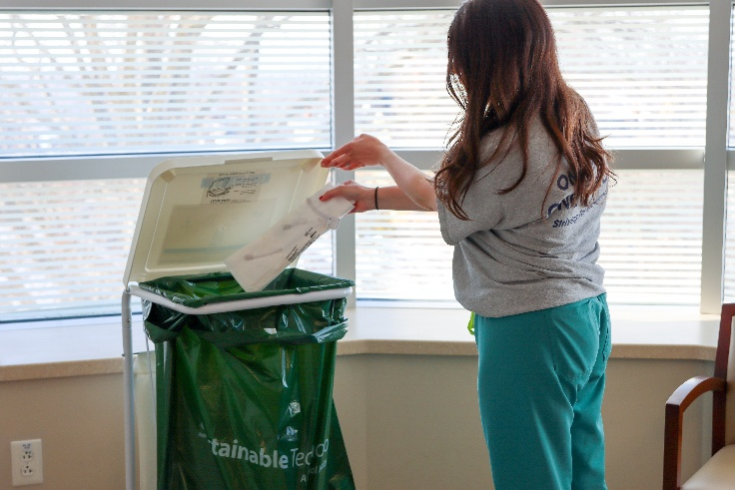
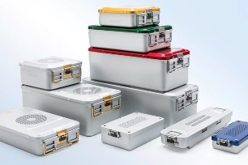
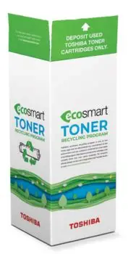

Waste Initiatives
Materials Diverted
Single stream: 22.44 tons
Cardboard: 256.59 tons
Electronics: 5.4 tons
9,500 medical devices recycled
Food Wate Reduction
23.2 tons composted
55% average reduction in food waste at hospitals
Elimination of Styrofoam in Food Services
Circular Economy
Diverted 8,000 pounds of equipment via donation
1000 reusable sterilization containers in rotation
launch of our toner recycling program!

Slide 26
Waste Initiatives
Expanding our recycling program with standardized signage
Increase composting to additional locations
About to launch our grab and go food donation program

Slide 27
Systems Drive Results
Thank you
Questions & Discussion
Notes:
What we’ve found is that the biggest impact comes when we redesign systems—not just when we rely on individual actions.

