Slide 1

Waste Diversion and Food Donation in Wellesley Public Schools
Amanda Crowley, Waste Reduction Coordinator
Town of Wellesley Department of Public Works
RecyclingWorks MA Spring Forum
May 27, 2026
Notes:
Good morning and thank you for that introduction! We are Amanda Crowley and Amber Keller, part-time Waste Reduction Coordinators for the Town of Wellesley. We are grateful to get to share with you today how Wellesley Public Schools worked through the state procurement process to embed sustainability requirements directly into their food service contract in order to reduce and divert waste.
We’ll touch on
Wellesley’s motivation for waste reduction
Working with DESE
Choosing sustainability measures
The specific sustainability measures Wellesley embedded in the RFP
While the information we’ll share is directly applicable to districts that contract out for food services, districts with self-op food services may find our discussion of sustainability measures helpful, as well.

Slide 2
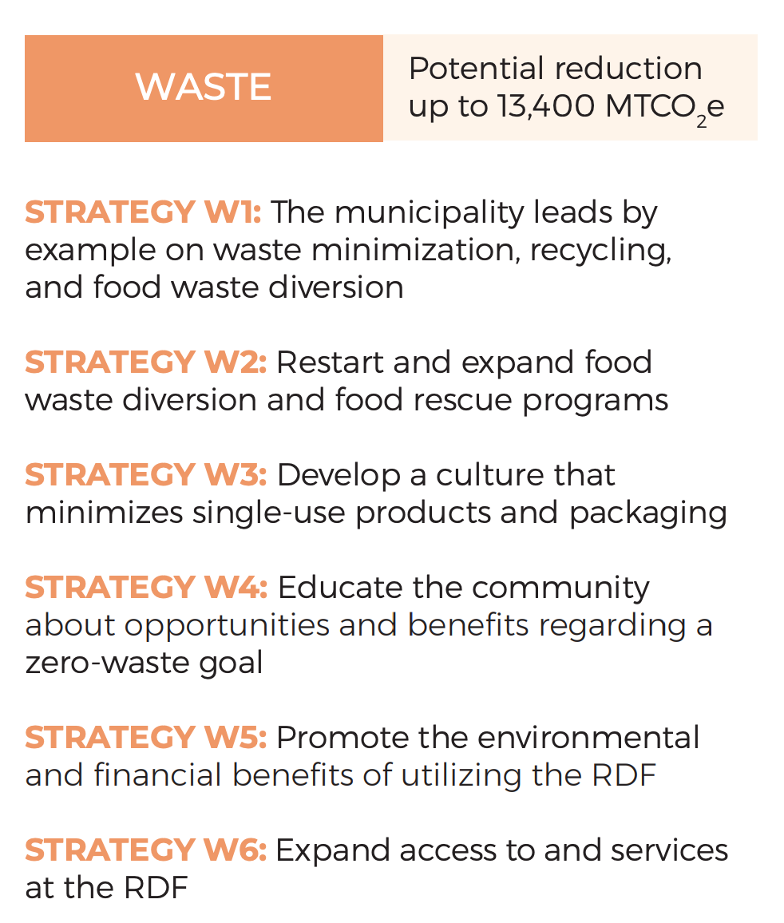
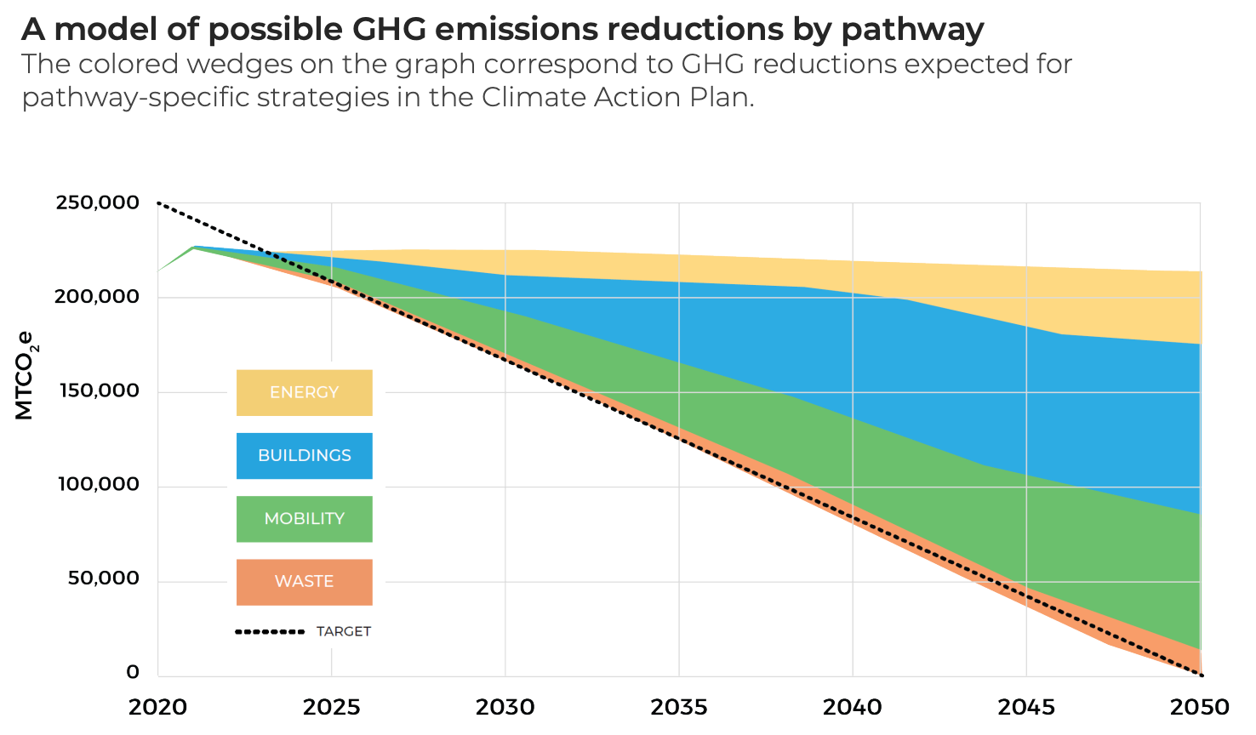
Town Climate Action Plan
https://wellesleyma.gov/2099/CAP-Waste-Action-Dashboard
Notes:
Wellesley Public Schools’ focus on sustainability in food services is rooted in shared community values around reducing GHG emissions. Since 2009, the Town of Wellesley has set and updated climate goals—most recently aligning with the state’s 2050 targets in 2021. The town engaged a variety of stakeholders in the creation of a roadmap with 6 pathways to GHG reductions, one of those pathways being waste reduction. Wellesley Public Schools played a key role, helping strengthen commitments around the district’s responsibility to reduce waste. We’ll see that here as we take a brief look at the Climate Action Plan.

Slide 3
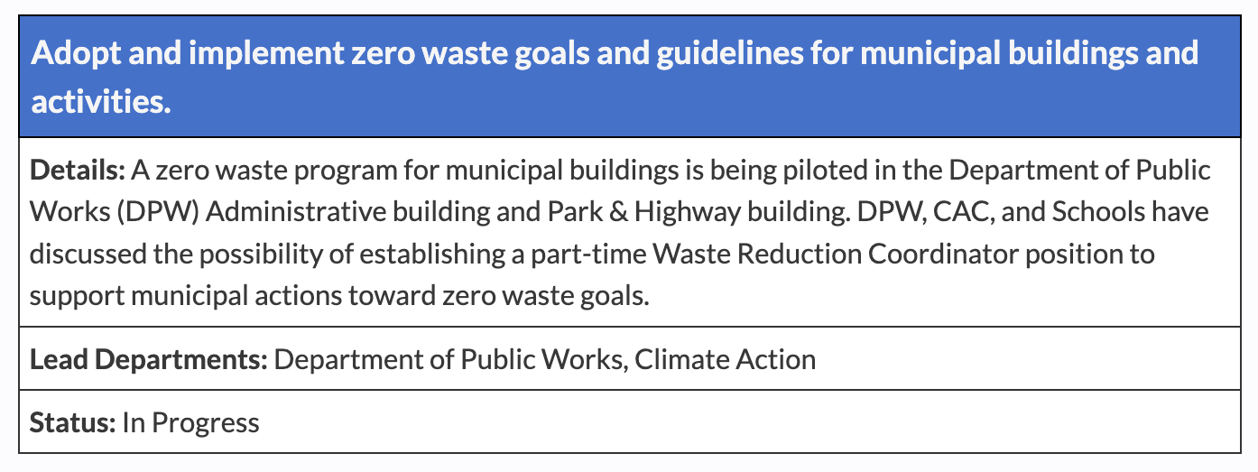
Town Climate Action Plan - Waste
Goal 1 Wellesley implements programs that move the community to zero waste.
Strategy 1: The municipality leads by example on waste minimization, recycling, and food waste diversion
https://wellesleyma.gov/2099/CAP-Waste-Action-Dashboard
Notes:
The first goal for waste reduction is implementing programs that move the community to zero waste, using a strategy of leading by example on waste minimization, recycling, and food waste diversion.
Our schools have a great opportunity to lead by example in the materials they procure and in how they direct students and teachers to dispose of those materials. But they need support to move toward zero waste. So the possibility for our job was written into the Climate Action Plan, and since September 2024 our job has been supporting the district in procuring materials that result in waste minimization and putting processes and procedures in place to divert as much material from the landfill as possible.
We partner with Cindy Mahr, the Assistant Superintendent for Finance and Operations, as well as the food services vendor; also, as employees of the DPW, we collaborate regularly with director of sustainability for town of Wellesley, the Climate Action Committee, Board of Health, and the grassroots organizations, Wellesley Green Schools and Sustainable Wellesley, to share updates, receive feedback, and keep the forward momentum.

Slide 4
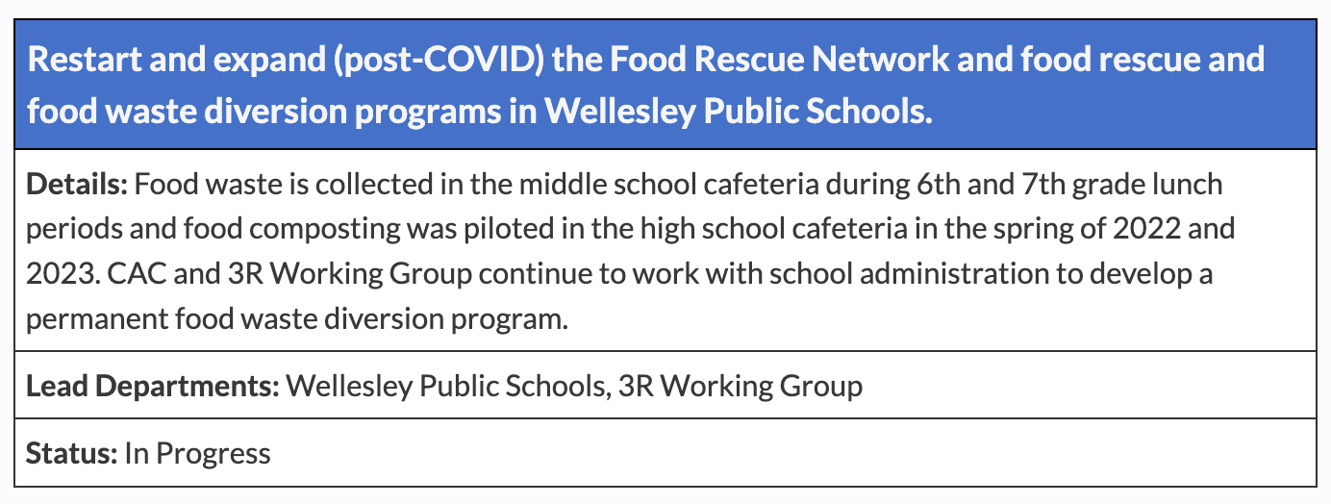
Town Climate Action Plan - Waste
Goal 1 Wellesley implements programs that move the community to zero waste.
Strategy 2: Restart and expand food waste diversion and food rescue programs.
https://wellesleyma.gov/2099/CAP-Waste-Action-Dashboard
Notes:
The second strategy to move the community to zero waste is to restart and expand food waste diversion and food rescue programs. Since 2017 there have been various attempts at food waste diversion in Wellesley schools with varying degrees of success – the only program persisting being the food diversion initiative at the middle school. Orginally started by teacher
As you can see, a detail in this strategy is to continue working with the school administration to develop a permanent food waste diversion program.

Slide 5
Food Waste Diversion
Kitchen
Menu
Offer vs. Serve
Food Scraps
Pre-consumer Food Rescue
Food Service Ware
Cafeteria
Post-consumer Food Rescue
Waste sorting
Notes:
As you all know, food waste diversion can happen in the school kitchen, or sometimes known as the back of the house - and the student-facing cafeteria. Diverting food waste through processes and procedures in both locations is desirable. But if a district contracts out for food services, it may be difficult or impossible to ask a vendor to alter their kitchen practices mid-contract. So our Wellesley’s Asst. Superintendent wondered –what if it embed sustainability measures into the contract in the bidding process through the RFP?
Last year as the food services contract was expiring, Cindy started exploring which sustainability measures would be most impactful and allowable in the RFP.

Slide 6
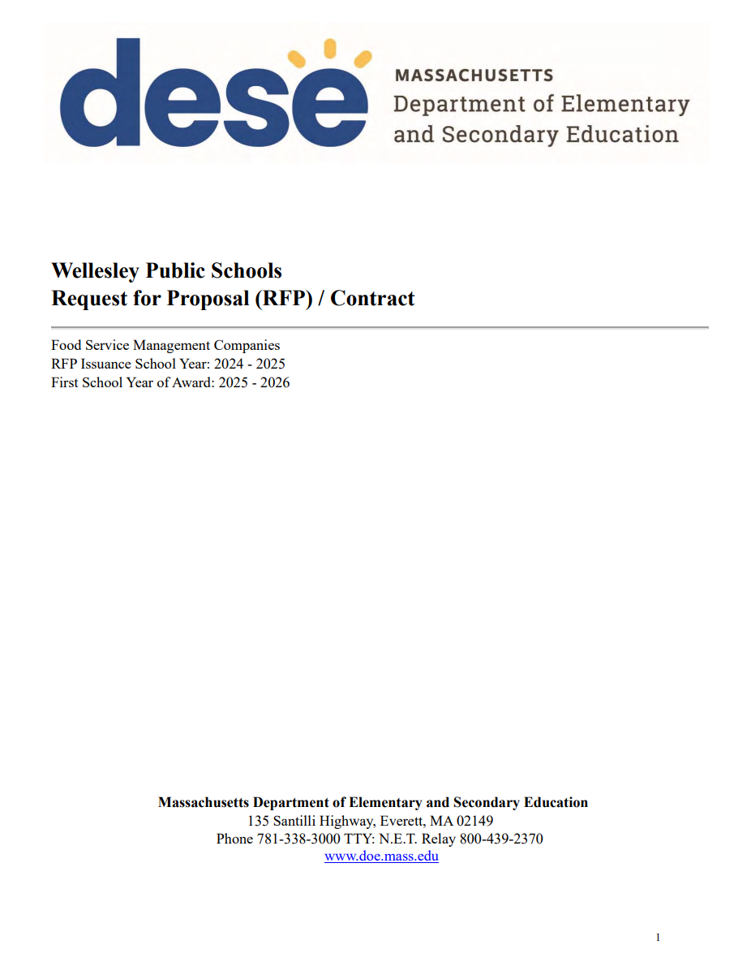
Key Opportunities:
Food Service Contracts and Standard Operating Procedures
Request for Proposal (RFP)/Contract
Embed clear sustainability requirements
Internally run systems less dependent on volunteers
Standard Operating Procedures (SOPs)
Formalize processes
Clear steps, all stakeholders agree and sign
Creates programs with “staying power”
Vendors know expectations
Notes:
Many of you may know that the Food Service Management Company Contracting procedures are managed by the Department of Elementary and Secondary Education (DESE), and the current RFP template does not include any sustainability language or a clear place to add that language.
So Cindy reached out to her contacts at DESE to determine what she could add.
She found that DESE is reasonable as long as you meet federal requirements. However, DESE did fear that Wellesley’s RFP review process would be too cumbersome with Cindy’s added criteria. So Cindy pushed back on that, reiterating that Wellesley values sustainability -- and then she added the criteria.
Here’s a few tips about RFPs in general, mostly specific to any business managers watching this presentation:
The more you know about an RFP and how to set criteria, the better
It’s important to know how to write criteria in order to evaluate it in the bid process
Consider using AI for procurement to help generate bid criteria
Some districts may have a town procurement officer to vet the process

Slide 7
Involving Stakeholders
School District
Business Manager (in Wellesley, she is Asst. Superintendent and is also a procurement officer)
Town
Department of Public Works
District Communications
School Administrators
Teachers
Students
Parents
Facilities Management Department
Director of Sustainability
Climate Action Committee
Grassroots Organizations
Food Services Management Company
Custodians
Recycling and Disposal Facility
Procurement Officer

Slide 8
Writing Sustainability into the RFP
Minimize Plastics
Replace plastic bottles with aluminum cans
Replace condiment packets with condiment dispensers
C.13, pg. 22
Schedule B Procurement Specifications, pg. 51
Reduce Compost Contamination
Replace condiment packets with condiment dispensers
Move to all certified compostable ware
C.13, pg. 22
Reduce and Divert Food Waste
Incorporate ingredients that reflect cultural preference and diversity
Prioritize operations that limit food waste.
Composting food waste
Partner with food rescue organization for pre-consumer and post-consumer food donation
C.13, pg. 19, 20, 22
Reduce Single-Use Items in Trash
Short-term: All certified compostable ware
Long-term: Piloting reusable trays
Prioritize recycling, NexTrex Plastic Film Recycling
C.13, pg. 22, 23
Section 7.6, pg. 34
Schedule B Procurement Specifications, pg. 51
Schedule B Procurement Specifications, pg. 51
Reduce toxins/ transportation emissions
Locally sourced within 250 miles
In-season products
Organic
Eliminate PFAS
C.13, pg. 19, 22
Quarterly Sustainability Meetings C.13. pg. 23
https://wellesleyps.org/wp-content/uploads/2025/02/WPS-Food-Service-RFP-Document_Approved-by-DESE.pdf
Notes:
So let’s take a look at the sustainability measures WPS landed on for their RFP.
[Provide link to RFP in chat so people can follow along in the document] Amanda does this

Slide 9
Standard Operating Procedure for Food Rescue
Existing SOP from 2017 no longer being utilized
- Opportunity to revise and update
New Food Service Vendor
- Opportunity to move the process to an internal program fully managed by food services
Standardize and roll out to all schools
- Replace processes that lacked long term viability
Notes:
In addition to reaching out to DESE, Cindy also looked to other districts that had recently gone through the FSMC RFP process, in particular, Newton Public Schools. Newton’s food service RFP had been issued the year before Wellesley’s, and learning about their experience in adding sustainability to their RFP helped inform Cindy’s approach.
Cindy also had conversations with Wellesley’s Board of Health regarding food rescue. And she worked with us and experts at the DPW to determine best materials and practices; for example, if food services is going to sell water and the community wants to move away from plastic, it is more sustainable to sell boxed water or canned water?
These conversations helped shape the sustainability measures she added to the RFP.

Slide 10
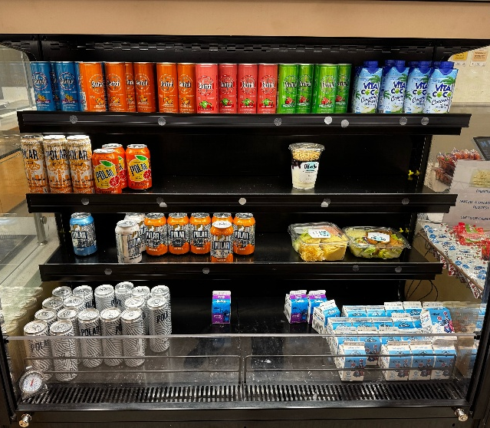
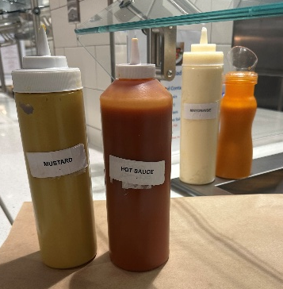
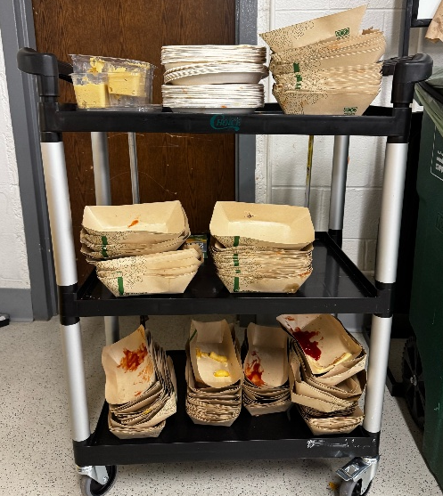
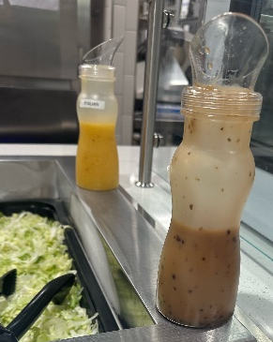
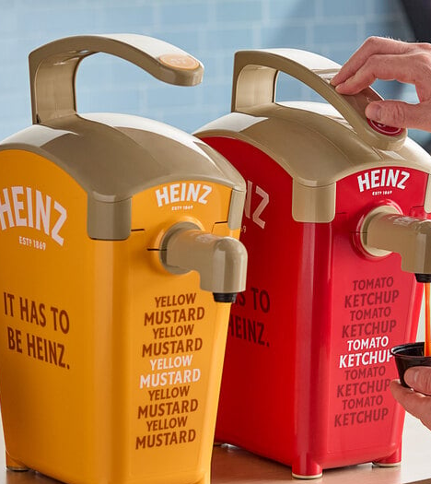
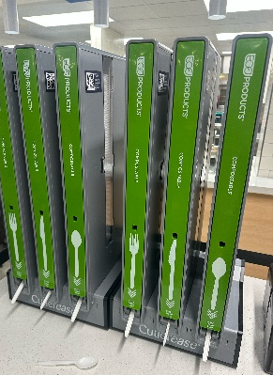
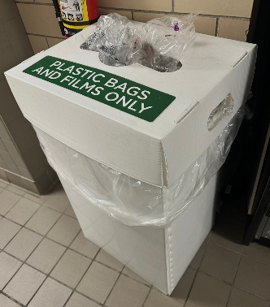
What this looks like in real life
Minimize Plastics
Reduce Compost Contamination
Reduce Single-Use Items in Trash
Notes:
So what does this look like in real life? We have greatly reduced plastic packaging, down to just containers that can’t be replaced by a compostable option, like milk cartons and bags from baby carrots, apple slices and other snacks sold. Whole apples and oranges are no longer wrapped in baggies.
Pump dispensers have replaced small condiment packets which is a huge help in reducing compost contamination. Salad dressing and other sauces are offered in squeeze or pour bottles instead of individual packets.
plastic cutlery contaminating the compost bin
Almost 100% of food serviceware going into the compost bin rather than the trash. We’ve gone from 12+ bags of trash to 3 full bags of trash per lunch day, and that’s with a student population of 910 students and a school lunch service participation rate of 48%
By stacking this compostableware, we’ve been able to reduce the number of Black Earth totes from 3-4 totes used per day to just 2 totes.
Food services recycling plastic bags and film through NexTrex

Slide 11

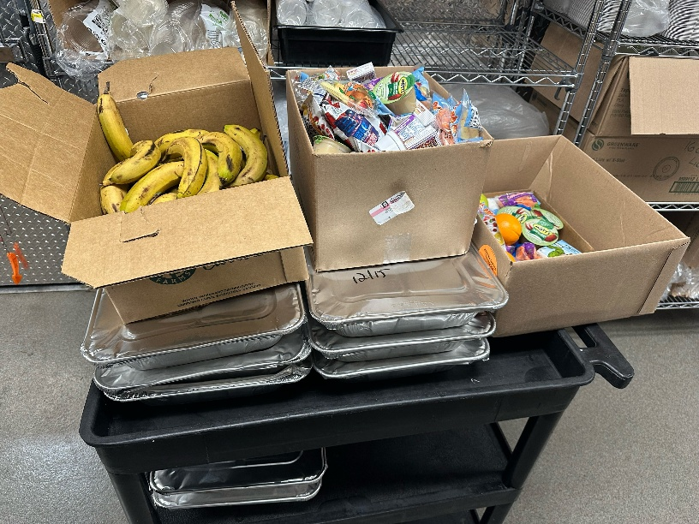
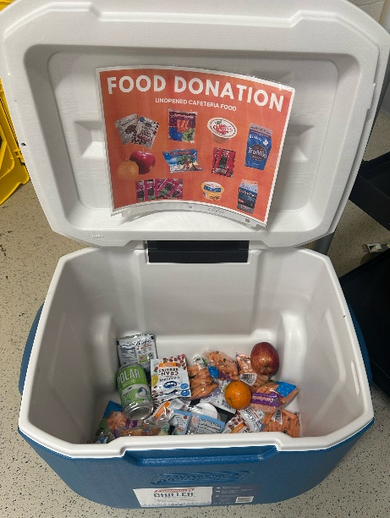
What this looks like in real life
Partnership with Rescuing Leftover Cuisine—pre and post consumer food is collected daily at schools, then transported by food service staff to the middle school where it is stored in preparation for weekly pick up
1,396 lbs of food collected
= 1,163 meals served
Notes:
At the middle school, students have their choice of fruits and vegetables, which helps to reduce food waste.
In the kitchen, food scraps are diverted from the trash through a separate compost bin in the kitchen/food prep area, and food extras are diverted from the trash through pre and post consumer food rescue.
Wellesley has a long-standing partnership with Rescuing Leftover Cuisine, a nonprofit that comes each Friday to pick up food from our schools. So far this year 1,396 lbs of food has been rescued, resulting in 1,163 meals served across shelters in the Boston area.

Slide 12
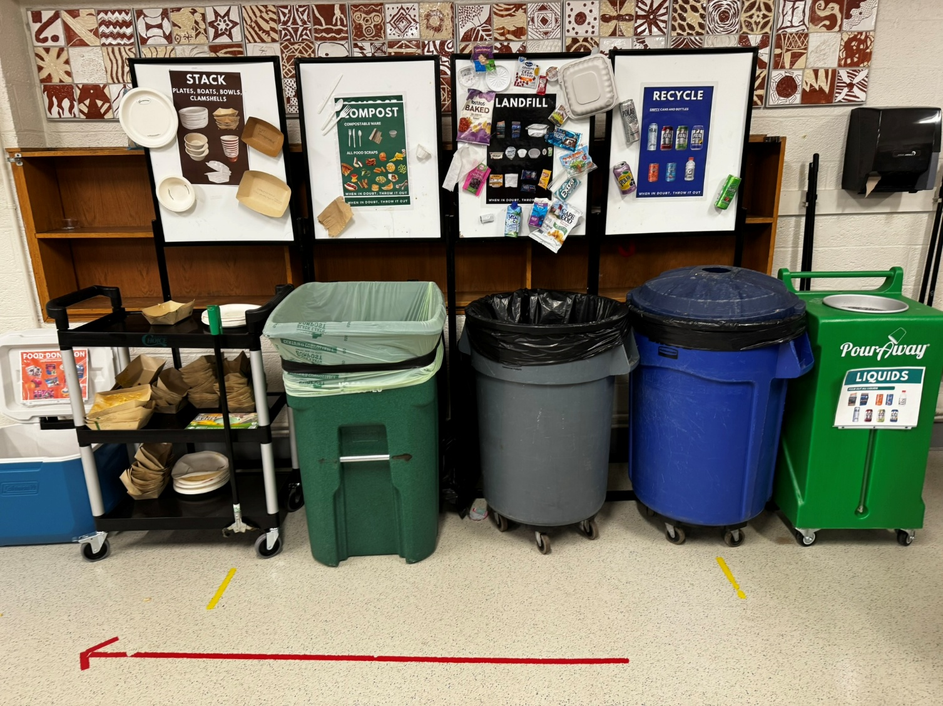
What this looks like in real life
Notes:
So what does this look like in real life?
While all these measures are part of the food services contract, waste reduction and diversion is currently happening to the highest degree at the middle school where we also have student-facing waste diversion happening in the cafeteria.
We have been on-site daily working to optimize this waste sorting system, including creating clear signage and procedures, performing compost monitoring, liquid pour-off using new Pour Away containers and food donation.
We’re helping to embed sustainable monitoring by working with janitorial staff to manage the Pour Away containers, Chartwells to manage the food donation coolers and the middle school faculty to monitor the compost, which they do on a rotating schedule. We have created a new training video for school staff to give them the “why” behind waste sorting, as well as the “how”. We’re hopeful that moving toward a model of staff fully monitoring the compost bins will result in sustainable daily monitoring.
We have also worked with teacher Jonathan Rabinowitz, principal Mark Ito, and the janitorial staff to expand composting to include the teacher lounge, which will be rolling out in April. starting soon.
Through these systems students are making waste sorting a habit, and teachers are learning it, too. All of this is supported through the clear goals that we have with the FSMC and their active participation.

Slide 13
Next steps and goals for Wellesley
September 2026 Goal: In addition to existing food rescue program, two elementary schools will roll out reusable lunch trays coupled with composting
Wellesley Educational Foundation grant awarded to offset year one costs for new school waste reduction initiative
Wellesley purchased several hundred stainless trays from Ahimsa, and RFPs are in progress to work with ReDish, the offsite dishwashing service, and Black Earth Composting, on this project
Notes:
[I’m thinking we don’t need this slide at all]
Our work with the school district targets school cafeterias since these spaces present the most significant opportunity for waste reduction and diversion of anywhere in the school. This is evidenced by a Minnesota public schools waste study that found that 50% of waste produced in their public schools is compostable, a figure that includes food waste, liquids, compostable trays.
While the pie chart for Wellesley schools’ waste might not match this exactly, the opportunities to impact our cafeteria waste landscape, including food waste, disposable dishware and plastic packaging, are significant and are also filled with challenges such as compost contamination and student confusion regarding sorting. Therefore, it was the district’s goal to design a system that makes waste reduction and diversion simpler and sustainable.
[Also include statement about food waste ban for schools]
Even with happy with current vendor, new regulations on the horizon. Need to create a sustainable model and embed

Slide 14
Summing it Up and
Lessons for Others
Use tools and RESOURCES
SOPs ARE USEFUL TOOLS TO PROVIDE ACCOUNTABILITY AND CLEAR GUIDENCE ON PROCESSES
LOOK FOR GRANT OPPORTUNITIES TO FUND PILOTS OR START UP COSTS
WORK WITHIN YOUR ORG
UNDERSTAND the needs of your community and who makes the decisions
Be mindful of any rules and restrictions
Don’t go it alone
STAKEHOLDERS ARE VALUABLE RESOURCES
COMMUNITY AND STATEWIDE GROUPS CAN PROVIDE GUIDANCE FROM THEIR OWN EXPERIENCES
PARTNER ORGANIZATIONS LIKE RESCUING LEFTOVER CUISINE ARE CRITICAL
Create lasting impact
Building sustainability directly into vendor contracts ensures a lasting impact on waste reduction, rather than one-off programs that don’t have the same staying power
Notes:
Build relationship with school district business manager, find out when food services contract is expiring. Even if contract is not expiring soon, start building that relationship and start having conversations about the positive impact sustainability measures in the food services RFP could have on reduction in waste -- especially considering that the threshold for food in the trash in MA schools may be going to zero in a few years. Propose they meet with Cindy Mahr at Wellesley to understand more. Easier to take the route of learning from a district that has already done it rather than going it alone.
Talk to districts who have gone out to bid recently (DESE will give business manager a list)
Learn what they wish they would have done differently
If any business managers are in this meeting, Cindy is presenting in May at MA Association of School Business Officials and is happy to talk with you and answer questions.

