Slide 1



Reusables
& Maximizing Food

Slide 2
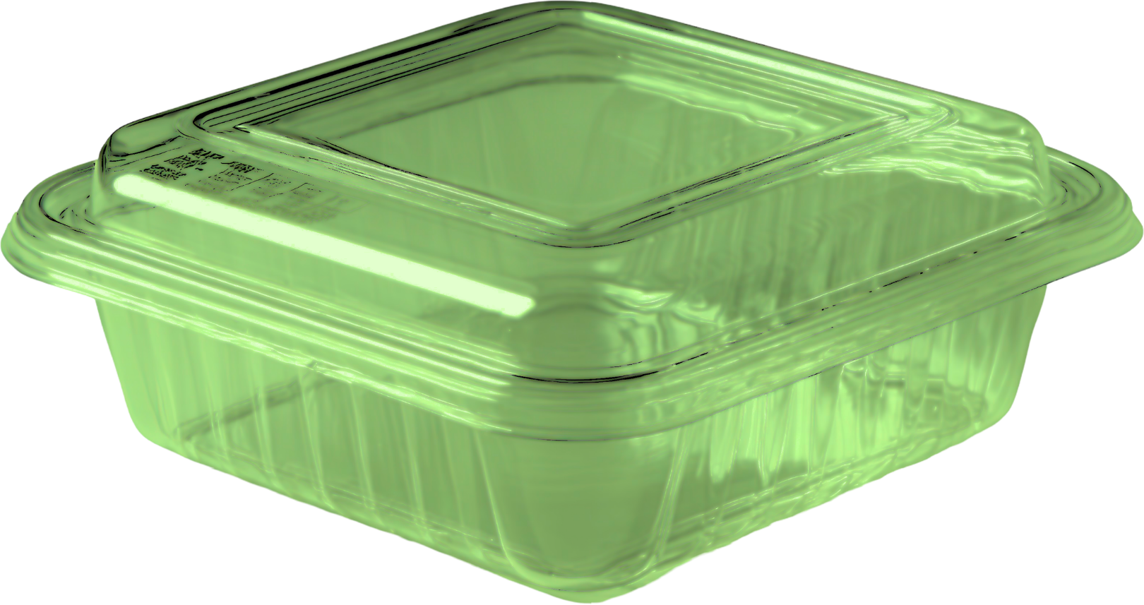
MHC’s Covid19 trial of a 3-part plastic container
Given to each student upon arrival to campus. Instructed to bring it back to dining upon next visit to get clean one. Often a science project growing inside.
No tracking system.
Not safe for heat exposure (e.g. from hot foods, microwave, or dishwasher).
Health concerns exist with all plastics.

Slide 3
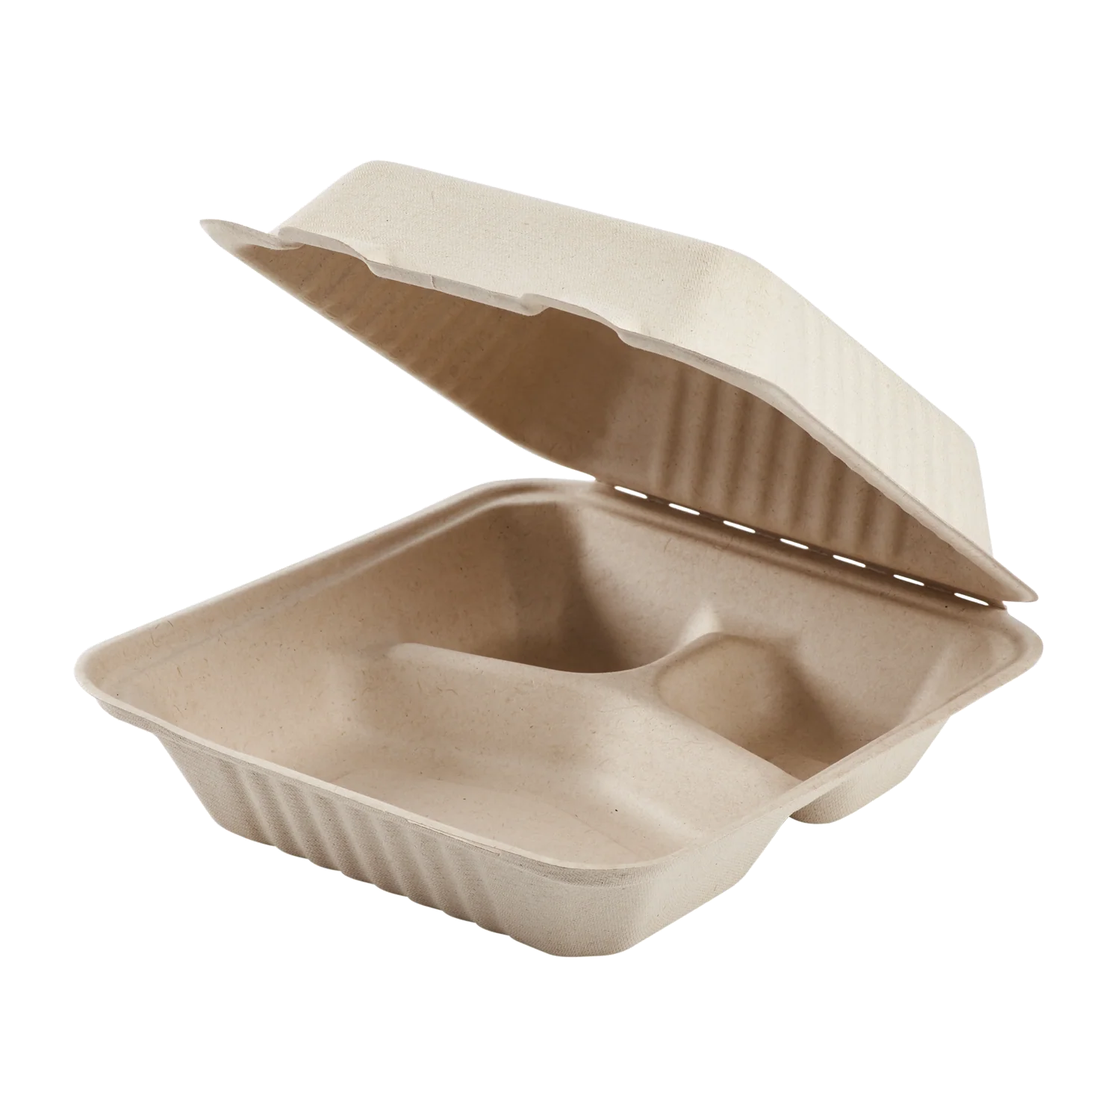
MHC transitioned from offering reusable plastic to compostable packaging in 2021
But that’s replacing one issue with another
251,000 containers a year
$75K
Petroleum-based, leaches microplastics
Contributes plastic waste to the environment
Must be processed at a compost facility to break down (rare in most US municipalities)
Often still lined with bioplastics
“Expensive trash”

Slide 4
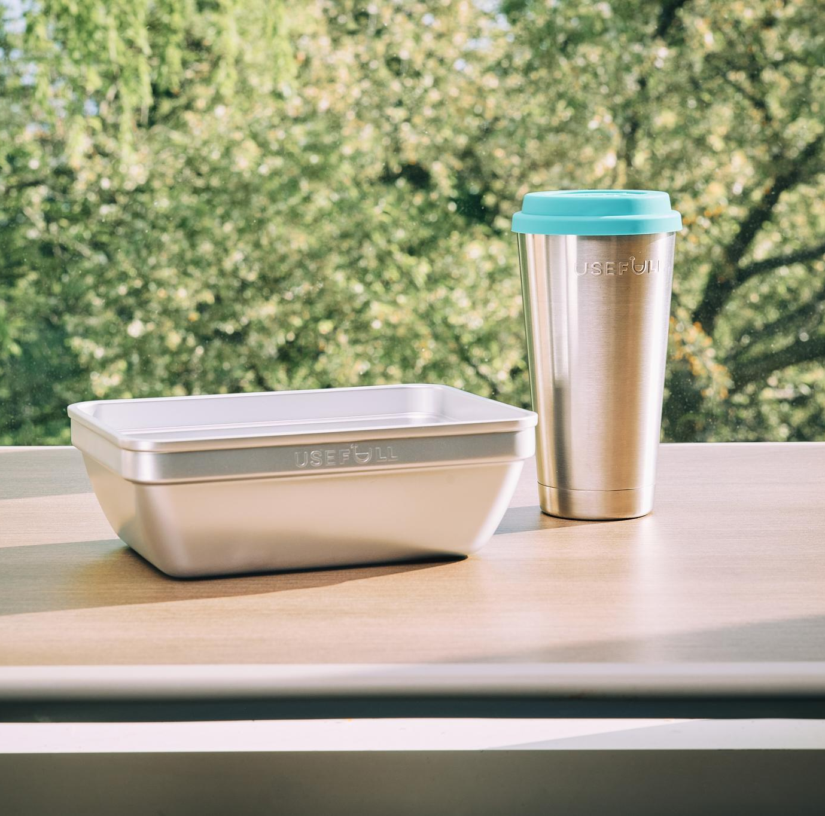
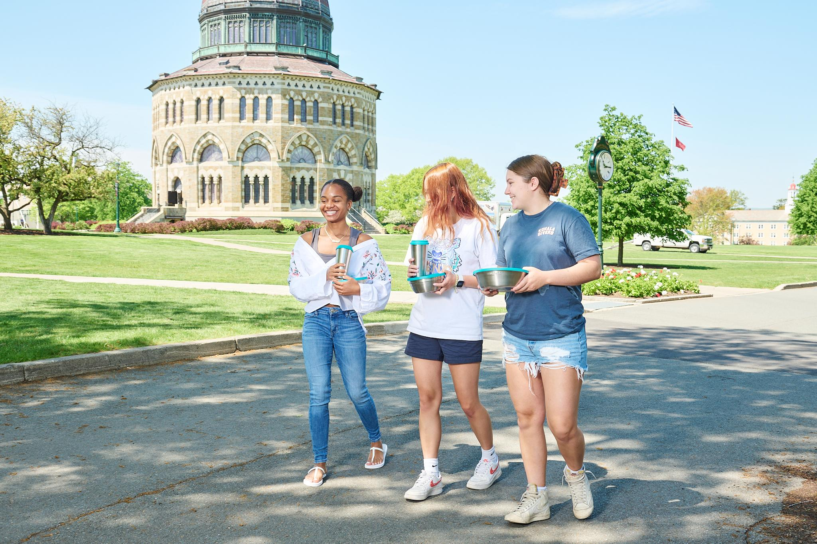
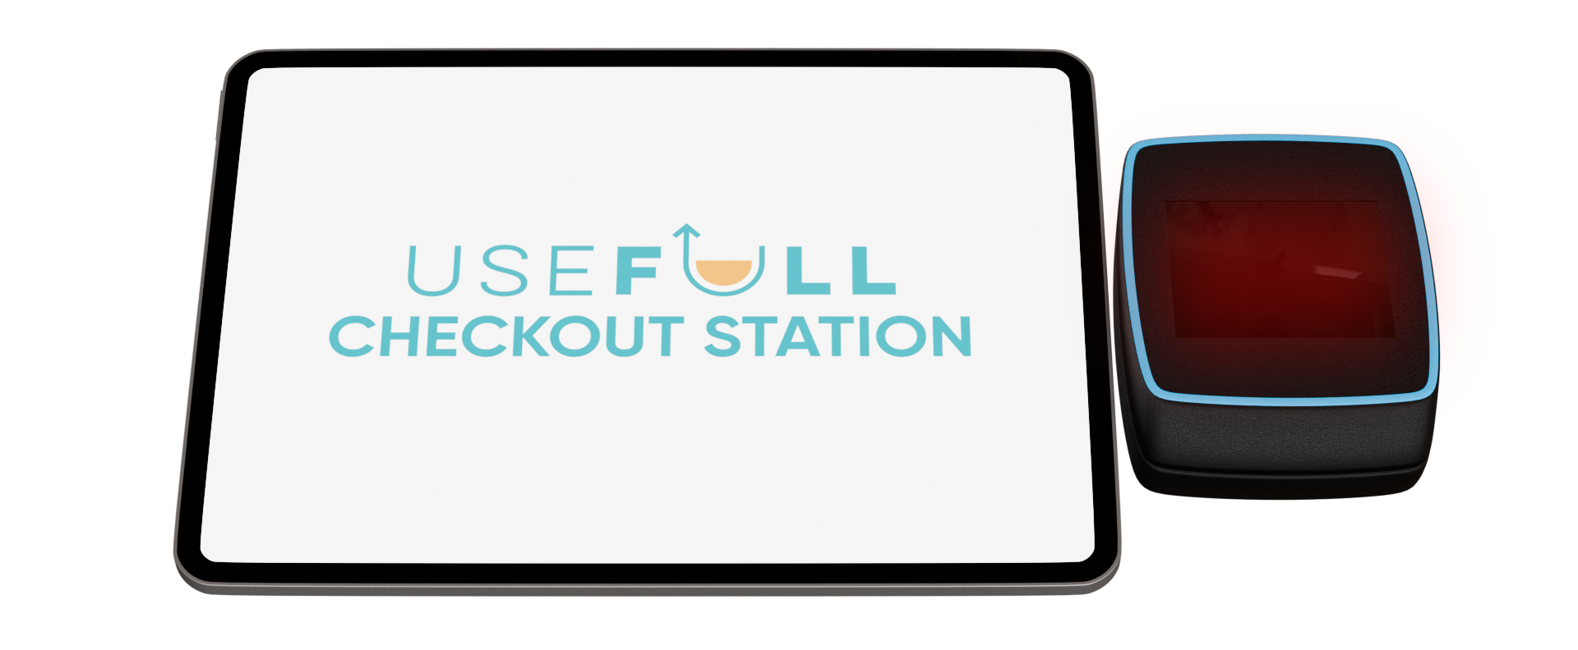
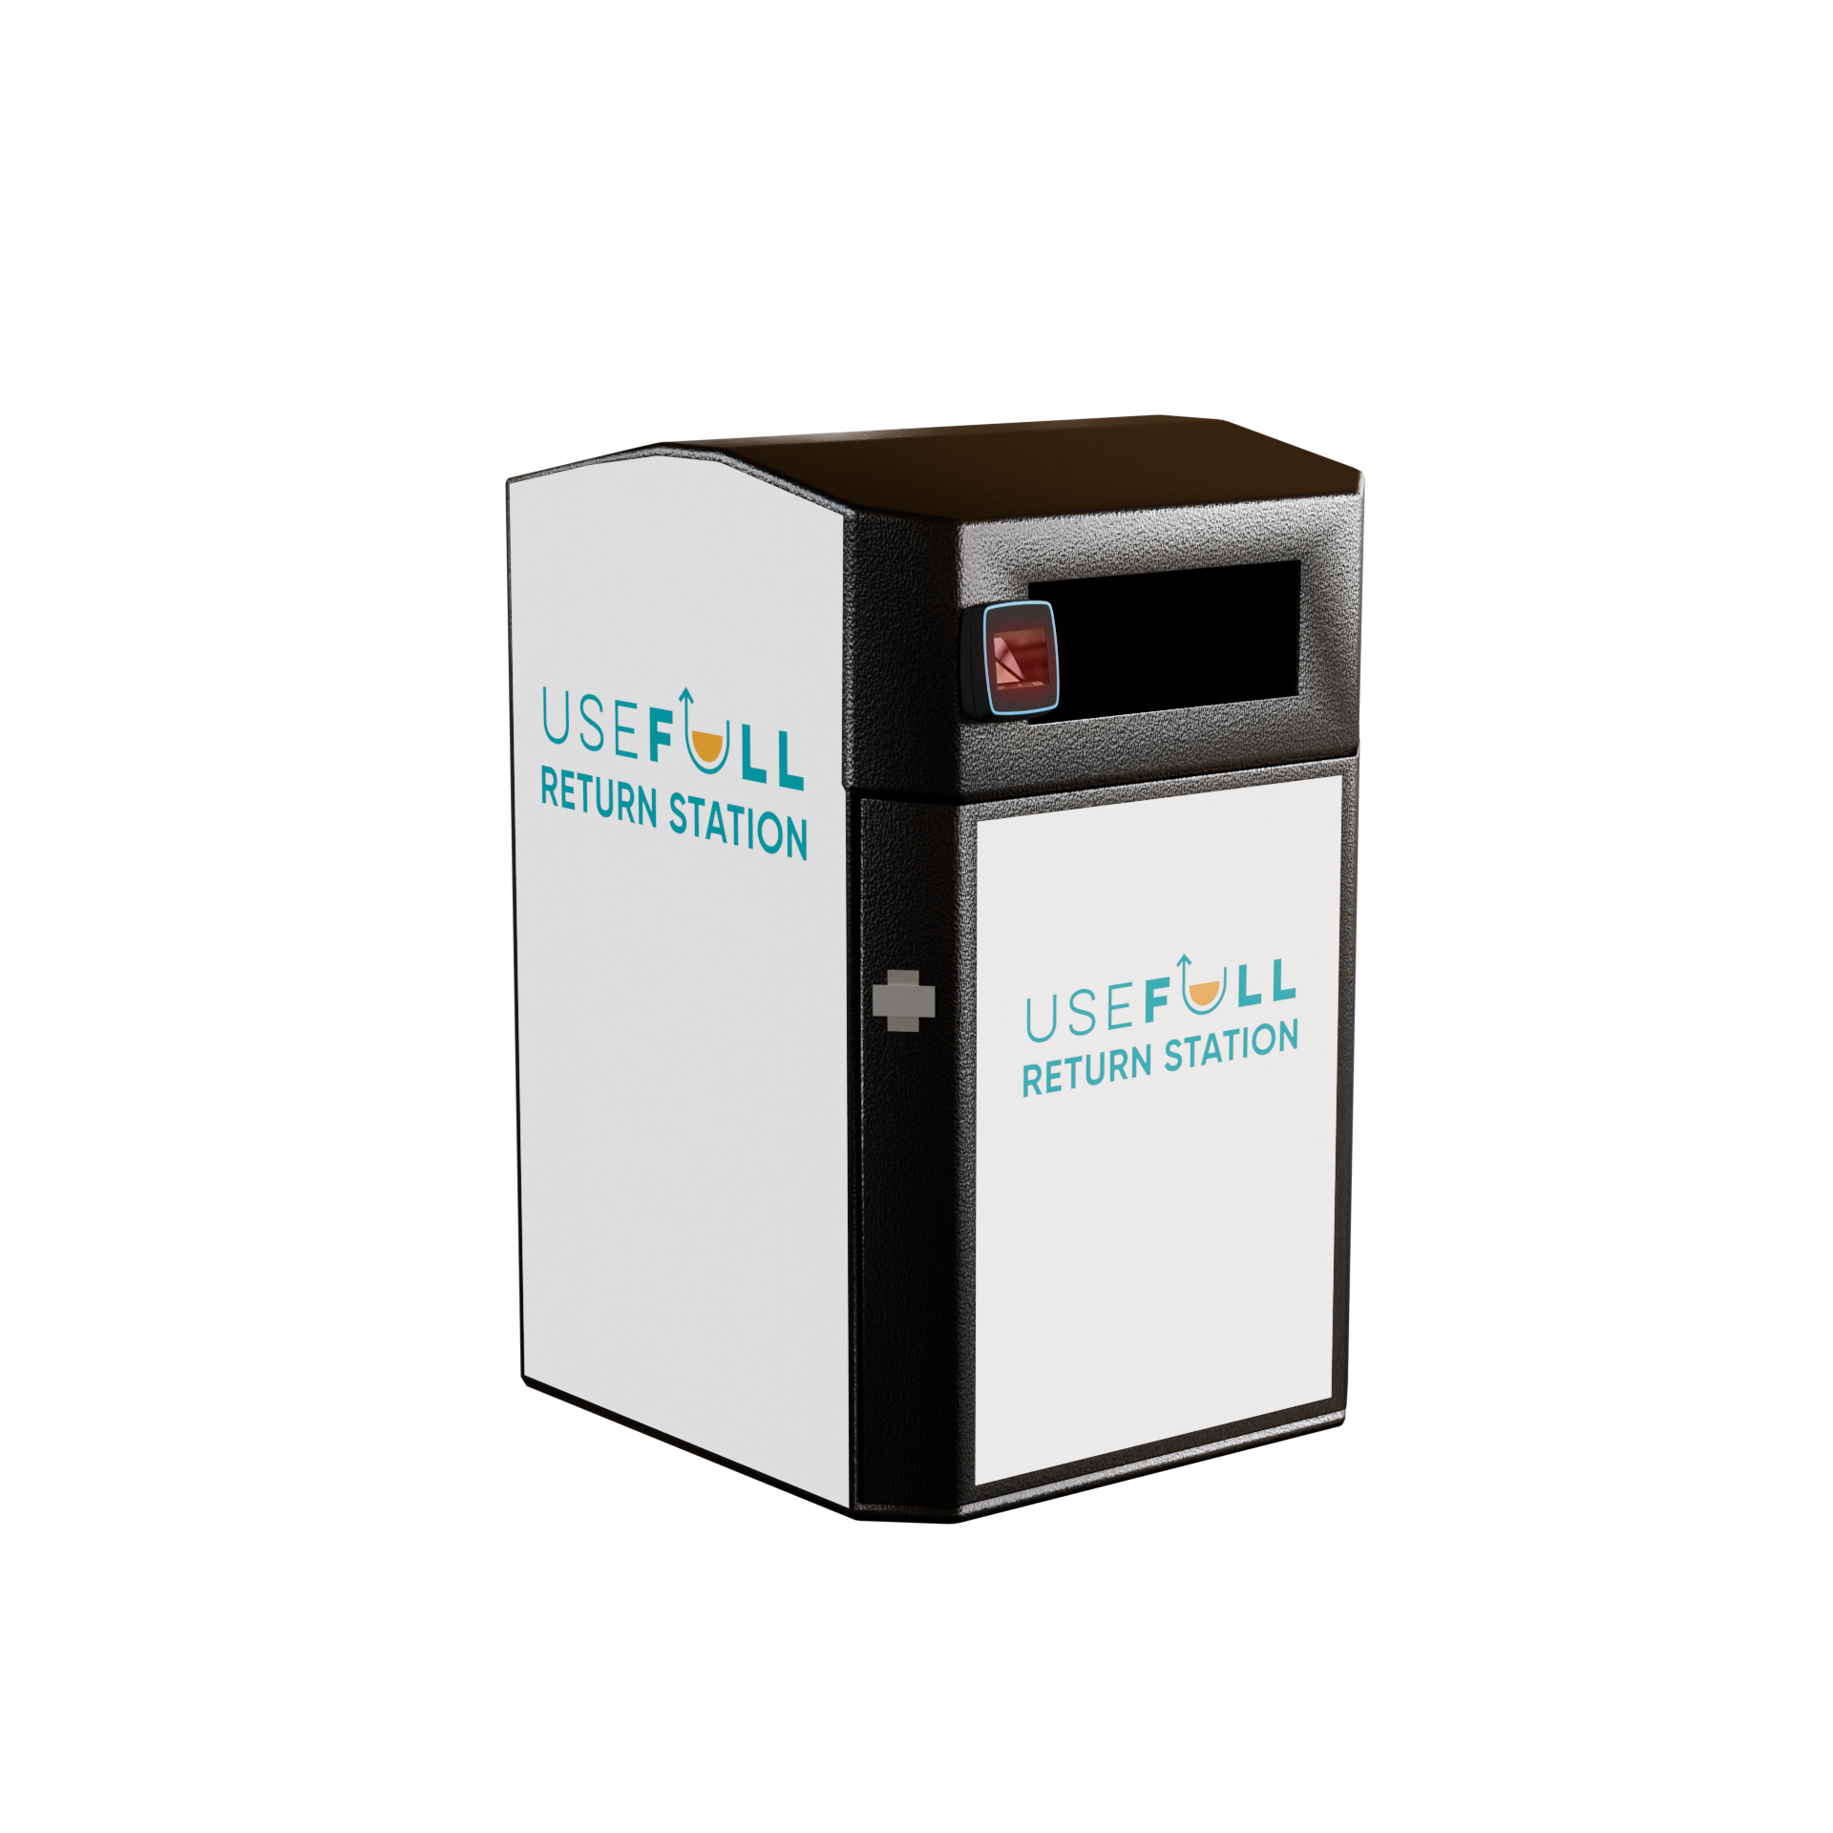
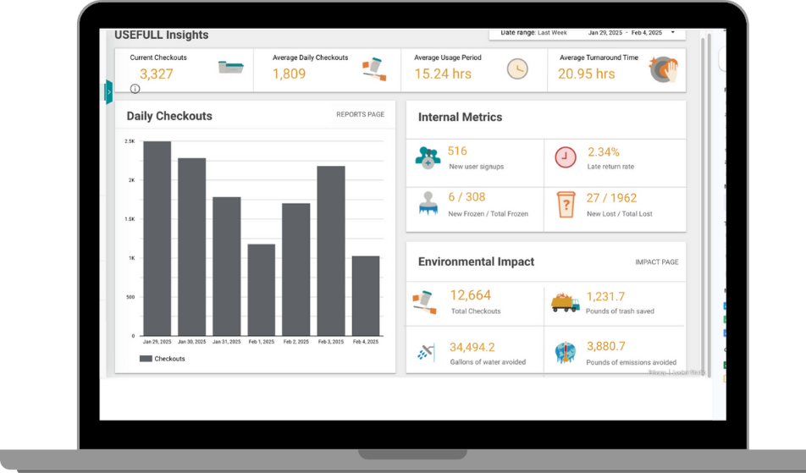

USEFULL CAMPUS LAUNCH FEB 2022
Opt-in Model
TRACKING TECHNOLOGY
13,000 checkouts
PLASTIC-FREE CONTAINERS
Opt-in model
INVENTORY MANAGEMENT
IMPACT REPORTING

Slide 5
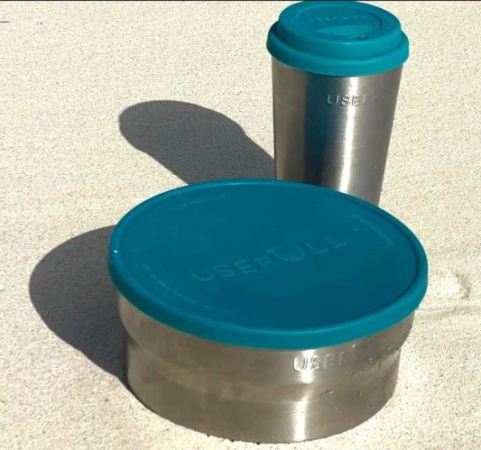
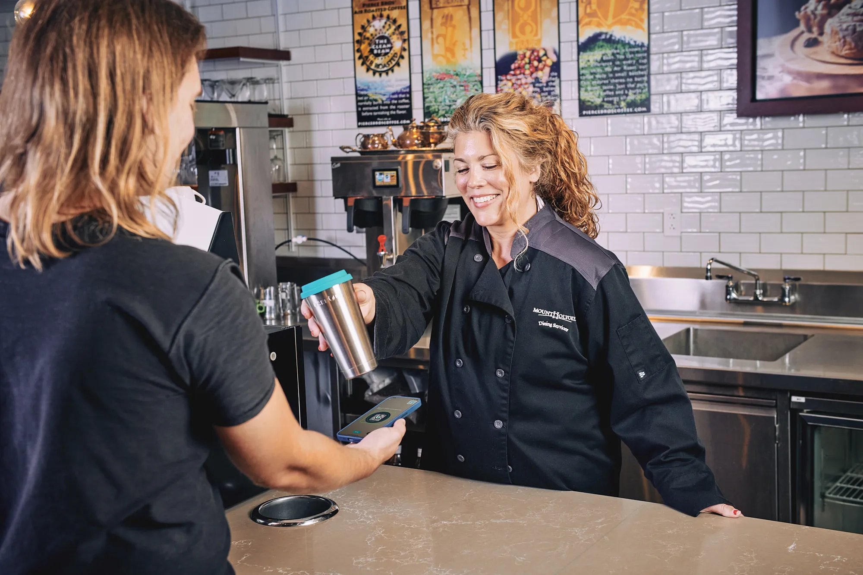
426,000
checkouts
$105K+
SAVINGS
USEFULL ONLY OPTION for takeaway
USEFULL @
Campus Pub & Campus Cafe
250,800/year
$75K COST
FEB
‘22
AUG‘22
APR ‘23
SEP ‘23
FEB ‘24
MAY‘26
‘21
188,000
checkouts
100,000 checkouts
Opt-in Launch
13,000 checkouts
Notes:
MHC usage is 75% bowls, 25% tumblers, cost for cups is much less than compostable clamshells
1.3Trillion tons of all man-made materials on earth, now outweighs all other life

Slide 6
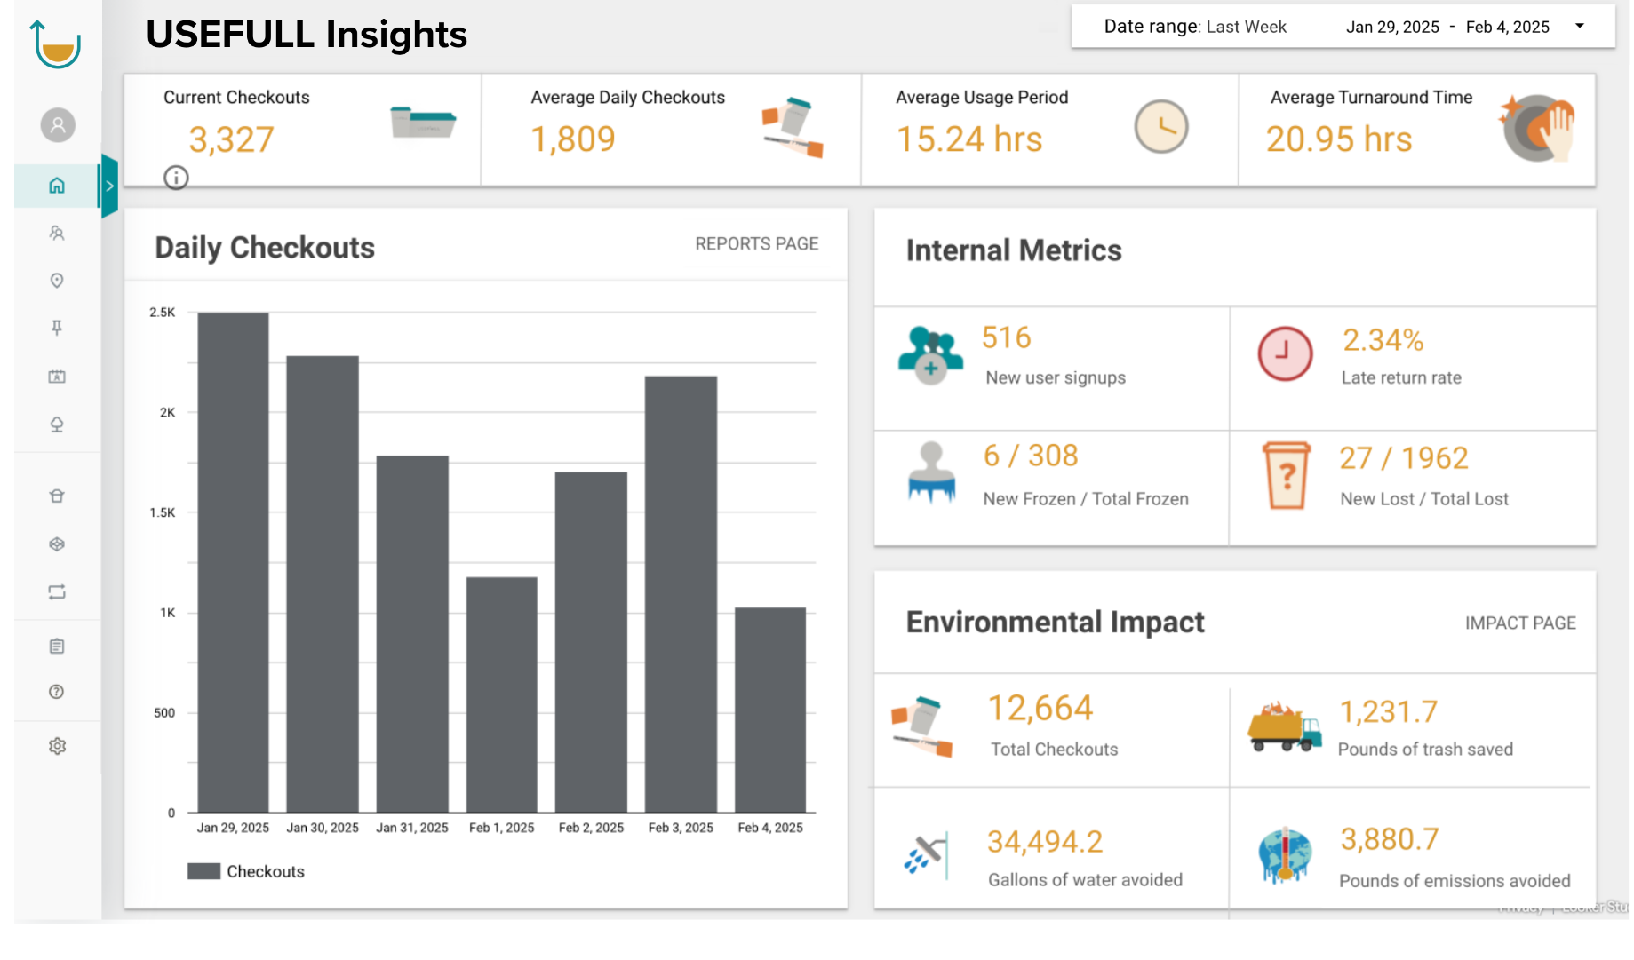
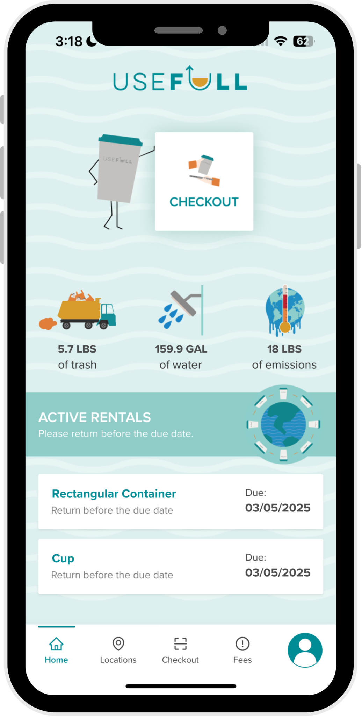
Tracking technology was key
Understanding usage
Overall environmental impacts
Return location
Preferred containers

Slide 7

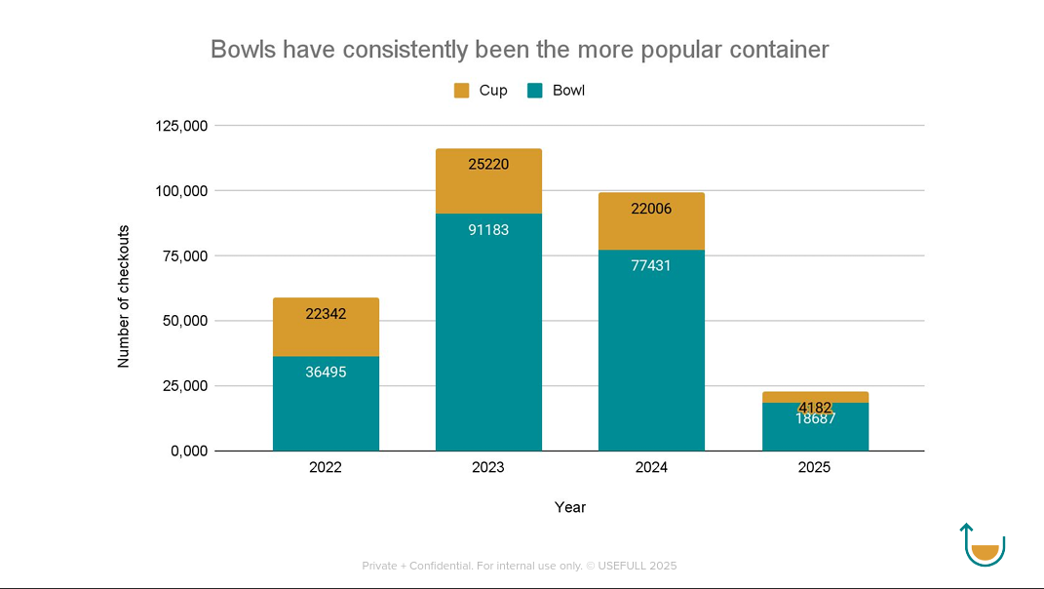

Slide 8
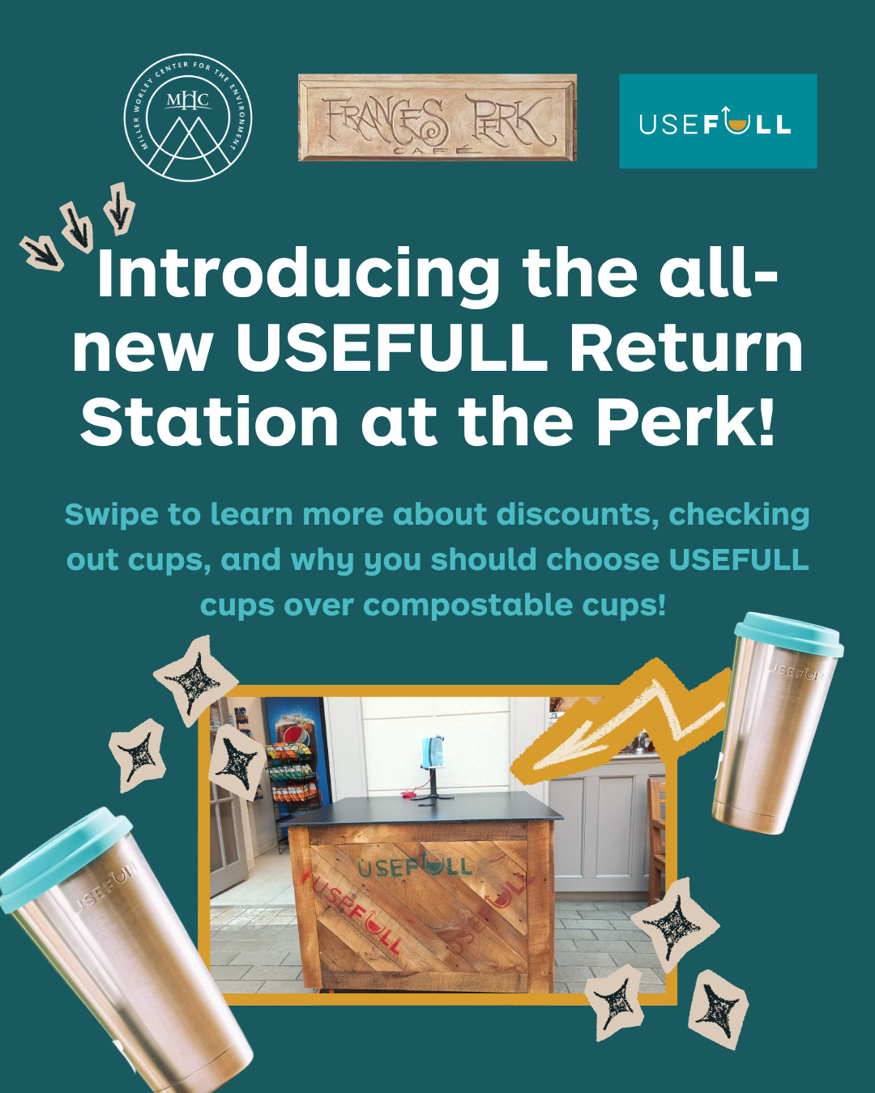
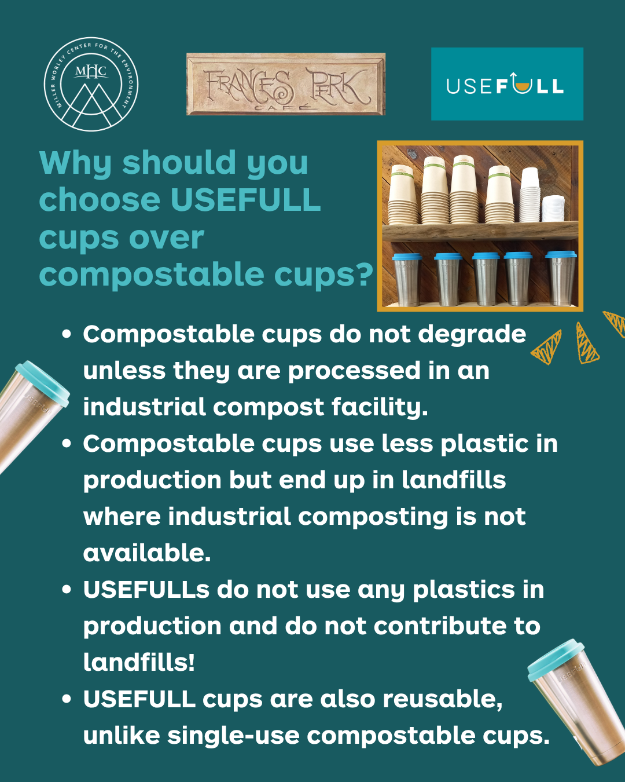

Slide 9



Slide 10
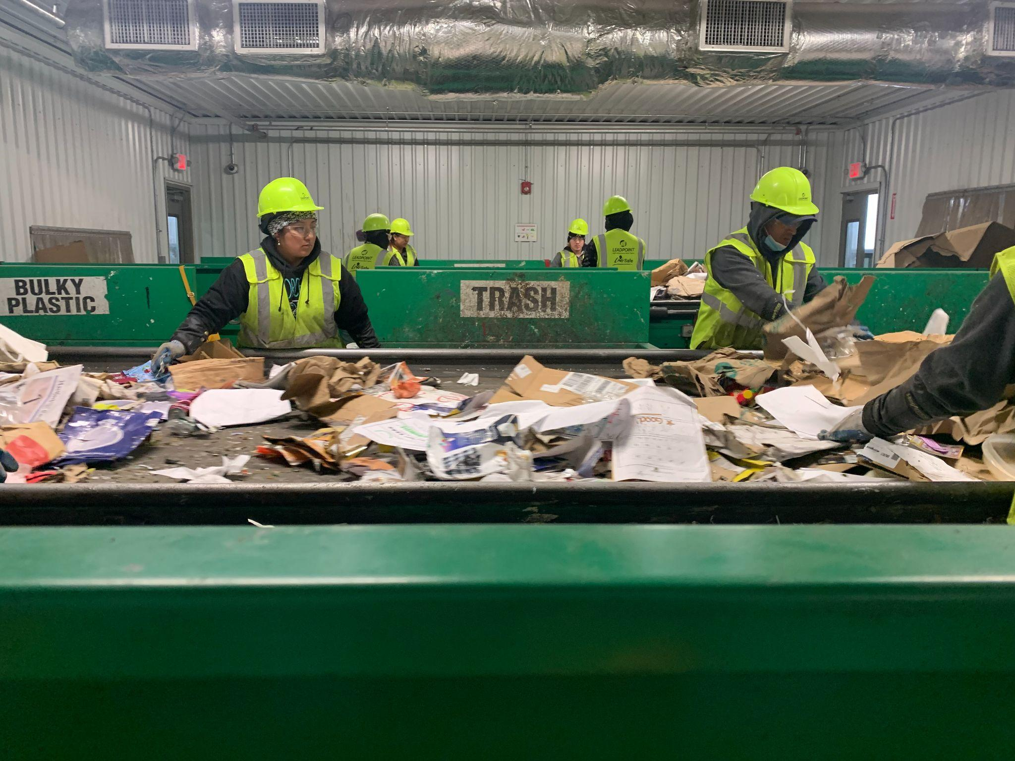
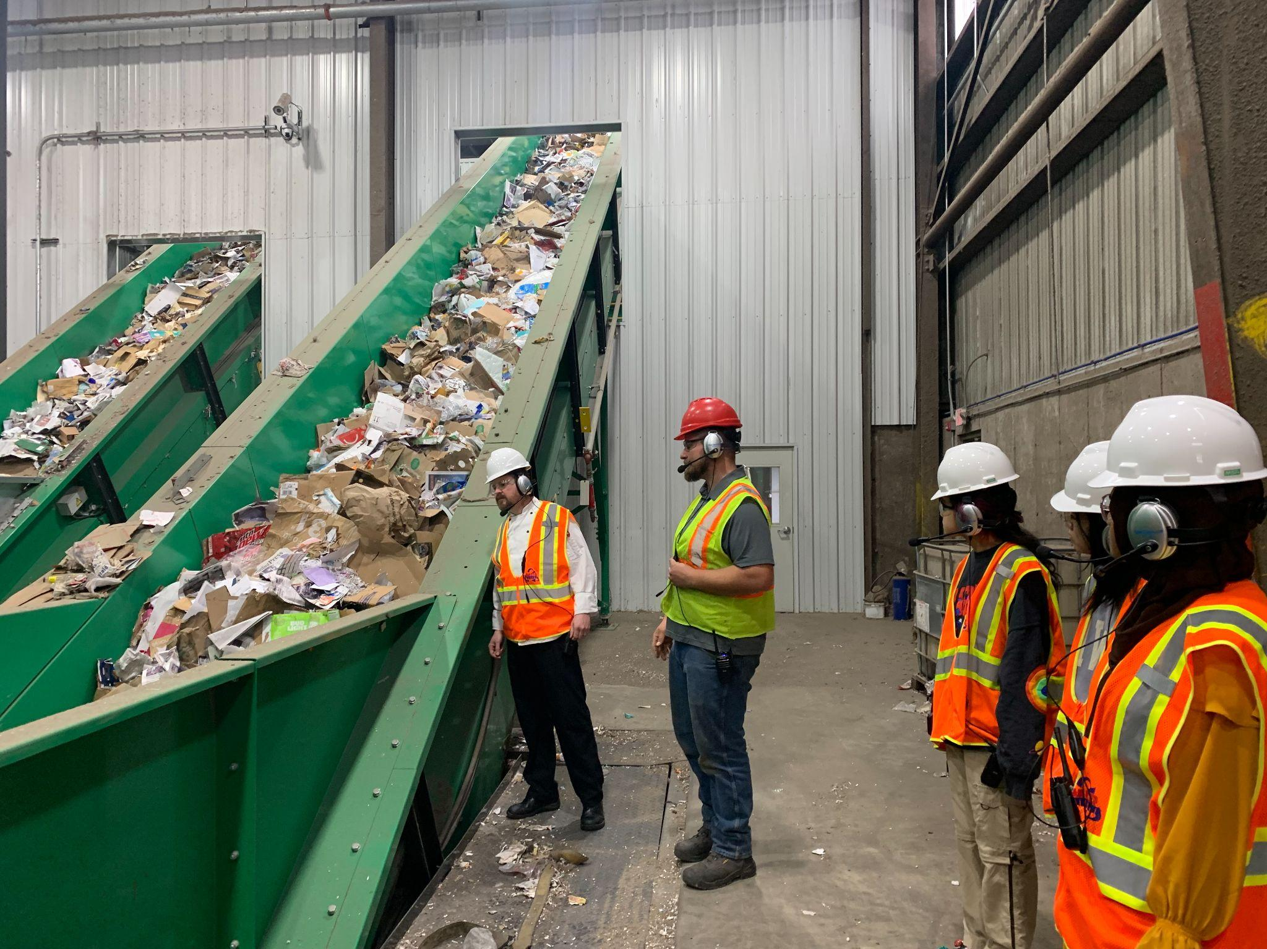
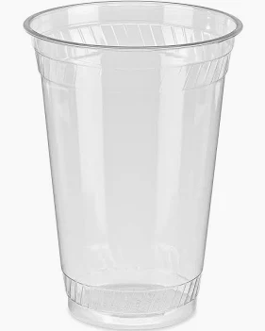
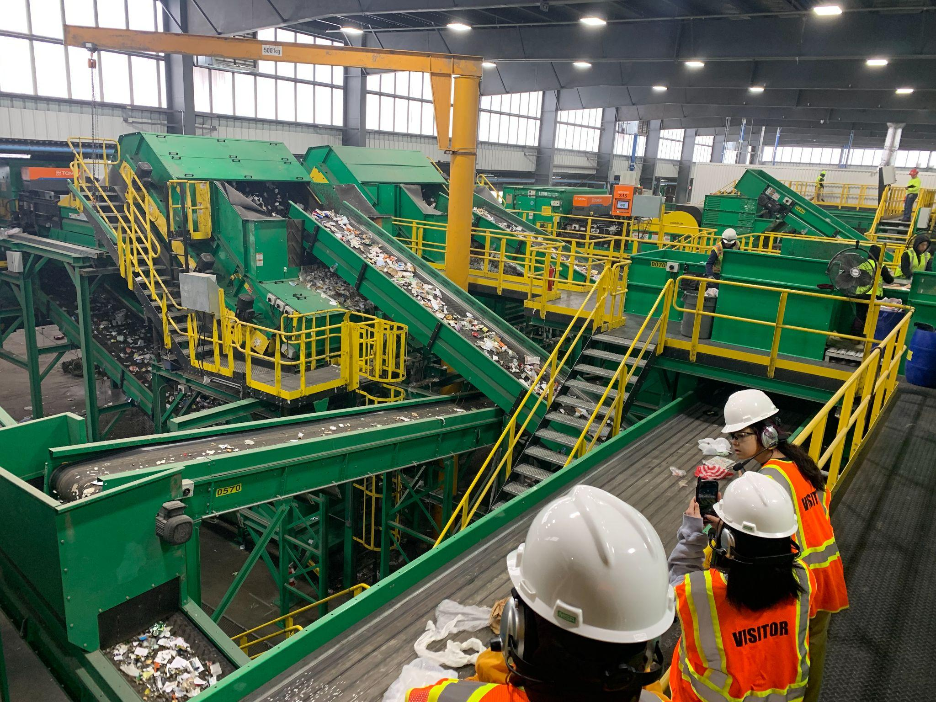
Compostable cups rejected by our MRF’s sensors

Slide 11
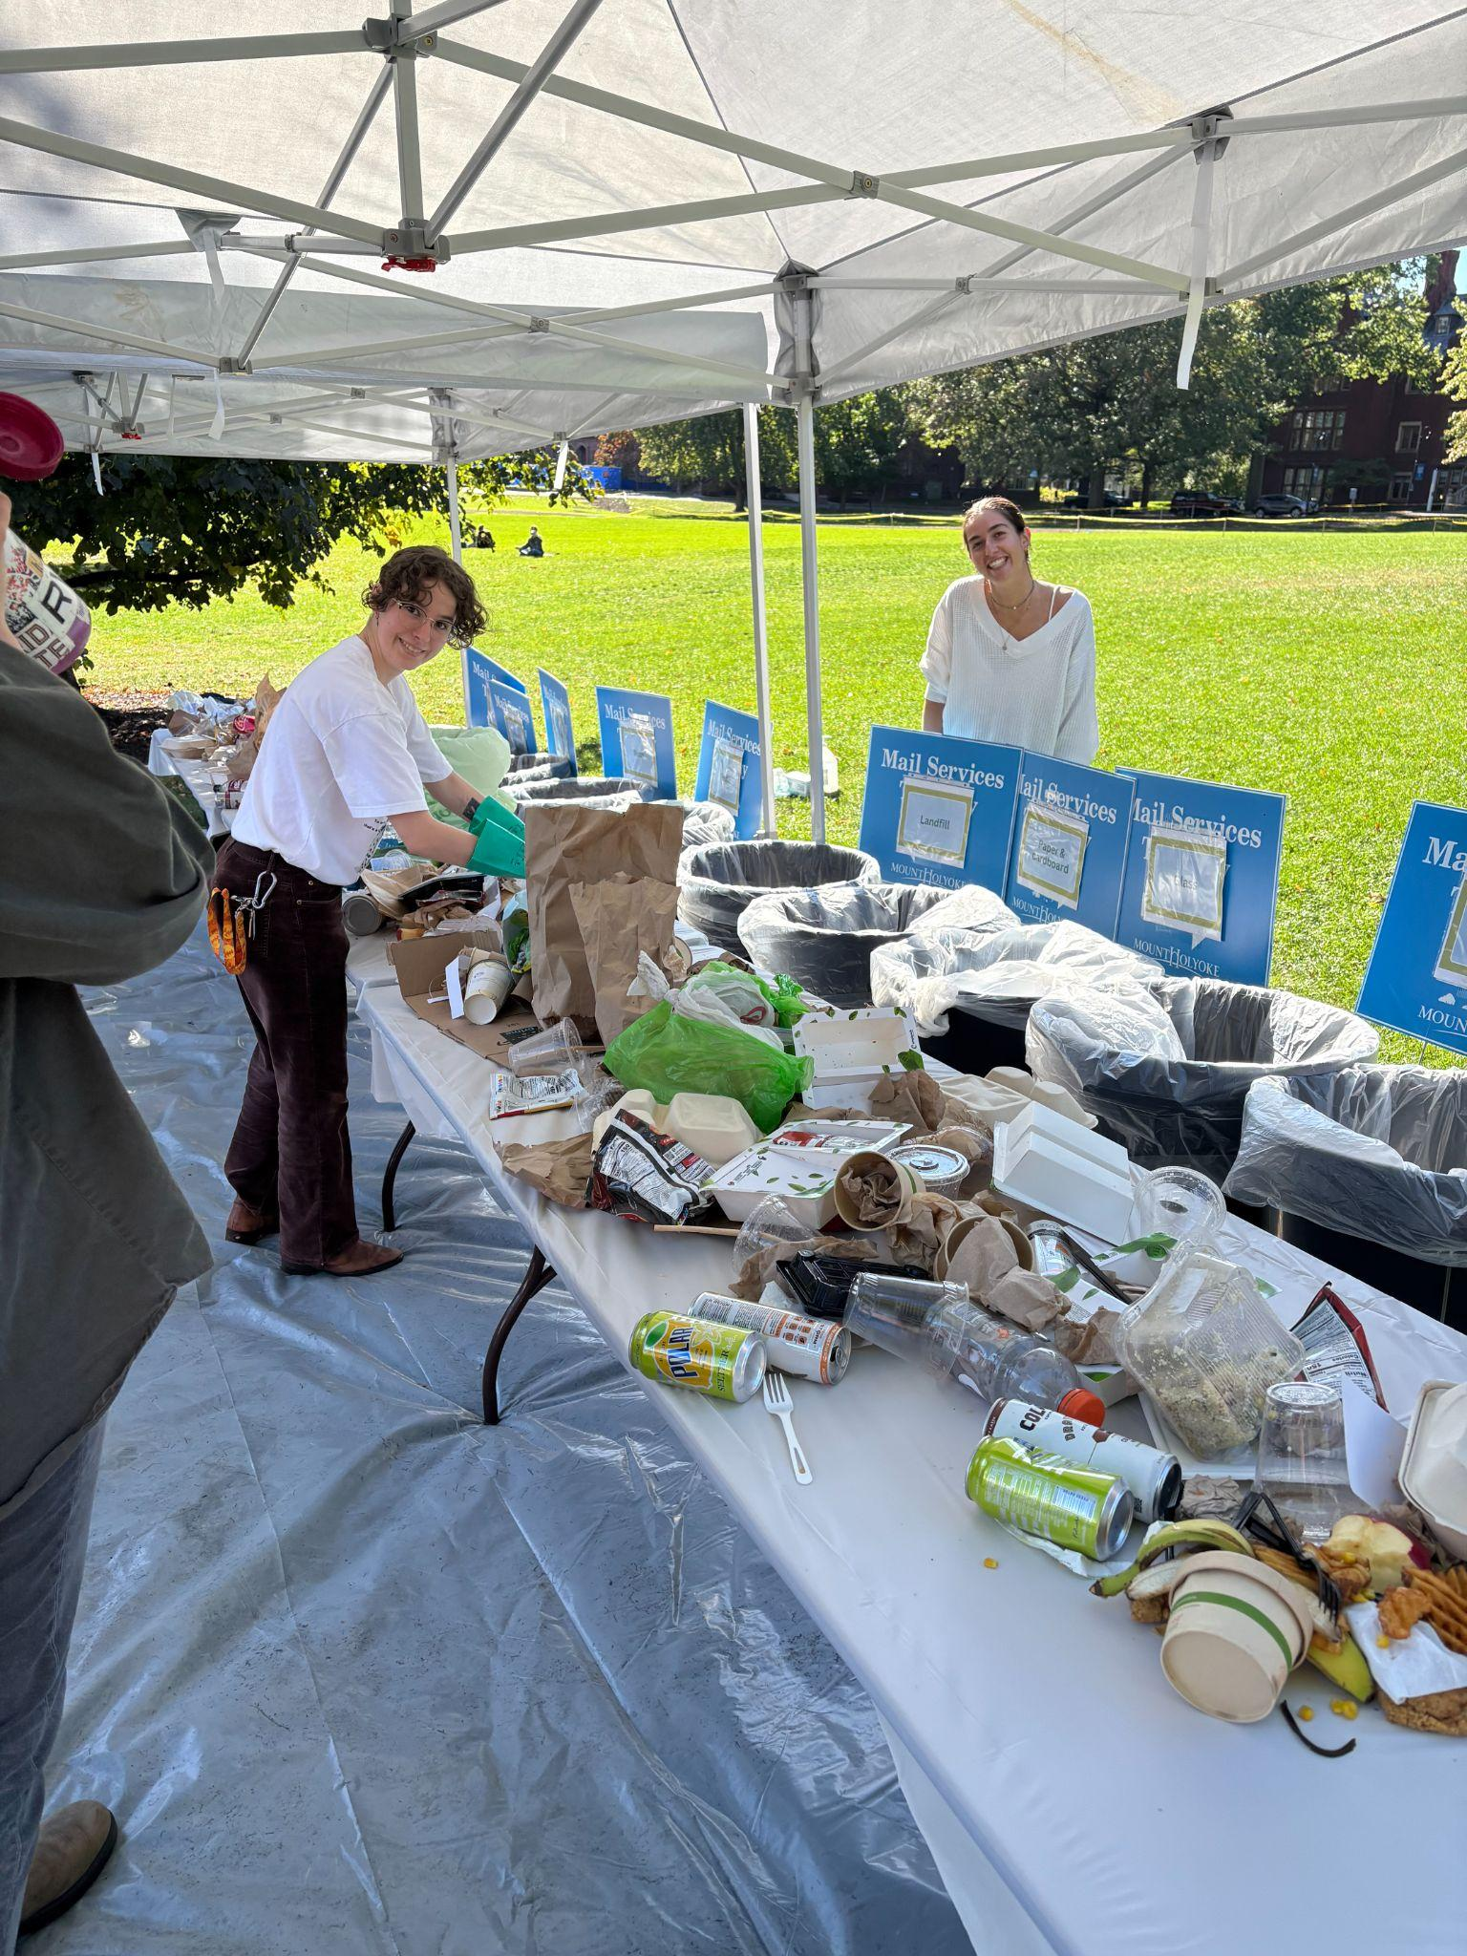
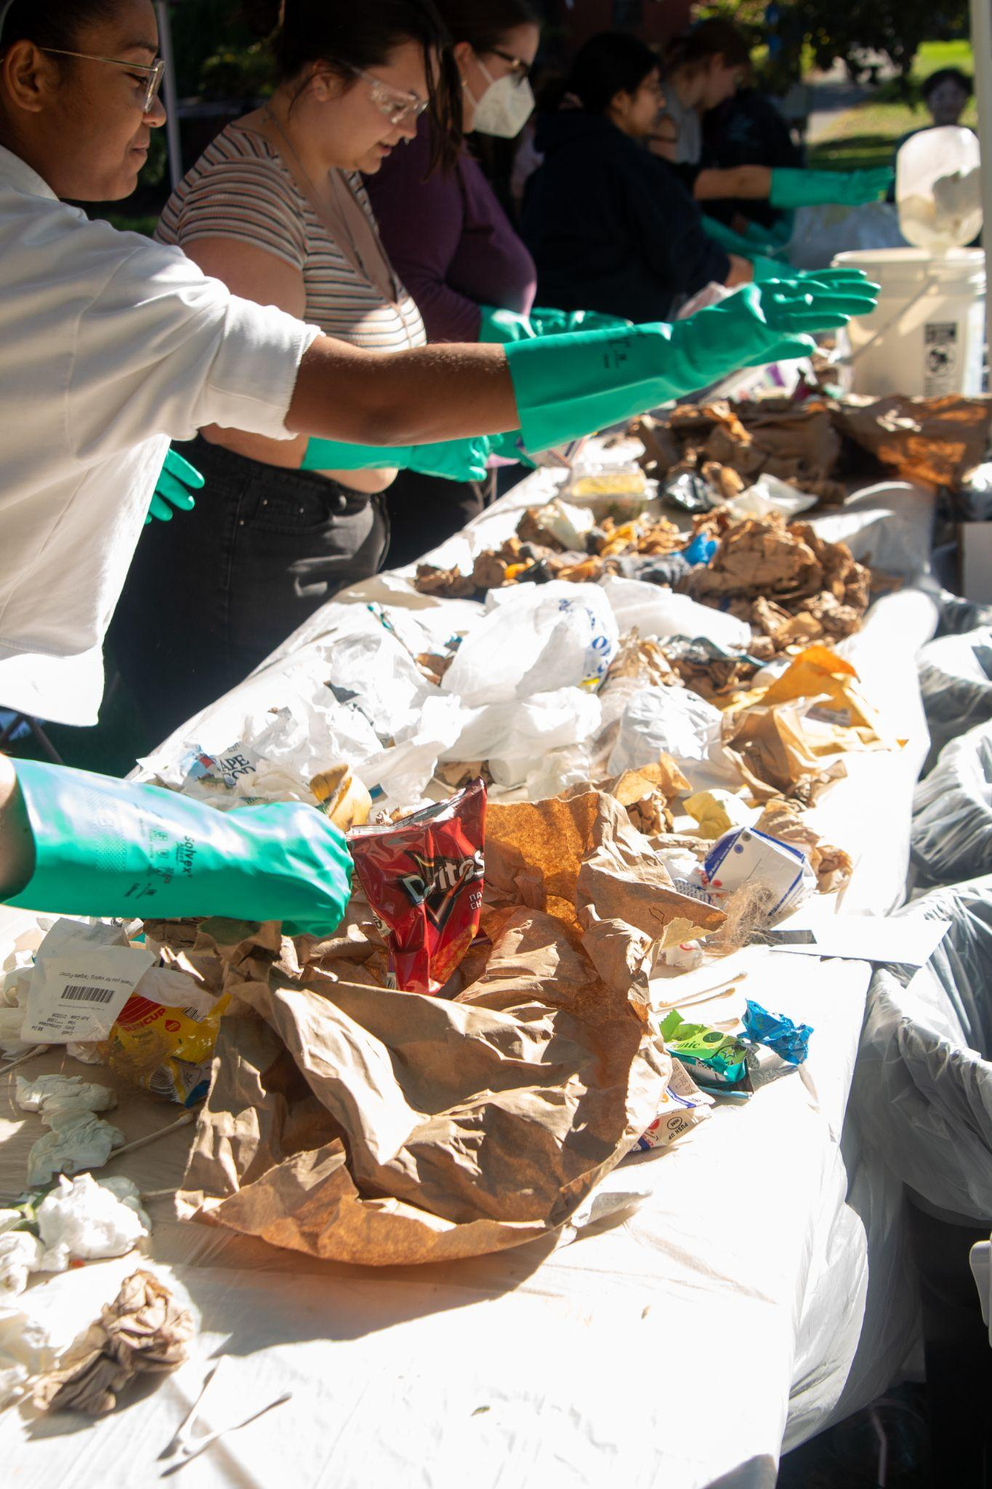
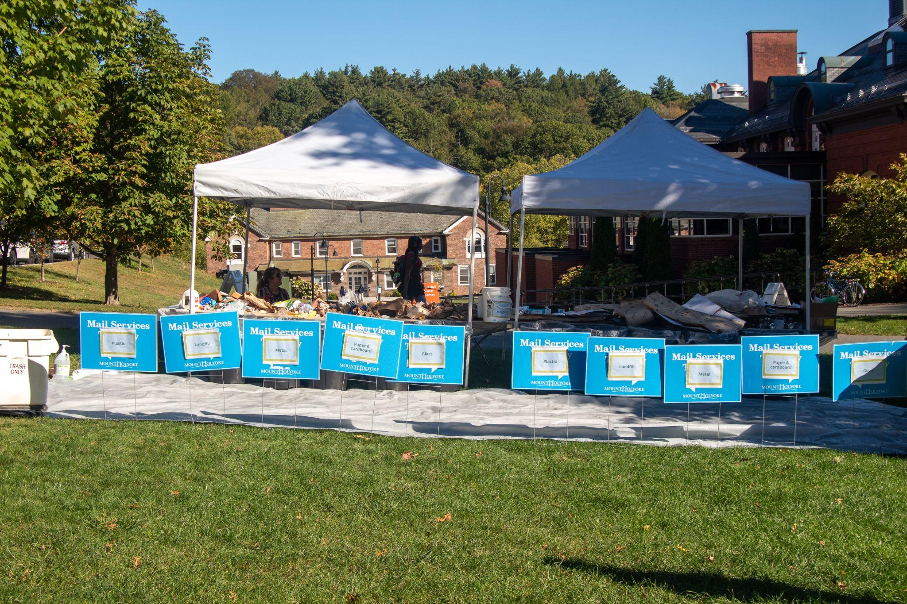
Waste Sort for Intro to Art Practices Course
Course focus on plastics and storytelling through puppetry using only recyclable materials.
Student learning on what materials can be recovered and what cannot and where the diversion streams from our campus go.

Slide 12

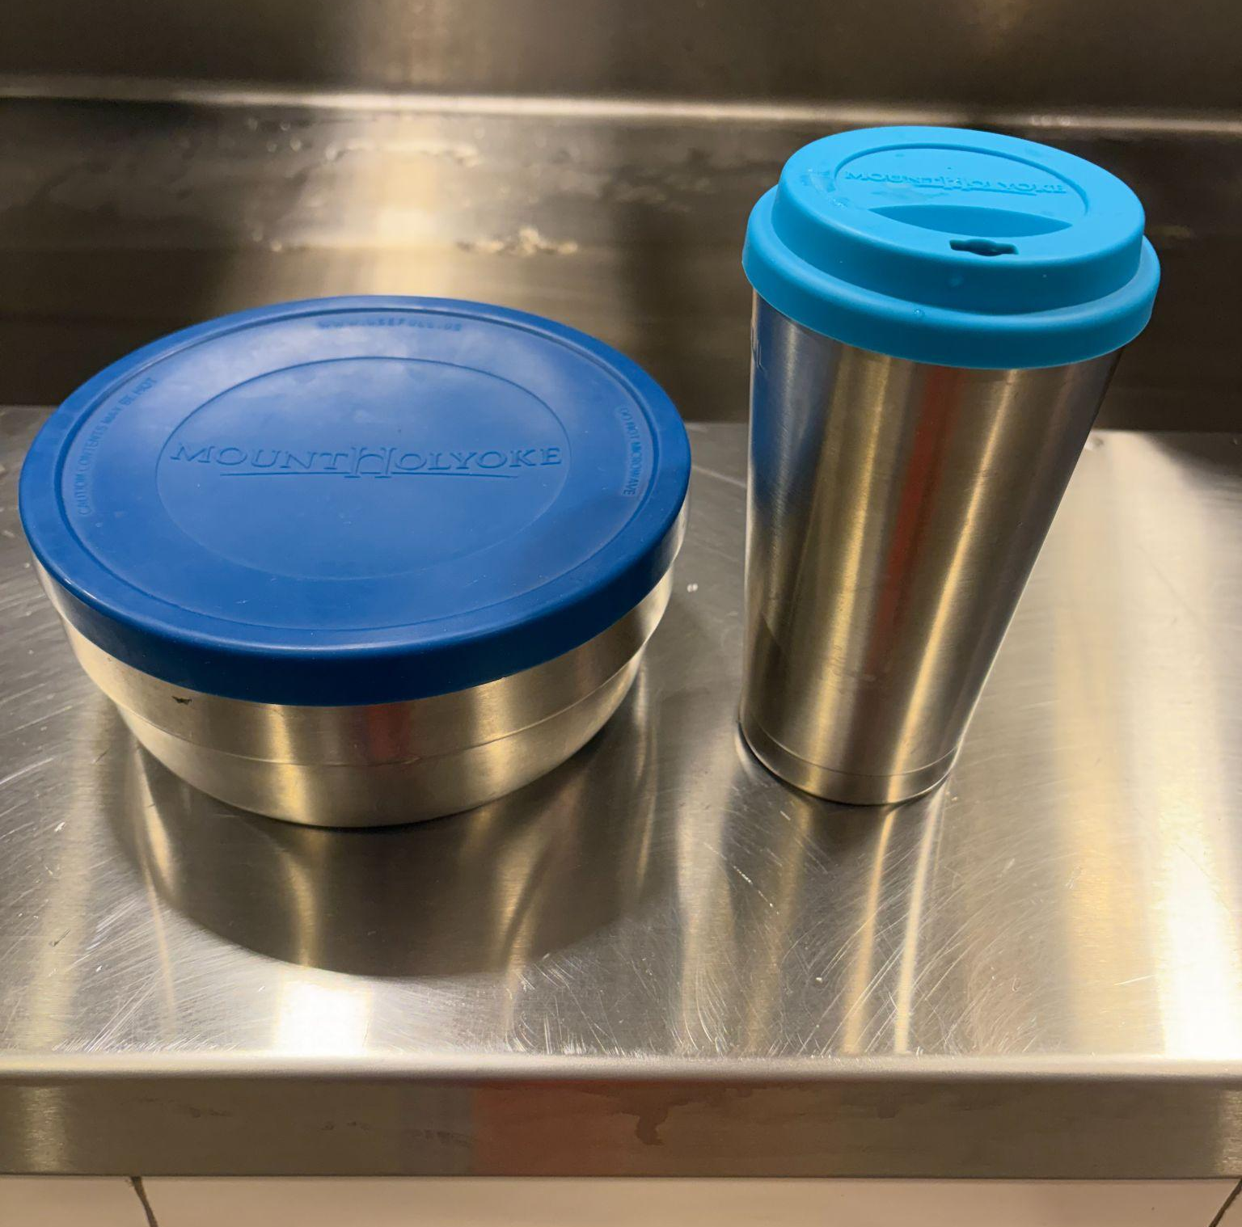
EPA’s Waste Reduction Model (WARM)
Overall lifecycle emissions of PLA that gets composted generates about 50% more CO2e than the overall lifecycle emissions of the same amount of #5PP that gets recycled.
Stainless Steel Reusables have a significantly lower overall lifecycle emission even if only used a handful of times.
Notes:
Compostables are still a single use product and not preferable from emissions standpoint
6 types of calculations can be produced from the WARM model: GHG, Energy, Labors, Wages, Taxes
Recycled material offsets upstream resource extraction. Composting (while incredibly valuable and important) releases some emissions, and compostable materials can’t be used as feedstock to offset production of new packaging

Slide 13
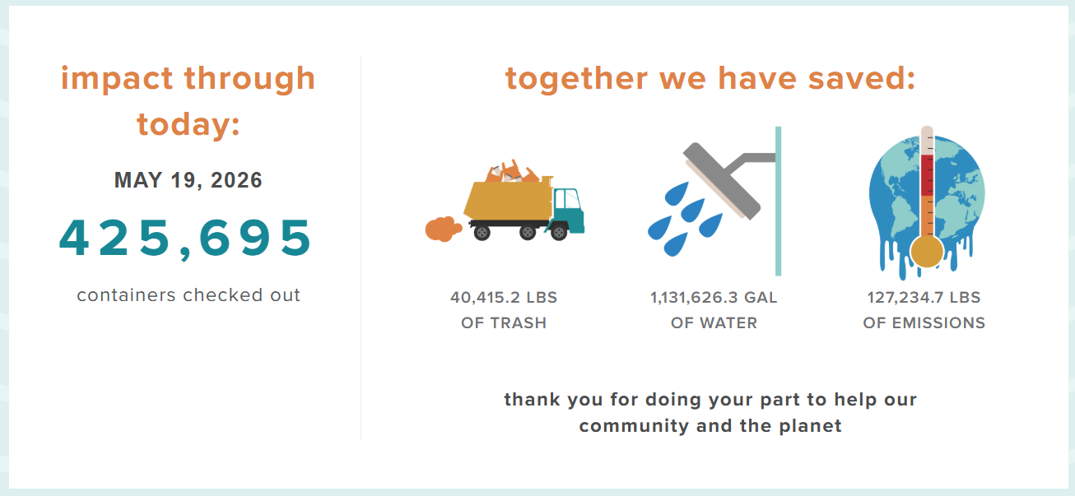
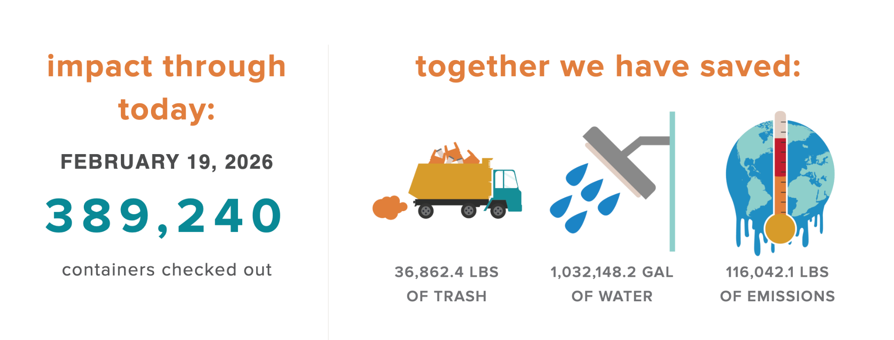
Impact Dashboard
Use this URL to view the live dashboard (can also be displayed on campus TVs): https://admin.usefull.us/tv/d207ab0e-9883-4503-a16f-850bec58c29a

Slide 14

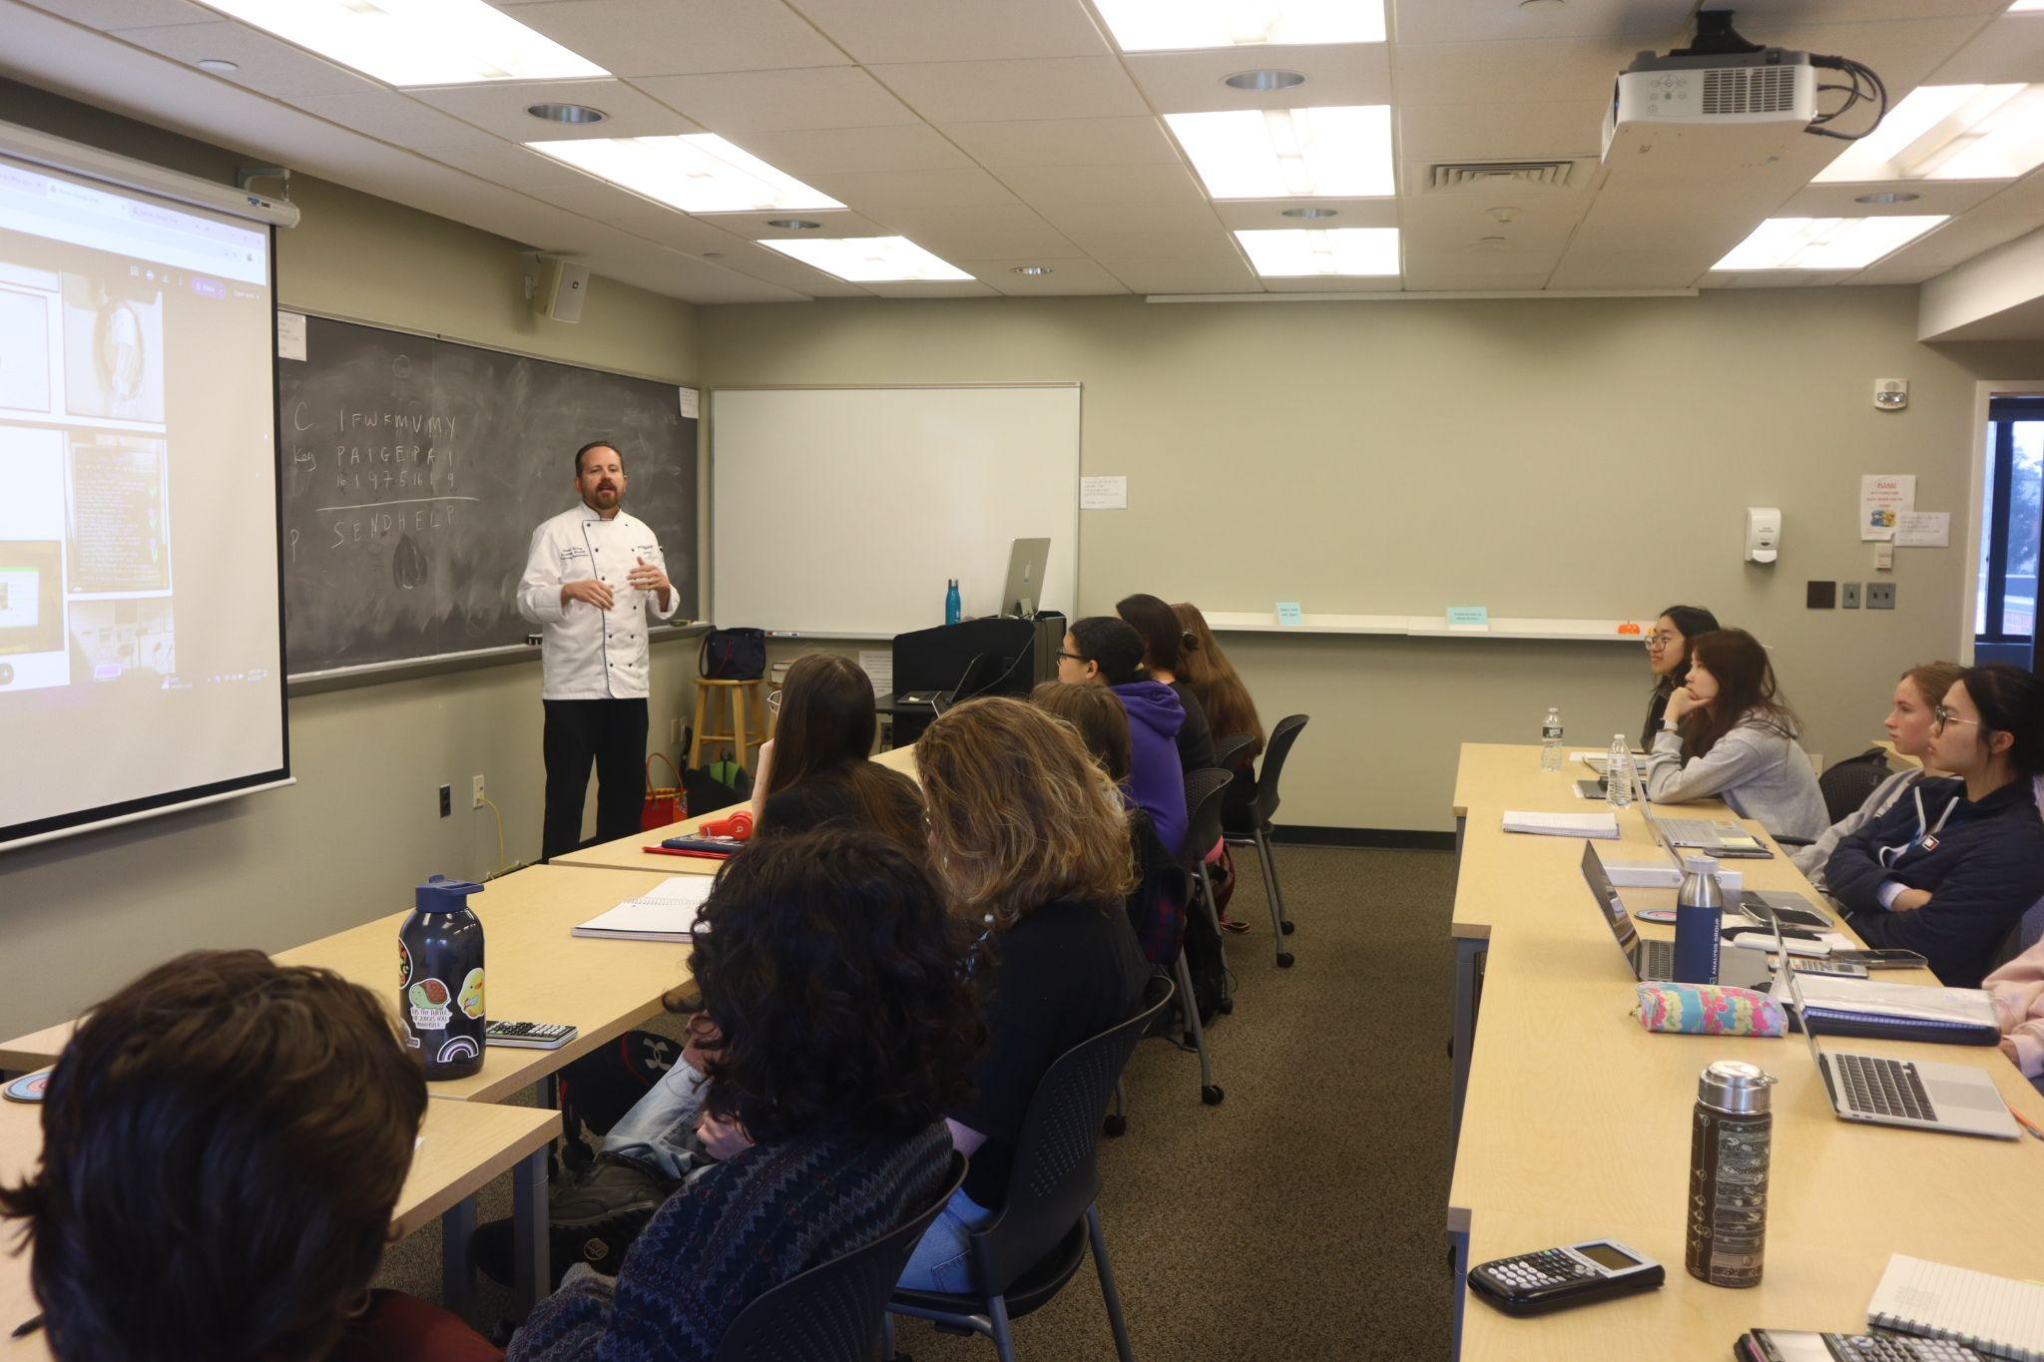
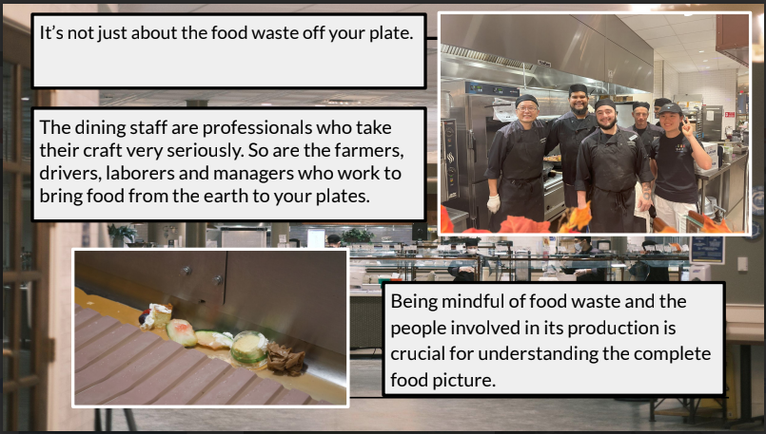
Education around Food Waste in FYS
Our Food Recovery Network Student Chapter’s Module
Reaching 200 students a year. Topics ranging from locations, sourcing, social impacts of food waste, campus volumes, call to action to reduce by 1oz.
Seeing a 10% reduction in post-consumer food waste totals.

Slide 15
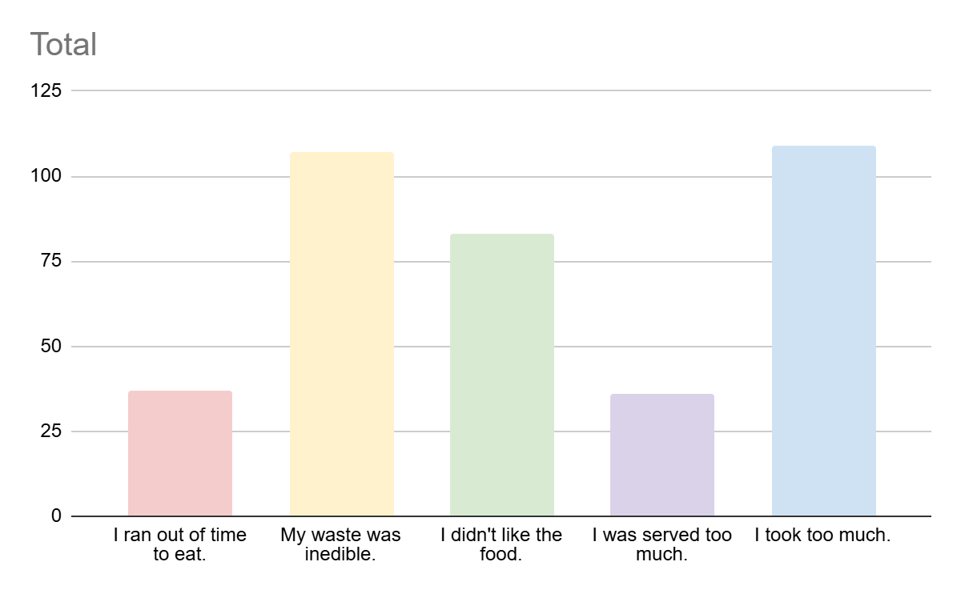
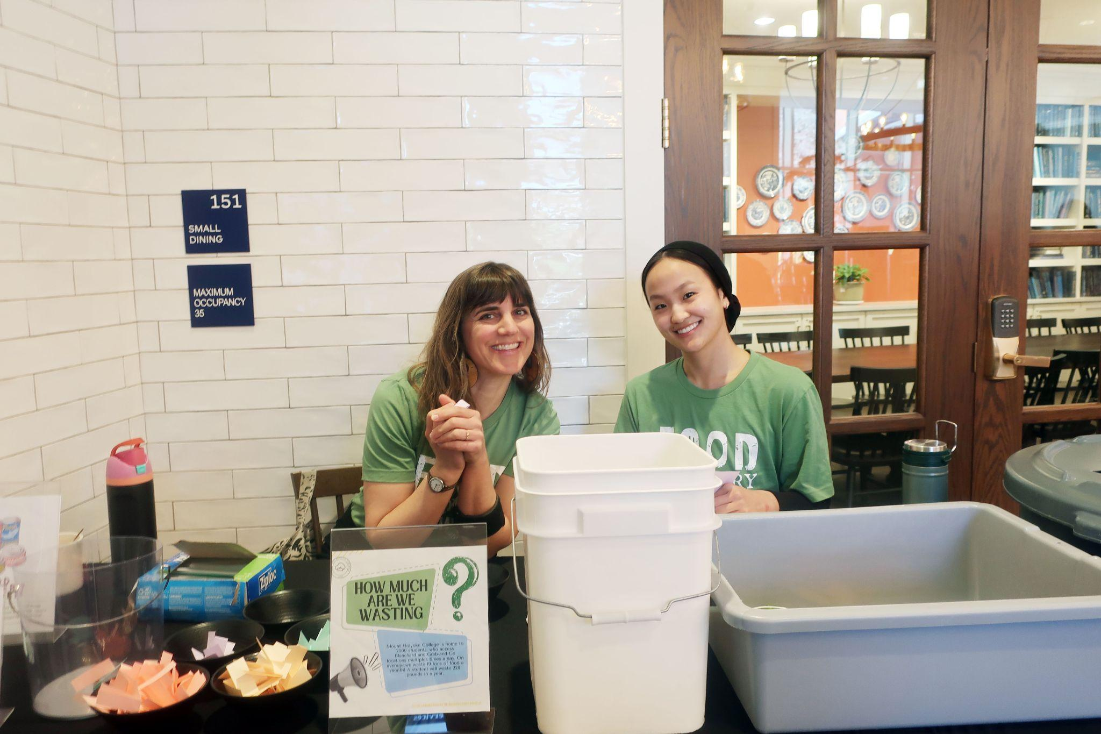
Food Recovery Network Student Chapter
Weigh the Waste Events
Understanding the reasons people have plate waste

Slide 16

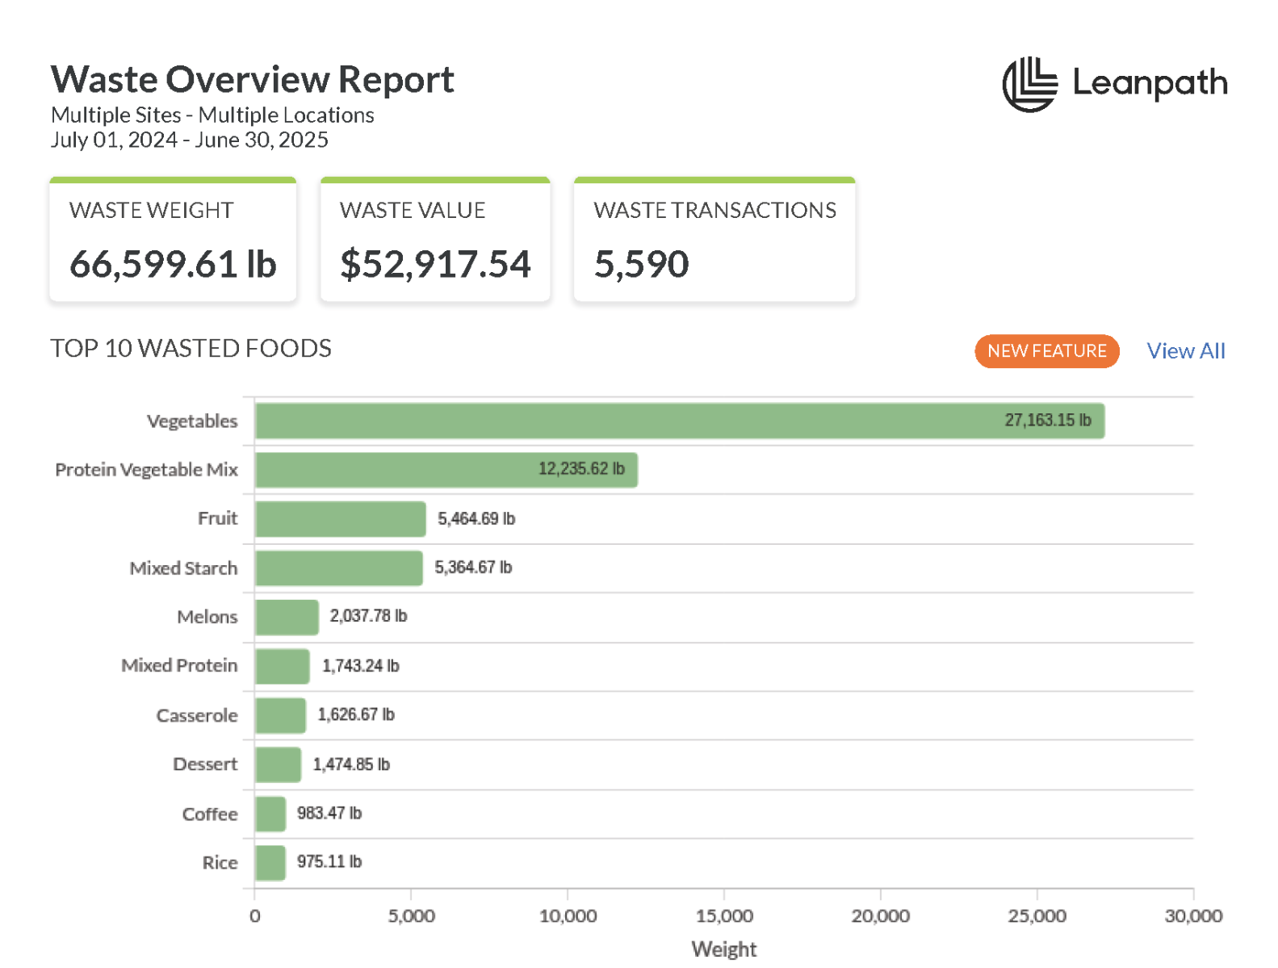
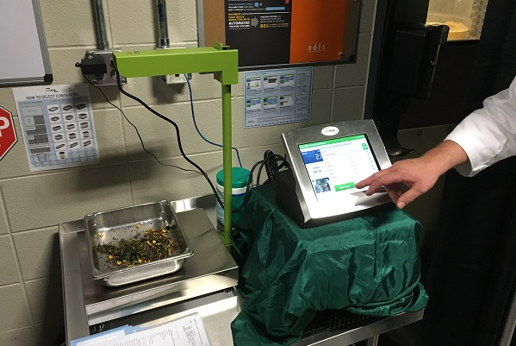
Maximizing Food @ Mount Holyoke College Dining Services

Slide 17
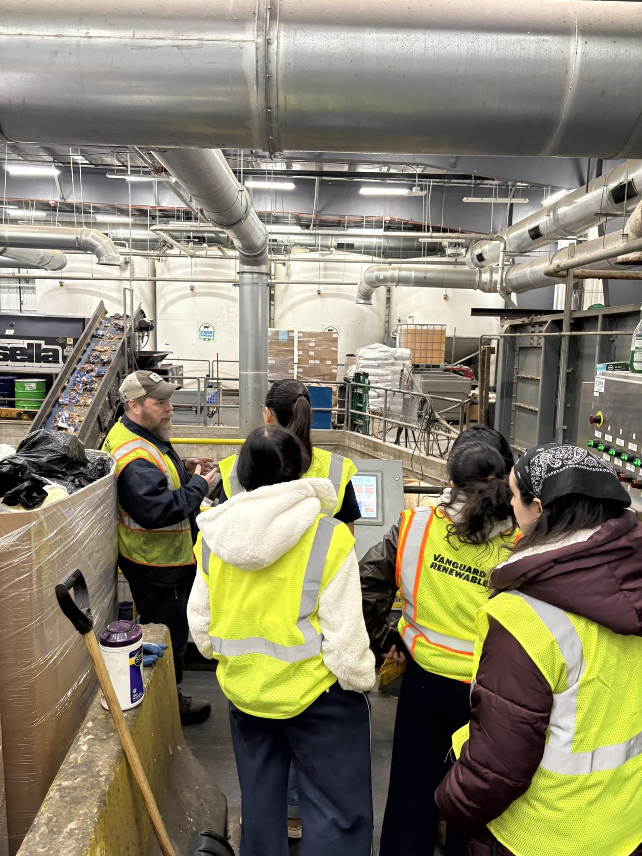
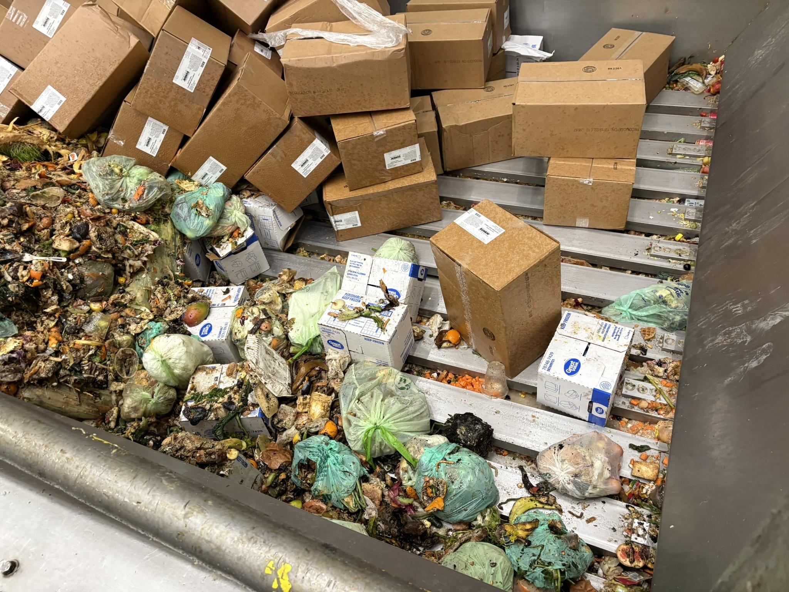
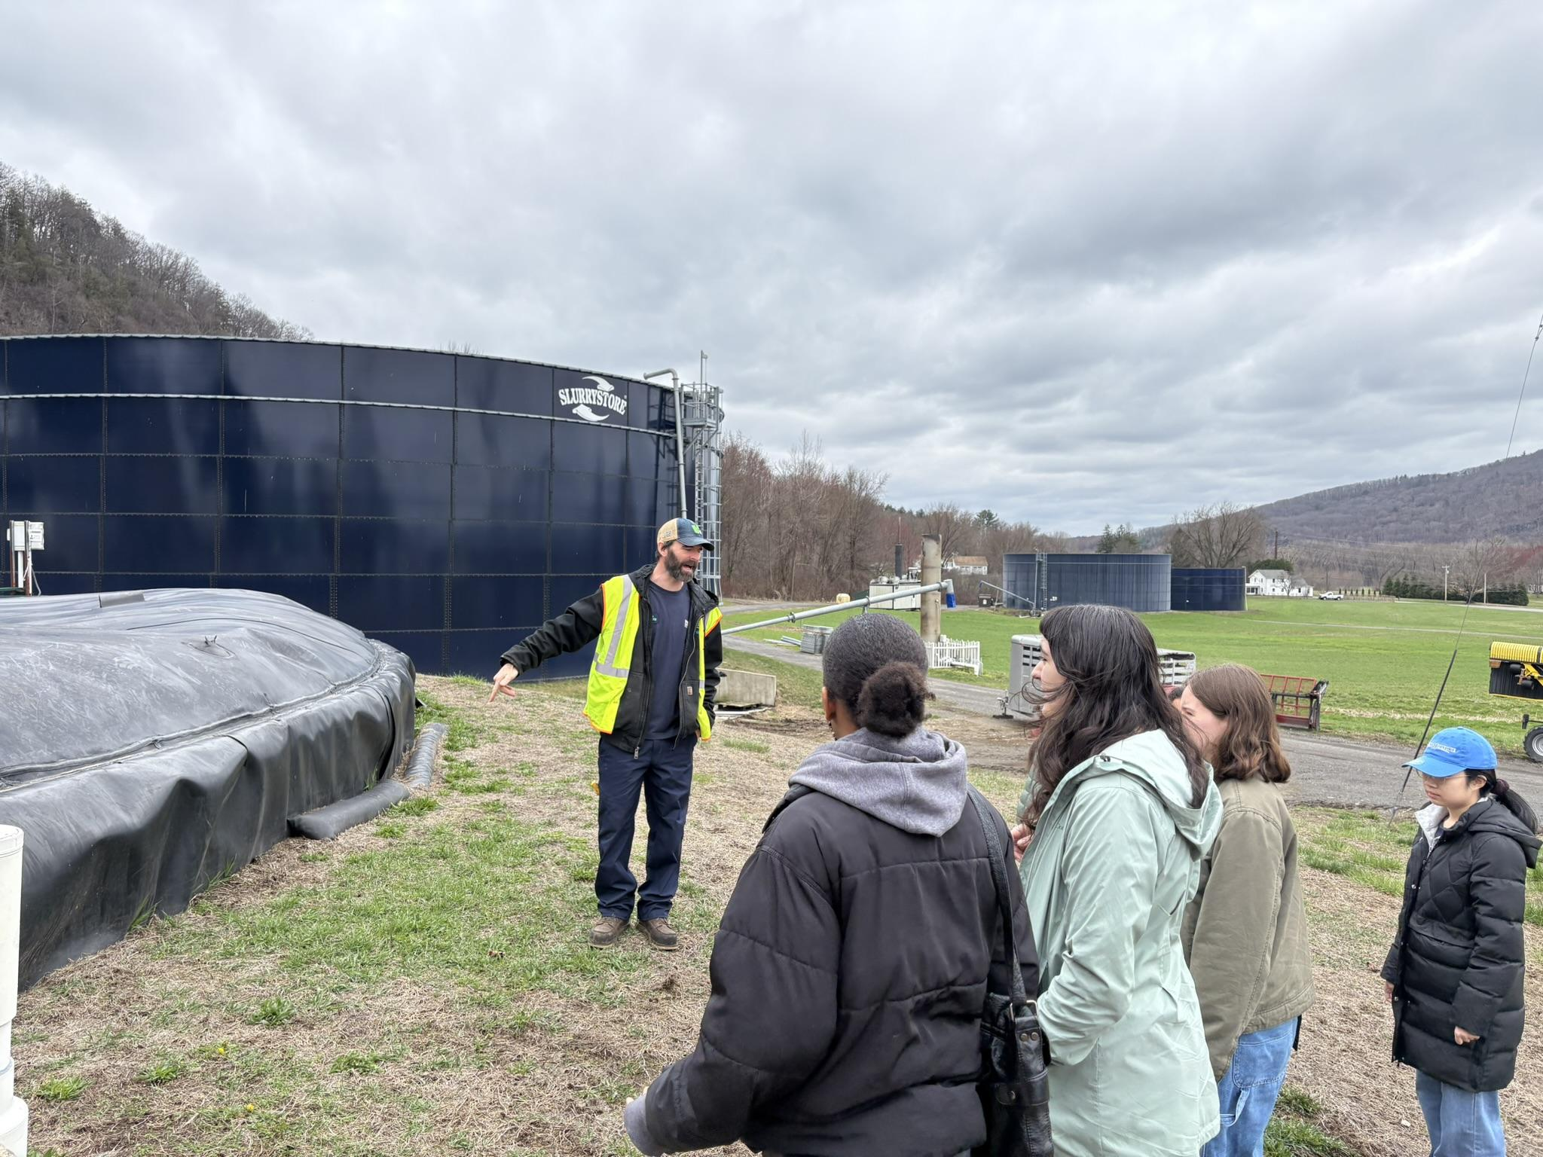
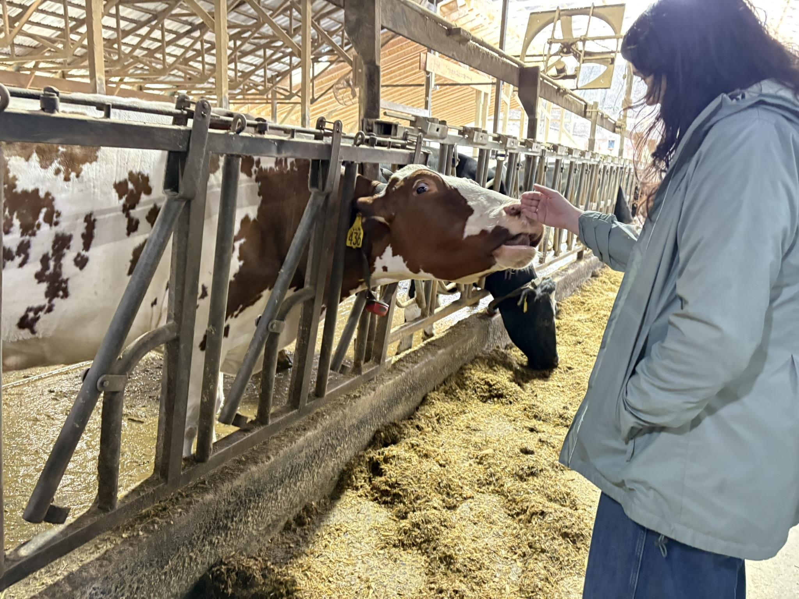
Food Recovery Network Student Chapter
Food Waste Journey Field Trips
To the depacking facility where our food scraps go,
To the farm where that material slurry gets sent and into energy through anaerobic digestion.

Slide 18
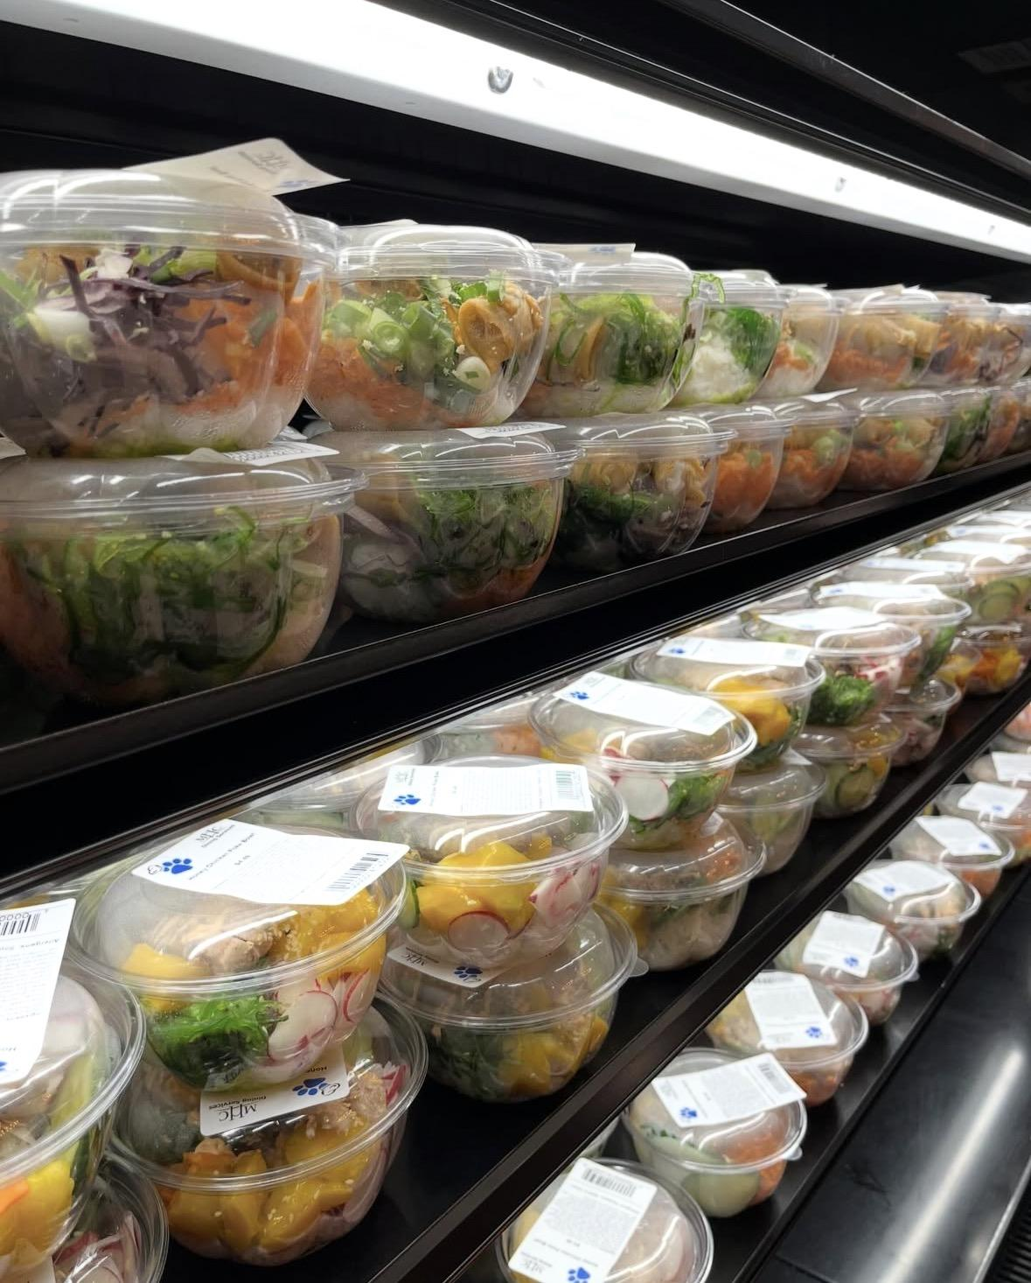
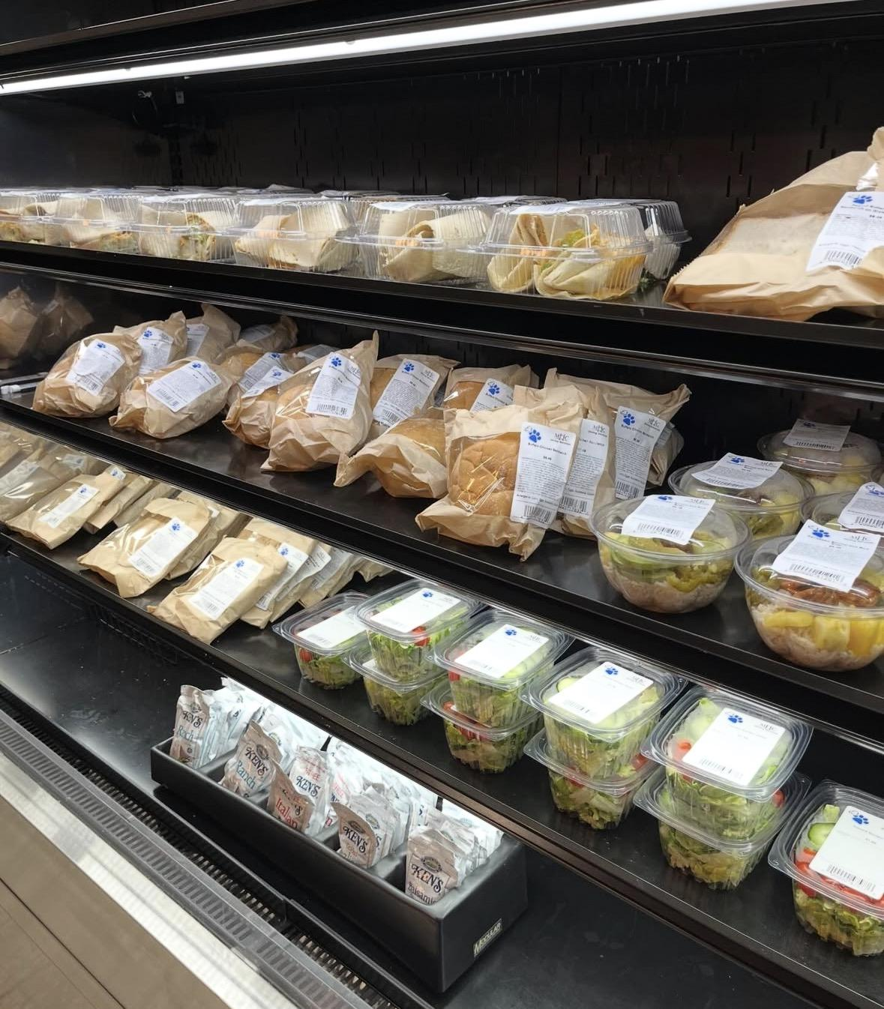
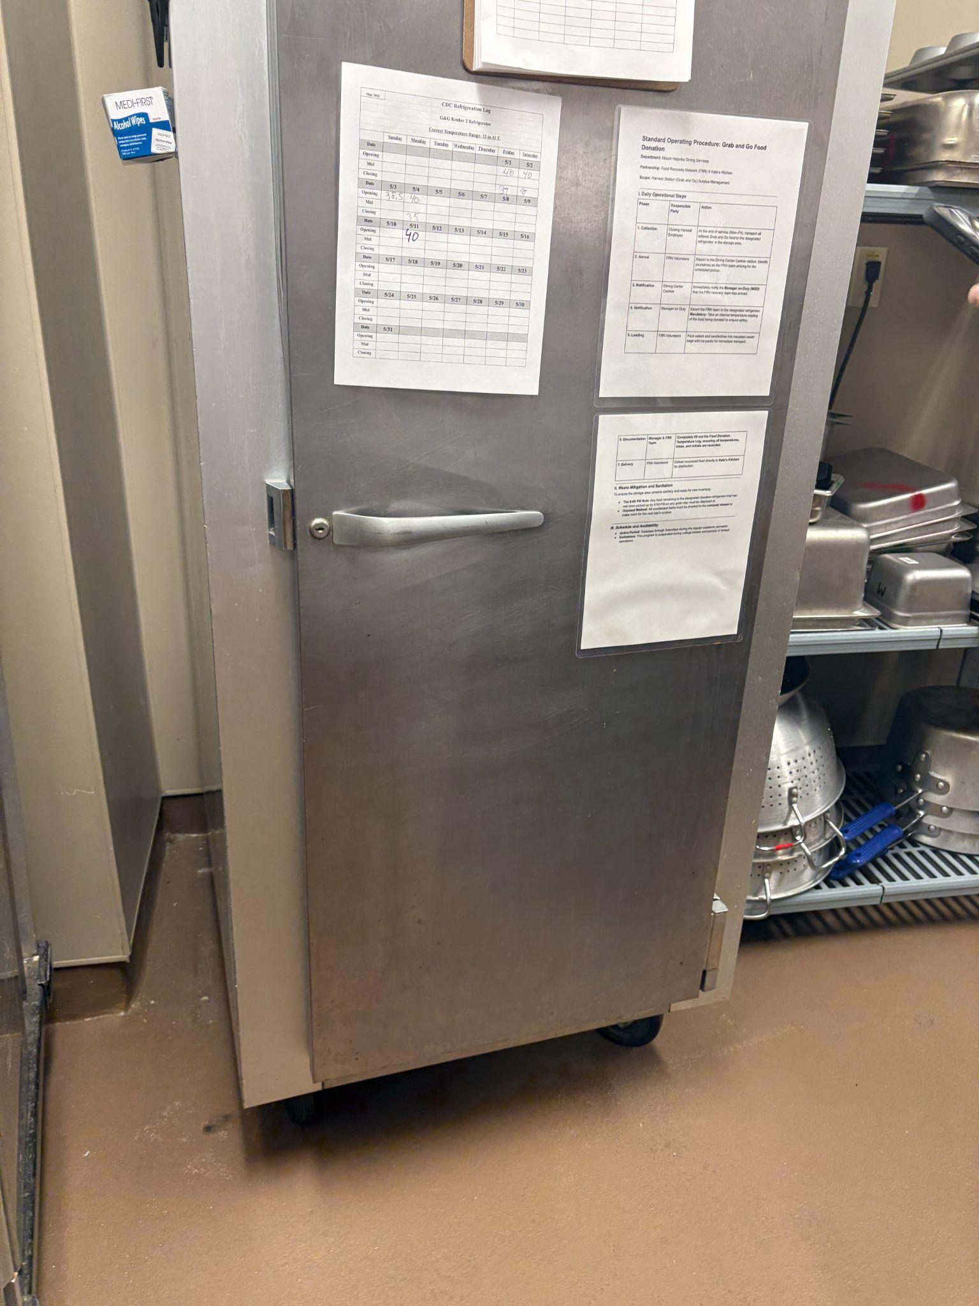
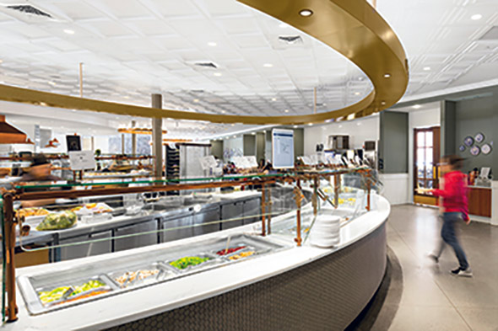
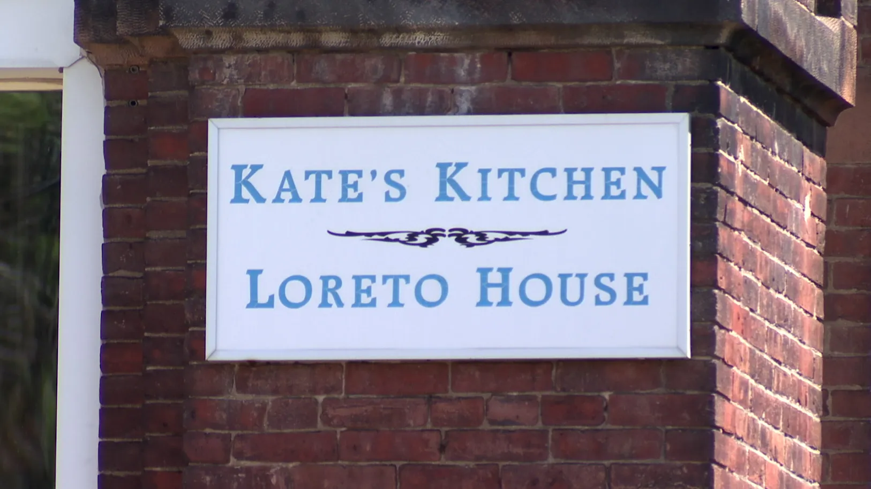
Maximizing Food with FRN
3/4/26-5/5/26 387 meals
donated

Slide 19


PLASTIC-FREE REUSABLE TAKEOUT
Questions?
Angie Gregory
agregory@mtholyoke.edu

Slide 20
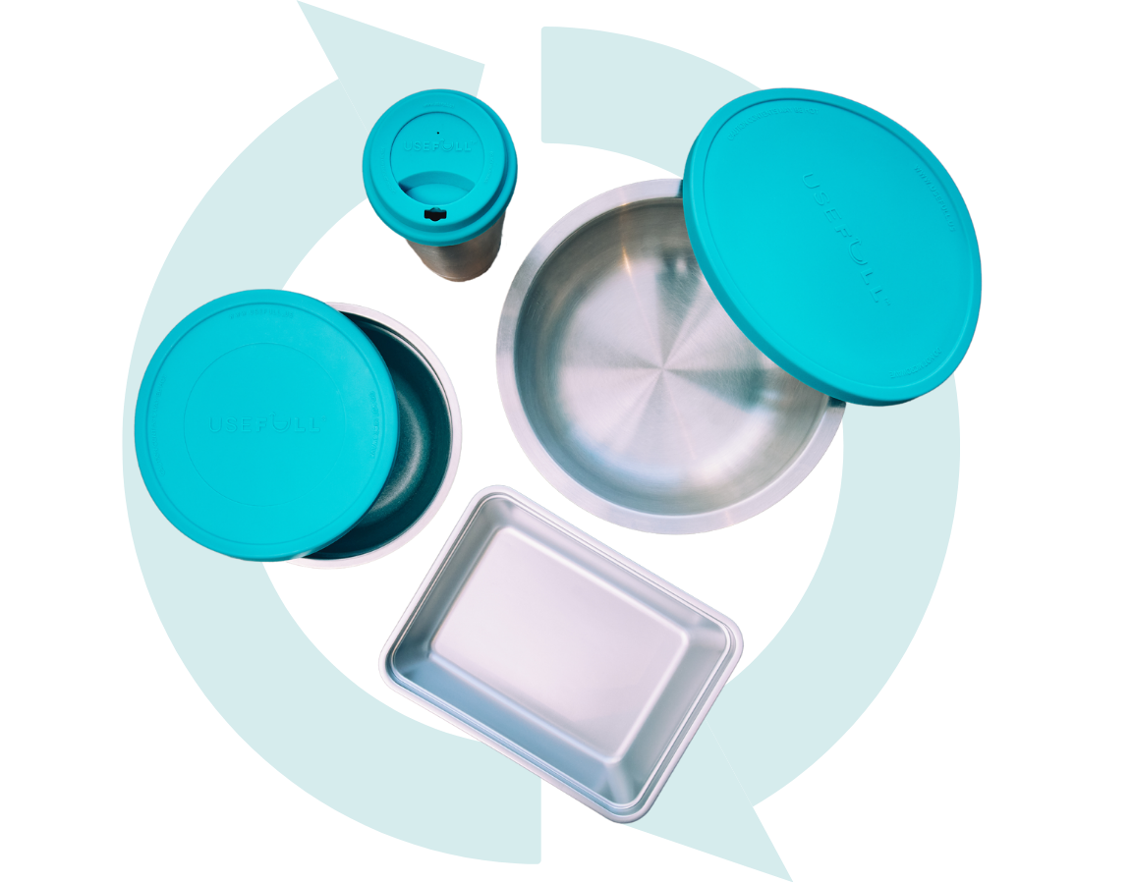
MHC’s Reuse Process
User requests USEFULL after checking in to dining center
Containers are checked out to user
Food and drink are served in USEFULL containers
User takes container with them
Returns by due date empty
Container is washed at dining center
Then it goes back out for reuse

Slide 21

CAMPUS RETURN STRATEGY
For MHC, USEFULL works like this:
Participation is FREE for users.
When containers are overdue, we charge late fees to ensure containers come back. Nominal $1/day late fees, up to 9 days. Day $15 loss fee inclusive of late fees $17/cup and $25/bowl.
Each container is uniquely named.
We know who has what at all times.
Mount Holyoke’s length of the user’s FREE usage period:
Students get 2 days and faculty and staff get 5.
Notes:
Meeting zero waste and zero plastic goals
Reducing food waste and food costs
Encouraging takeout to accommodate for limited seating, hours of operation constraints
Reducing packaging & waste hauling costs
Eliminating high loss rates (seen with other reuse companies)
Limit residential takeout to meal plan customers
Eliminate “science experiments” growing in reusable containers
Residential takeout - efforts to contain food costs

Slide 22

Lifetime Metrics
4.7k
Registered users at MHC
389K
Checkouts since launch
95.3%
Of containers returned on time
28.5
Hour average rental length

Slide 23
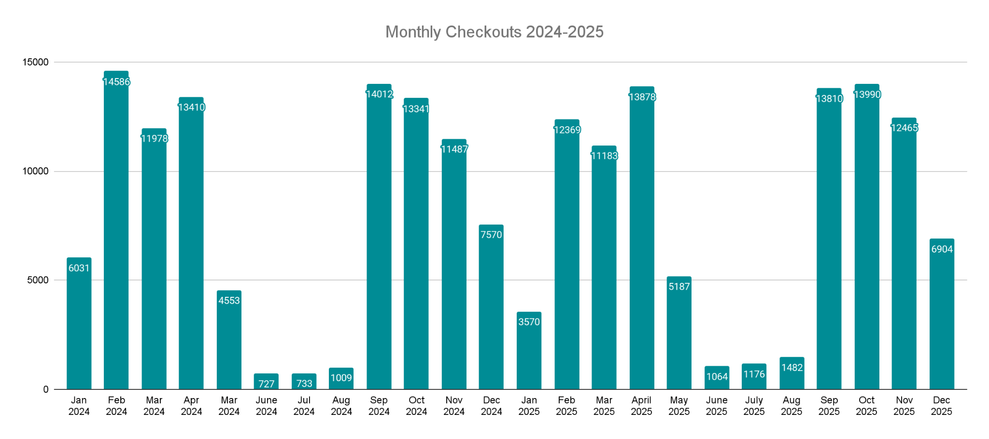
Checkout Trends
Spring 2024
Fall 2024
Spring 2025
Fall 2025
44,527
46,410
42,617
47,169

Slide 24
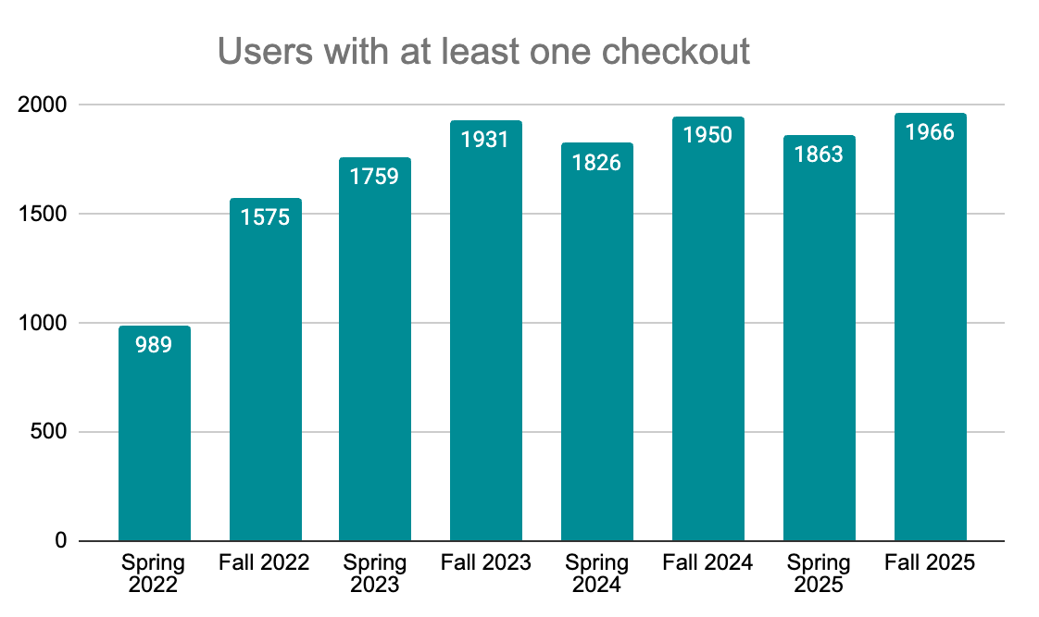
Student Engagement
90% of undergrads had at least one checkout in Fall 2025

Slide 25

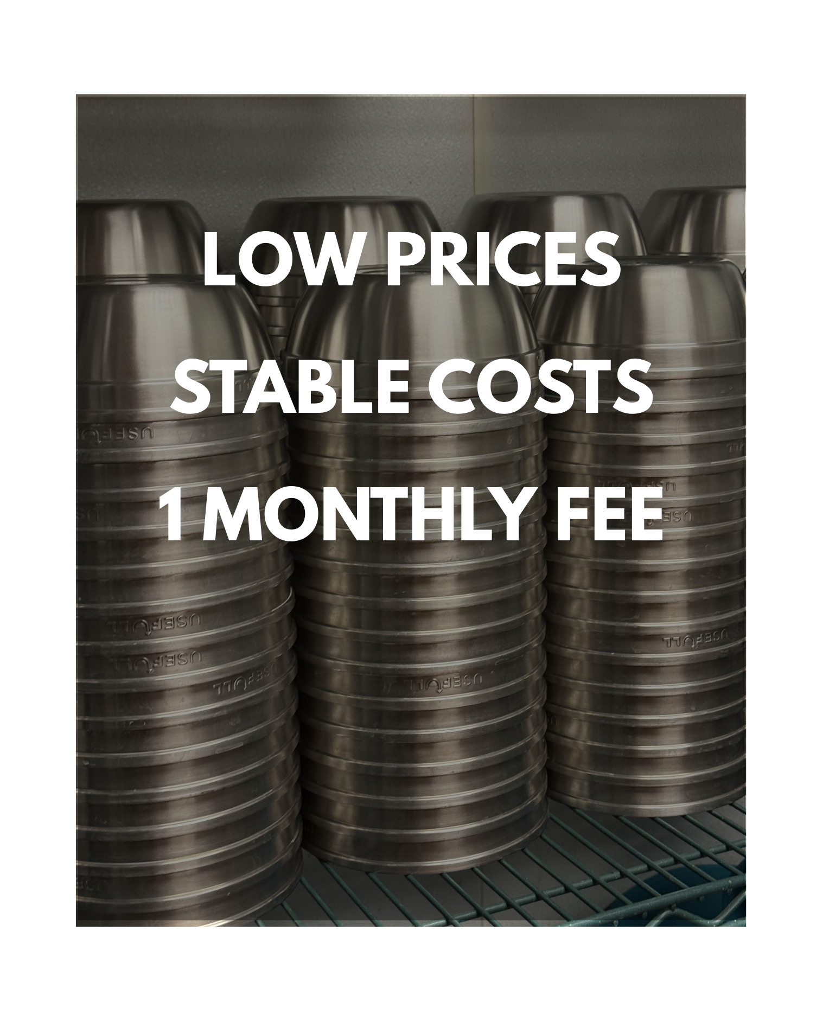


Switching to USEFULL saves businesses 30-50% against single-use compostables
VS.

