Slide 1
School Meals
In the business of feeding kids, not trash cans!

Slide 2
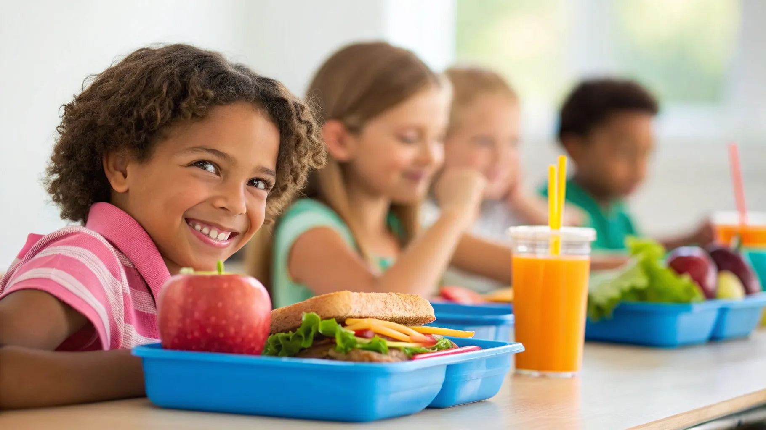
Who has not eaten a school lunch in more than 10 years?

Slide 3

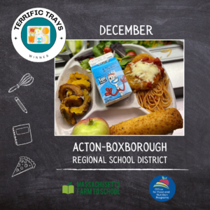
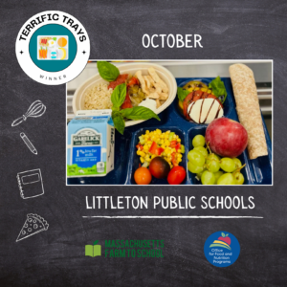
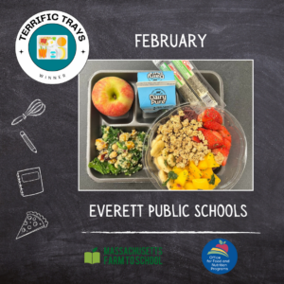





Slide 4
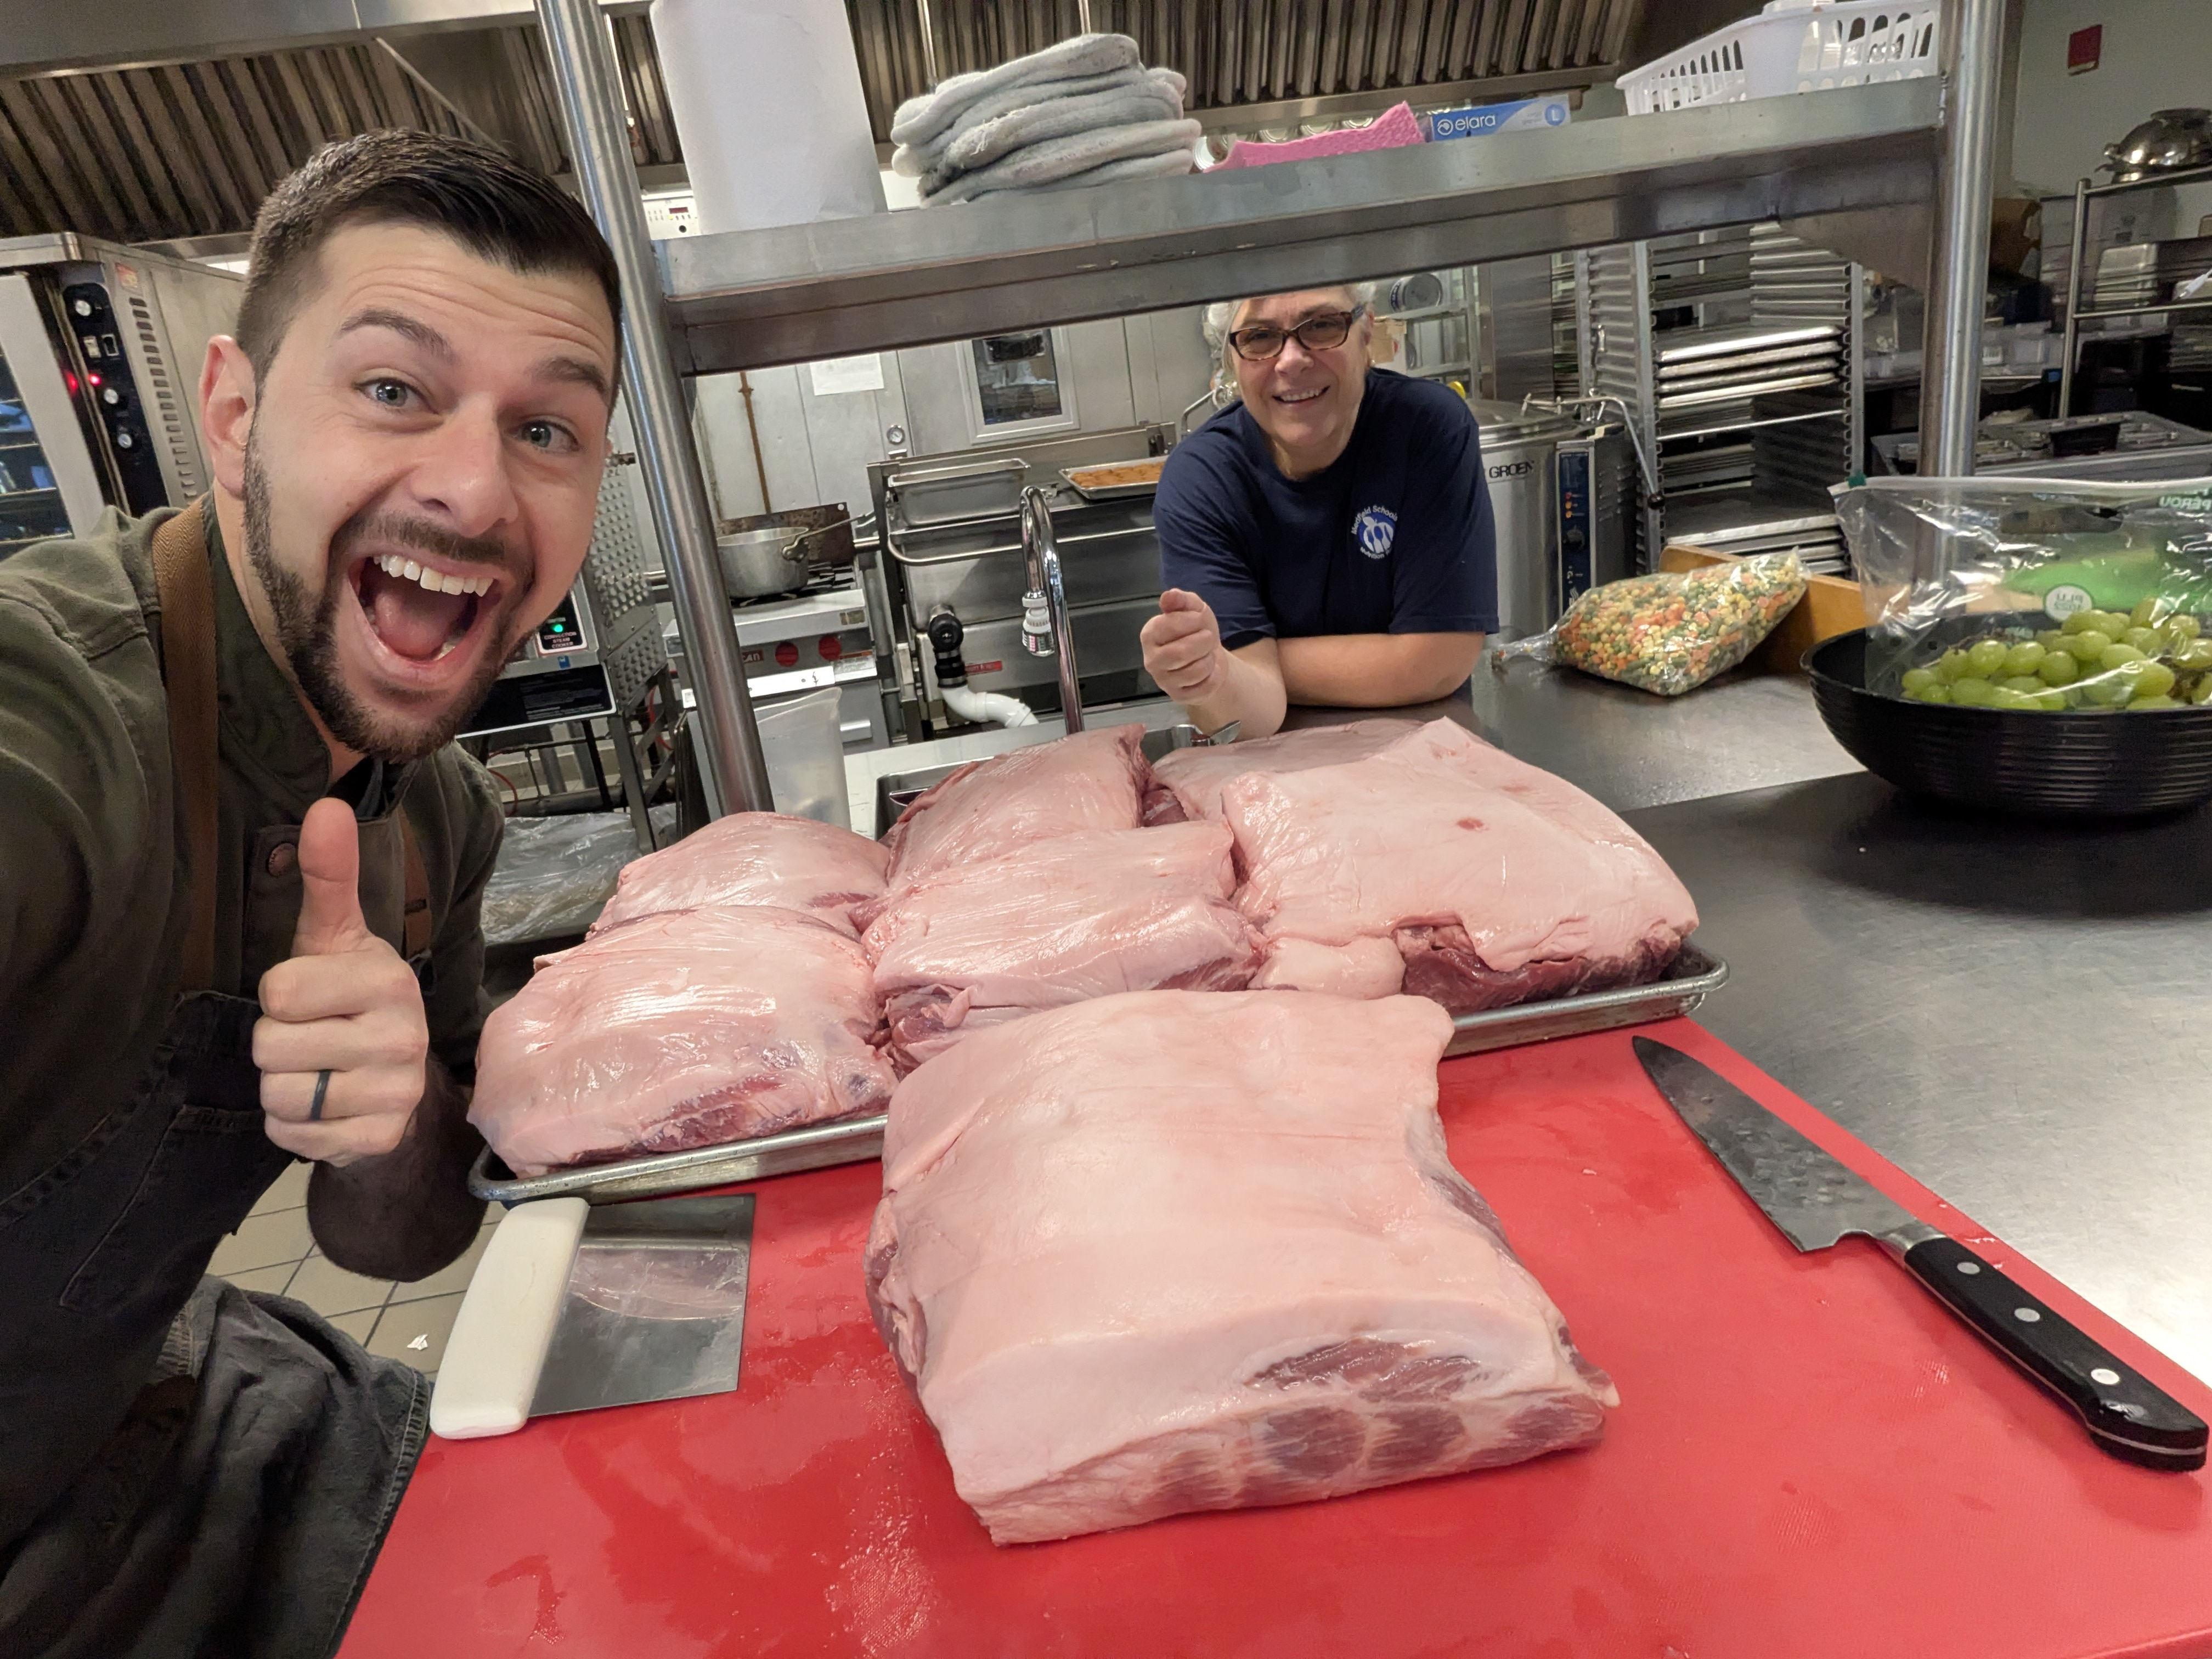
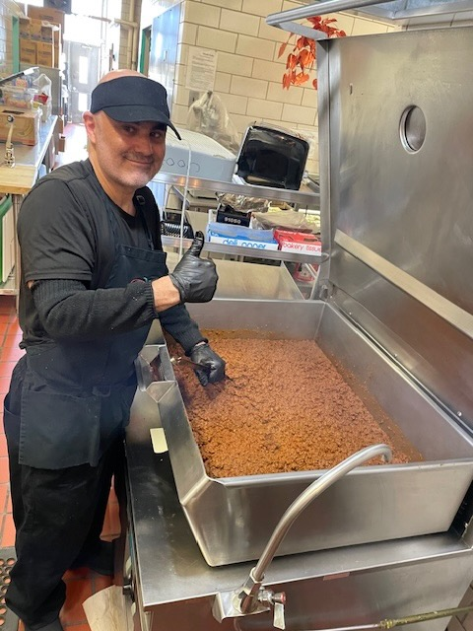
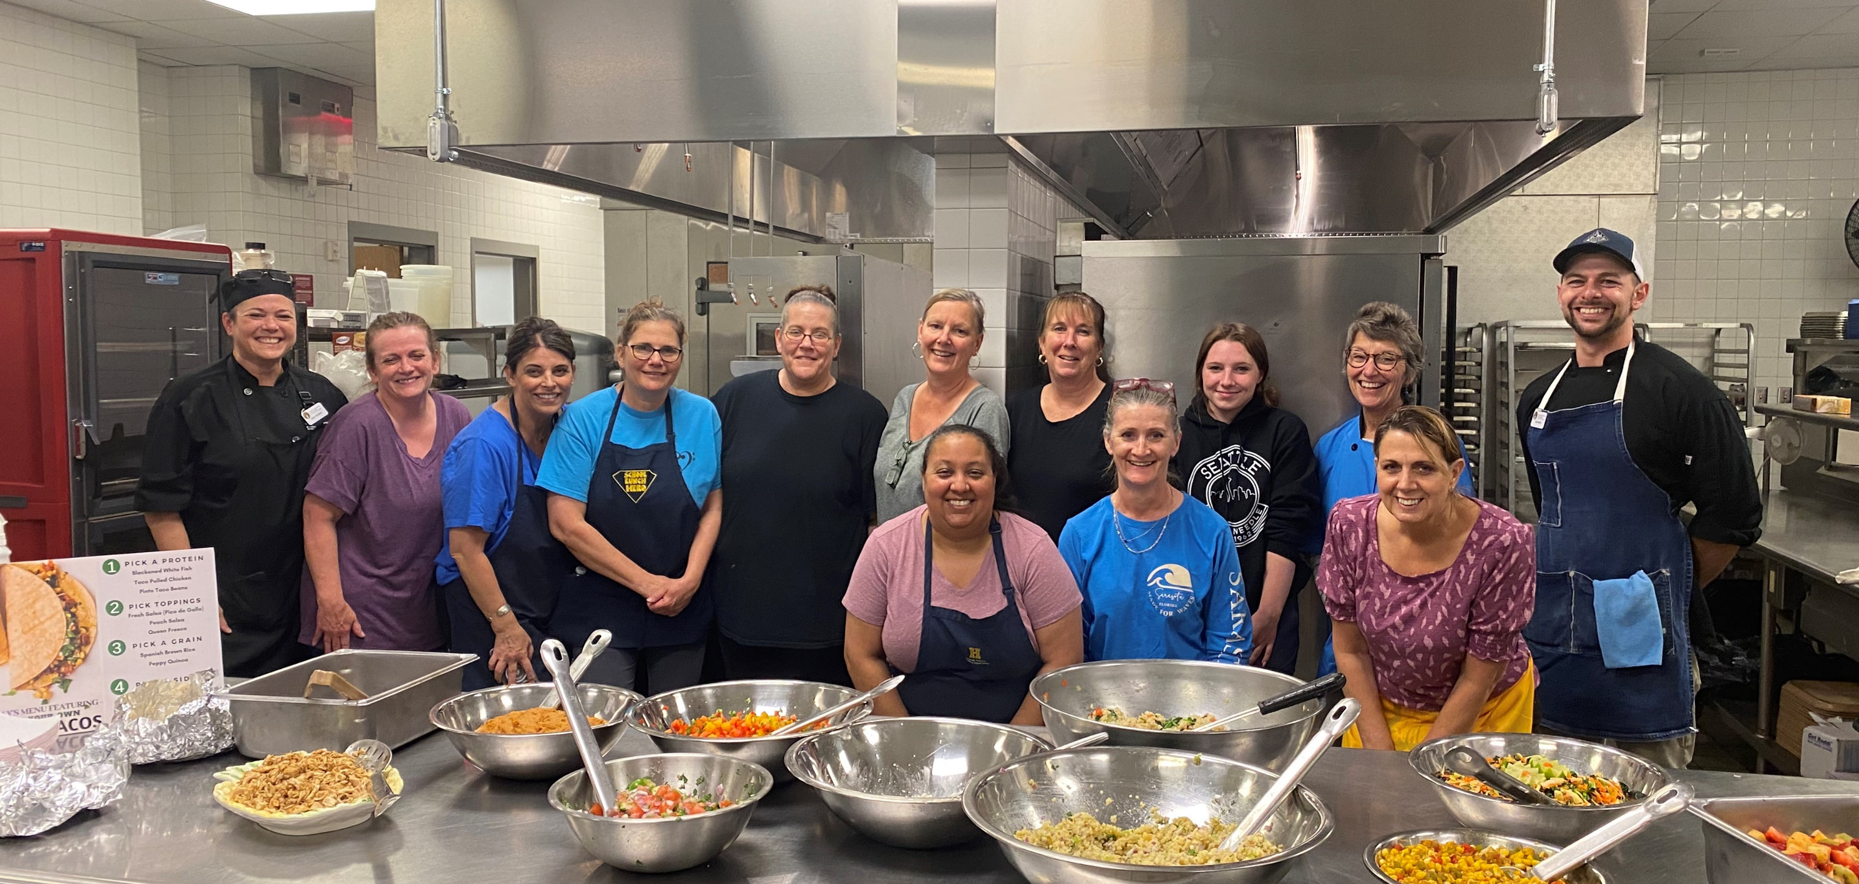

Slide 5
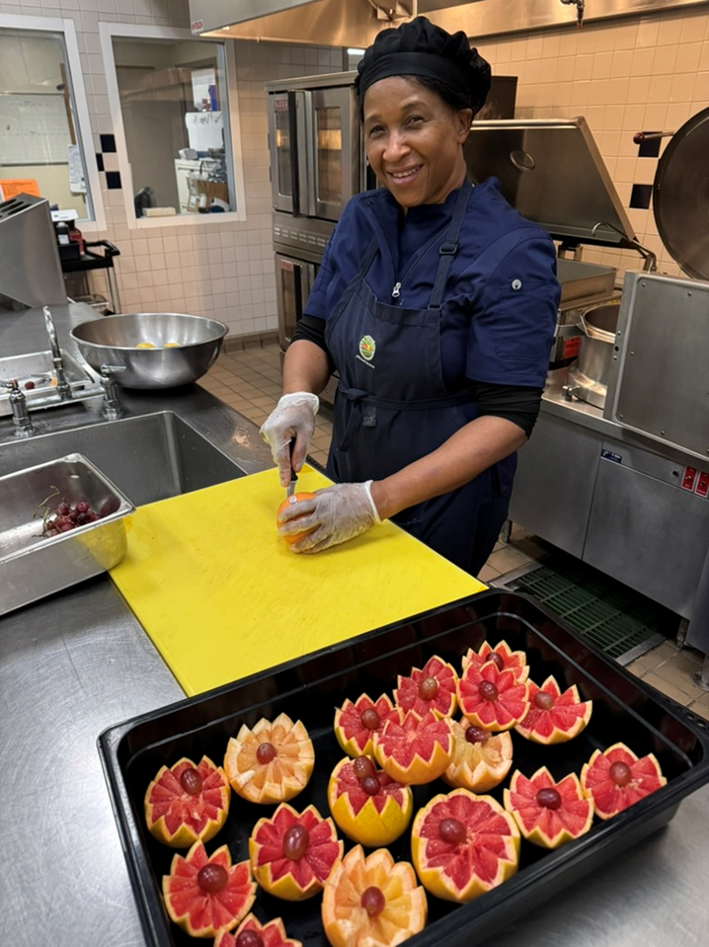
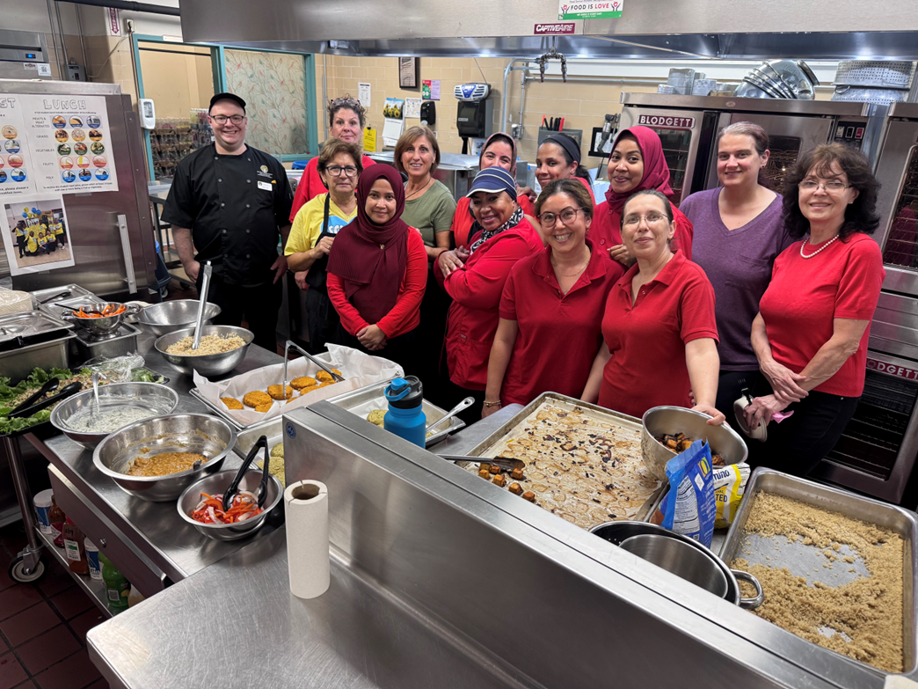
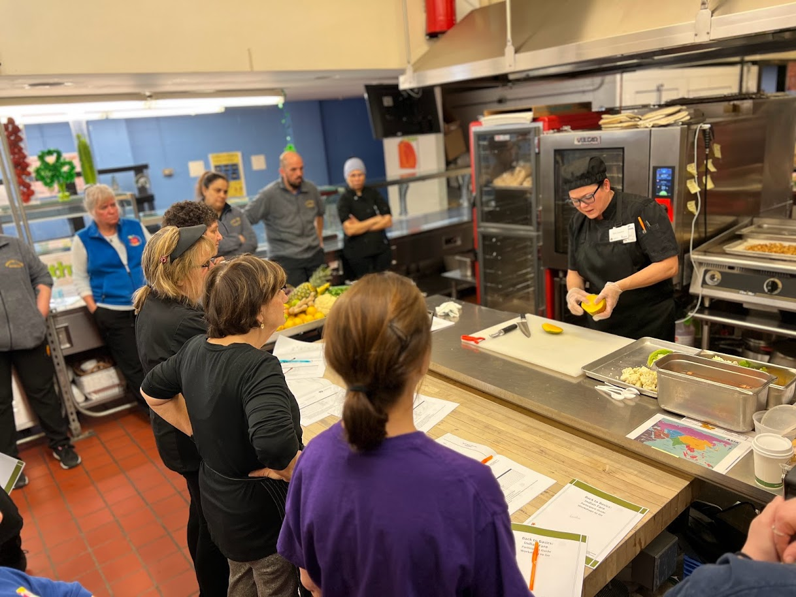

Slide 6
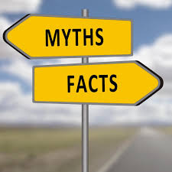
Milk needs to be offered on the line, but water also always has to be available where meals are served.
Often, they can choose to only take 3/5 of the components
Kids today have very broad pallets
They have to take ½ cup of fruit or vegetable at each meal.
Kids are only allowed to drink milk
They have to take all 5 components
Kids don’t eat fruits and vegetables

Slide 7
Why is there food waste?

Slide 8
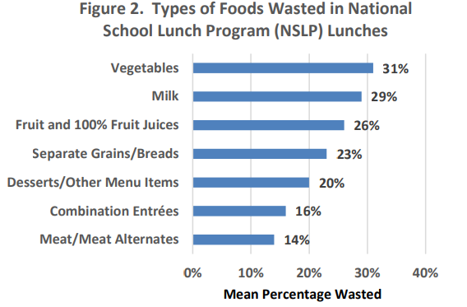
USDA Food and Nutrition Service’s School Nutrition and Meal Cost Study conducted during the 2014-2015 school year with school across the United States

Slide 9
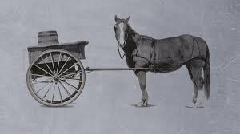
Food Waste
Food Consumption

Slide 10
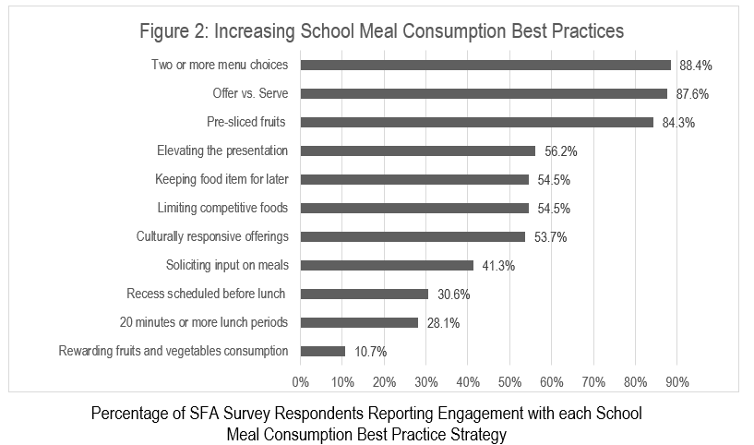
Massachusetts School Meal Consumption Strategies

Slide 11
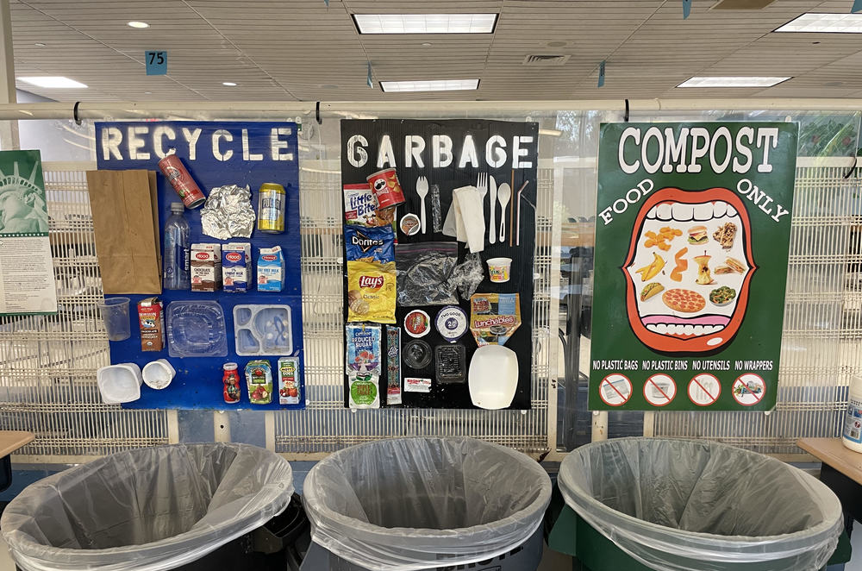
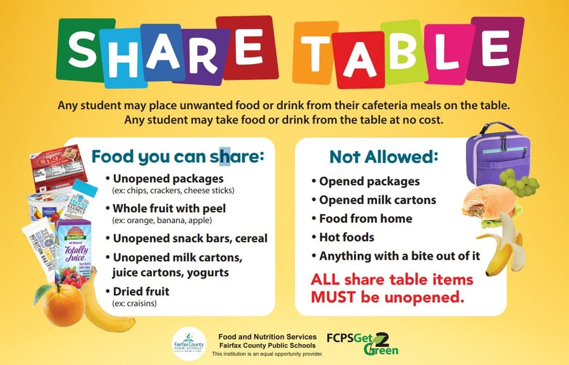
Post Consumer Waste Diversion

Slide 12
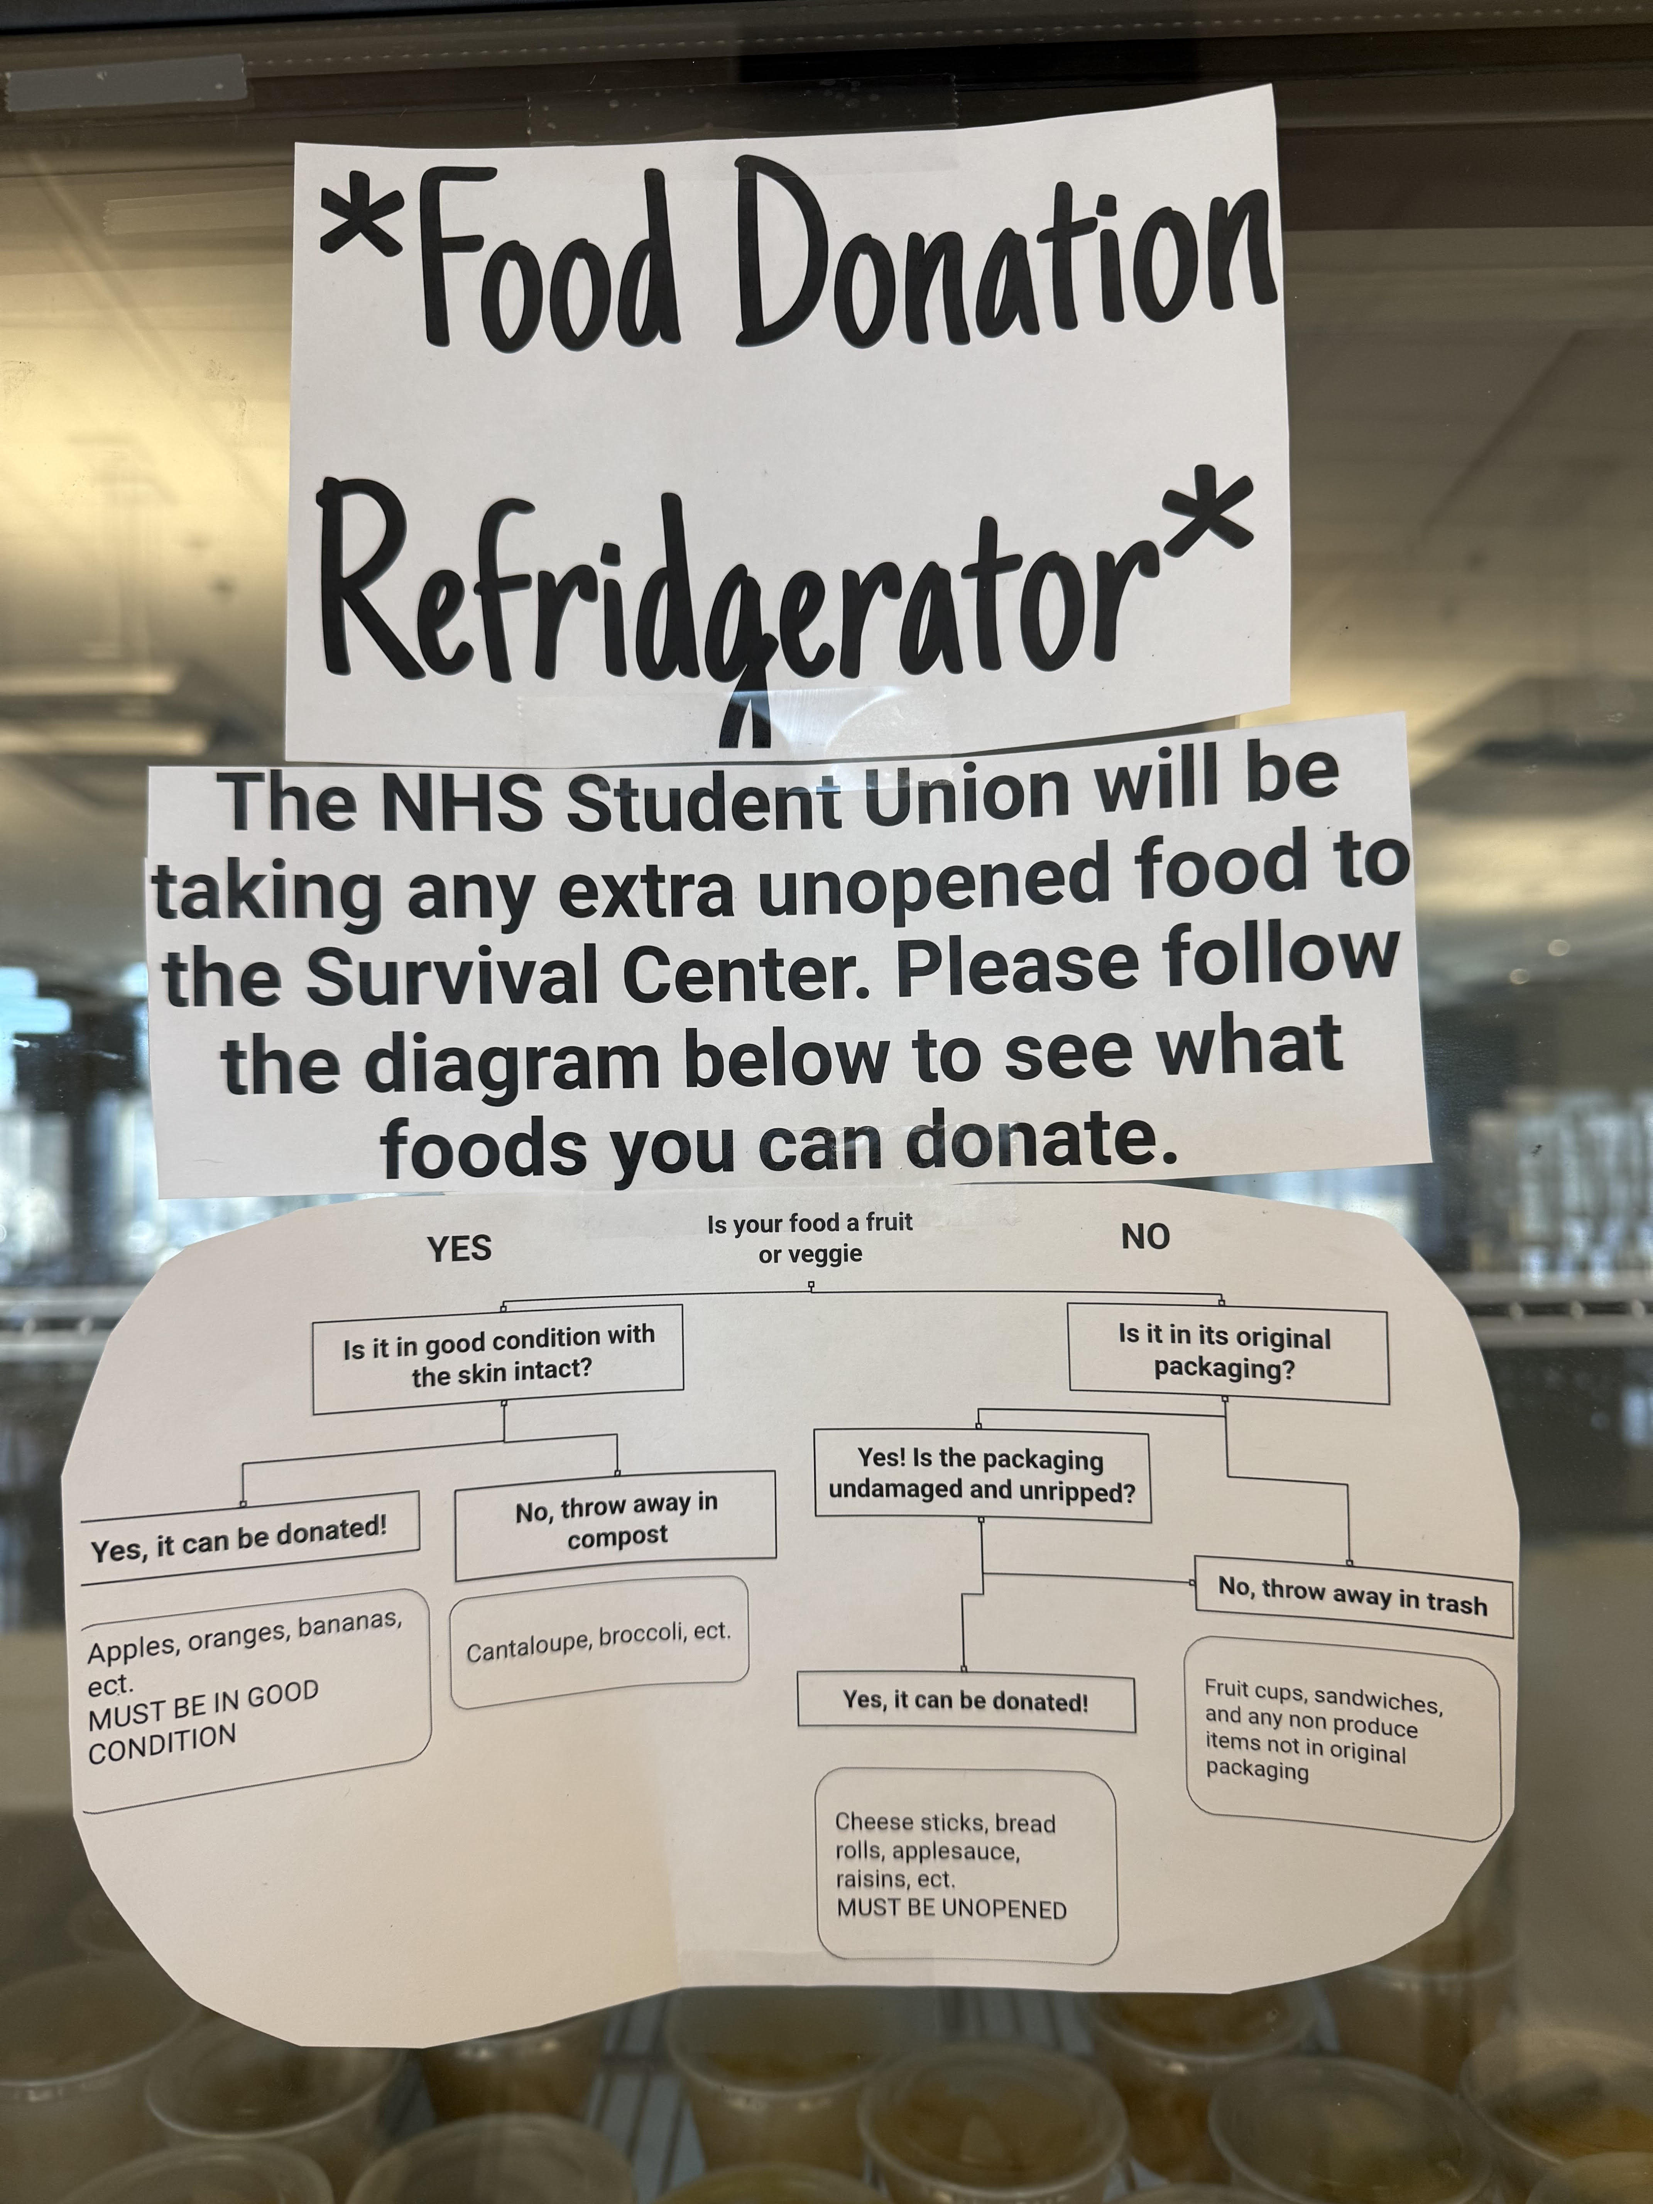
Food Donation

Slide 13

Thank You!
For general questions, please email us at Nutrition@doe.mass.edu

