Slide 1
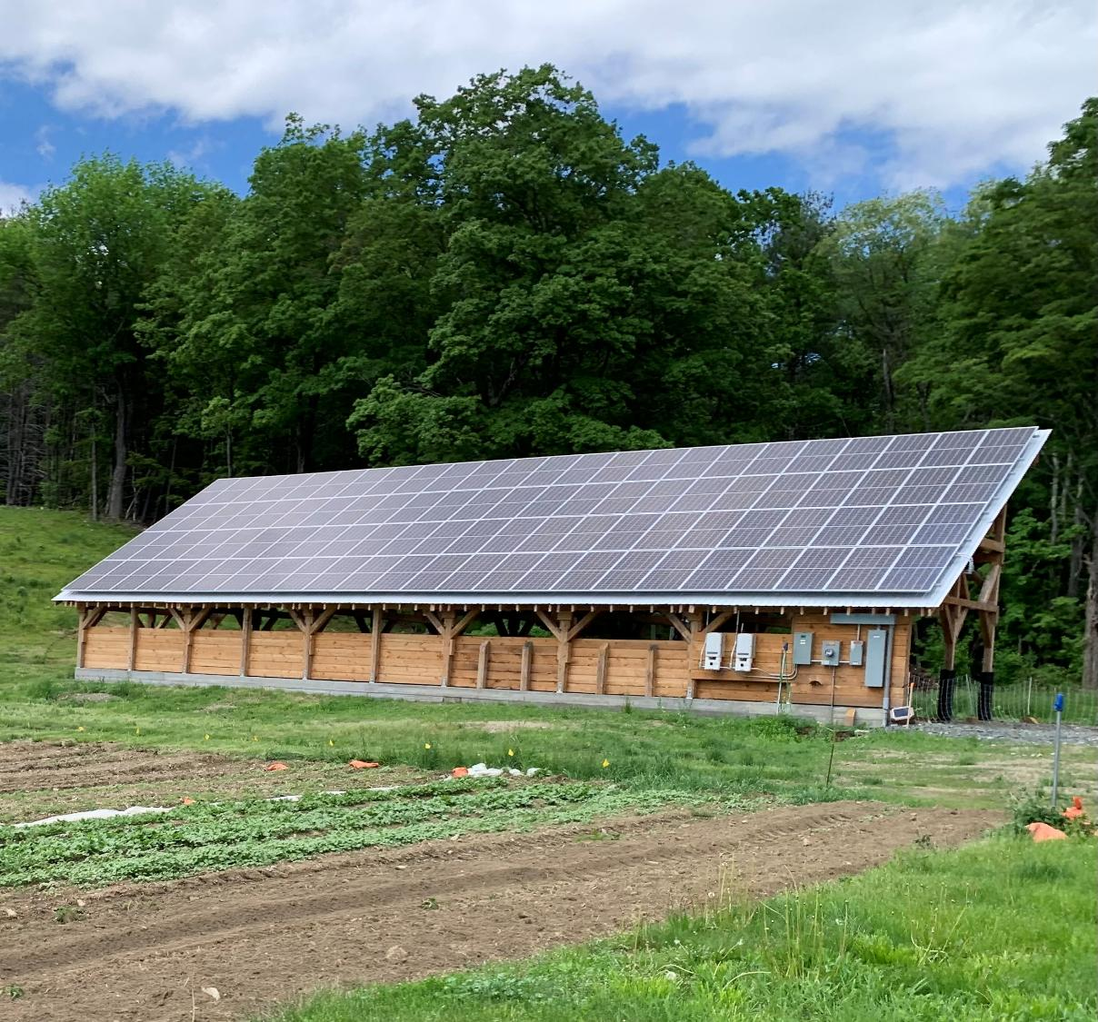
Community-Scale Composting
Models & Strategies
James McSweeney
Compost Technical Services & The 131° School of Composting

Slide 2
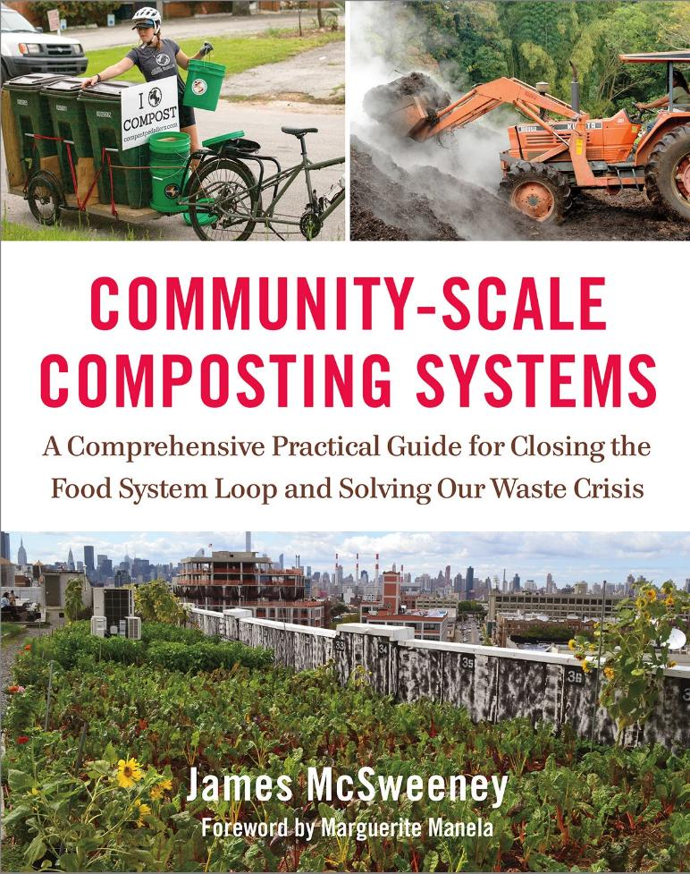
I wrote a book…
And can say with confidence that we understand composting systems quite well
But there is so much more to this topic than the systems

Slide 3
What are we talking about today?
What is community-scale composting?
How do community composting operations develop?
Where might systems be developed?
What are the economics here?
Are there examples to use as a road map?
Why do people develop them?
Who is involved?
What is managed composting?

Slide 4
Community Composting
Community-Based Composting
Community-Scale Composting
What is it?

Slide 5
“One of the community composting movement’s greatest strengths is that it doesn’t fit into one mold.
Yet there is a collective identity that’s been coalescing for some time now.”
Nora Goldstien
Nora Goldstein, editor of BioCycle magazine, email to the author, January 5, 2018. (Community-Scale Composting Systems, 2019)

Slide 6
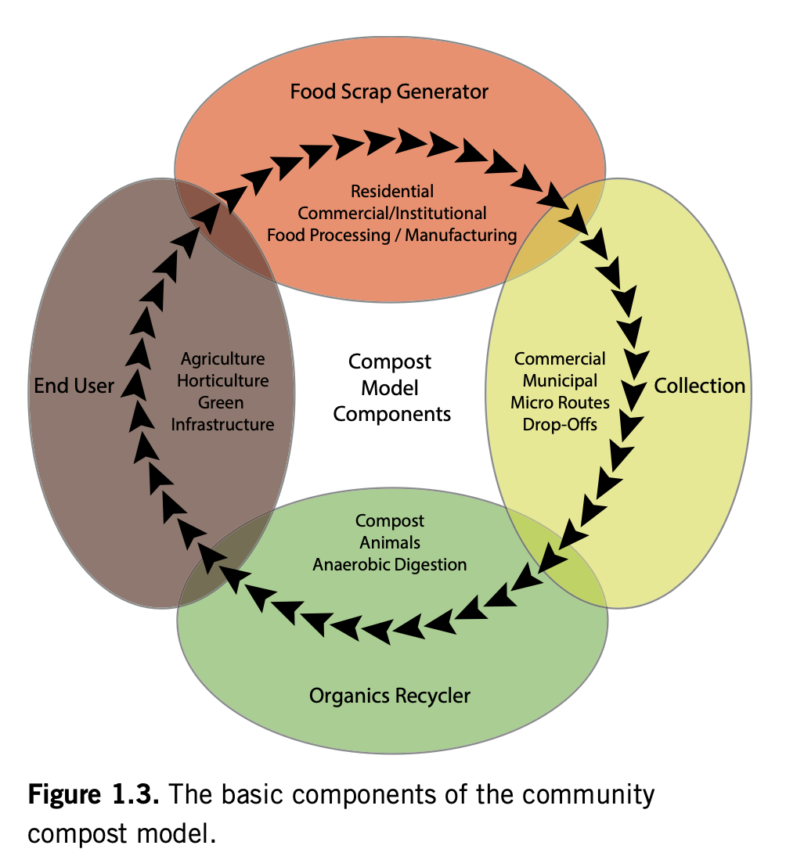

Food scraps are unifying element, we all eat…
P. 15

Slide 7
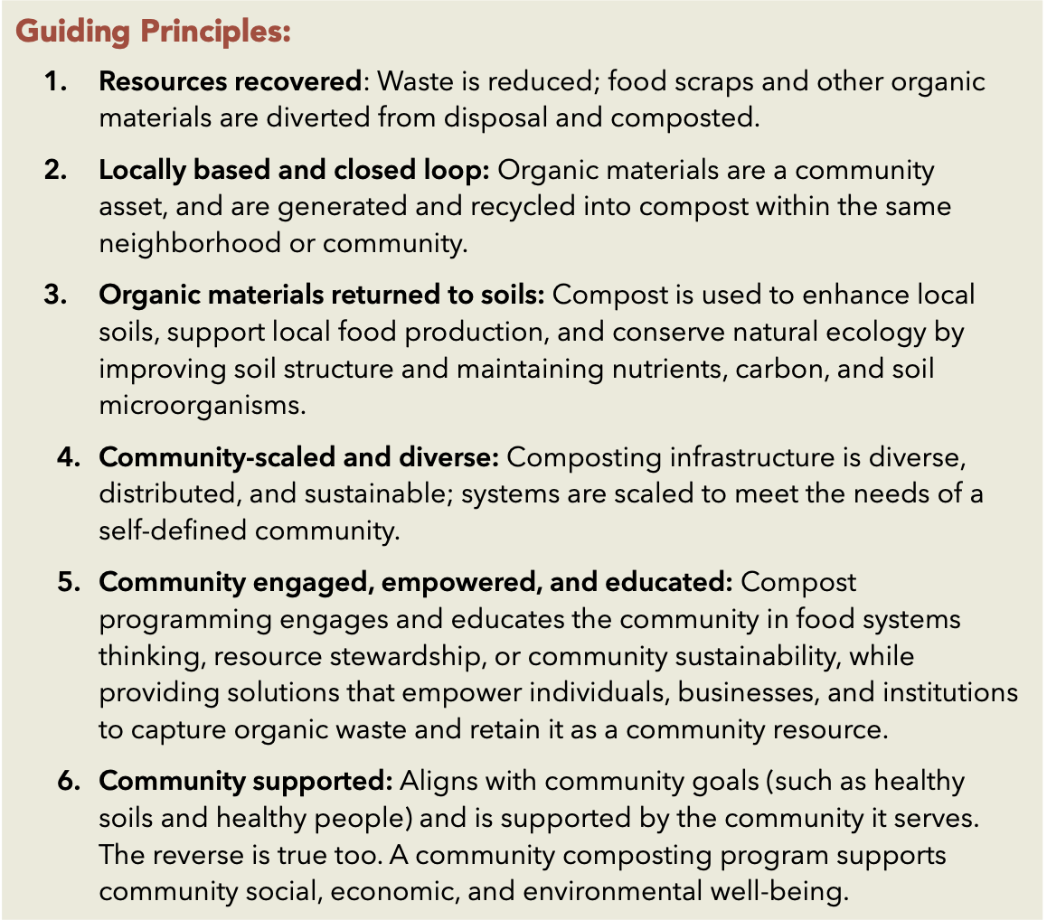
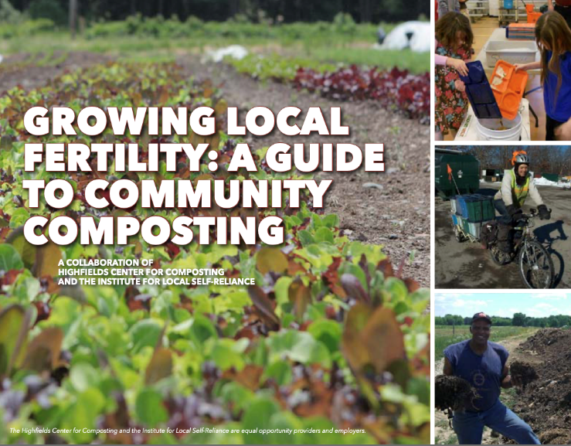

P. 7

Slide 8
Why do people develop community composting operations?
“Necessity” is the mother of invention
The idea of “waste” is antithetical to many (most?) people’s ideals
The “need” to not waste is seen as an opportunity to more functionally manage resources across systems and scales
Within this larger “not-wasting opportunity” exist a long list of “whys”
Composters are often driven by a sense of purpose well beyond “not wasting

Slide 9
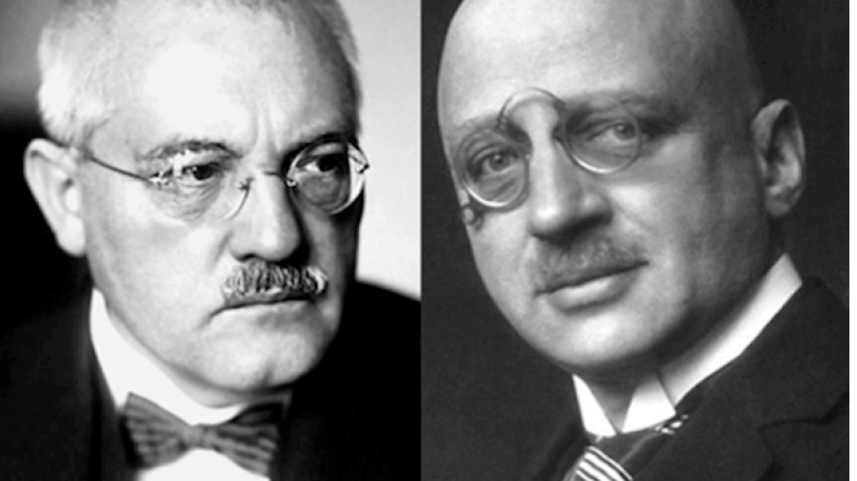
My Composting Why
50% of world’s food is supplied with synthetic nitrogen produced via the Haber-Bosch Process

Slide 10
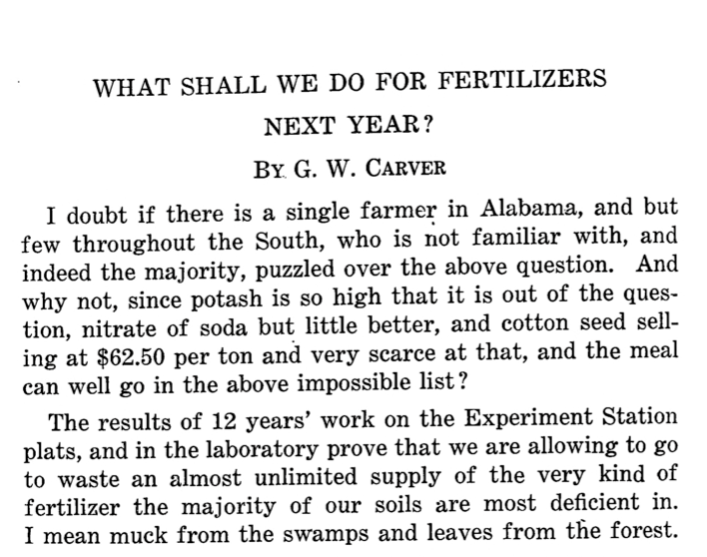
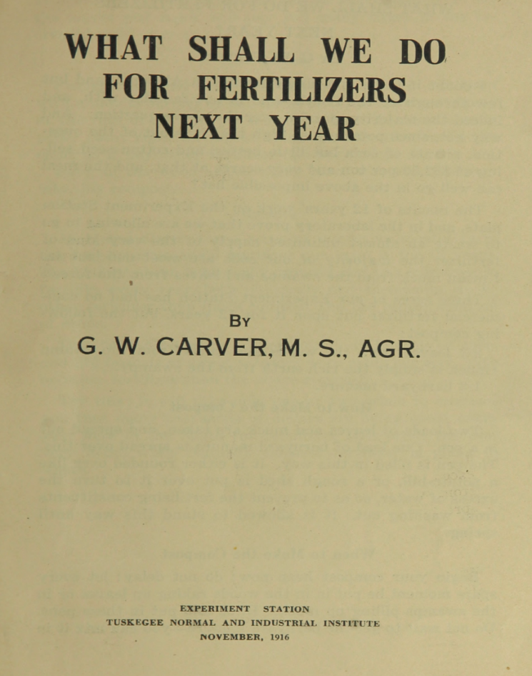
My Composting Why

Slide 11

Life on our planet is a tenuous miracle.
The basis for all terrestrial life is soil and the basis for soil is decaying refuse.
Therefore, my relationship to waste grown into one of reverence and awe.
My Composting Why

Slide 12
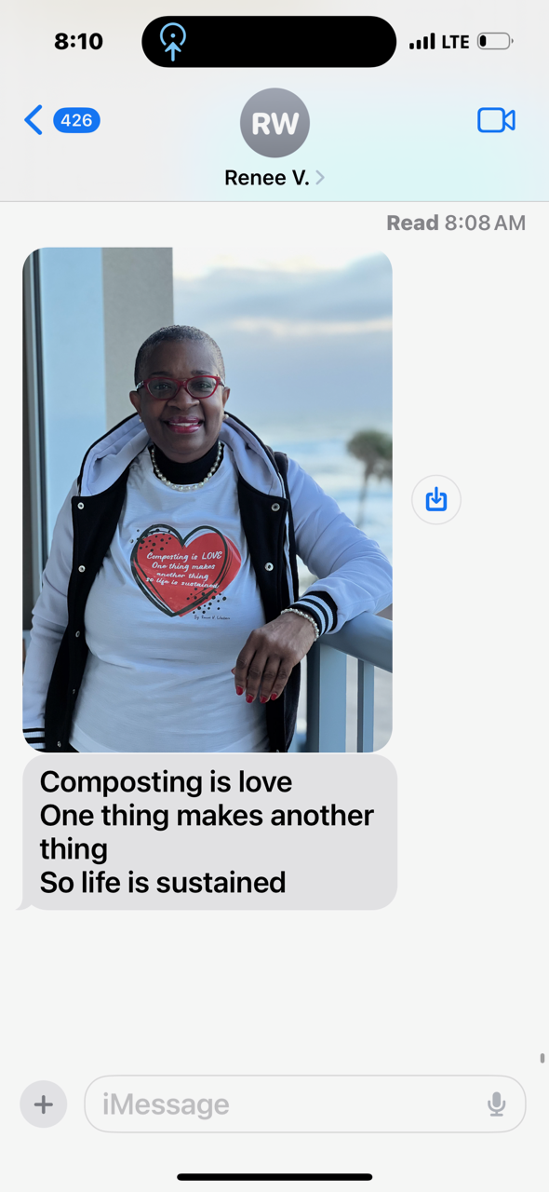
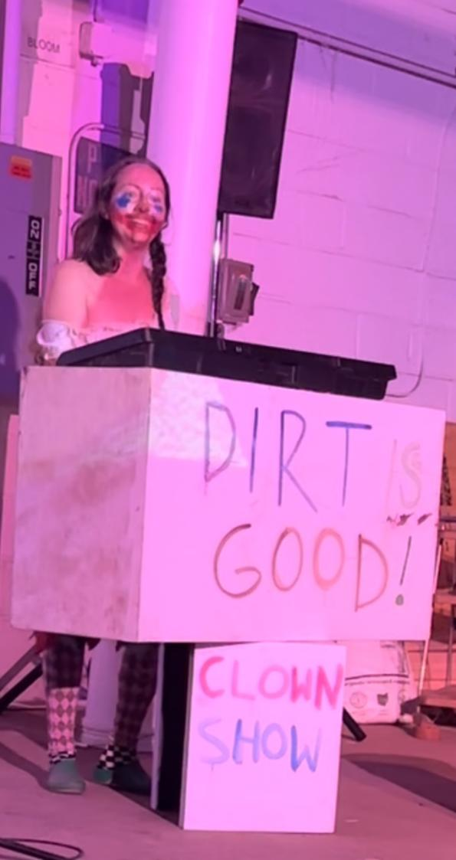
Alex Tatarsky (@tartar.biz)
Composting Inspiration

Slide 13

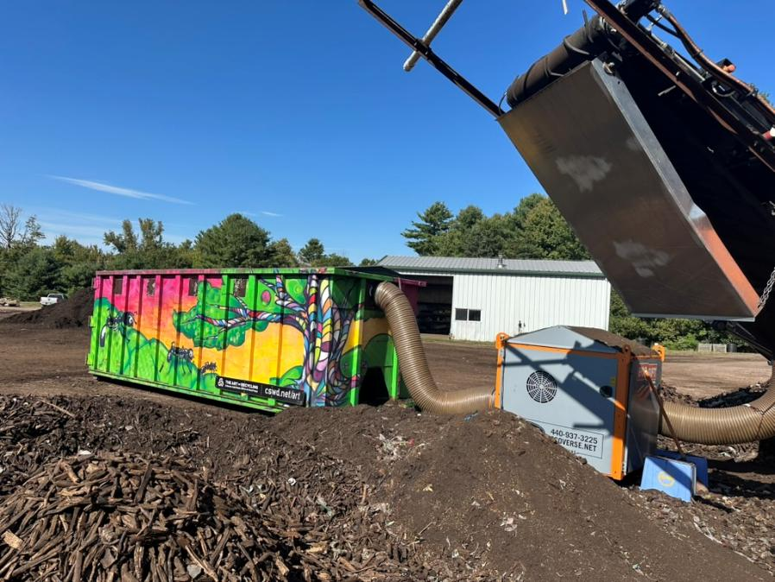
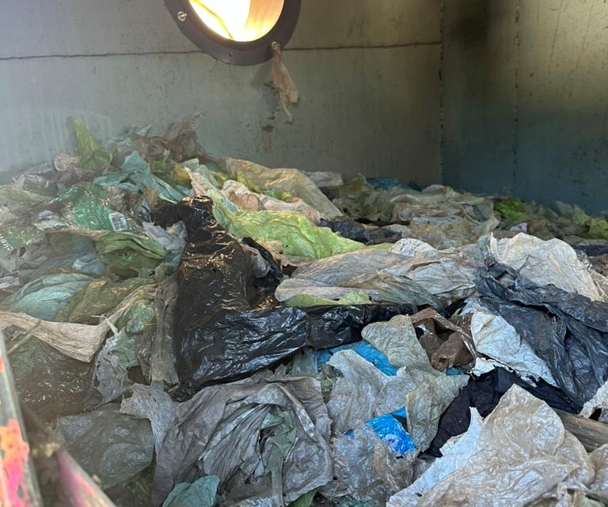
Composting Inspiration
Chittenden Solid Waste District
Art of Recycling Mural Project

Slide 14
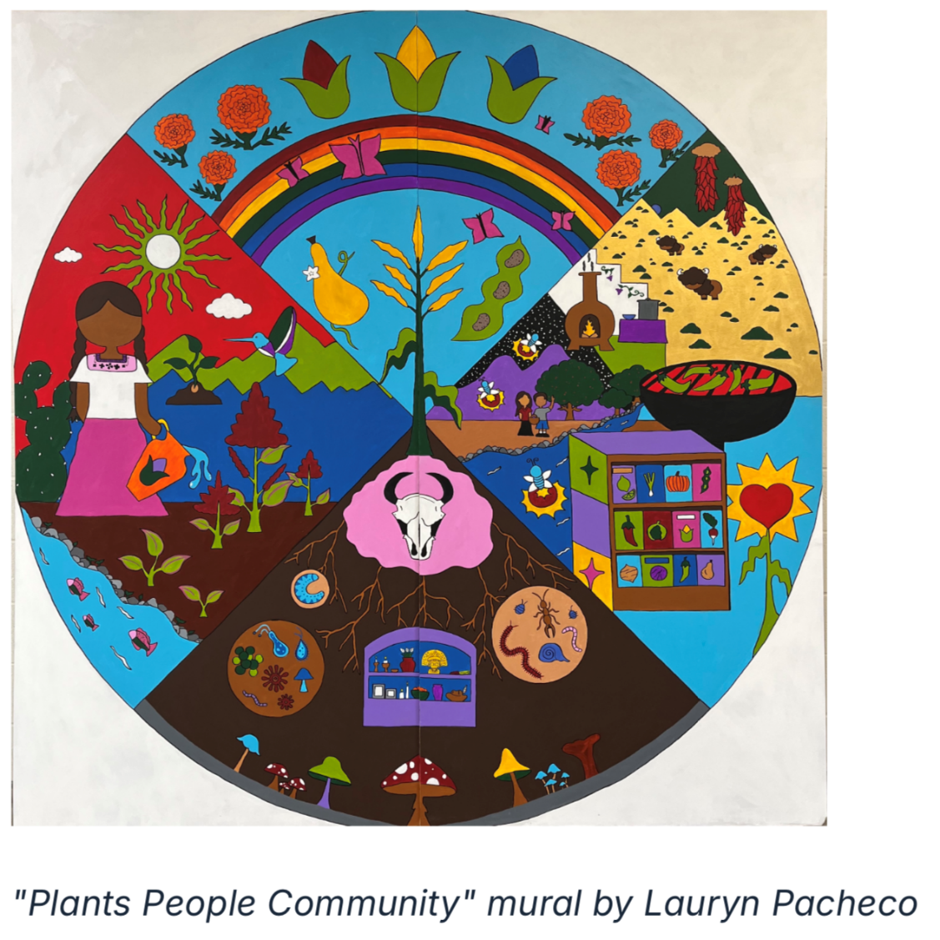


February 1, 2026 in Sacramento

Slide 15
Notable Qualities of Community Composting
Small represents less risk – NIMBYism is major roadblock
Community composters are often the pioneer species of the organics recycling ecosystem
“Ownership” as outcome – any business or organization where the customers feel like they are contributing to a valuable service or action has staying power
Composting can be a cultural foundation rather than side feature
Community education is often a core driver of the system

Slide 16
Who Develops Community-Scale Composting Operations?
Common “Community” Composters
Less Common “Community” Composters
Commercial Farms
Livestock
Field crops
Community Farms/Gardens
Organizations/Non-Profits
Haulers
Educational Institutions
Individuals/Neighborhoods
Solid Waste Districts
Conservation Districts
Municipalities
Food Rescue Organizations
Co-operatives

Slide 17
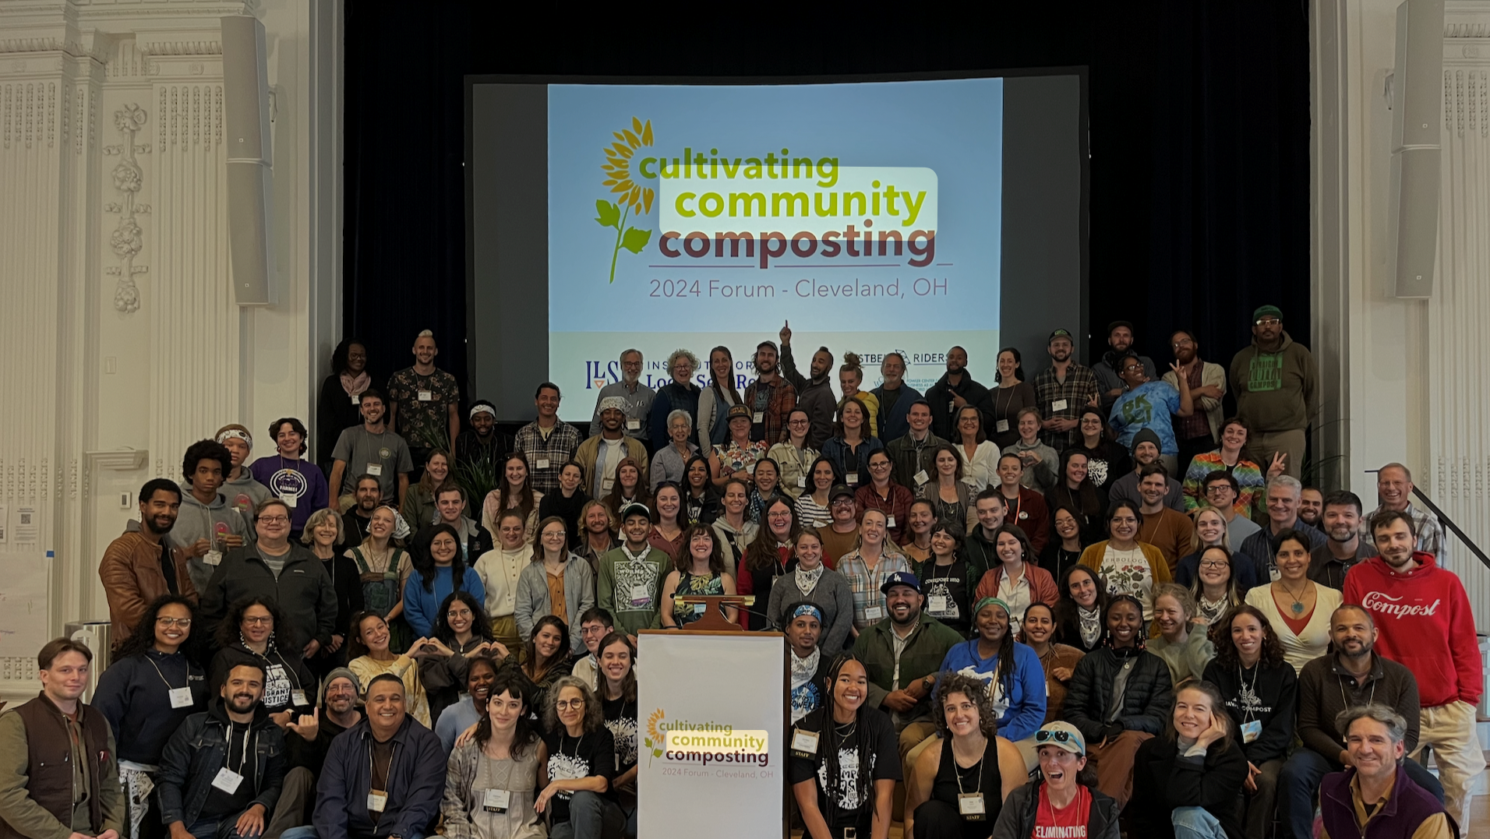

Slide 18

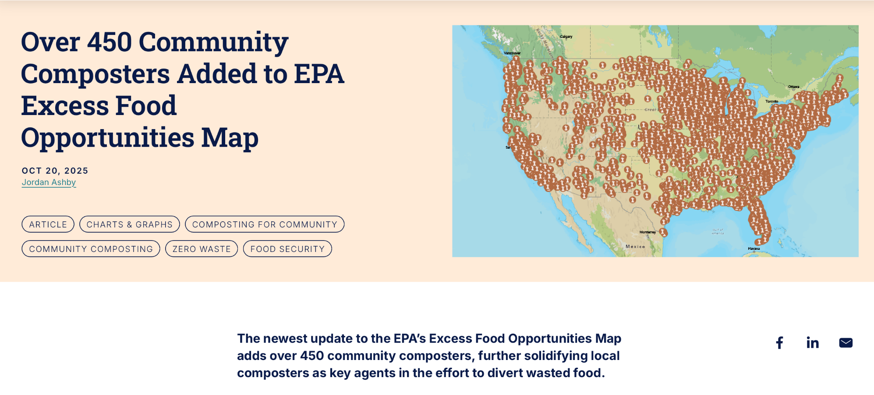

Slide 19

February 1-2 in Sacramento (leading into USCC)

Slide 20
Relationality: Community composting does not happen in a vacuum… Partnerships are critical
Land Use
Operational
Non-Profit
Public
Sector
Funding
Community
Thought
Network

Slide 21
Public Sector Partnerships
Who?
What?
Federal
State
Municipal
Solid Waste Districts
Conservation Districts
Funding
Technical Assistance
Contracts
Regulatory
Policy
Land

Slide 22
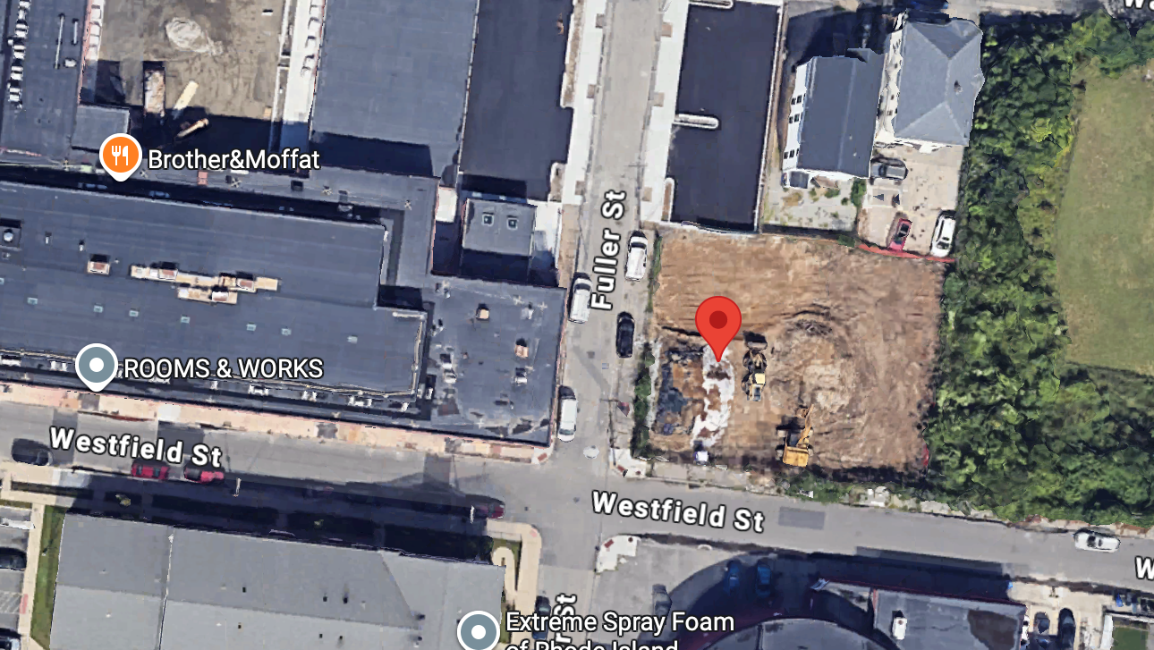
How do community composting operations develop?
A Birds Eye View of the Development of Community-Scale Composting

Slide 23
A Key Goal is Managed Composting
Prevents the very real concerns and risks
Speeds up the decomposition process
Mitigates potential pollution from the concentrated nutrients and pathogens in the raw organic materials being processed
Has global impacts

Slide 24
What is Managed Composting?
Planned compost system with adequate capacity
Knowing your raw materials
Character
Volumes
Using a recipe
Blending materials
Containing putrescible materials

Slide 25
What is Managed Composting?
Pile monitoring
Turning and aerating
Heat treatment
Preventing nuisances
Odors
Vectors
Pollution
Maturing compost and ensuring product quality

Slide 26
Discover > Define > Design > Develop > Deploy
Discovery means asking the key questions early on:
Rule out dealbreakers
Define a concept that realistically aligns with the operational vision
Regulatory framework
Local (Zoning rights/permits)
State (MA General Permit for Composting or MA Agricultural General Permit)
Federal (airports)

Slide 27
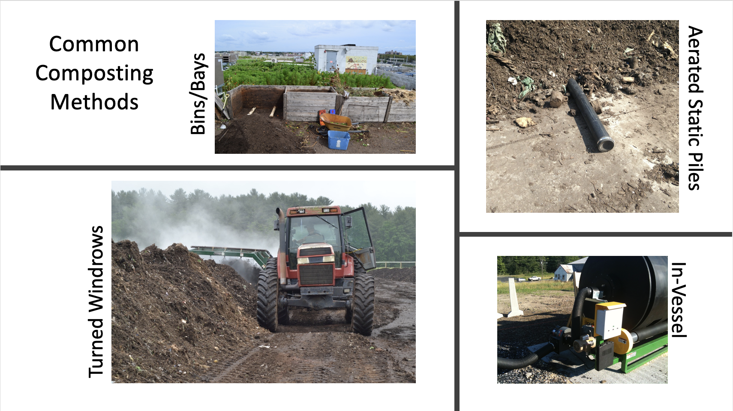

Slide 28
Where might systems be developed?
Land is scarce
Massachusetts agricultural land is 3rd most expensive in the country (2025 USDA)
Development pressure and NIMBYism are significant factors
We need to support and value our existing composting infrastructure (it’s not getting easier to build stuff)

Slide 29
Where might systems be developed?
On-site at schools, universities, corporate campuses, food processors
Farms, community farms, community gardens
Parks
State lands
Brownfields
Capped andfills
Vacant lots, airports
Public spaces

Slide 30
What Are the Economics Here?
Kind of like trying to understand and compare cell phone plans…
Is this a basic service that everyone should have access to?
Is the organization/facility/community meeting its goals and aligning with its principles?
Does it pass the carrot test?

Slide 31
What Are the Economics Here?
Of course, we’ve all got to eat (that is is the goal here after all)…
VALUE COMPOST, COMPOSTING, AND COMPOSTERS (VALUE YOURSELVES)
Food scrap collection generally most profitable
Don’t hesitate to charge for your services (please charge)
More sustainable
People will value the service more
Also, we need to figure out ways for everyone to access the services and benefits of composting in our community
Municipalities who offer a curbside trash collection service should theoretically save money when people compost (depending on structure)
This may be mechanism to support composting and composting access

Slide 32
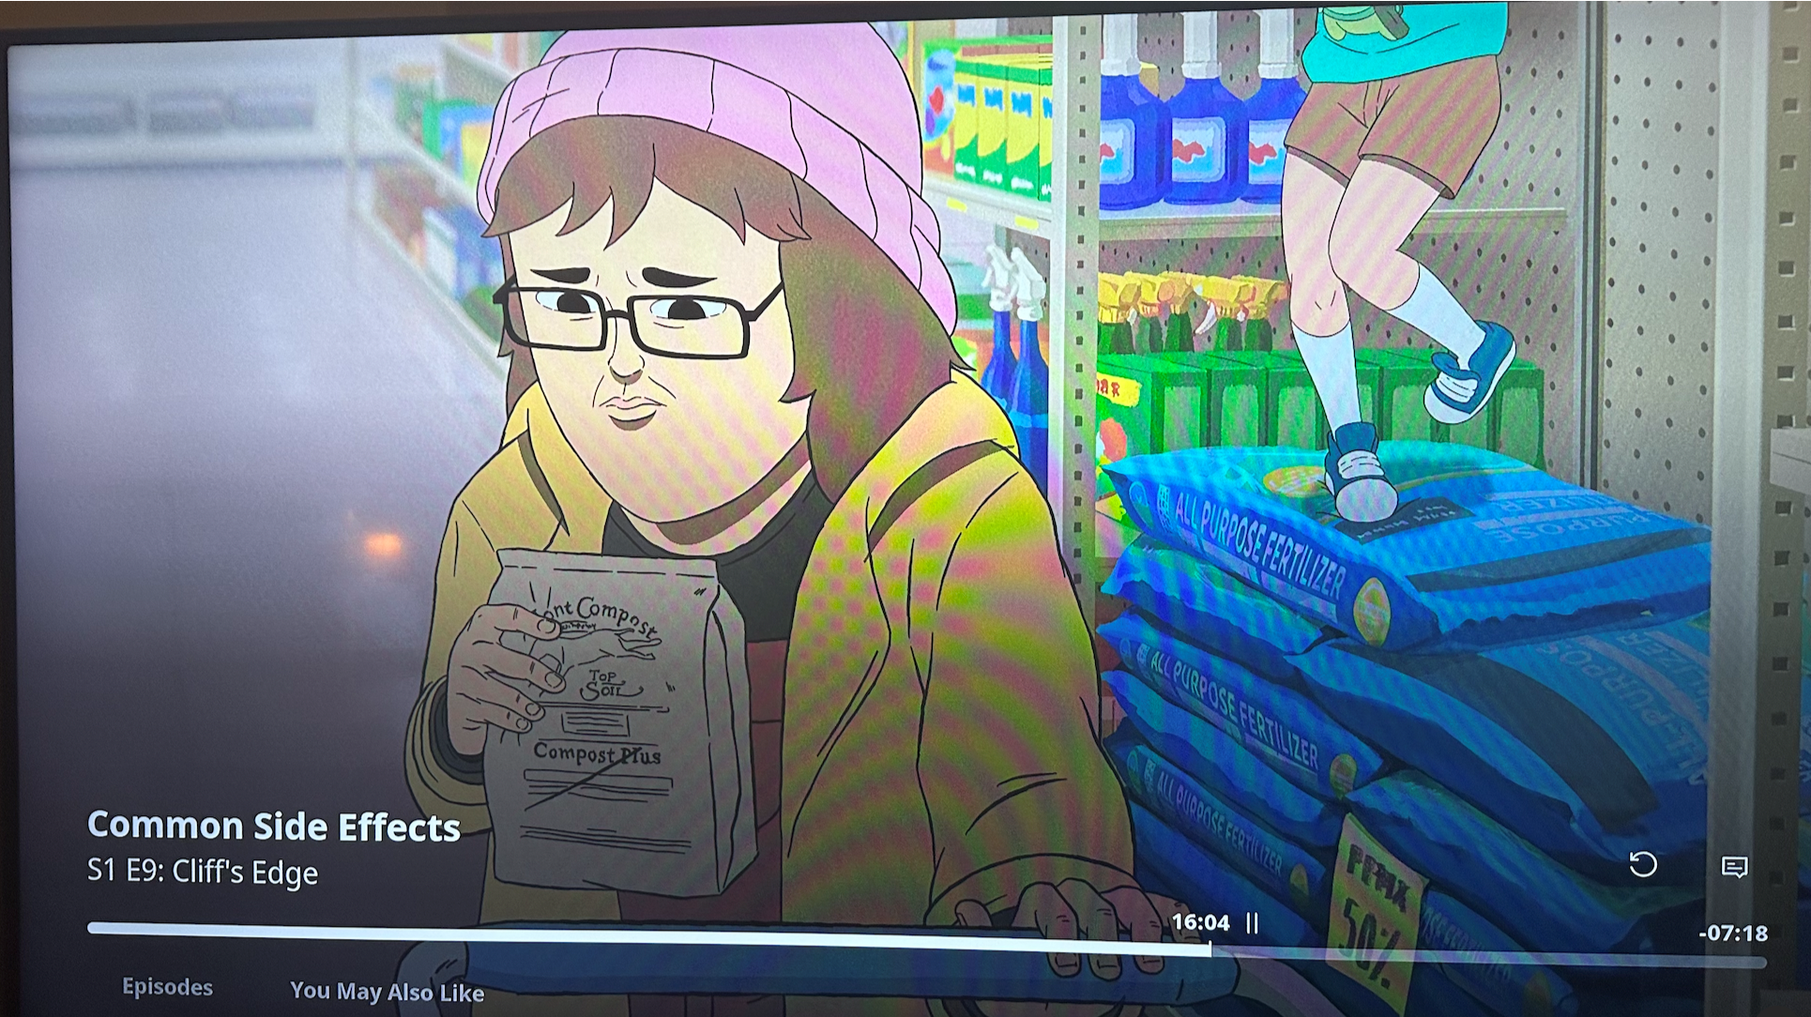

Slide 33
Vermont Compost Company took decades to develop their business model

Slide 34
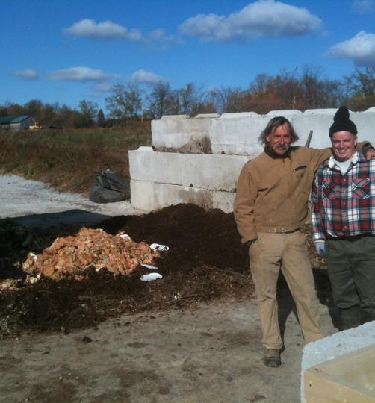
Pilots
Make small mistakes not big ones
Build community trust and support
Get to know
what you don’t know
you don’t know

Slide 35
Are there models we can use a road map?
Many roads
Many maps

Slide 36
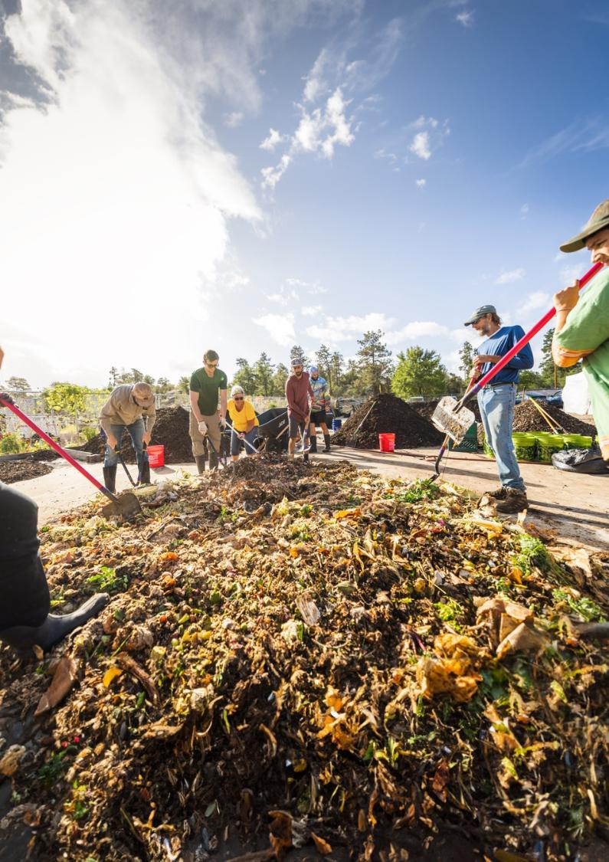
Prescott Community Compost (Prescott, AZ)
Who?
Prescott Farmers Market Community Compost Program
Founded by Gabriel Kerbs & Kathleen Yetman (Farmers Market Director)
Annie Baker - Compost Manager (Program Director)
2 Assistant Managers
Hundreds of Volunteers
Partners
City of Prescott
Grant Partner
Land Owner
Credit: Prescott Community Compost

Slide 37
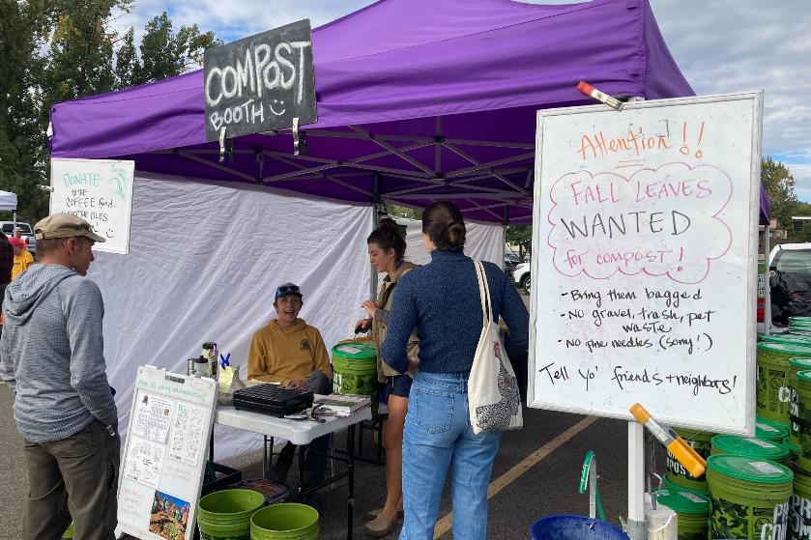
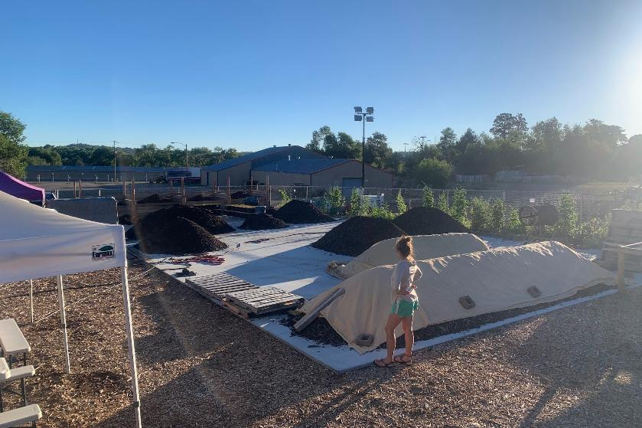
Where?
Drop-off at Prescott Farmers Market
Site at Prescott Rodeo Grounds
High desert
When?
Founded 2020
Construction 2020-2021
Credit: Prescott Community Compost

Slide 38
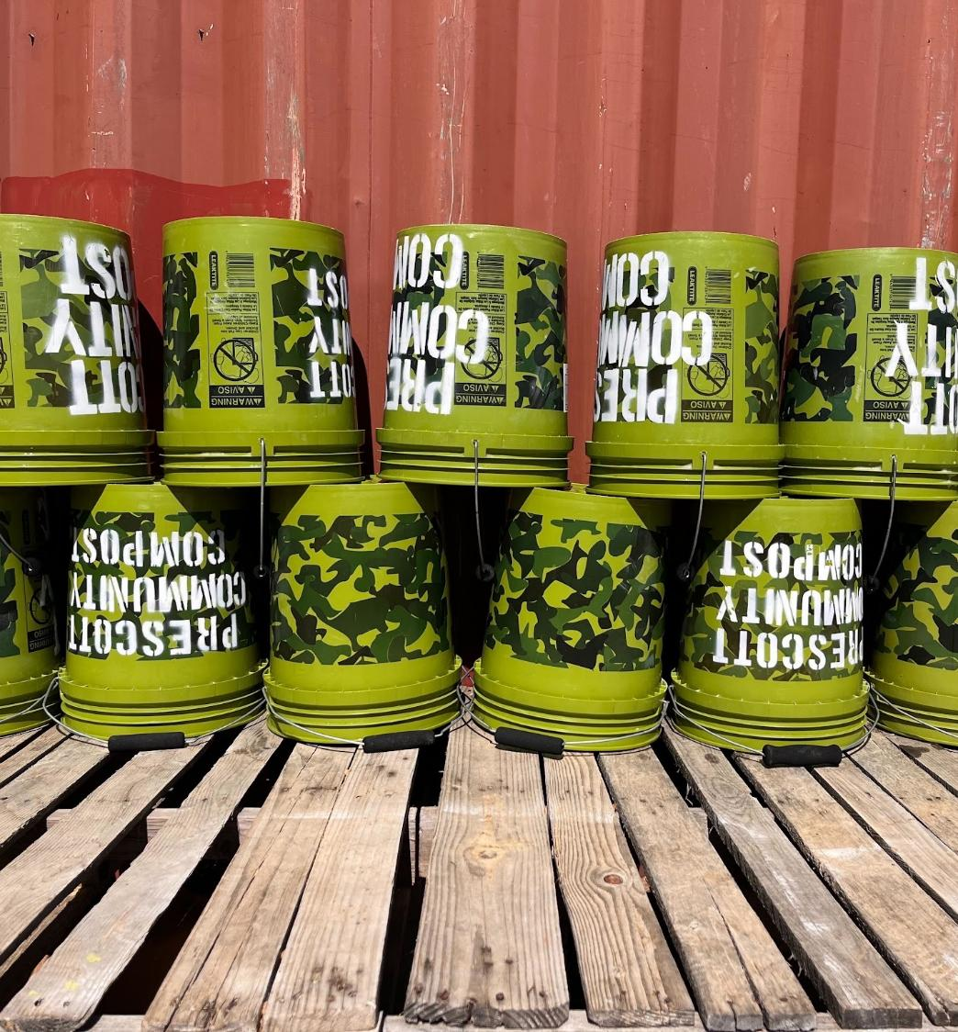
What?
Green Bucket Food Scrap Drop-Off Program
250+ Participants Drop Off at the Prescott Farmer’s Market each week
$10/Month Swapping + Cleaning
$1 Per Drop w/ Own Container
2,500 Pounds/Week (1.25 Tons)
Credit: Prescott Community Compost

Slide 39
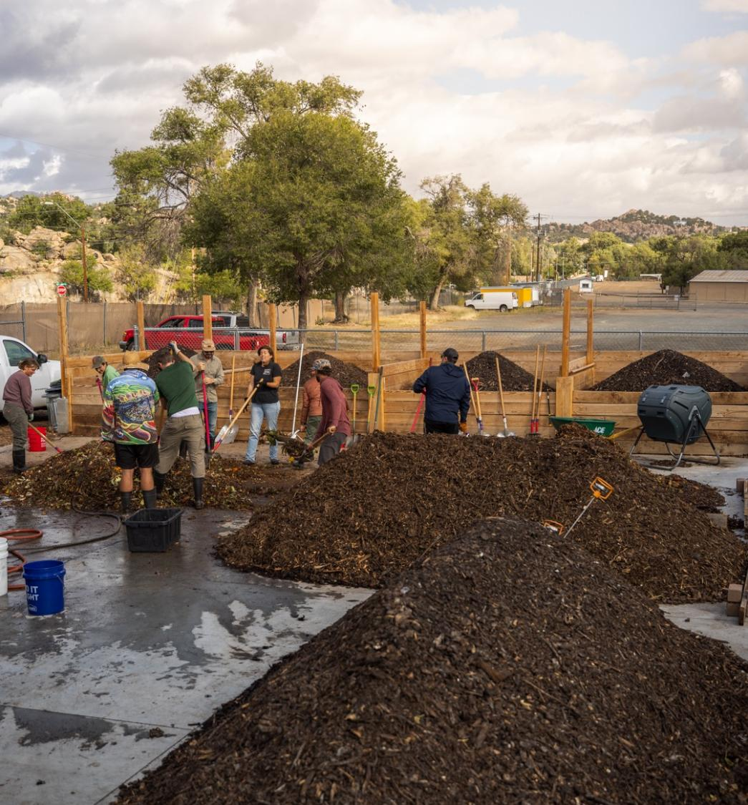
What ?
4,000 Sq/Ft pad
Feedstocks
Sawdust
Wood chips
Leaves
Four 10’ x 10’ Aerated Bins
2 week’s worth of material per bin
Retained for 2 months
Volunteers Hand Turn Windrows
9-12 Months finishing time
¼” & ½” screened
Credit: Prescott Community Compost

Slide 40
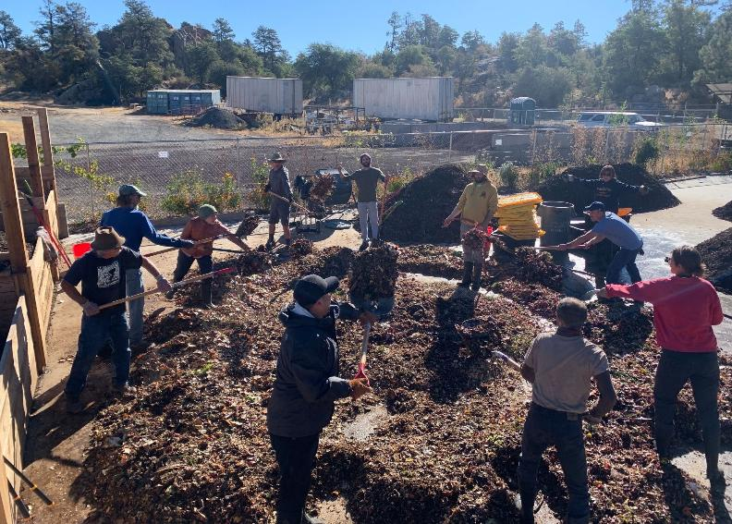
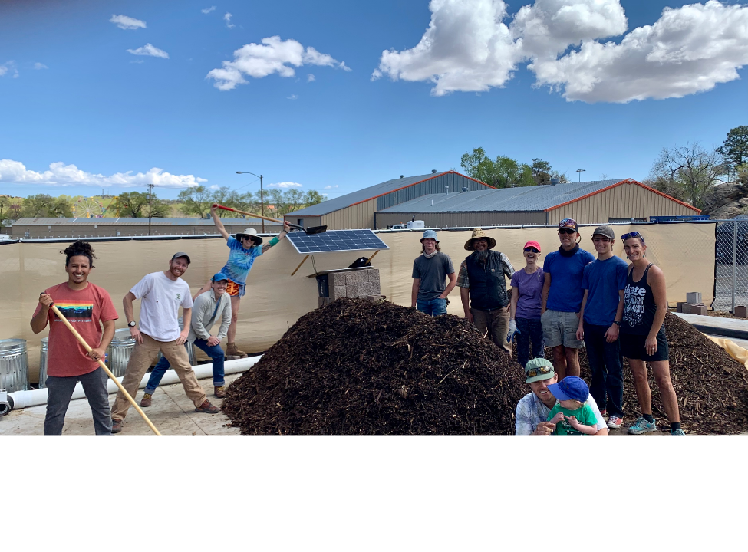
How?
Worked with City to apply for and receive an $80,000 Community Compost & Food Waste Reduction Grant through USDA’s NRCS
Only municipalities were eligible
Worked directly with City Manager
Initially there was a land use agreement with the city, but currently no lease or legal agreement
Volunteer powered
Core volunteer crew
Field trips
Community service
Credit: Prescott Community Compost

Slide 41
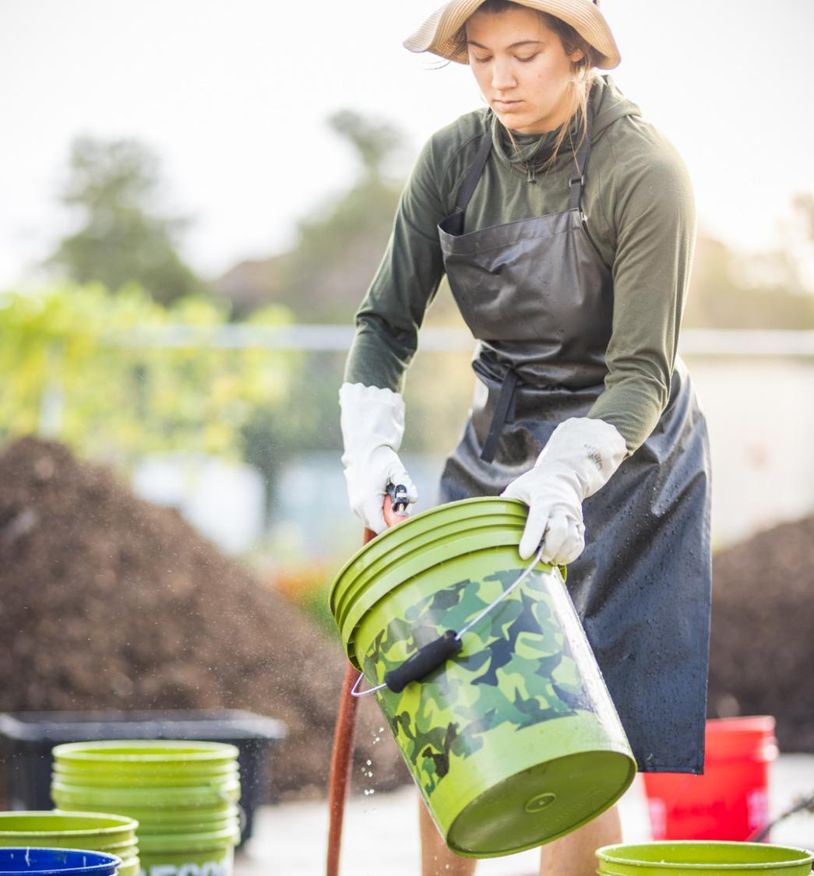
How?
Permit Exempt at state level
Collection & swap service income (~40%)
Compost sales (~55%)
$20 cubic foot bag
$15 five-gallon bucket
Some bulk (~5%)
Market provides admin & financially supports mission
Workshops, field trips (~2%)
Some used on site
Donations (~3%)
Credit: Prescott Community Compost

Slide 42
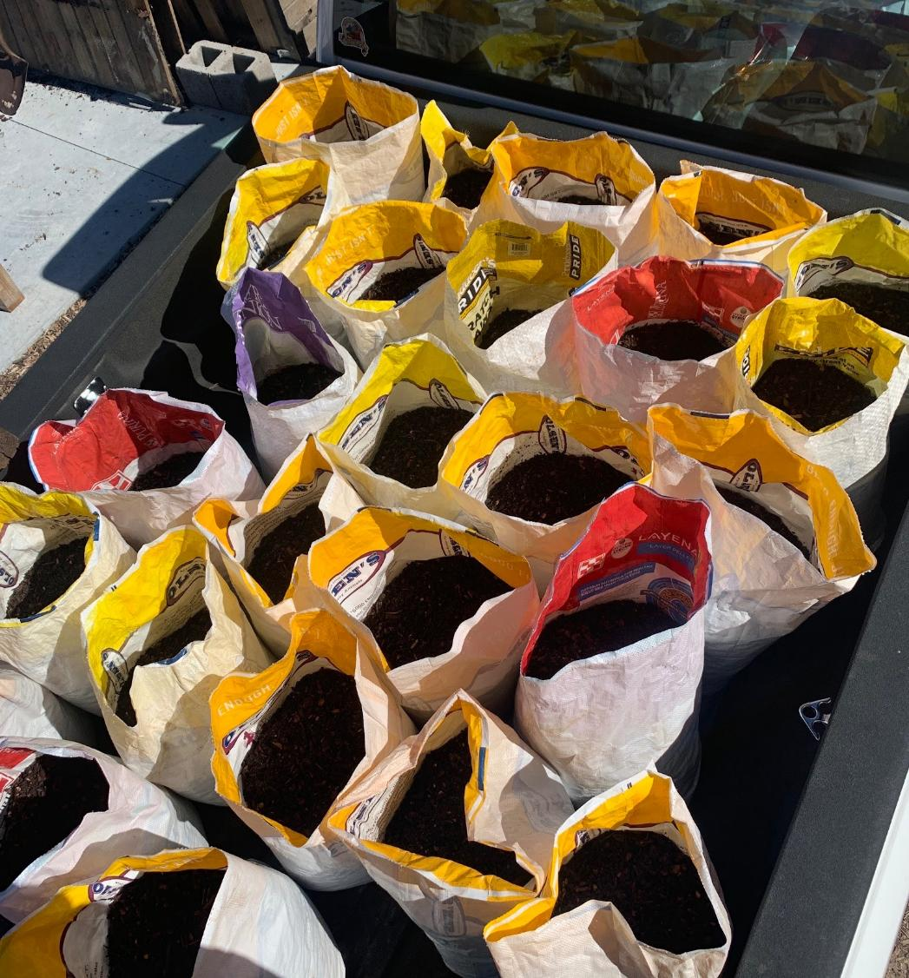
Why?
Founder had passion for gardening
Poor soil, arid climate, hard to grow without building soil
Lots of interest and demand in region
Community building and education – motivates volunteer run operation
Driven by the logic of not wasting
Credit: Prescott Community Compost

Slide 43
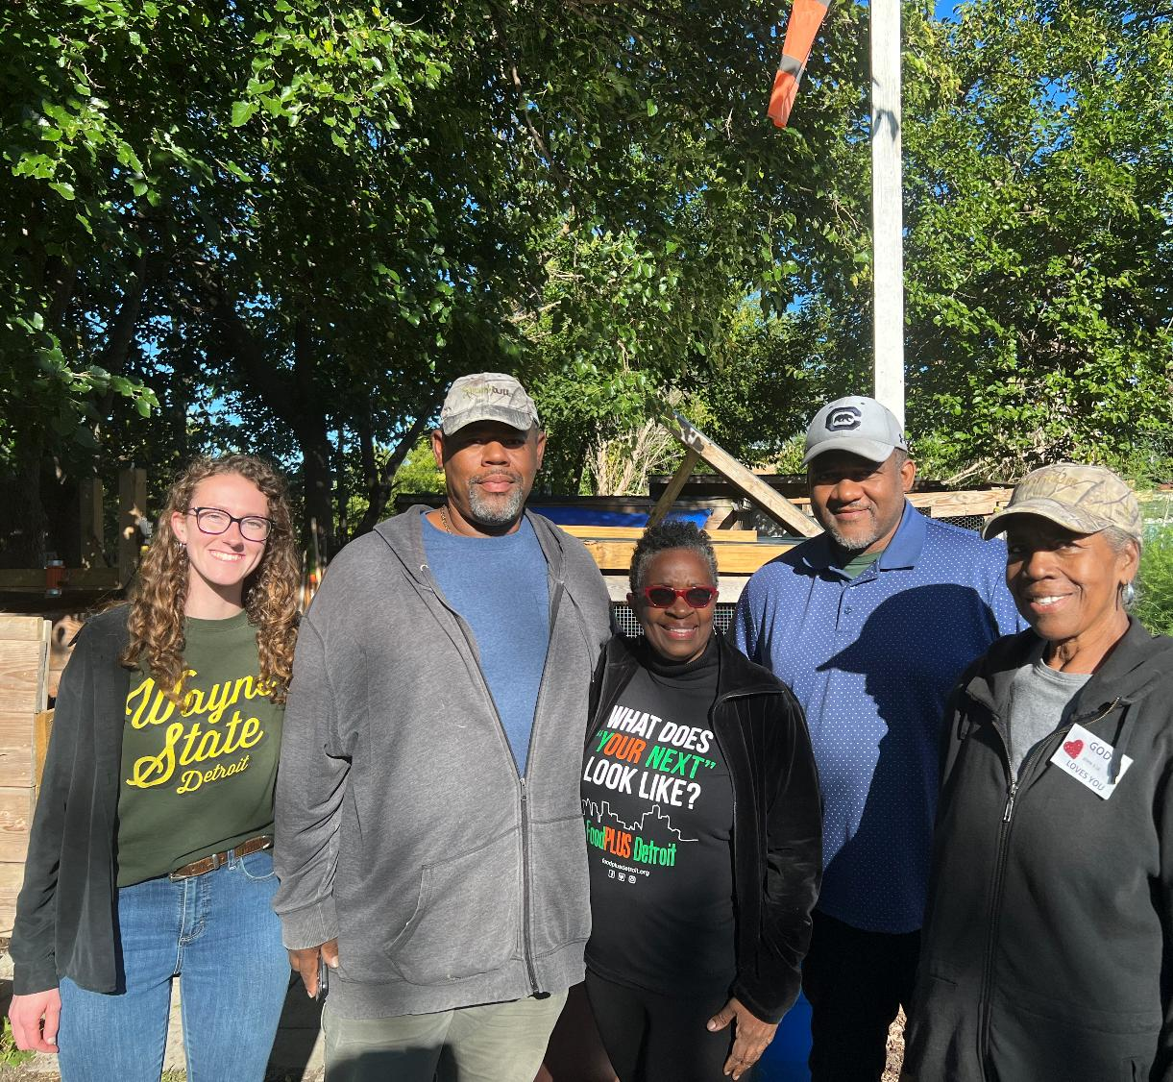
Georgia Street Community Collective (Detroit, MI)
Who?
Mark Covington – Executive Director, Farmer, Bee Keeper
Georgia Street Community Collective
Non-profit
Community Resilience Hub
Credit: Food Plus Detroit

Slide 44
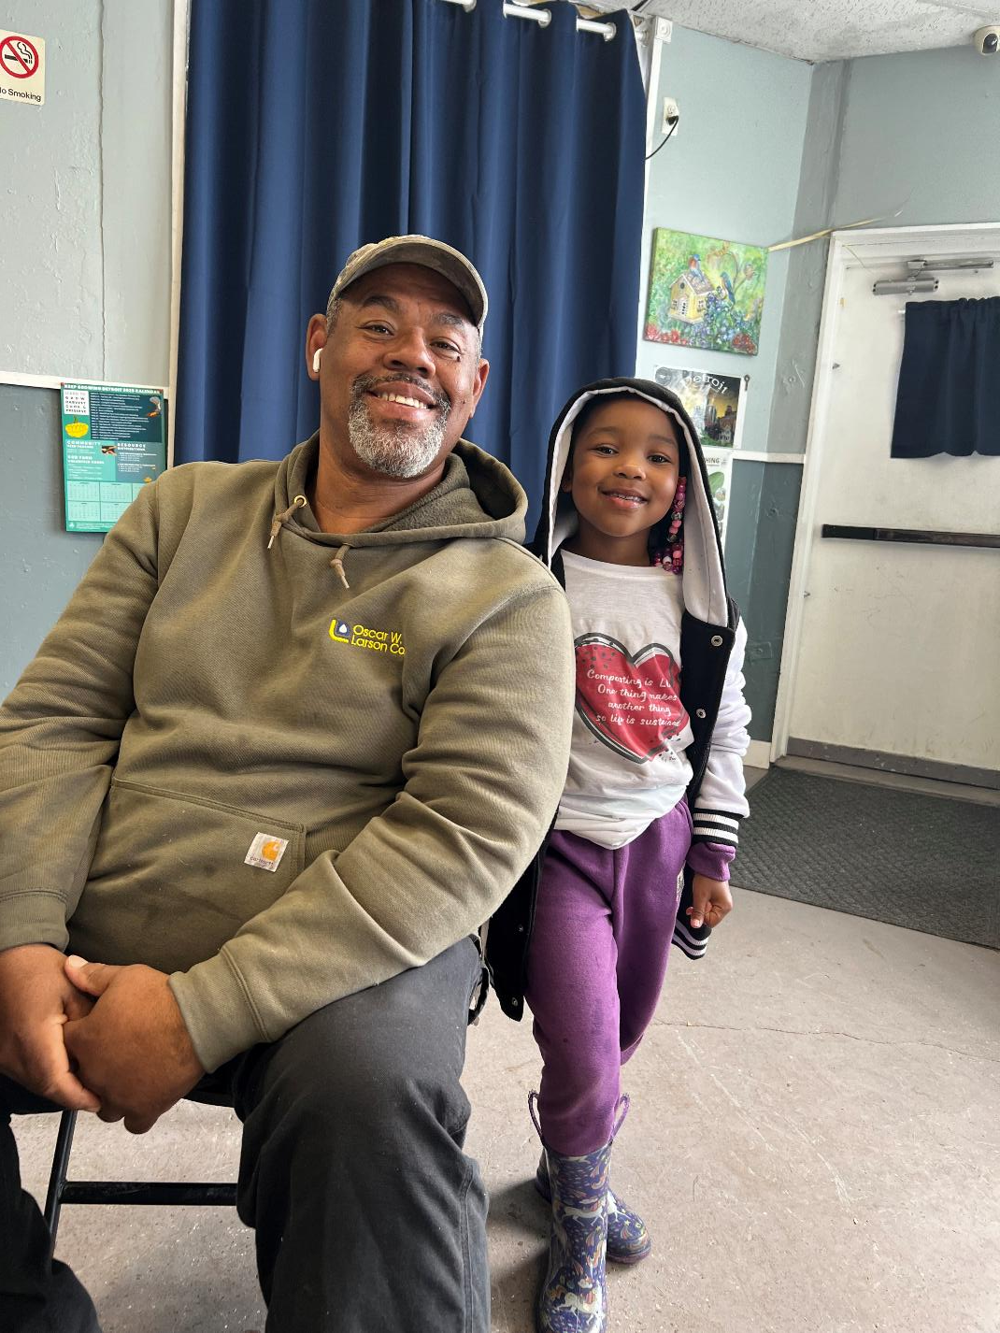
Partners?
FoodPLUS Detroit – Renee V. Wallace
Key community composting collaborator
Program development & implementation
Education, advocacy, networking
Catalyst & thought partner
East Side Community Network
Community development non-profit since 1970’s
Partners w/ 12 Resilience Hubs to provide resources to community (food, mental health, etc)
Keep Growing Detroit
Food Sovereignty
Seed through harvest & distribution
Wayne State University
Credit: Food Plus Detroit

Slide 45
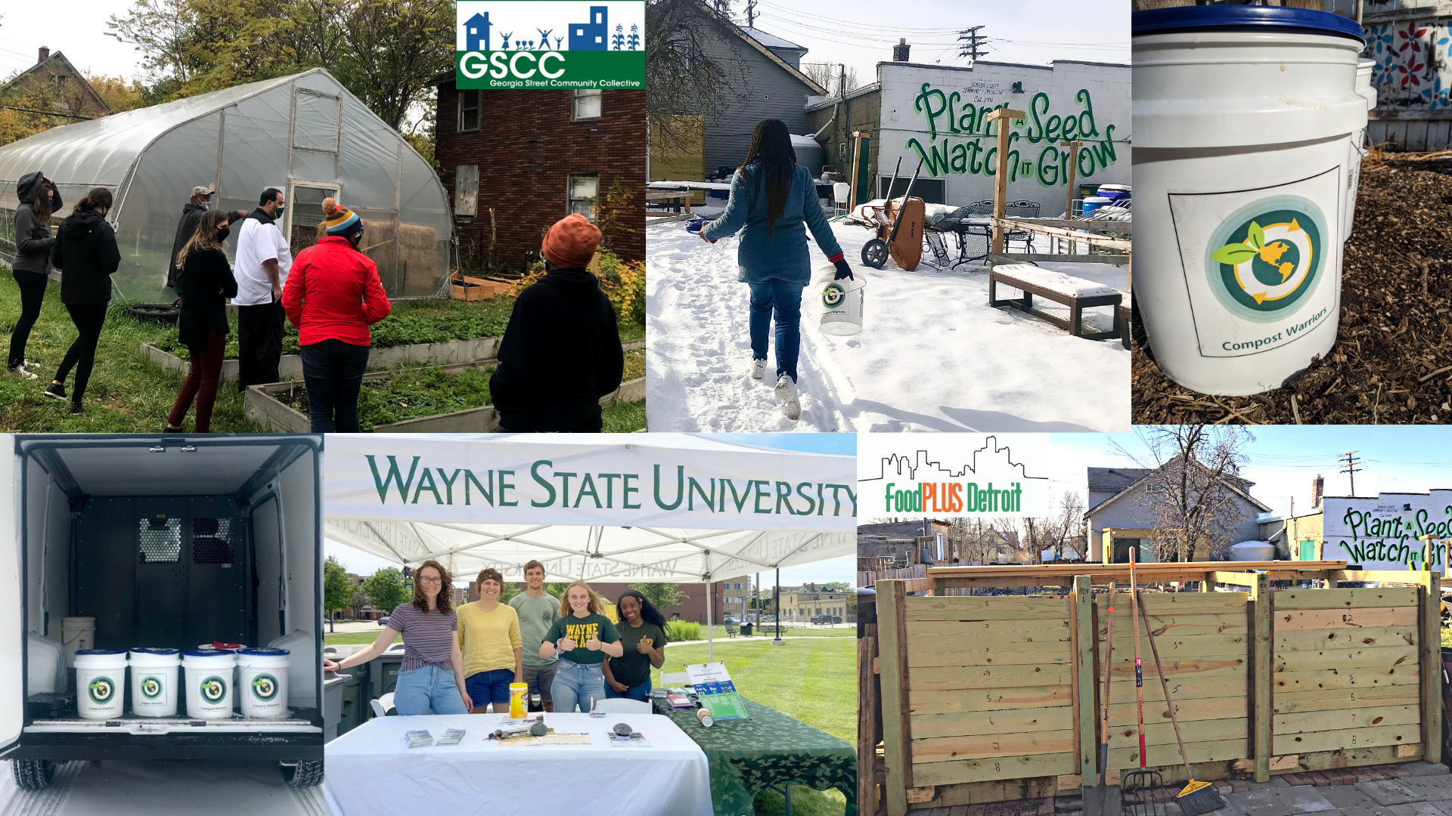
Credit: Food Plus Detroit

Slide 46
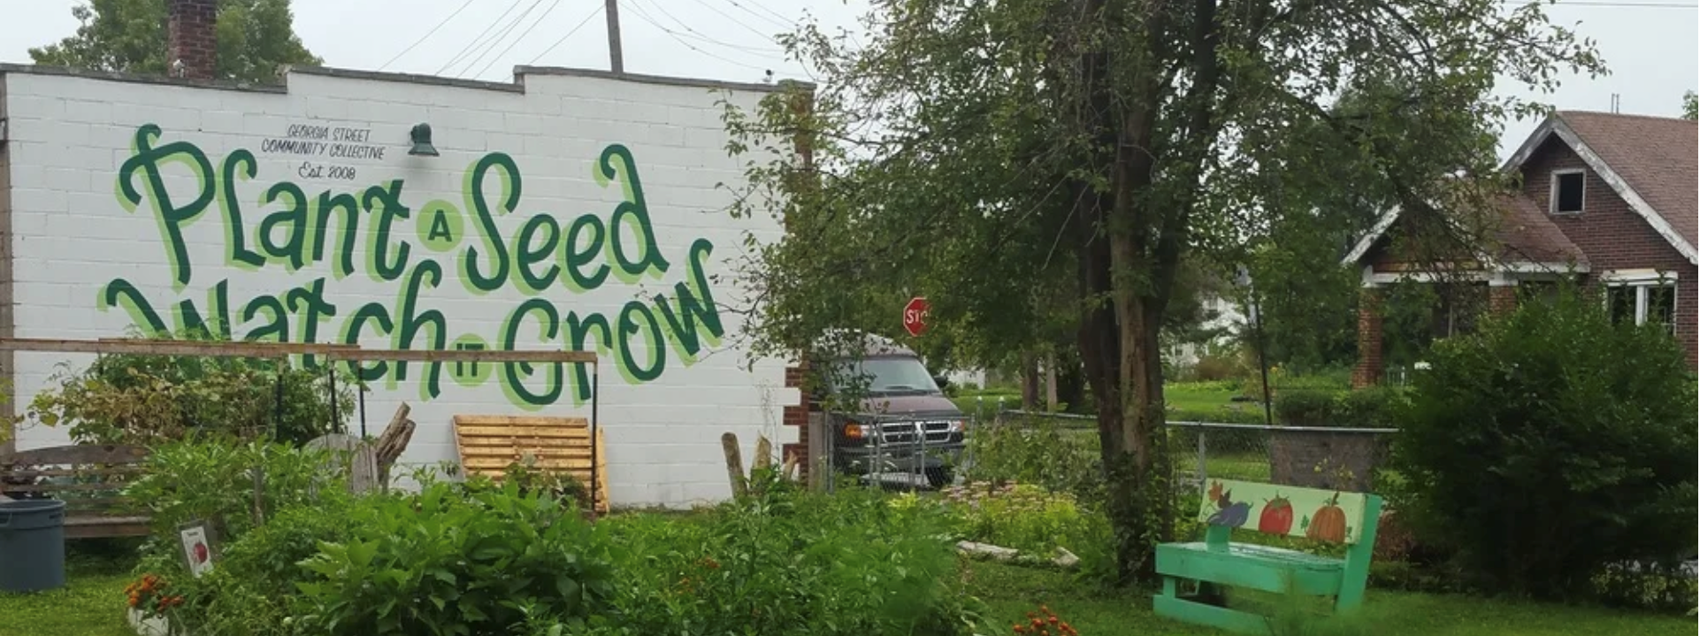
Credit: Georgia St Community Collective
Where?
17 Adjacent properties that make up just over an acre of vacant land
+2 Properties with buildings including Mark’s Home
Residential neighborhood
When?
Founded 2008?
Unofficially composting neighborhood organic materials since then
Officially composting community food scraps since 2020

Slide 47
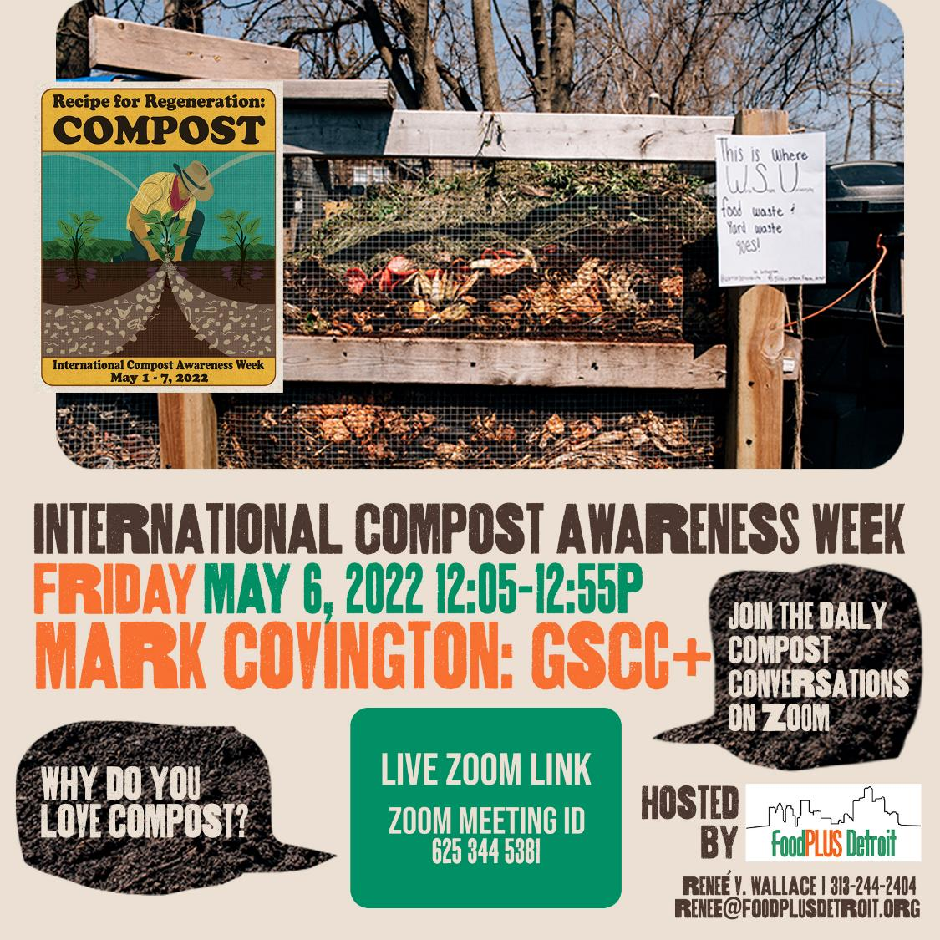
What?
Started composting with on the ground/pallet system
Food Scraps from Wayne State University
Dining halls and campus restaurants – delivers material
Provides volunteers, leaves, woodchips, & machinery
Community drop-off at the farm
~0.25 Ton/Week
Credit: Food Plus Detroit

Slide 48
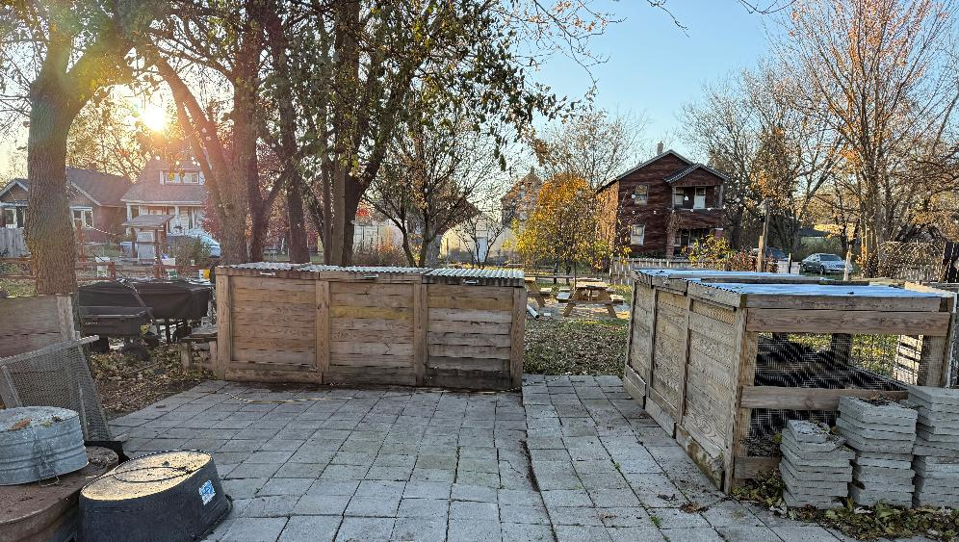
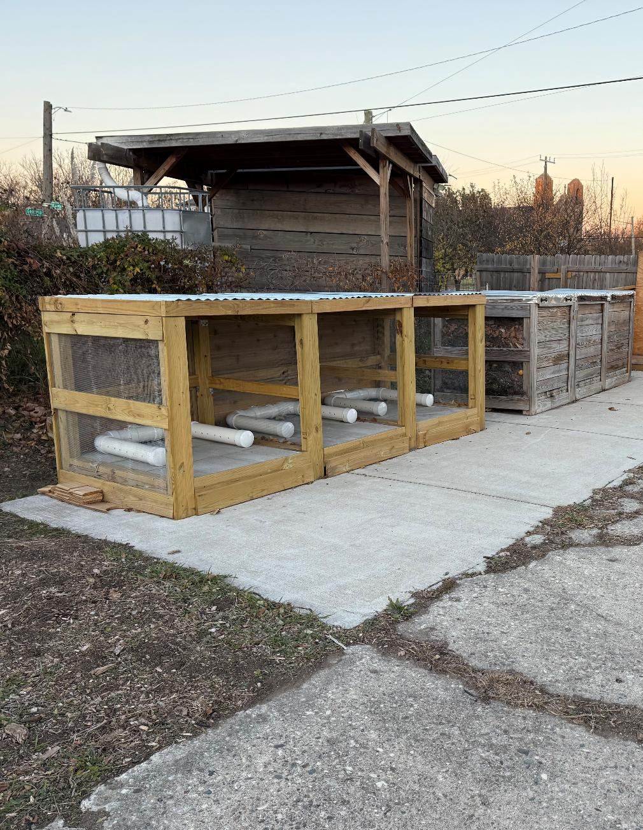
What?
Compost Knox Bins
Adding solar powered O2 compost ASP to Knox bins
Small tractor with capacity to access bins
Mostly hand powered
Credit: Georgia St Community Collective

Slide 49
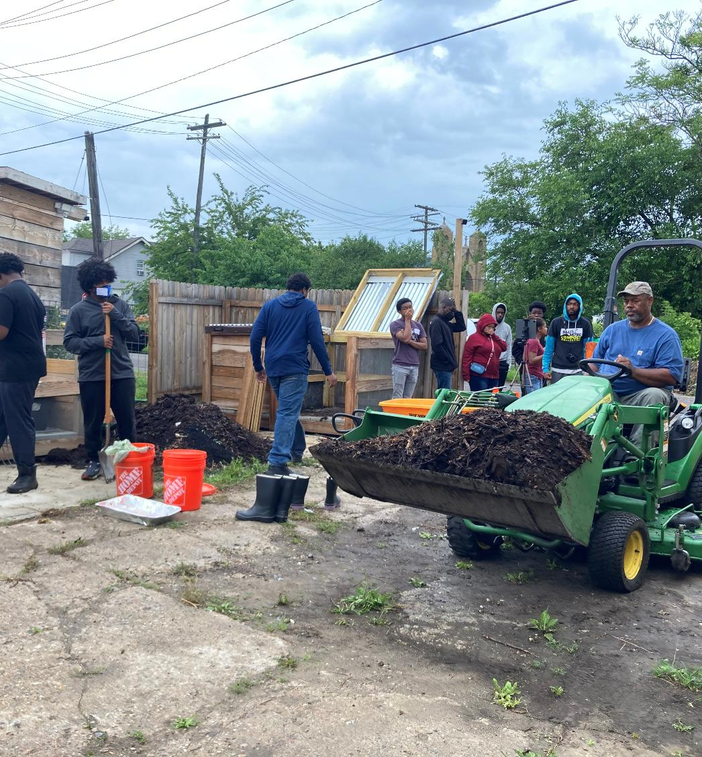
How?
Mark makes compost and grows food with it to share with his community!!!
Volunteers
Grants ~40%
NRCS Conservation Programs – EQIP – Cost share’s practices such as compost making/use, mulch, no till, rainwater (year 3 of 5)
Robert Wood Johnson Foundation
EGLE (Michigan Department of Environmental, Great Lakes, & Energy)
Donations ~50%
Fiscal sponsorship 10%
Credit: Food Plus Detroit

Slide 50
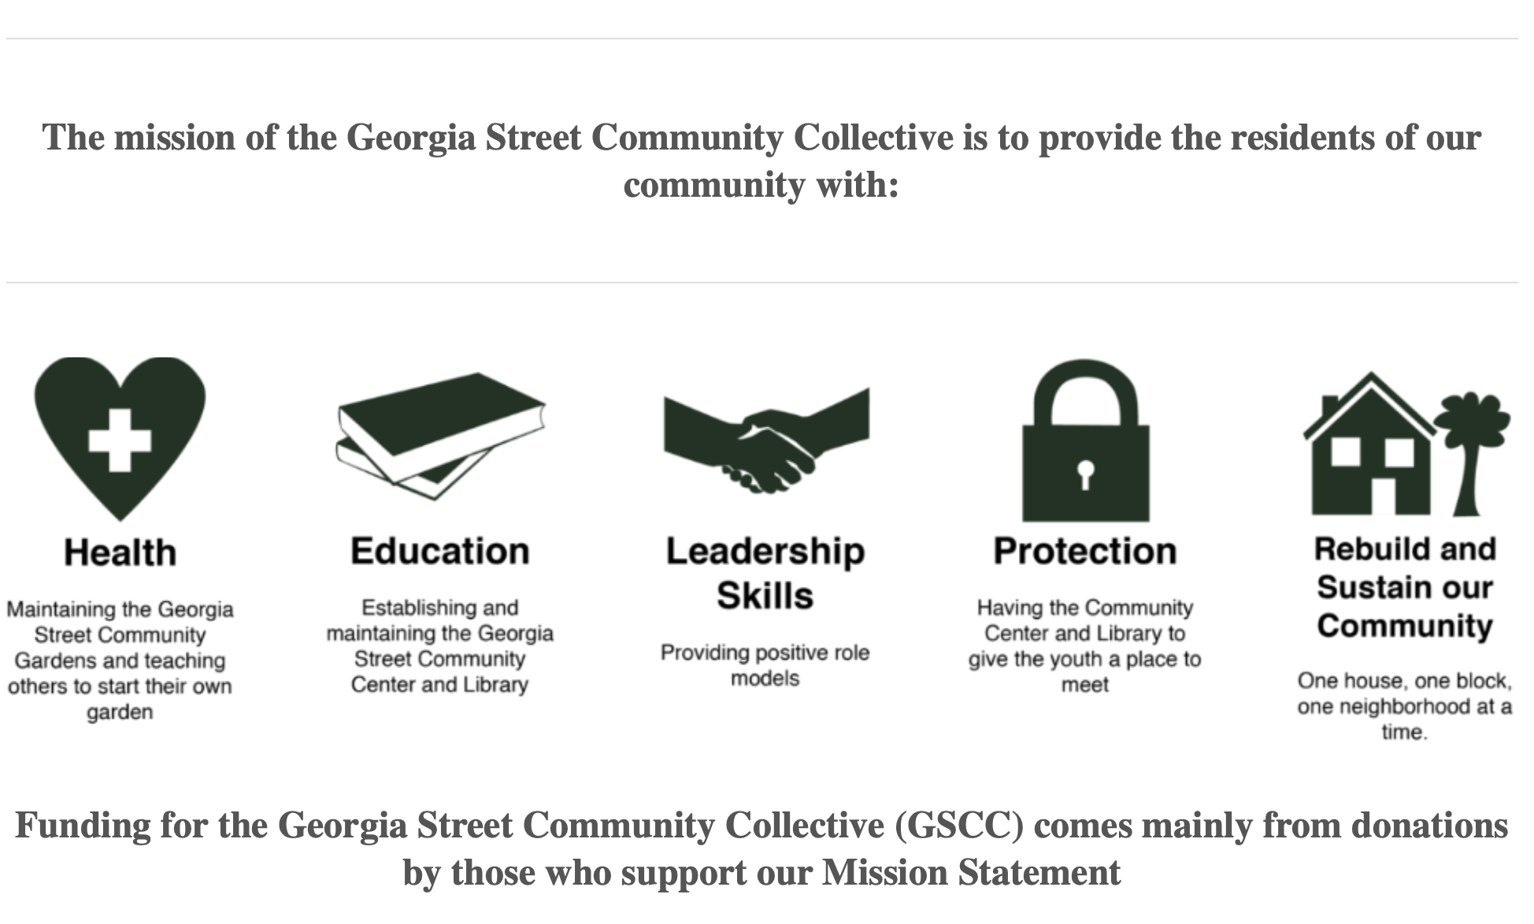

Slide 51
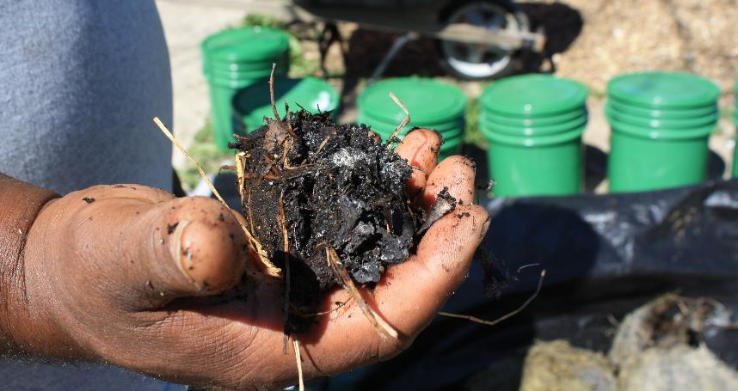

Why?
Community has food insecurity
Farm grows and picks fresh healthy produce
People come to get it at community fridge and farm stand
Food insecurity is increasing crisis in shutdown
Make Food Not Waste - Upcycled rescued foods cooked by chefs
Adding two days of meal distribution in fridges
Nutrient Cycle/Soil Sovereignty
Development of replicable model
Being a resource to implement composting and other resiliency models
Support the Farm’s Community
Credit: Food Plus Detroit

Slide 52
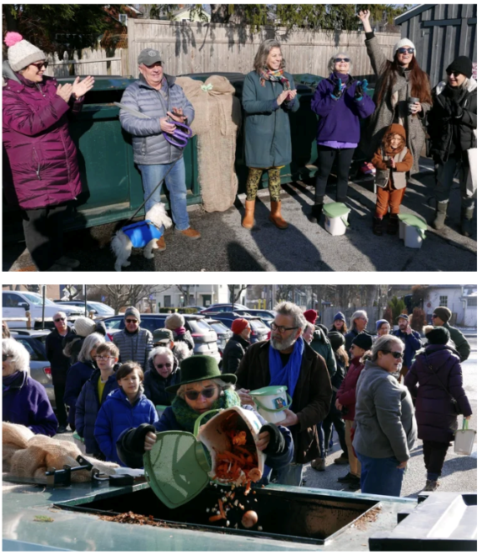
Village of Rhinebeck & Ellerslie Stables (Rhinebeck, NY)
Who?
Village of Rhinebeck
Vanessa Bertozzi – Village Trustee, Climate Smart Task Force Coordinator
Ellerslie Stables
Michael DeCola - Owner, Operator
Partners
Outreach partners
Town of Rhinebeck
Local Businesses
Credit: Village of Rhinebeck Compost

Slide 53
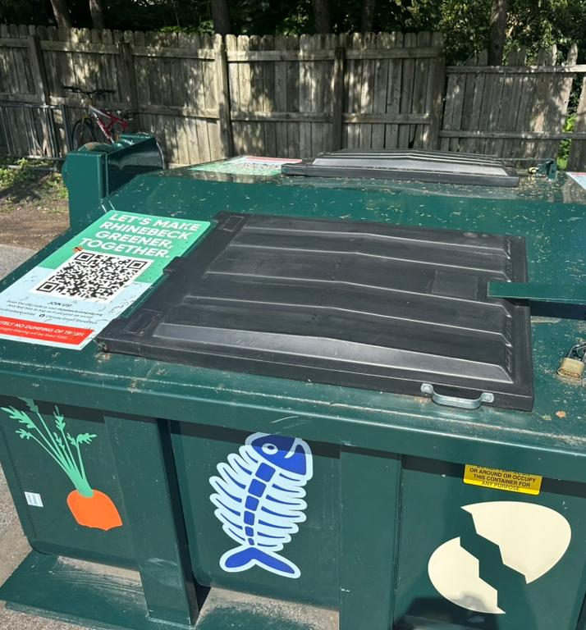
Where?
Drop-off in Village
Composting on farm/stables
Existing horse manure composting bays
When?
Pilot food scrap collection 2023
Food scrap composting program started in new year 2025
Site improvements made in spring 2025

Slide 54
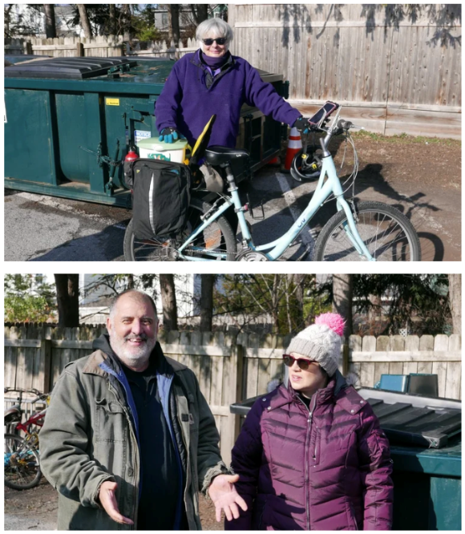
What?
Community drop off in village in roll-off container (no cost) hauled by farm
Residents
Farmers Market
Aerated static pile compost system added to existing bays
Also added asphalt mixing and finishing areas
Credit: Village of Rhinebeck Compost

Slide 55
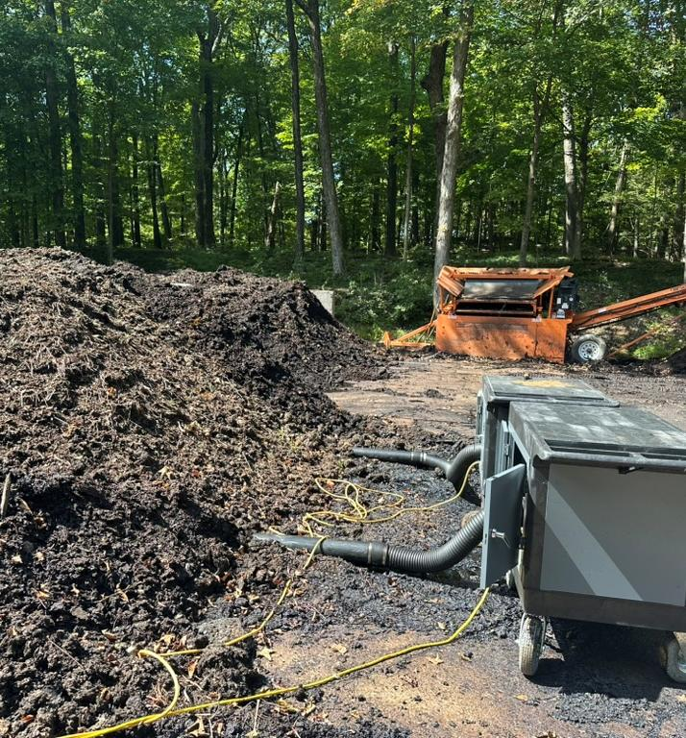
What?
Excavator main tool for material management, but also:
Bobcat, screener, bagger, manure spreader, wash system, and dumpster/roll-off truck
Electrical and water installed
Upgraded access roads
2-3 yards/week food scraps currently (1-1.5 Tons)
Capacity for at least 8 Tons/Week of food scraps

Slide 56
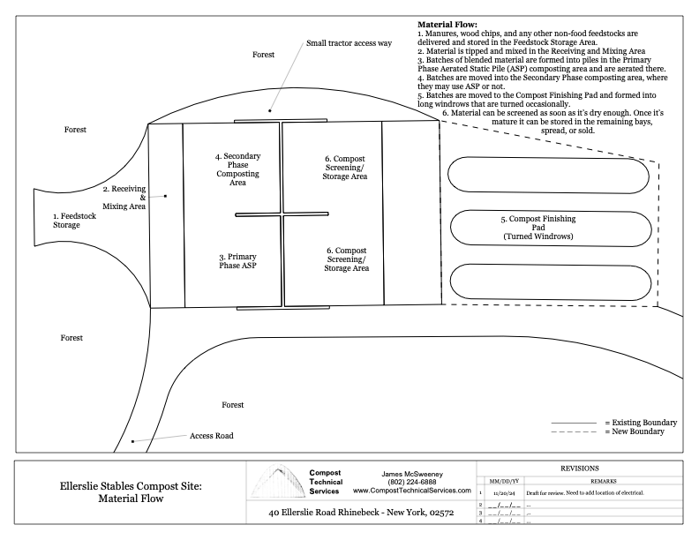

Slide 57
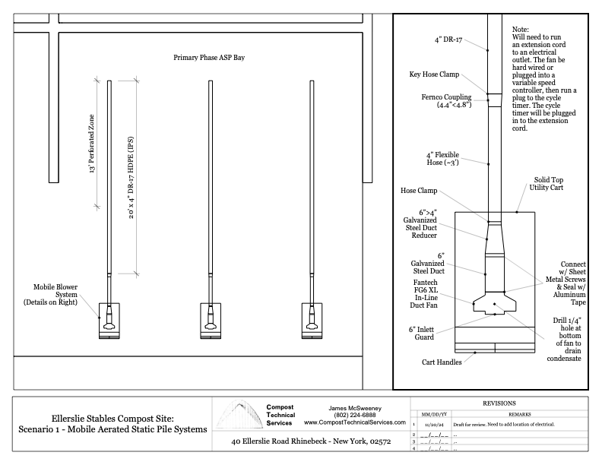

Slide 58
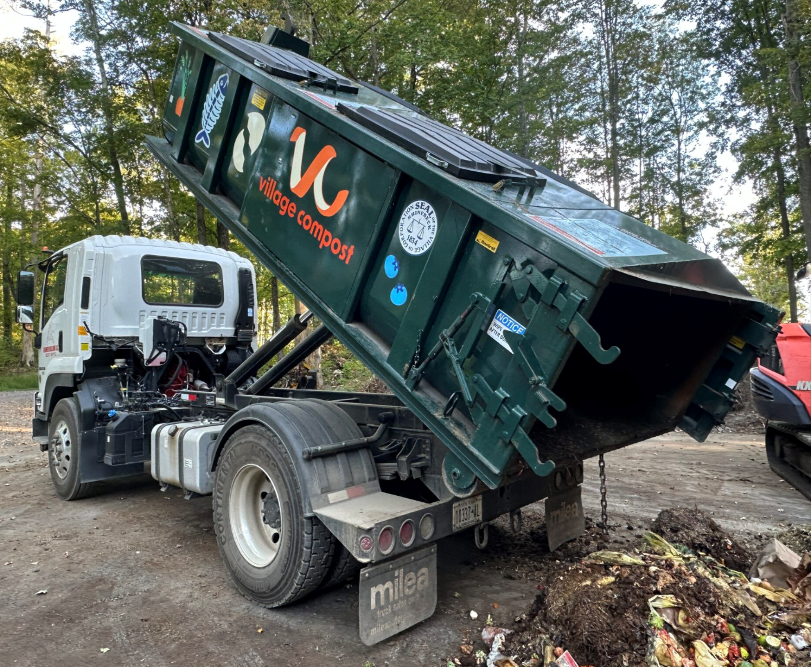
How?
2023 Pilot Food Scrap Drop-Off
Village Highway Department site
$100,000 Grant Hudson Valley Partners for Climate Action – had to be given back
$200,000 Village applied for NY DEC food scraps recycling grant
Reimbursement
25% match
Neighbors & Town fought original site
Stables expressed interest in being an alternative processing partner
Significant existing farm resources
Protections in State code for composting on a farm
Credit: Emily Sachar

Slide 59
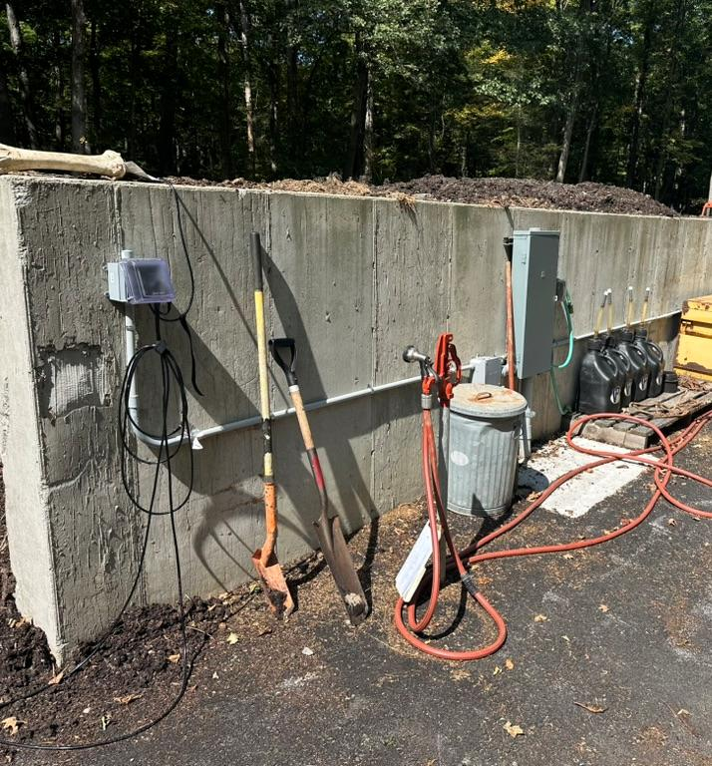
How?
State allowed reallocation of grant to go to processing contractor
Bidding process for Contracting Services
25% grant match provided by farm in services
Grant used to set farm up with infrastructure & implement drop-off program
Contractor/Vendor agreement – 7 years – useful life of ASP equipment
Does hauling – no tipping fee
Maintenance of equipment
Purchased systems and site improvements for farm – added significant capacity
Up to 10 yards/Week for 7 years

Slide 60
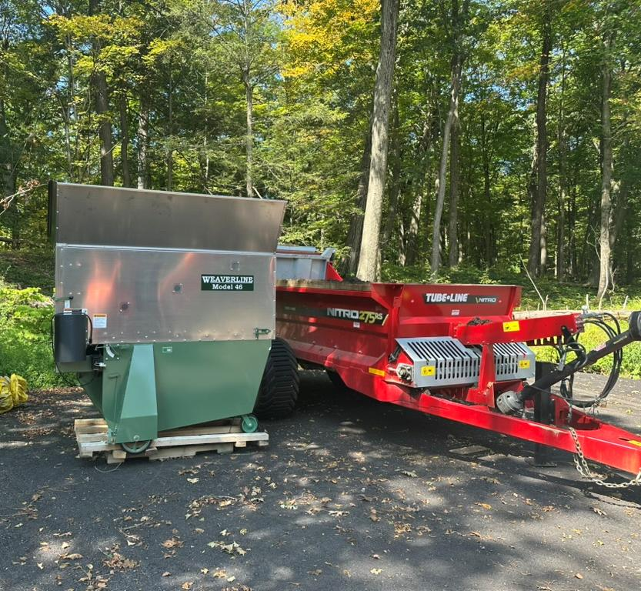
How?
Compost Facility Registration from NY DEC
Compost Site Technical Assistance through NY Wasted Food Solutions Program
Provided by CET w/ CTS as subcontractor
Site & ASP Design/Parts list
Training – multiple trainings including NY Operator Training & CREF COCT
Staff – Have to manage manure anyway – many farms pay for hauling
Food scraps add time, but it’s relatively efficient
Revenue from compost sales – premium product
Approved for use on organic farms

Slide 61
Motivated by Climate Action Plan framework developed through NY Climate Smart Communities Program, which includes organics management
Regenerative approach to waste
Interest by volunteer collaborators
Village of Rhinebeck’s
Why?

Slide 62
Ellerslie Stable’s Why?
Important community project and Michael wanted it to work
Adds value to what the farm is already doing (managing manure)
Hemp hurd - value as compost feedstock, side business, and potential industry in US
Adding and diversifying farm revenue streams

Slide 63
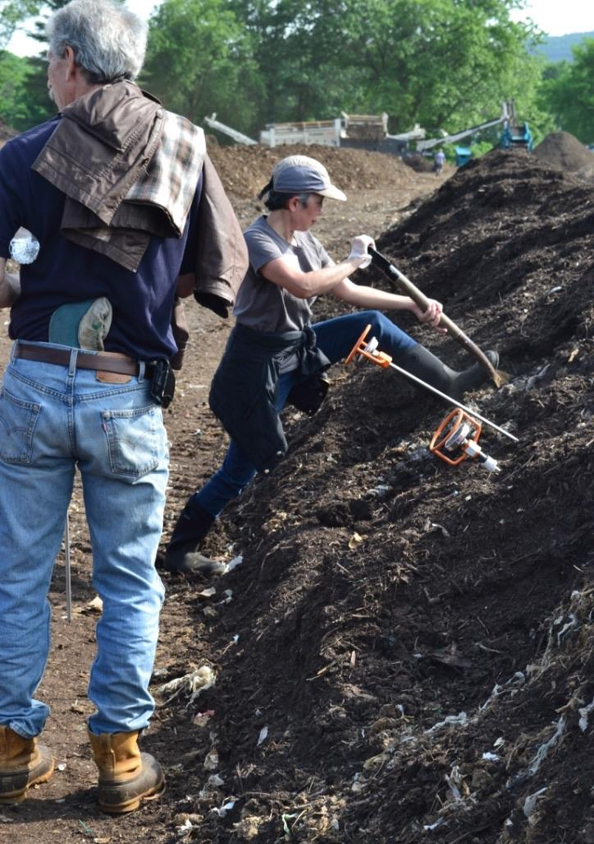
Resources
RecyclingWorks MA Compost Site Technical Assistance
Institute for Local Self-Reliance (ILSR) Composting for Community & Community Composting Coalition (https://ilsr.org/composting/)
Intensive trainings
Maine Compost School (1 Week)
Compost Research & Education Foundation Compost Operator Certification Training (1 Week)
The 131° School of Composting
Compost Operator Certificate
Course on Aerated Static Pile Composting
Free Operator Discussion Series
ILSR Compost 101 – relevant to smaller operations

