Slide 1
Raytheon’s Zero Waste Journey
WasteWise Forum
December 1, 2016
Notes:
CONTENT OWNERS: ALWAYS REVIEW CONTENT WITH YOUR EX/IM or CONTRACTS REPRESENTATIVE FOR APPROPRIATE MARKINGS
WARNING – Users should ensure they follow the layout instructions found in Raytheon Policy 5024-RG (Global Trade Compliance: Marking and Protection of U.S. Export-Controlled Technical Information) – with the full marking on the first page and a smaller carryover marking on subsequent pages, if required.
TITLE SLIDE PAGES
Security markings can be inserted by clicking into the text block of “Type EX/IM marking, if appropriate, as required by 5024-RG (ex. "ITAR Controlled")”.
INSIDE SLIDE PAGES
Security markings can be inserted by going into the Slide Master Template.
Go to the top menu bar, pull down “View”.
Click the “Slide Master” icon in the horizontal bar.
Click on the top Slide 1.
Type appropriate classification in header and footer.
This will then be applied to all slide pages (except the cover slide).

Slide 2
The Journey Began
With the signing of a Resource Management Contract with EL Harvey in 2005
This brought the focus squarely on waste reduction and how we could generate less waste and recycle/reuse more commodities
A shared responsibility with RTN and El Harvey
Incentivized to drive down waste volumes
As the contract matured we moved to include composting, wood, scrap metal and e-waste
Strong supplier partnerships are required for successful Zero Waste Programs

Slide 3
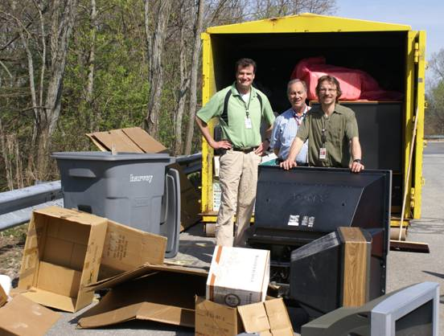
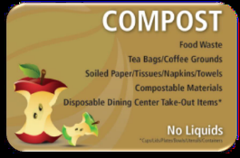
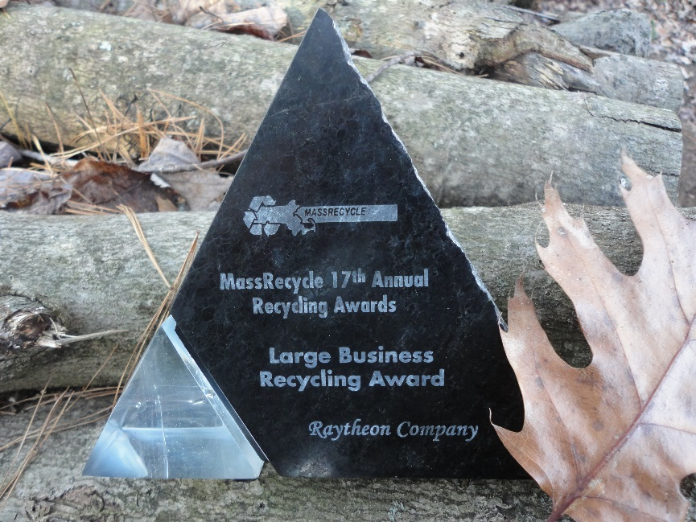
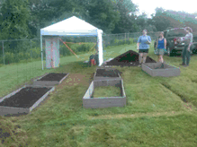
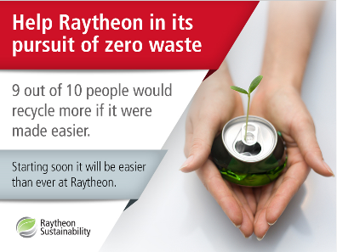
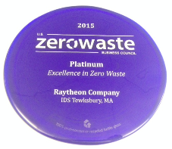

Slide 4
Raytheon Sustainability
Our commitment to future generations
Engaging our employees, customers, suppliers and communities to protect our environment and conserve natural resources
Strategic Focus Areas:
Energy Efficiency
Greenhouse Gas Emission Reductions
Recycling and Waste Minimization
Water Conservation
Design for Sustainability
Eco-Friendly Supply Chain
Environmental Stewardship
2008

Slide 5
Raytheon Sustainability Vision and Aspirations
Be a global leader in sustainability through innovation,
employee engagement, and stakeholder collaboration.
Integrate
Integrate principles of sustainability into the design of our products, processes and services through their entire lifecycle.
Optimize
Optimize environmental performance throughout the value chain by engaging in responsible resource management.
Collaborate
Collaborate with suppliers, customers, industry, academia, and communities to develop and deploy sustainable solutions.
Empower
Empower our employees and partners to work and live sustainably.
2015

Slide 6
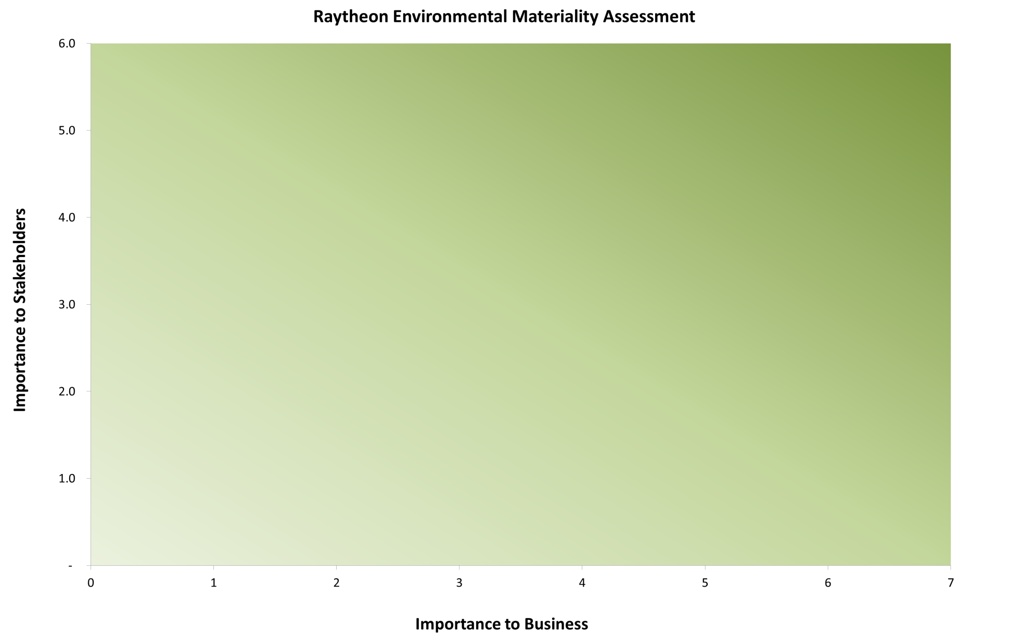
Materiality Matrix
water use
GHG emissions
energy use
global EHS standards
sustainable products & services
supplier performance
renewable energy
sustainable sourcing
design for sustainability
supplier standards
sustainable buildings
materials of concern
eco-manufacturing
waste
contaminated
site mgmt.
use of scarce resources
air quality
water quality
ozone depleting substances
land stewardship
climate change advocacy

Slide 7
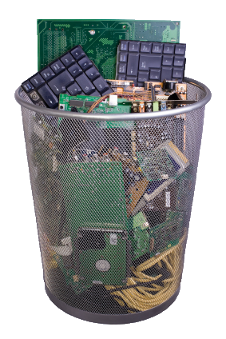
Putting the Lights on Zero Waste….

Slide 8
2015 Sustainability Goals
Energy Efficiency
Greenhouse Gas Emissions
Eco-Friendly Supply Chain
Energy
Use
IT Energy
Use
GHG Emissions
Travel/Supplier GHGs
Eco-
Friendly Procurement
Supplier
Sustainability
Achieved
56%
Reduction!
10%
1 MW
10%
5%
20%
Green
Buildings
Renewable Energy
Recycled Paper Use
100%
5%
100%
Recycling / Waste
Water Use
Stewardship
Design for Sustainability
Landfill & Incinerated
Waste
Eco-Responsible
E-Waste
Water
Use
Fleet Petroleum
Materials of Concern in Design
Product Material Content
35%
100%
25%
20%

Slide 9
Highest and
Best Use

Slide 10
2020 Sustainability Goals
Operations
EHSS
Engineering
Energy
Consumption
Water
Use
Solid Waste
Diversion Rate
Zero Waste Certification
Product
Material Content
Materials of Concern in Design
10%
10%
82%
20 sites
Supply Chain
Renewable
Energy
Greenhouse
Gas Emissions
Supplier
Sustainability
Assessment
Supplier Sustainability Commitment
IT
Next-Gen Virtual Collaboration Environment
Enterprise Data Centers: Advanced Energy Mgt
5%
12%
90%
90%
Supplier
Packaging
Eco-Friendly Procurement:
Tech Data Packages
100%
100%
10%
80%

Slide 11
Zero Waste Certifications
Six sites achieved ZW certification in 2015 – all in Massachusetts
Billerica, Waltham, Sudbury, Marlboro, Tewksbury and Woburn
Next will be Lemmon Ave. in Dallas, TX
Raytheon now has 6 Certified Zero Waste Business Associates
MA -2, MS-1, CA -3
We have a plan to get to 20 sites by 2020!

Slide 12
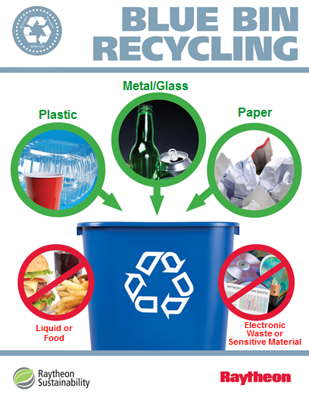
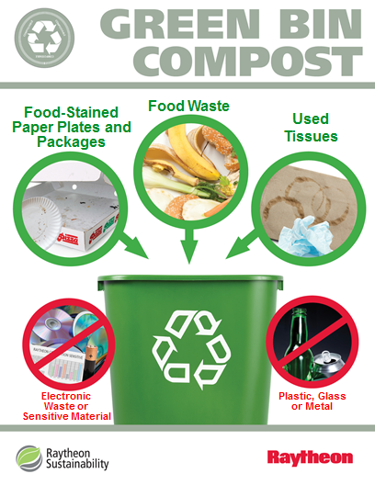
Is Zero Waste Really Zero Waste?
E-waste can be one of the unique exceptions to the typical recycling / composting collection program
Special collection containers can be used to collect phones, cables, mice etc.

Slide 13
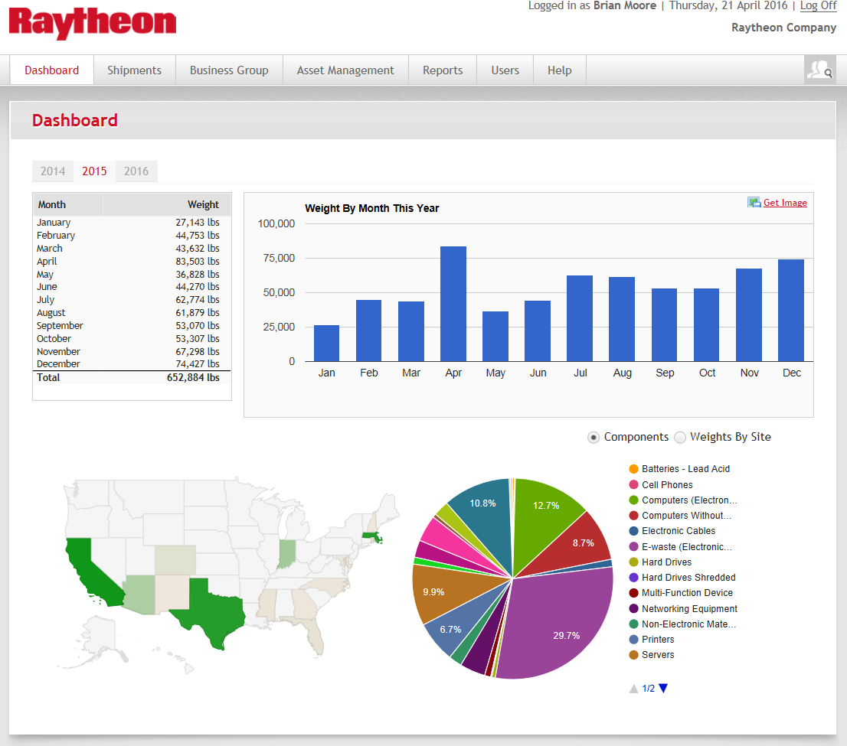
E-Waste Portal – Robust Metrics
We processed over 652K pounds of e-waste in 2015!
Financial returns of over $175K annually!
Notes:
Early this year we did a survey.. Culture and practice ensured…

Slide 14
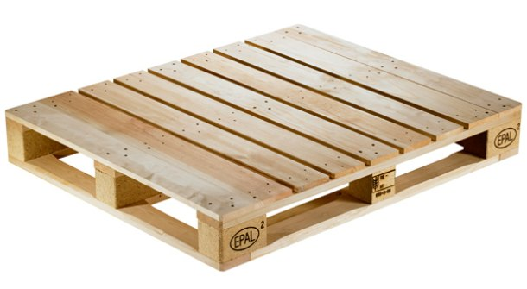
Responsible Packaging: Reusable Container for E-Waste
Reusable container (4’ x 4’) piloted by in New England
Eliminates the need for wooden pallets and shrink wrap (40.5 lbs. / shipment)
Can be collapsed flat when not in use
Better ergonomic design to facilitate loading and unloading
Notes:
Container is same size as a wooden pallet – 48” square

Slide 15
Brian Balukonis

