Slide 1
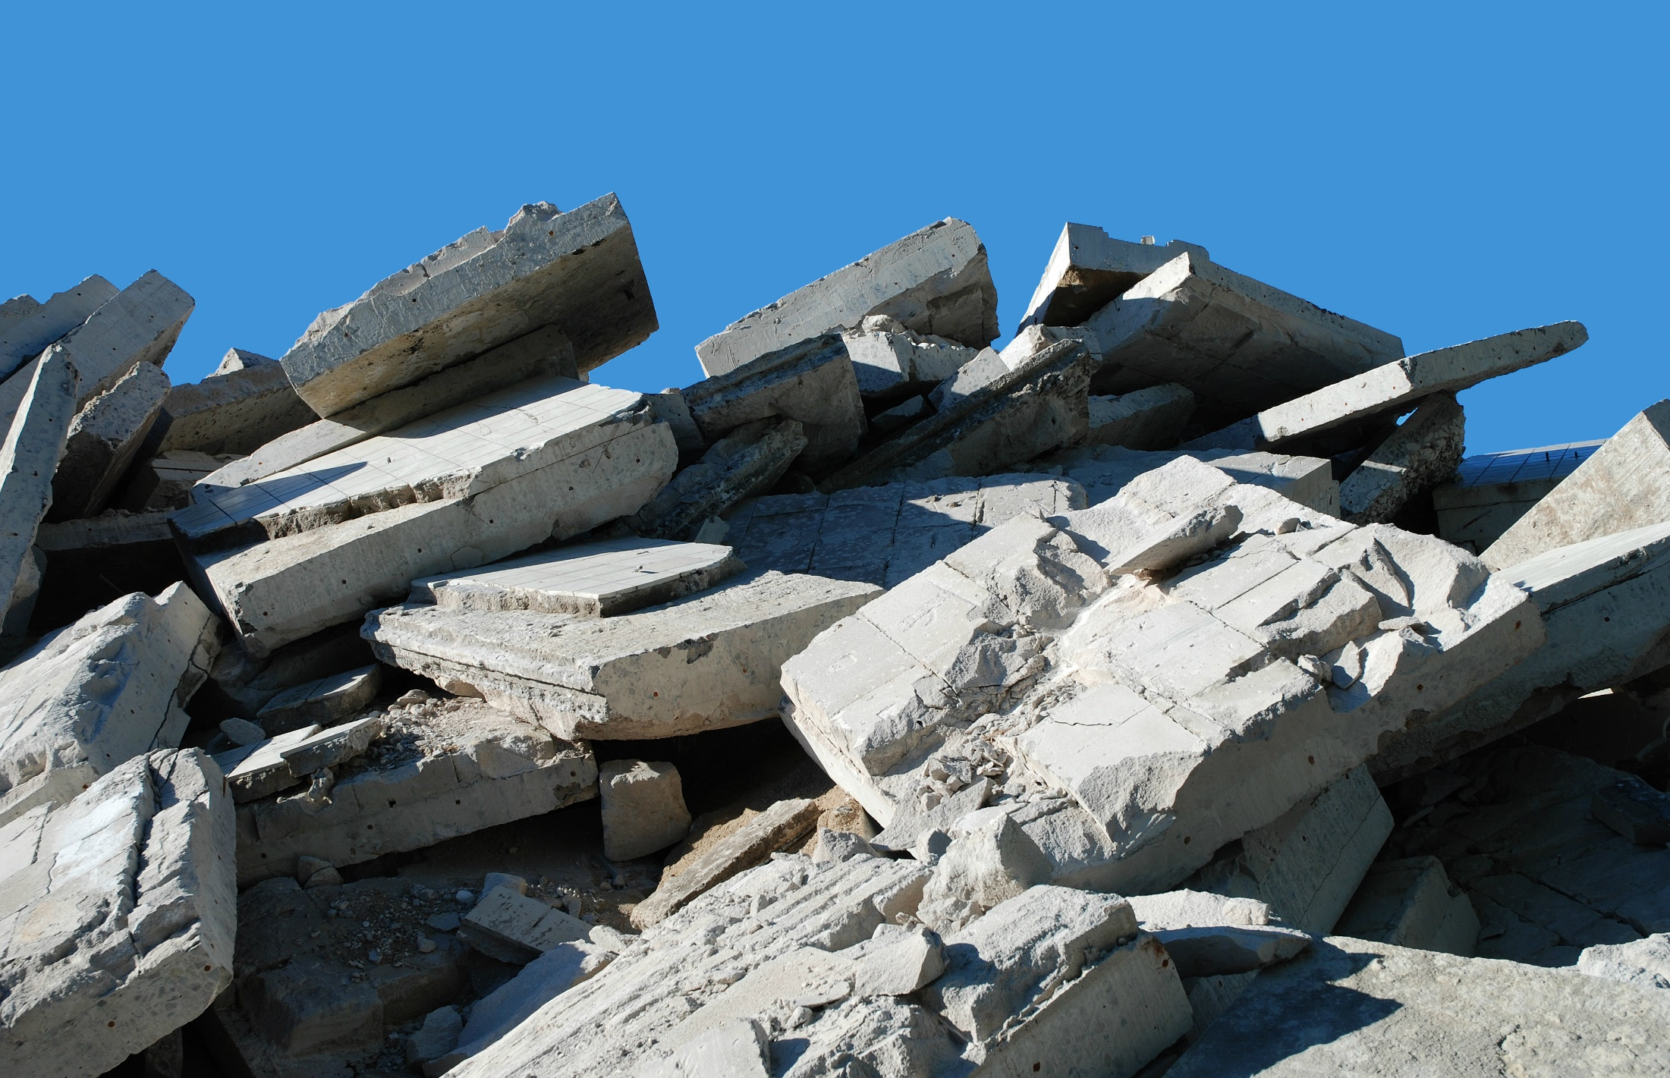
RecyclingWorks in Massachusetts
Best Management Practices Planning Session for C&D Management
December 1, 2016

Slide 2
RecyclingWorks in Massachusetts
Helps businesses and institutions
Comply with MassDEP Waste Bans - includes some C&D materials
Maximize waste diversion
Save money
Improve Customer/Employee satisfaction
Funded by MassDEP, delivered under contract by the Center for EcoTechnology
Notes:
Waste bans – include some C&D materials such as:
ABC (asphalt, brick & concrete)
clean gypsum

Slide 3
RecyclingWorks in Massachusetts
Services include:
Online Resources
Email and Phone Hotline
Technical Assistance
Events and Workshops
C&U Program Administration
http://www.recyclingworksma.com

Slide 4
C&D Material Best Management Practices
Similar approach to the 2013 creation of food waste collection BMPs and 2015 Food Donation BMPs
Engage stakeholders – MassDEP, Contractors, Architects, Haulers, Processors, Bldg Inspectors
Objective is to increase reuse and recycling of C&D materials
Notes:
End Product: Guidance for contractors, demolition companies etc
Not coming up with new ideas – instead, finding examples of what is happening already so that we can share it and capture more material
Discussing this topic at about a dozen meetings, some that we are hosting ourselves, others, like this, where this topic is on the agenda for an association meeting. This is the fourth stakeholder meeting.
Each meeting builds on the previous one, building towards guidance that we can share

Slide 5
Stakeholder Meetings
Eastern Mass Meeting, June 23 in Boston
National Association of the Remodeling Industry Eastern MA Chapter, Sept 7 in Natick
Central Mass Meeting, Sept 22 in Worcester
USGBC Meeting, Oct 3 in Boston
Western Mass Green Night, Oct 12 in Northampton
NESEA Pro Tour, Oct 21 in Wayland
College & University Forum, Oct 25 at UMass Lowell
Associated General Contractors of MA, Oct 26 in Wellesley
Cape Cod Cooperative Ext Workshop, Nov 9 in Barnstable
Western Mass Meeting, Nov 10 in Springfield
Home Builders & Remodelers Assoc of Western MA,
Nov 17 in Springfield
Boston Society of Architects, Nov 30 in Boston
WasteWise Forum, Dec 1 in Tewksbury
Notes:
Have been hosting a series of meetings across the state on this topic – this is the final meeting.

Slide 6
Discussion Points
Reuse
Recycling
On-site source separation
Comingled collection and C&D processing
Other topics?
Notes:
- These issues will vary depending upon scale, building type, and materials (eg, small stick-built residential different than large concrete/steel/glass commercial structure)
For each discussion point, I’ll go over what we have heard so far and then open it up for discussion.
Since the BMPs are in development, presenting general themes and specific issues we have heard. I’ll mention some specific components that will likely end up comprising the BMPs – but everything will be sent out for review before finalizing and posting

Slide 7
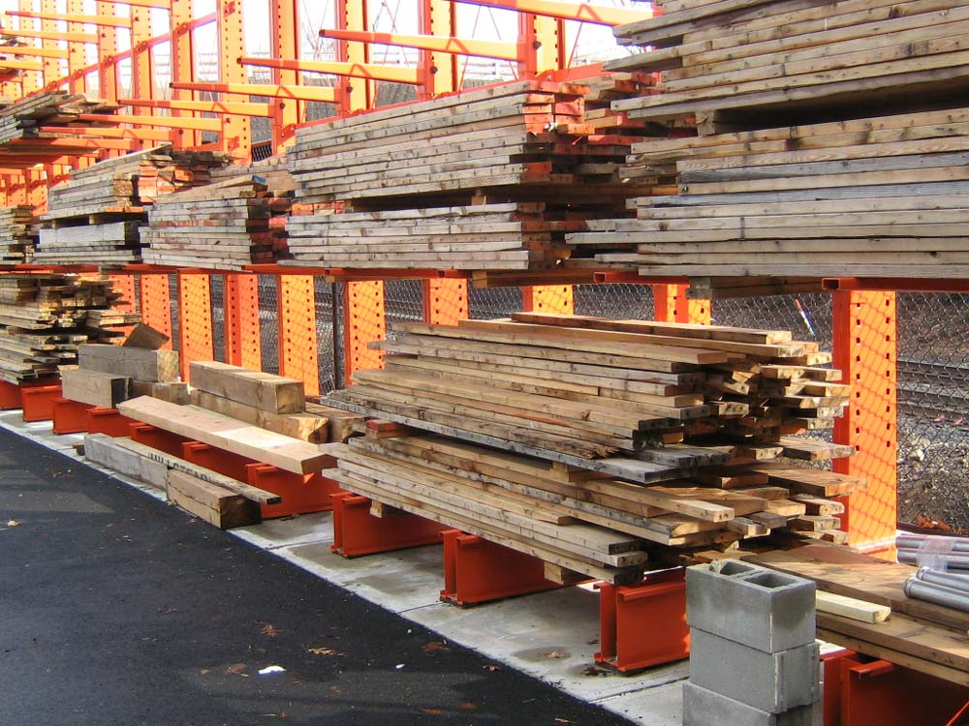
Reuse
Deco vs demo cost analysis
Labor and Disposal fees
Tax benefits for donation
Connecting with a reuse outlet
Focus on materials homeowners might buy
Other salvage outlets
Notes:
Informal reuse strategies - esp on small projects -using leftover materials from previous projects, using craigslist, taking materials to a free shed at a local transfer station
Tax benefits of donating reusable materials
Claim up to $5,000 deduction per EVENT without an appraisal; don’t know if there is a limit
Connecting with a reuse/salvage outlet:
There are a number of these across the state (BBR, Eco, Habitat network of 11 Restores)
Walkthroughs to identify salvageable materials – recommend before getting bid from demo contractor – get two bids, one just demo, one combines decon w/ demo
Will pick up materials, often for free.
Do not do deconstruction themselves but can refer to contractors in your area that do deconstruction
Highlight materials to target for reuse
Cost-effective, high resale value, environmental benefit
Materials salvage outlets want: their customers are mostly homeowners and landlords of residential properties, so items folks would use in a home remodel are most desirable: kitchen cabinets, sinks, tubs, toilets, hardwood flooring, wood, landscape materials such as pavers (not out of date, eg, pink toilet)
Foam insulation (foundations)
Projects with most salvage potential
Those with the materials homeowners want to buy (houses)
Hotels, senior living centers, apartments, condos, timeshares
Things in commercial properties tend to not be as desirable
Other
Other outlets for salvaged material
Architectural salvage and wood salvage businesses
Larger salvage businesses (often international focus), Furniture Trust, IRN, Re-Stream, GRRO International, Bikes Not Bombs
May be a gap for reuse of larger commercial projects (eg, 100 commercial doors)
Gaps / other challengers
There may be a gap in the reuse market for larger commercial projects (eg, 100 commercial doors)
Interim storage
Liability for donation?

Slide 8
On-site source separation
Building Product EcoSystems: Gypsum Separation https://vimeo.com/135889925

Slide 9
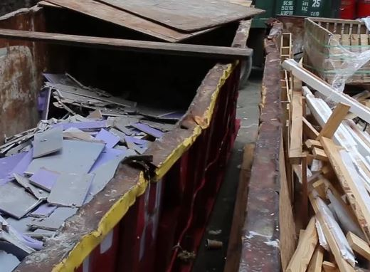
On-site source separation
What materials?
Markets
Value
Include dumpster staging in timeline
Flooring first
Financial benefits
Notes:
What materials?
What materials have viable processing infrastructure in Massachusetts? What don’t?
Gypsum – changing market, currently sent to PA, 3 collection sites in MA
Ceiling Tiles – Armstrong program
ABC (asphalt, brick, concrete – can also include some ceramic)
Asphalt shingles (great candidate, gaps in infrastructure)
Cardboard (great market)
What materials might have a commodity value and could be sold if you have enough of it?
Dumpster Staging
Rotate dumpsters depending upon stage in project (eg, gypsum recycling dumpster when installing gypsum)
Remove flooring at beginning
Especially carpeting (otherwise too dirty)
Financial Benefits
Eg, example of large scale commercial remodel in a high rise, saved $1 million by source separating 98% of materials, scale needed for saving $?

Slide 10
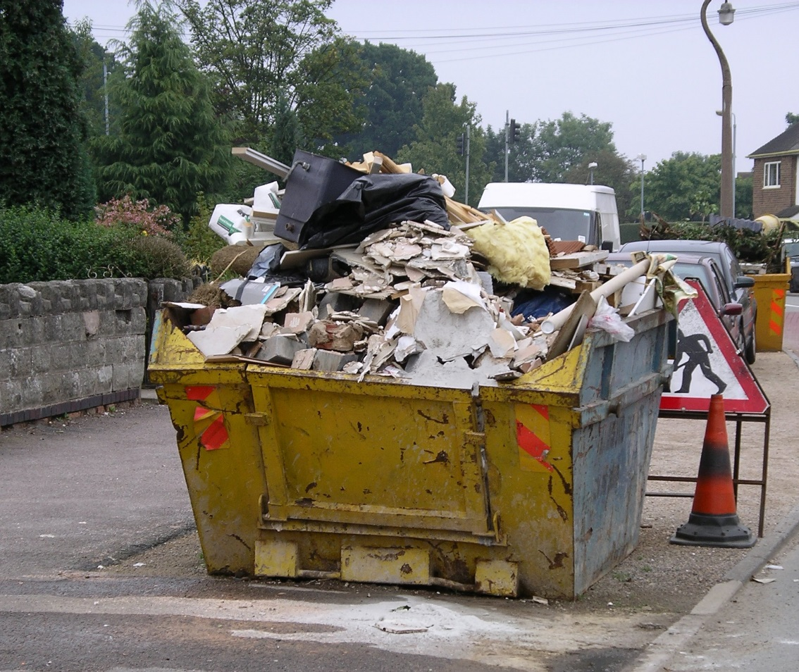
Comingled Collection and C&D Processing
Metal: high value and easy to separate
Wood and cardboard: easy to separate
Gypsum, ceiling tiles, carpet, plastic sheeting: hard to separate
Notes:
Metal is most high value
Wood and cardboard are easy to separate, wood has little advantage when source separated, cardboard could get higher diversion rate
Difficult materials include: gypsum, ceiling tiles (crumble, fines); carpet, plastic sheeting (tangle in machinery)
Provide information to contractors about what happens at comingled sorting facilities (especially helpful for those pursuing LEED certification)
Materials w/out a market:
Window glass is challenging, no recycling market, hard to separate
Vinyl, no market?
Spray foam insulation, no market?

Slide 11
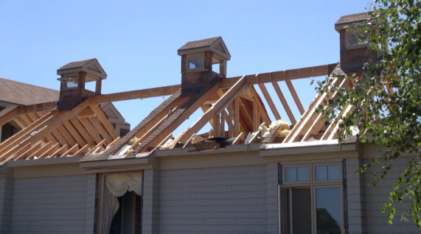
Other topics
LEED credits
Role of building officials
Design for durability and deconstruction
Waste management plans
MassDEP C&D Debris Industry Study
Other topics???
Notes:
LEED Credits – provide info about LEED v4 Construction Waste prerequisite
Construction Waste Plan (target at least 5 materials) Prerequisite
Alternative Daily Cover is NOT considered diversion, waste to energy might count
Source reduction is a new option for compliance
LEED credit based on overall processor data, not individual project data – no credit for specific material stream from your project
Source separation could bring down overall recycling rates at C&D sorting facilities, affecting overall rate for LEED points
Bldg officials can help provide reuse/recycling info when contractors apply for bldg permits
Could benefit if doing decon – shorter waiting periods
Some municipalities (eg, Portland) have laws related to deconstructing buildings
Source reduction – design bldgs to use materials that are durable rather than disposable, have potential to be reused or recycled when bldg. is later renovated or demolished (EPA manual on deconstruction)
Waste management plans – owner/architect helps set standards for what materials will be reused or recycled
MassDEP C&D Debris Industry – looking at residuals from C&D sorting facilities to identify potential materials to target for increased diversion

Slide 12
Next Steps
Spring – Fall 2016: Stakeholder Engagement
13 Stakeholder Meetings, over 150 participants
MassDEP C&D Subcommittee Meeting, Dec 6 in Boston
Present outline of main topics
Winter 2016/17: Develop draft BMPs
EBCNE Annual C&D Summit, January 26: Present Draft BMPs
Distribute draft BMPs and collect comments
Spring 2017: Finalize and post BMPs to RecyclingWorksMA.com
Present at March 2017 C&D Subcommittee Meeting
Contact RecyclingWorks with questions or comments:
info@RecyclingWorksMA.com or (888) 254-5525
Notes:
Subcommittee Mtg
Contact RecyclingWorks for further input or feedback. Also, to request assistance.

