Slide 1
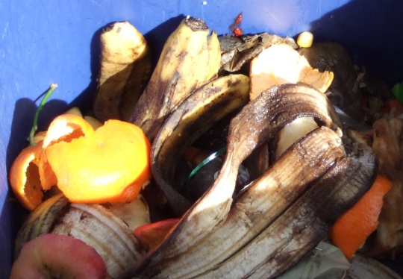
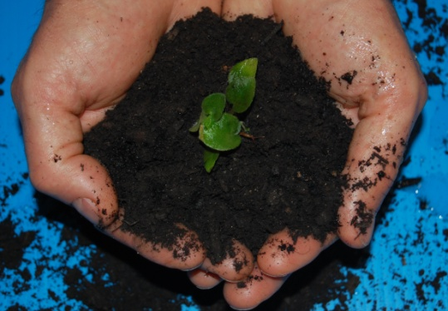
Sustainable Food Waste Management Through the Food Recovery Challenge June 13, 2013 Waste Wise Forum Janet Bowen -U.S. EPA-New England
www.epa.gov/foodrecoverychallenge

Slide 2
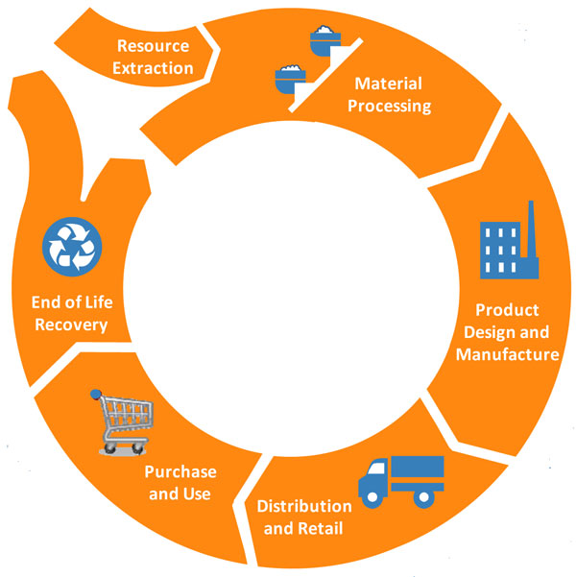
WASTE vs. MATERIALS Management
Disposal
Recovery
Notes:
This is a simple chart that shows the lifecycle of a product: resource extraction, processing, manufacturing, distribution, use, and finally recovery or disposal. All materials follow this lifecycle. Traditionally, programs focused on “waste management” at the end of a material’s lifecycle, which is represented by the small circle in this graphic. Waste management could include recycling, burning for energy recovery, composting, and landfill disposal.

Slide 3
Materials Management: A Working Definition
“Materials management is an approach to using and reusing resources most efficiently and sustainably throughout their lifecycles. It seeks to minimize materials used and all associated environmental impacts.”
From EPA, Opportunities to Reduce Greenhouse Gas Emissions through Materials and Land Management Practices (PDF) (98pp, 1.5MB)
Notes:
Here is a working definition of materials management. [READ definition] “Materials management is an approach to using and reusing resources most efficiently and sustainably throughout their lifecycles. It seeks to minimize materials used and all associated environmental impacts.” So, now that we’re all on the same page about the lifecycle impacts of materials, the question still remains: “how do we reduce these impacts?”

Slide 4
So how can you reduce your food waste and save money?
For more info: www.epa.gov/foodrecovery
Notes:
EPA’s food waste hierarchy encourages taking action at the source reduction and donation level, with landfilling and incineration as the as the least preferable, or last resort, food management option. I will walk you through food management opportunities and share success stories from other FRC partners at each level of this hierarchy. This year we will be focused on nationally on recruiting venues (sports, conference, entertainment), universities, and grocers to the Food Recovery Challenge and this will be reflected in examples to follow.

Slide 5
Source: Sustainable Food Waste Symposium, 2012

Slide 6
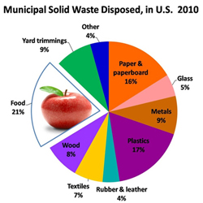

Slide 7
So how much food are we throwing away every year?
In total, just under 34 million tons of food waste was disposed of in landfills/incinerators in 2009 (14% of the country’s total waste stream)
Less than 3% of food waste was recovered for recycling (composting) in 2009 (EPA, 2010)
Notes:
That makes Food waste the single largest component of our municipal solid waste stream that ends up in the landfill.
Sometimes “recycling” is confusing in the food waste context. Might want to change to composting when you talk about this slide.
Need to work on this slide and remove the amount generated/correlate it to the money lost each year.

Slide 8
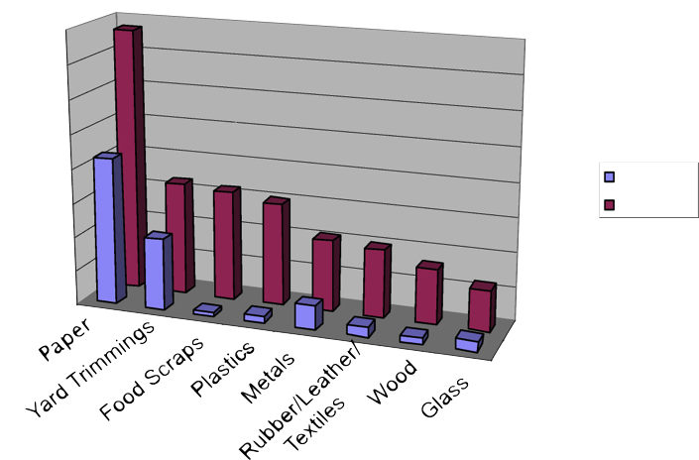
Recycling vs. Waste Generation
80
70
60
Recycling rates vs. waste generation
50
40
30
millions of tons
Recycled
Generated
20
10
0
EPA 2008 Facts and Figures
Notes:
This next EPA chart shows that in 2008, as a nation, we were pretty good at recycling paper and yard debris but have significant room for improvement in all other material categories, including food scraps and yard trimmings. Just a different way to visualize this information.

Slide 9
Food waste is a problem because it impacts the economy.
Financially, wasted food costs America more than $100 billion annually (Bloom, 2007)
Disposal cost of municipal waste management
Over purchasing costs
Cost of lost energy
Notes:
Add in case study examples in talking points

Slide 10
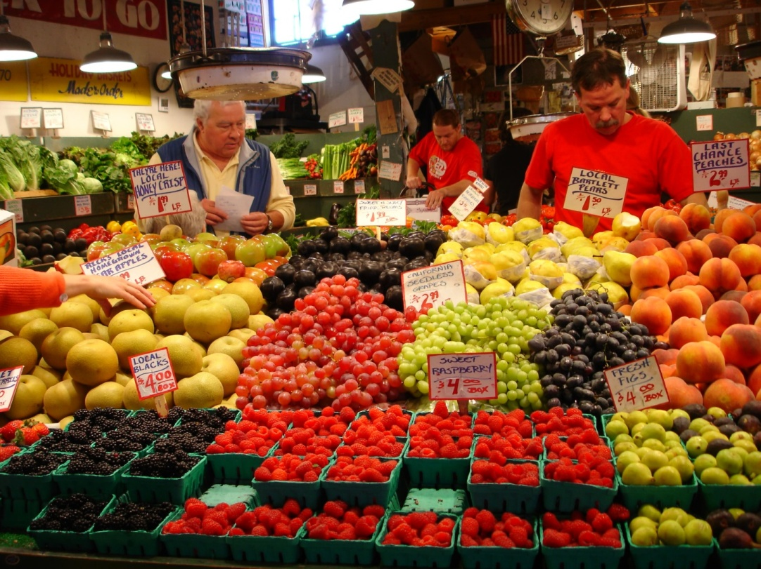
It impacts society.
50 million Americans, or 14% of American households, were food insecure in 2009 (USDA).
Food insecurity can increase the likelihood for an individual to have major health concerns.
Notes:
1 in 8 people in Philadelphia and other urban settings are food insecure. Effects children and seniors disproportionally.
Food insecurity is when people don’t “at all times have access to sufficient, safe, nutritious food to maintain a healthy and active life”. (World Food Summit, 1996)

Slide 11
It impacts the environment.
Food that enters a landfill produces methane, a greenhouse gas with 21 times the warming potential of CO₂
Food production impacts water quality, soil productivity, and contributes to about 13% of the nation’s greenhouse gas emissions.

Slide 12
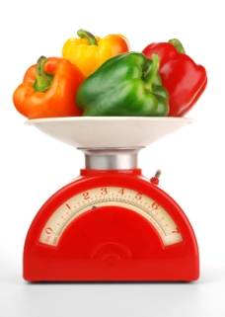
Government Actions
EPA’s Food Recovery Challenge
Mass WasteWise Program
Notes:
Also new program by USDA The US Food Waste Challenge http://www.usda.gov/oce/foodwaste/index.htm
The UN SAVE FOOD: Global Initiative on Food Losses and Waste Reduction
http://www.fao.org/save-food/en/

Slide 13
EPA’s Food Recovery Challenge (FRC)
Recognition & Awards
Technical Tools / Assistance
Waste Tracking System
Cost Savings and Brand Recognition
Supporting Your Community
Reducing Environmental Impact
Notes:
Supporting your community – could also be changed to “meeting your social responsibility obligations” or helping your neighbors
Public recognition and communications assistance
Free technical assistance
An online waste reporting and data management system
The opportunity to compete for WasteWise (or SMM??) Awards
Brand recognition, trust and reputation as a group is a more significant driver than money. Per recent UNGlobal Compact and Accenture report, $$$ is second.

Slide 14
The FRC is a great tool to help you reduce your food waste.
The FRC is a FREE, simple tool.
You’ll receive free technical assistance from regional EPA staff.
Standardized metrics allow for easy data tracking & comparison (internally & externally).
Opportunity to learn about best management practices.
Be recognized for your innovative work on food waste reduction & recovery.

Slide 15
What We Can Do For You…
EPA tools and technical assistance
WasteWise Tool Re-TRAC for tracking waste
Personalized annual progress report with Climate Profile
Other EPA Tools
Food Waste Management Calculator
Food Waste Source Reduction Auditing Tool
Regular webinars on food waste related issues
Clearinghouse for case studies, tools, templates, BMPs, and outreach materials
Notes:
Webinars: Sept 29th – kick-off webinar. Then more sector specific webinars – Nov. 10 Green Chill Webinar with Grocers on FRC; Nov 17. SMM Webinar on recycling and the FRC with Venues; Dec. 15 Grocers and the FRC and Jan 19 Universities and the FRC – leading up to Recyclemania launch in February
By early 2012 you will have access to a clearinghouse of case studies….

Slide 16
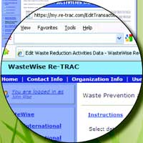
Re-TRAC thru WasteWise
What WasteWise Re-TRAC does:
Compiles and analyzes your waste management data and maintains historical files.
Submits your annual data to the WasteWise program with a click.
Generates instant reports on program performance and trends, and calculates GHG emission reductions associated with your activities.
Provides your official EPA Climate Profile report on an annual basis.
"The new Re-TRAC system is beyond fabulous. It really improves the data entering experience. Thank you, thank you, thank you!!!!" - Mariah Titlow Tinger, Senior Environmental Program Coordinator, Genzyme Corporation

Slide 17
EPA Food: Too Good to Waste Toolkit
The complete toolkit and research reports can be downloaded from our FTP site at: http://bit.ly/Food_Too_Good_To_Waste

Slide 18
What We Can Do For You…
Recognition
Website
Awards
Case Studies

Slide 19
What’s In It For You?
Reduce your costs
Improve your image
Feed your communities
Protect your environment.

Slide 20
Join Now!
And… take a bite out of food waste!
http://www.epa.gov/foodrecoverychallenge
Four Easy Steps!
Assess It! Conduct baseline food waste assessment
Commit to It! Set a goal.
Do It! Undertake food waste reduction and recovery activities to meet your goals!
Track It! Report annually using WasteWise tool

Slide 21
Participants November 2011 Thank You!
US Coast Guard Academy
MIT
Harvard University
Clark University
C/U- Food Recovery Challenge Partners

Slide 22
Participants June 2013
C/U- Food Recovery Challenge Partners
Assumption College/SODEXO
Bates College
Bentley University
Boston College
Clark University
College of the Atlantic
College of the Holy Cross
Harvard University
Johnson & Wales University
Johnson State College/SODEXO
Keene State College
Lesley University
Lyndon State College/SODEXO
Middlebury College
MIT
Northeastern University
Plymouth State University/SODEXO
Roger Williams University
Salem State University
Suffolk University
Tufts University
UCONN
UMASS Amherst
UMASS Dartmouth
University of New Hampshire
University of Maine – Farmington
University of Maine – Orono
University of Southern Maine
US Coast Guard Academy
VT Technical College
Wellesley college
Wesleyan University
Westfield State University/SODEXO
Worcester state university

Slide 23
Contact Information
Christine Beling
beling.christine@epa.gov
(617) 918-1792
Janet Bowen
bowen.janet@epa.gov
(617) 918-1795
http://www.epa.gov/foodrecoverychallenge

Slide 24
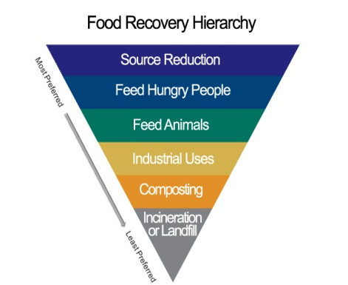
Notes:
Food waste is all over the main stream media and state and local programs. Here is a small sampling !

Slide 25
Details for Joining the FRC
Join Waste Wise and the Food Recovery Challenge at http://www.epa.gov/osw/partnerships/wastewise/join.htm
Make sure to choose Food Recovery Challenge when you join
Conduct baseline food waste assessment within 90 days of joining
Done using the WasteWise Tool (http://www.epa.gov/osw/partnerships/wastewise/retrac.htm)
Set a goal for reducing the amount of food waste reaching landfills.
Year One: Commit to at least one of the three food diversion categories (prevention, donation, and composting). If you have no data from a previous year for a category, partners may select a site-specific goal.
Report annually
Done using the WasteWise Tool
Get Recognized!
Annual awards for outstanding participants
Notes:
Can take out if it is too detailed for your audience.

