Slide 1
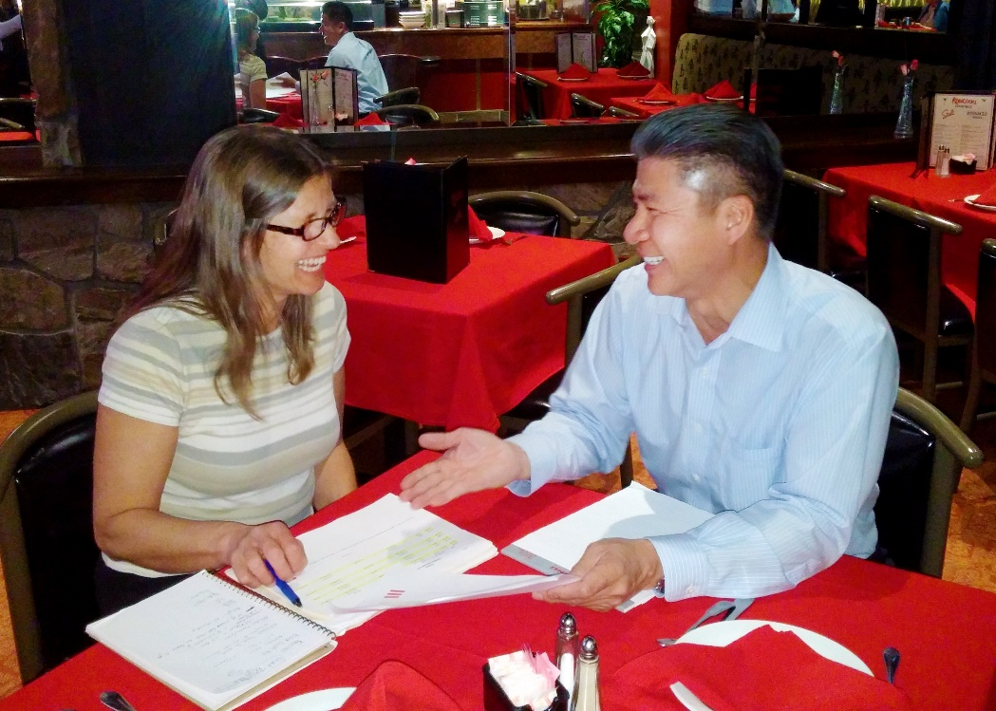
RecyclingWorks in Massachusetts
Best Management Practices Planning Session
Business Guidance for Hauler Contracting
December 1, 2016

Slide 2
Discussion Points
Know The Waste
Waste Ban Compliance
Reporting and Contamination
Effective Communication
Adjustments to contracts
Other topics?
Notes:
These are the discussion points.
As meetings progress and feedback is provided, more information will be added for our BMPs

Slide 3
Know The Waste
Evaluating waste before meeting with a hauler
Checking dumpsters
Responsibility for all parties

Slide 4
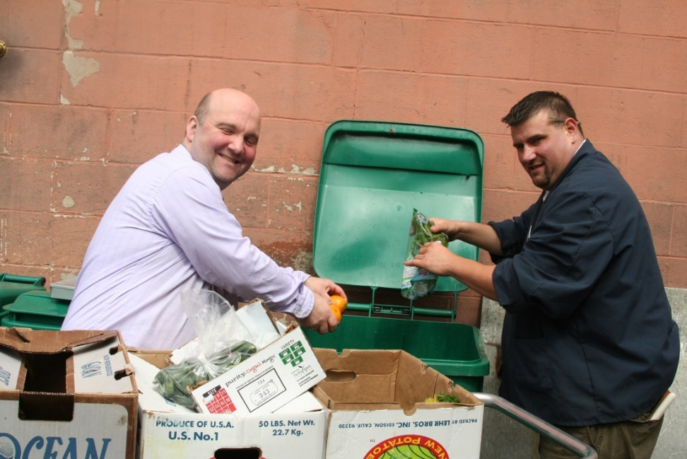
Waste Ban Compliance
Sector based handout
Municipal Hauler Regulations
Waste Management Policies
Locking compactors?
Notes:
Is there a way to ensure customers’ awareness and responsibility for waste bans? Are they aware of the bans when they come to you?
How frequently are customers and haulers talking about waste bans?

Slide 5
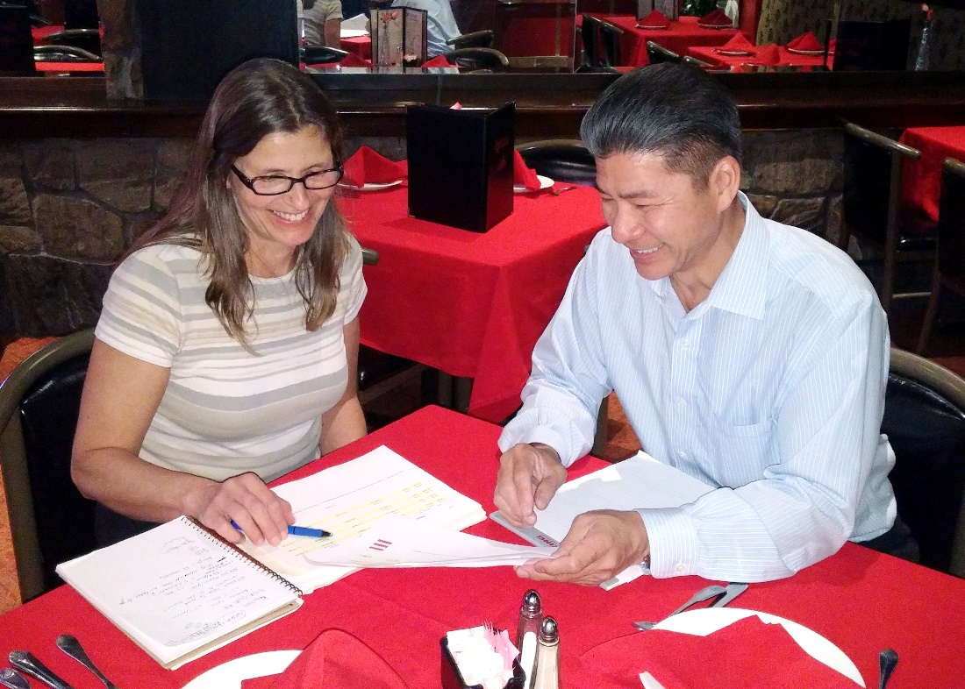
Reporting and Contamination
Penalties for contamination
Providing metrics
Notes:
>What is the mechanism for feedback for improper disposal? Pictures, statements, bills, etc.?
>What are the different penalty levels?
>Resource Management Contract
>Reporting process to know contamination

Slide 6
Effective Communication
Updating and reviewing current programs
Using RecyclingWorks as a resource
MassDEP Resource Management Contracting
Notes:
What are the key steps businesses and institutions should take to communicate and partner more effectively with haulers?
A glossary of terms for the customer/generator?
Customer should also ask how they can improve
Using RecyclingWorks as a resource

Slide 7
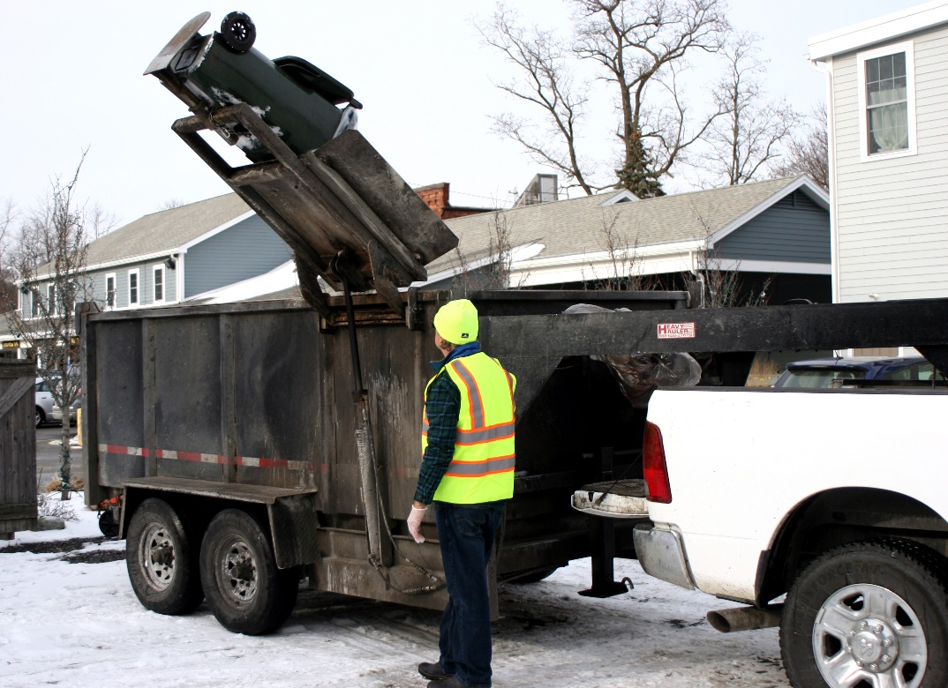
Adjustments to Contracts and Services
Service level changes
Right sizing
Sub-contracting
Negotiation
Notes:
How can contracts be structured to enable changes in service levels while being fair to both business customers and haulers?
Topics: On-call service, what can customers expect?
Is there flexibility in the contracts?

Slide 8
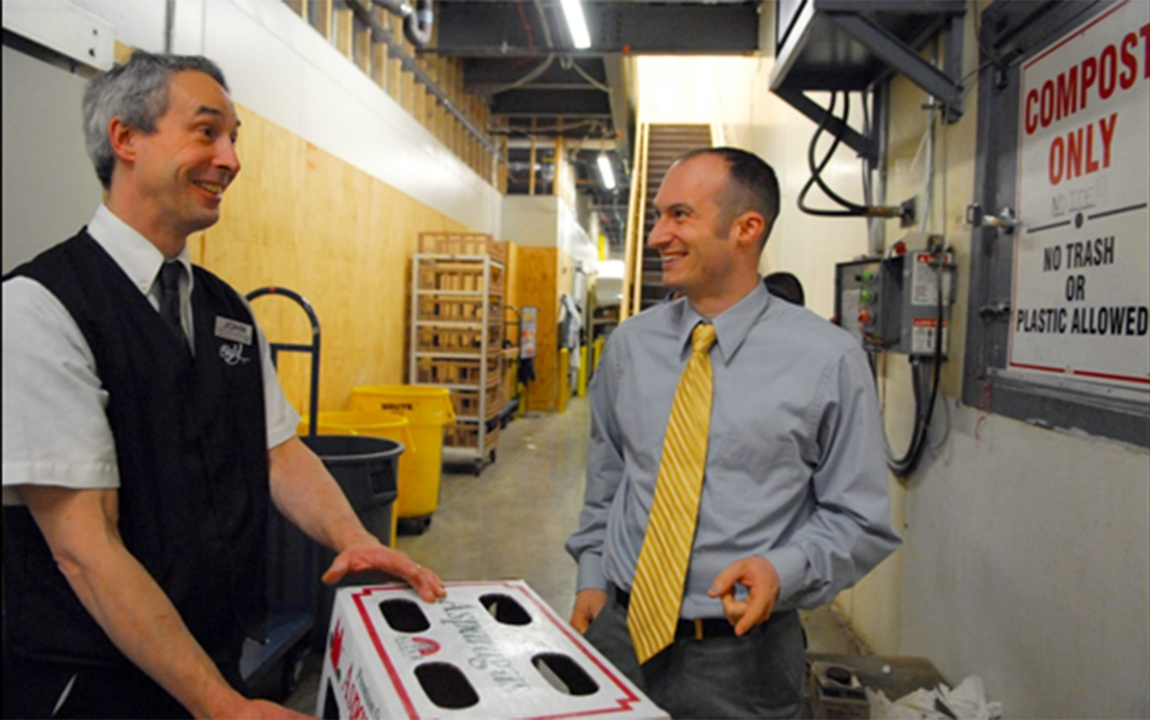
Other topics
What key issues have we missed?

Slide 9
Next Steps
Draft of Best Management Practices will be sent out for feedback
Call or email RecyclingWorks with any questions or comments
info@RecyclingWorksMA.com
(888) 254-5525

