Slide 1
UTEC Mattress Recycling
College & University Recycling (CURC) Fall Forum:
Food Donation & Mattress Recycling
December 10, 2015
www.utec-mattress.org

Slide 2
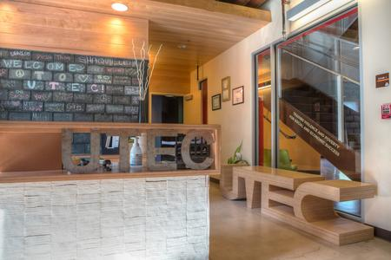
Discussion Overview
UTEC
Social Enterprises
Source of Volume
Process
After Market

Slide 3
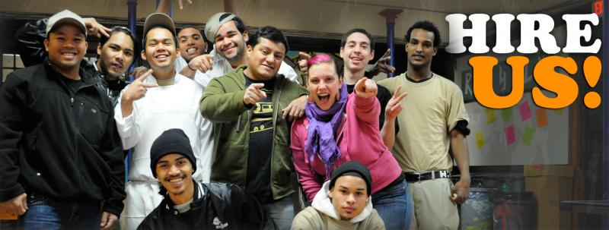
UTEC & Social Enterprise
UTEC founded 1999
Serving “proven risk” youth 16-24
Focus on education, employment and reduced criminal recidivism
Social Enterprises
Culinary
Woodworking
Mattress Recycling
Commercial Kitchen

Slide 4
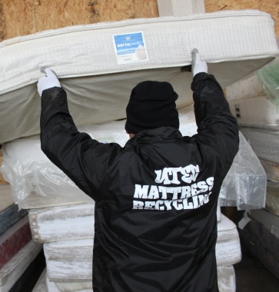
Mattress Recycling
Mattress program begun 2012
Consultant work – Saint Vincent de Paul
University pick-ups
Low volumes
Business ramped up in FY 2014
7000 sq. ft. deconstruction space
City of Lowell contract, along with 18 new municipalities and growing
Contracts with hotels, universities, and aggressive pursuit of state and government run facilities
Took in 6,400 mattresses in FY15, expect 15,000 in FY16

Slide 5
Mattress Recycling

Slide 6
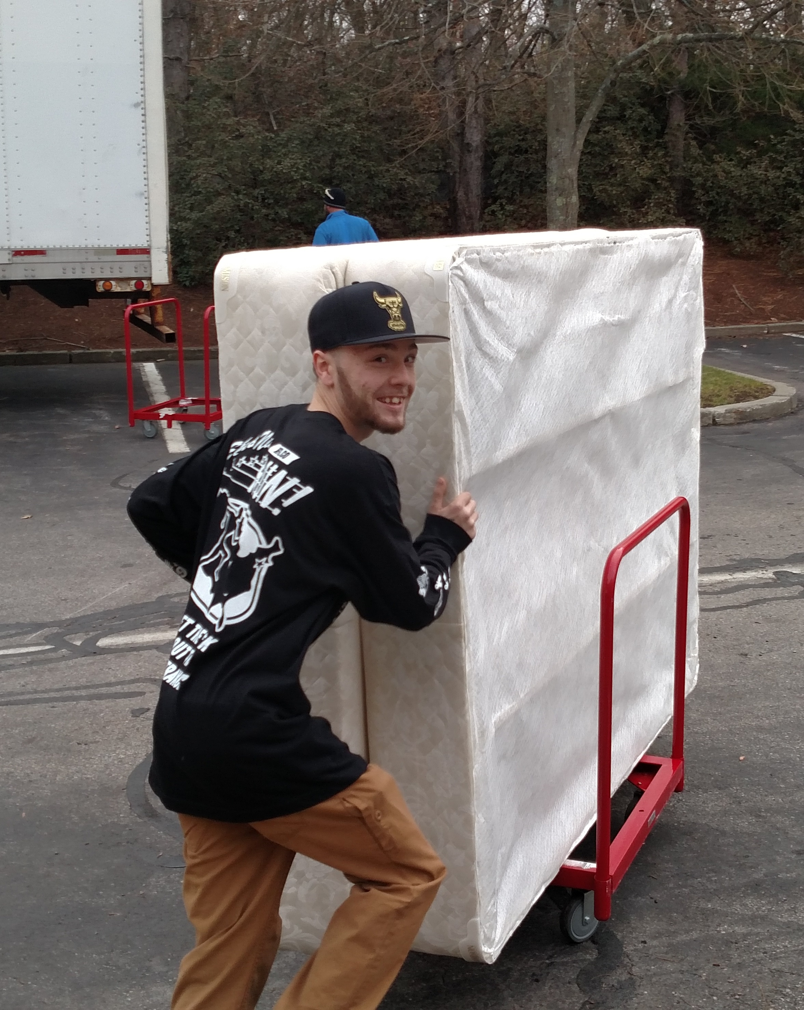
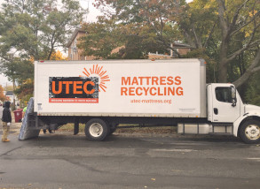
Mattress Recycling
Current State of Business
Hauling 500-1000 mattresses/month
Municipal pick-up agreements
Lowell, Newburyport
Transfer station pick-up agreements
DEP Partnerships
University/School pick-ups
10 schools in FY 2015, 11 in FY 2016
Hotels
5 hotels in FY 2014, 4 in FY 2016

Slide 7
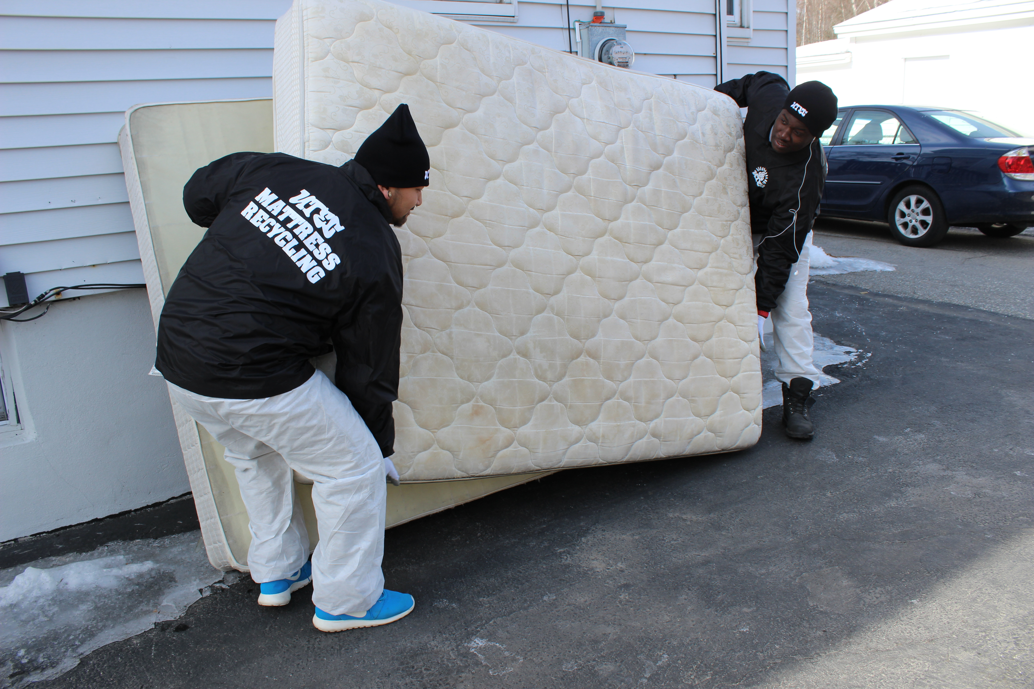
Mattress Recycling
Process
Customers pay UTEC to haul
UTEC does pick-up or takes drop off
Youth involved in pick ups and deconstruction
Offers move in and take away service
Staff oversees process
Mattresses disassembled in warehouse by hand
85% of materials recycled

Slide 8
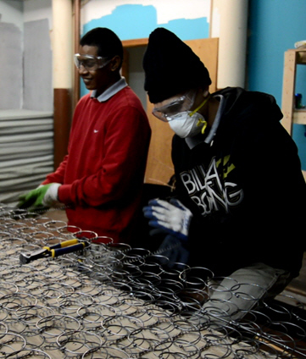
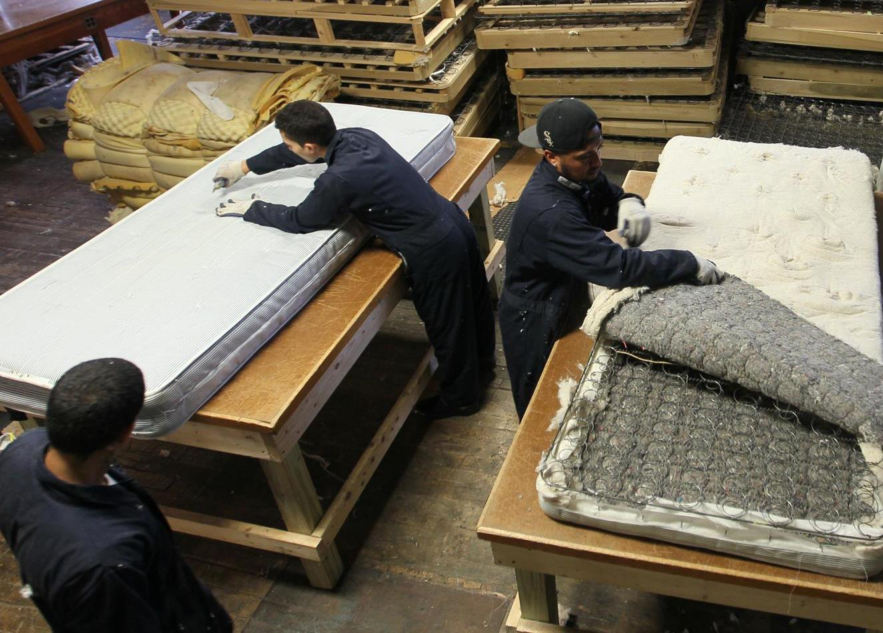
Mattress Recycling
Process
Protective suits
Goggles
Masks
Gloves
Box cutters

Slide 9
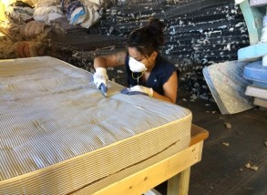
Mattress Recycling
Process
Four cutting tables
Youth and staff hand cut each mattress
Everything broken down
Target minimal amount of trash
Bedbug inspection and quarantine
PureHeat site inspection and training

Slide 10
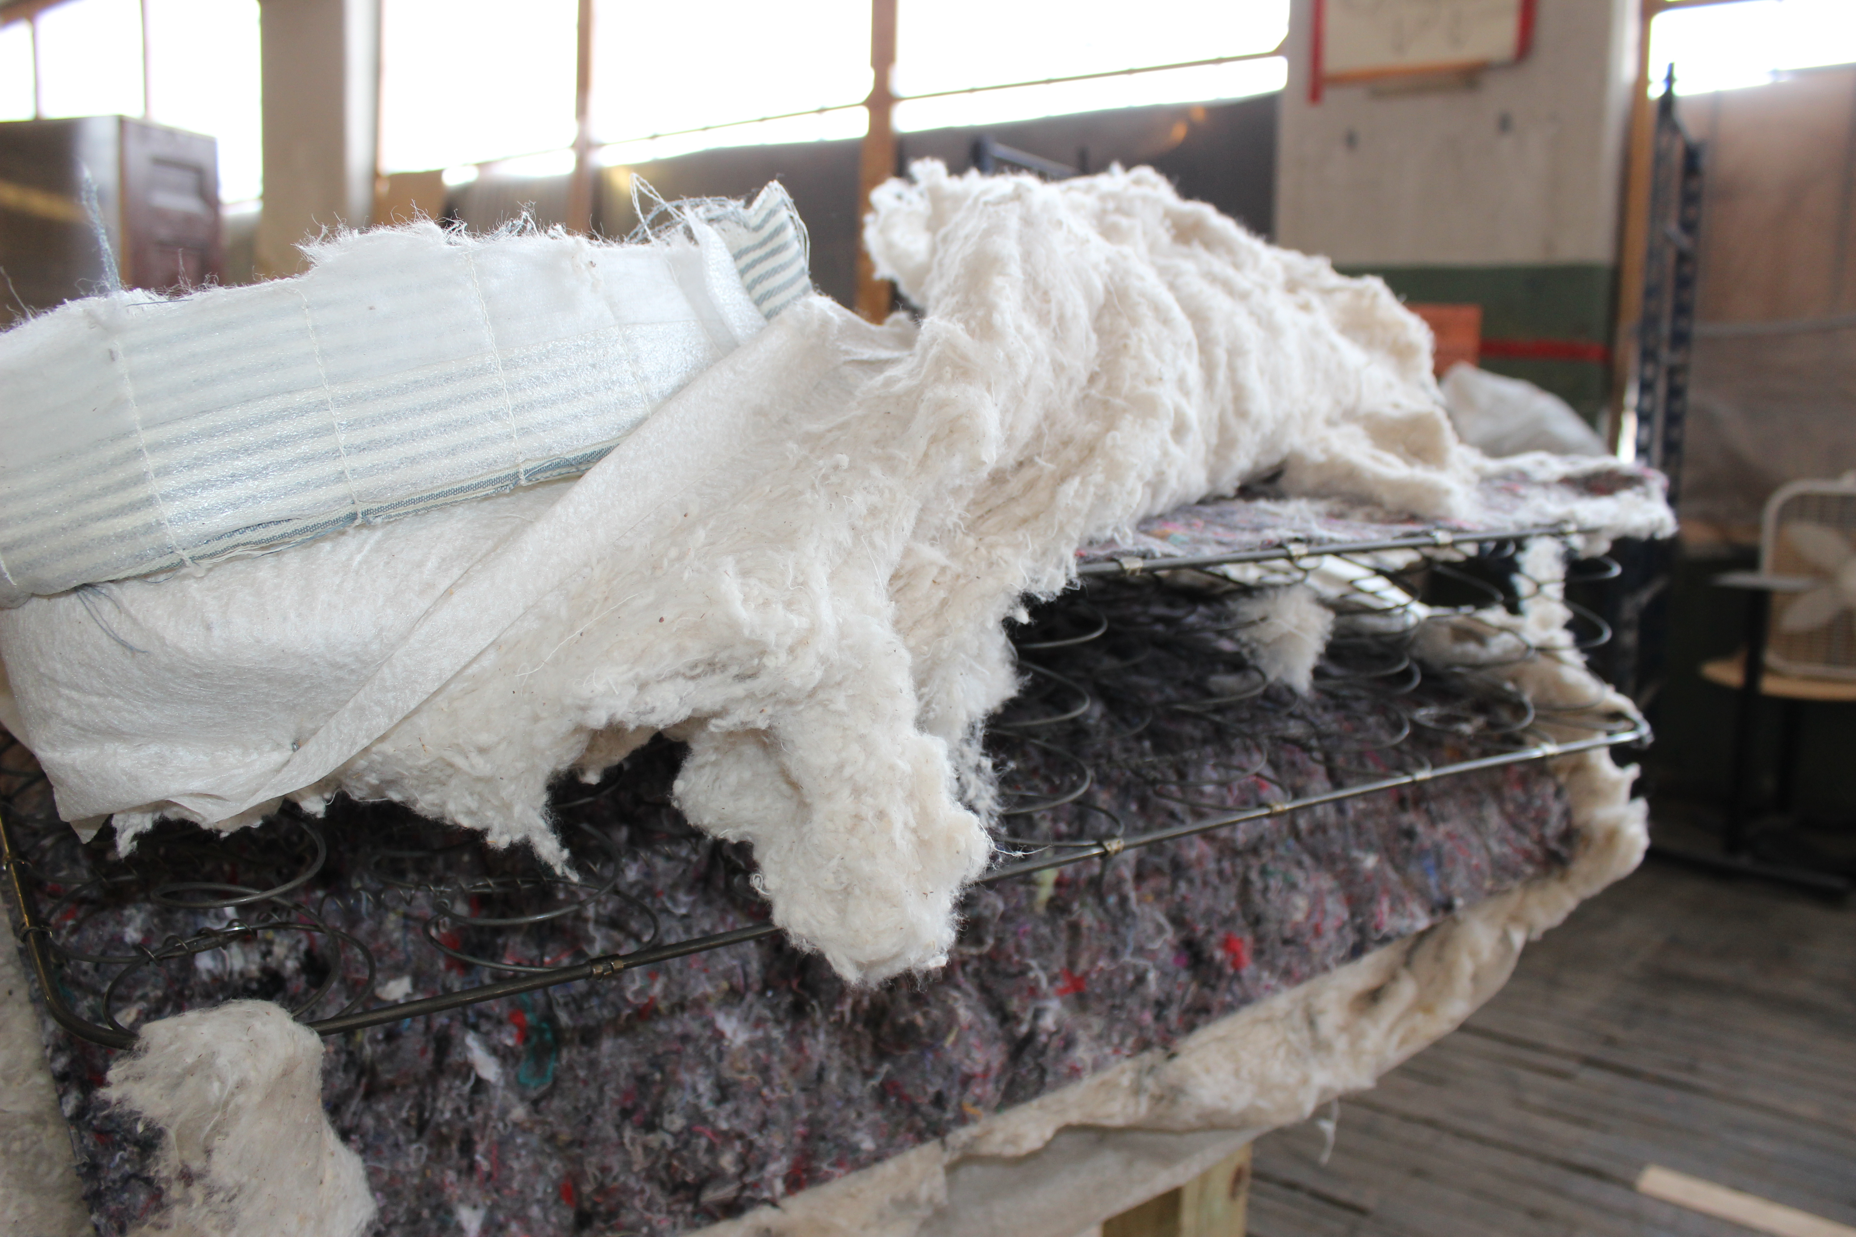
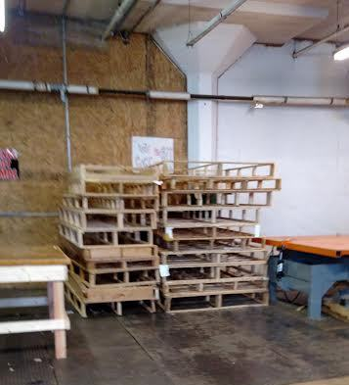
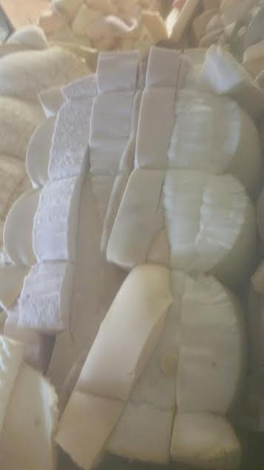
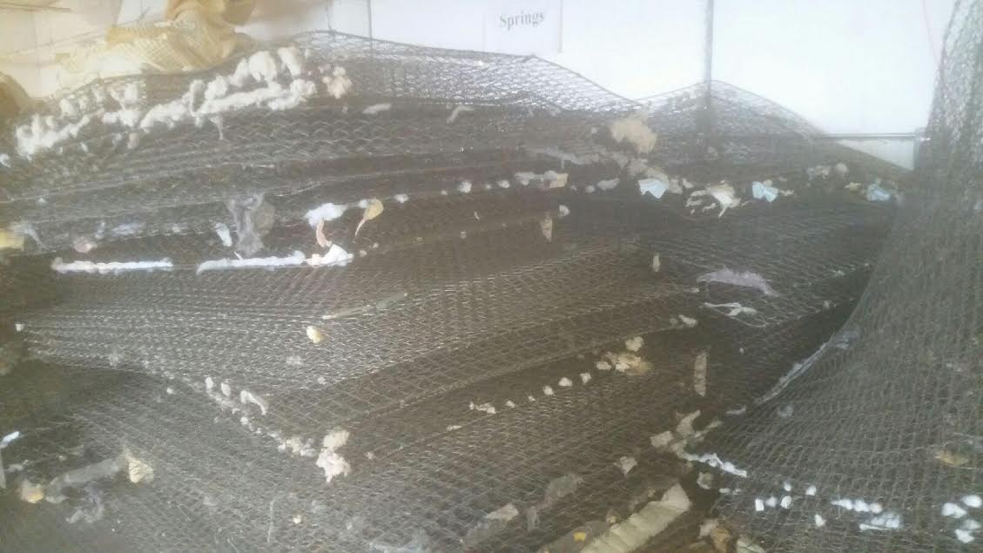
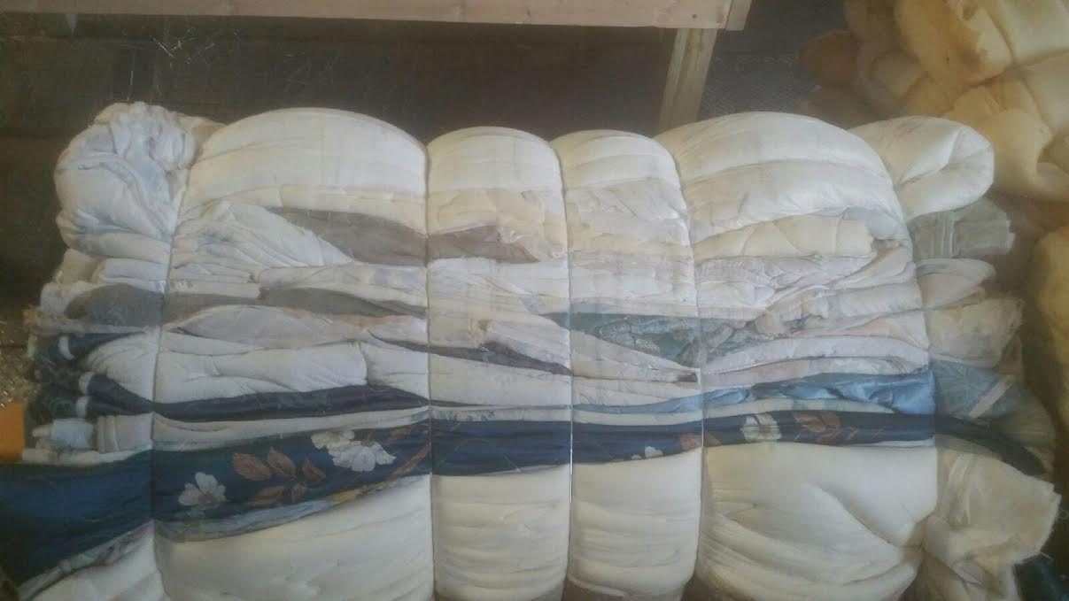
Mattress Recycling
Process
Materials separated into piles and baled
Springs
Foam
Toppers
Enduralator Pads
Cotton

Slide 11
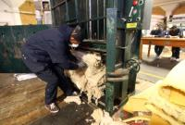
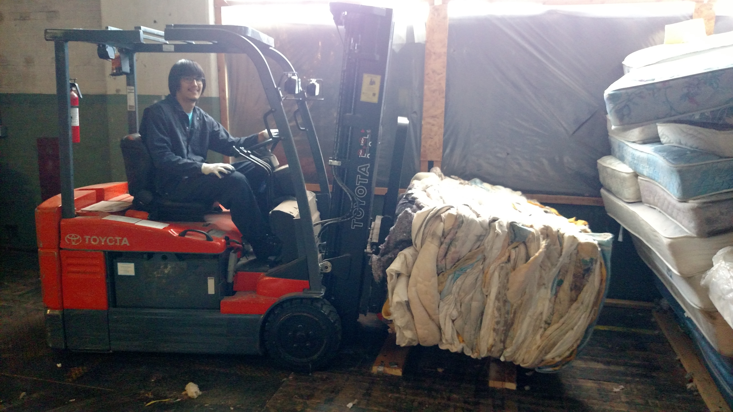
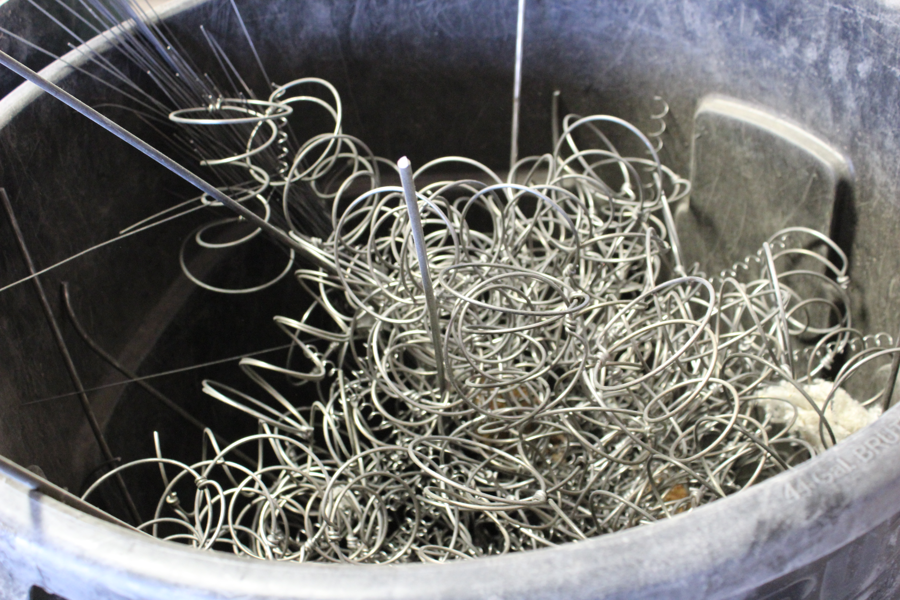
Mattress Recycling
After-Market
Different buyers for different materials
Pursuing local and international repurposing opportunities

Slide 12
UTEC Social Enterprises
For more information contact us:
UTEC Mattress Recycling
35 Warren St.
Lowell, MA 01852
www.utec-mattress.org
Call Jennie Sawyer 978-856-3915

