Slide 1
Federal Initiatives on Food Efficiency and Recovery
Christine Beling
Assistance and Pollution Prevention
U.S. Environmental Protection Agency-New England
December 10, 2015

Slide 2
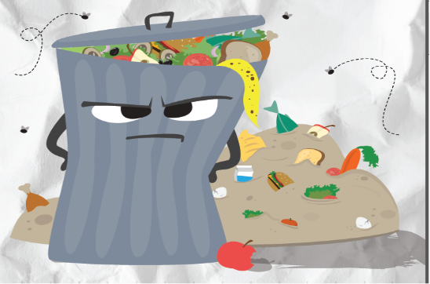
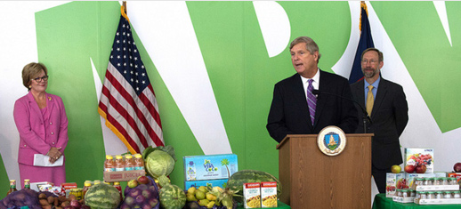
U.S. 2030 Food Waste Reduction Goal
On September 16, 2015, US EPA Deputy Administrator Meiburg and USDA Secretary Vilsack announced the United States’ first-ever national food waste reduction goal.
Reduce wasted food by 50% by 2030.
Notes:
https://www.choosemyplate.gov/lets-talk-trash
The 2030 Food Loss and Waste Domestic 50% Reduction goal is a federal goal with USDA and EPA taking leadership roles.
The baseline for the goal is Per Capita food waste for 2010 (218.9 lbs/person).
The 2030 goal is 109.4 lbs/person.
The measure focuses on food loss and waste at the retail and consumer level.
To quote EPA Administrator Gina McCarthy "Let's feed people, not landfills. By reducing wasted food in landfills, we cut harmful methane emissions that fuel climate change, conserve our natural resources, and protect our planet for future generations" The USDA/EPA announcement presents a major environmental, social and public health opportunity for the U.S., and we're proud to be part of a national effort to reduce the food that goes into landfills."

Slide 3
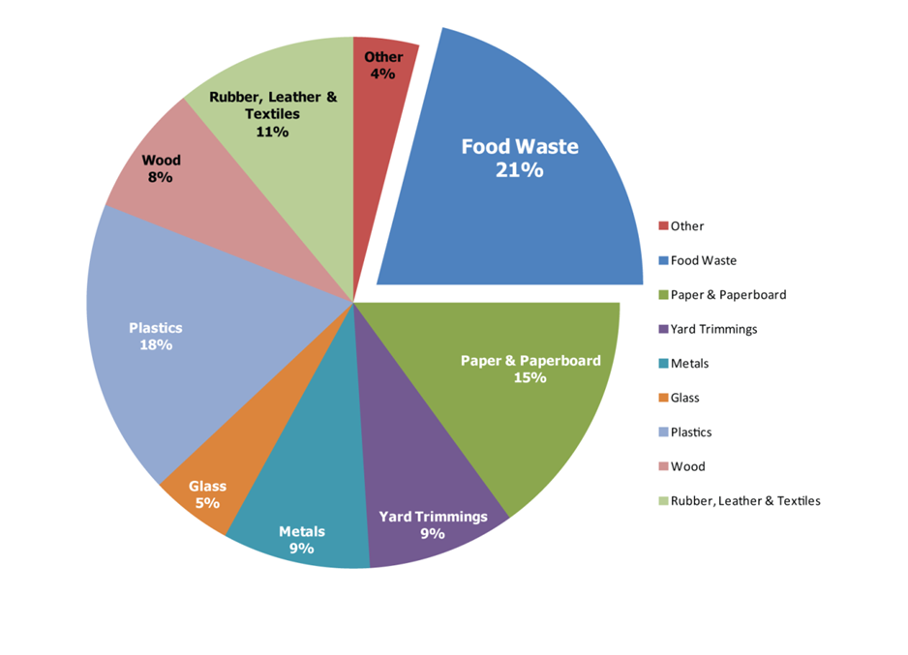
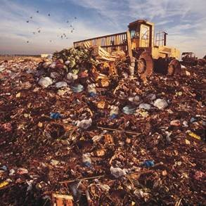
U.S. Wasted Food Profile

Slide 4
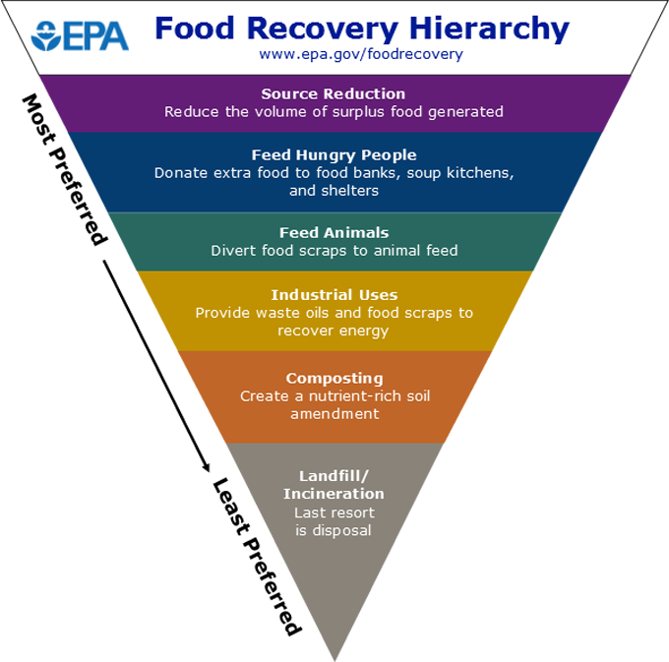
What is EPA Doing?
Food Recovery Challenge

Slide 5
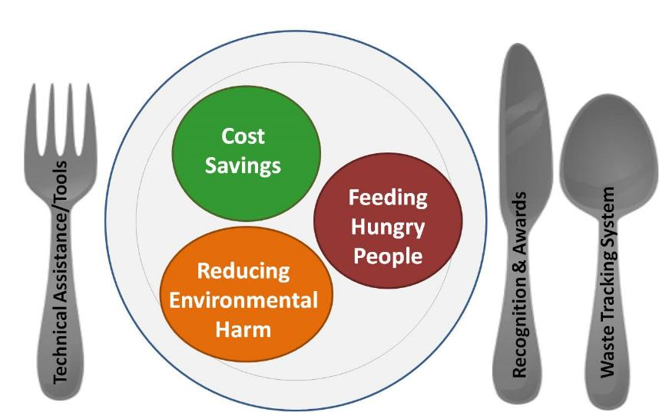
The Food Recovery Challenge
The Challenge encourages organizations to:
Change practices to purchase leaner to minimize waste
Divert surplus food away from landfills to local hunger relief organizations
Compost food scraps
Benefits to participants:
Improve your bottom line
Support your community
Reduce your environmental footprint

Slide 6
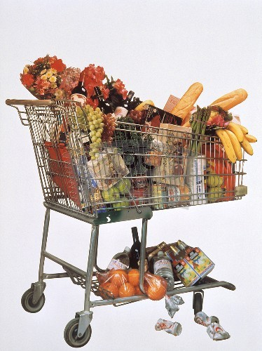
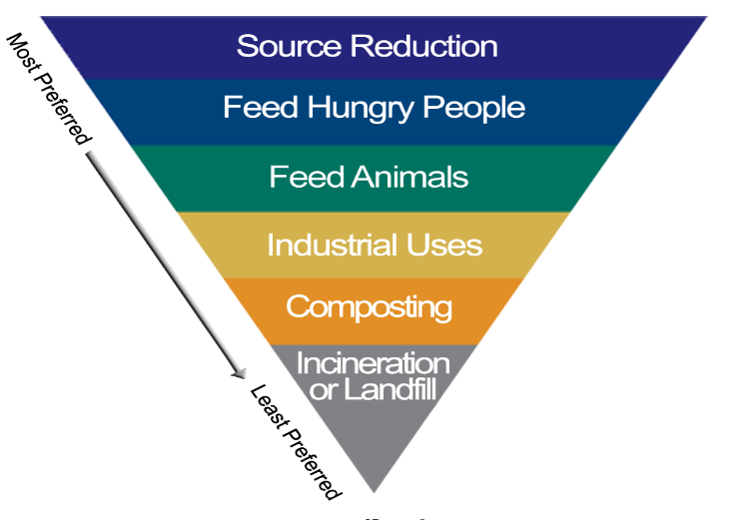
Challenge Accomplishments
Over 800 participants - ranging from your local corner store to one of the largest hotel chains.
Our participants prevented over 600,000 tons of wasted food from going to landfills this year.
Challenge participants dramatically increased source reduction – from just 7,00 tons in 2013 to 85,000 tons in 2014.

Slide 7
2015 Food Recovery Challenge Data-Driven Awardees
Colleges and Universities: Salem State University; Salem, Massachusetts
K-12 Schools: Pearl City High School; Honolulu, Hawaii
Grocers: Sprouts Farmers Markets; Tucson, Arizona
Hospitality: Ortega National Parks, LLC: White Sands Trading Company; Alamogordo, New Mexico
Restaurants and Food Service Providers: Serendipity Catering; Denver, Colorado
Sports and Entertainment Venues: SAVOR…Chicago-McCormick Place South; Chicago Illinois
Other Organization: Orange County Sheriff’s Department, Theo Lacy Facility; Orange, California
Notes:
EPA has just announced the 2015 Food Recovery Challenge Winners.
Congratulations to these Data-Driven Award Winners. Each of these winners are outstanding leaders in reducing food waste and protecting the environment!
The data-driven award recipients are those Challenge participants that achieved the highest percent increase of wasted food diversion and prevention in their sector in 2014.

Slide 8
2015 Food Recovery Challenge Narrative Awardees
Source Reduction Winner: University of California (UC) Santa Cruz; Santa Cruz, California
Source Reduction Honorable Mention: Clark University; Worchester, Massachusetts
Leadership Winner: MB Financial Park at Rosemont/Village of Rosemont; Rosemont, Illinois
Innovation Winner: Crystal Creamery; Modesto, California
Innovation Honorable Mention: City of Philadelphia: Philadelphia Prison System; Philadelphia, Pennsylvania
Education and Outreach Winner: Keene State College; Keene, New Hampshire
Endorser Winner: Massachusetts Department of Environmental Protection; Massachusetts

Slide 9
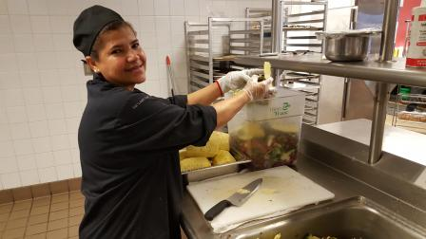
2015 NATIONAL FRC Awardee: Salem State University (operated by Chartwells) Data-driven Winner, Colleges and Universities
Notes:
Salem State University
Data-driven Winner, Colleges and Universities
“Chartwells is honored to work with Salem State University in support of sustainability initiatives and proud to receive the EPA’s Food Recovery national award. By implementing programs that provide solutions, Chartwells’ will continue to build upon sustainable food management practices that support the environment and local communities.” -- John Hayes FMP, Resident District Manager at Salem State University

Slide 10
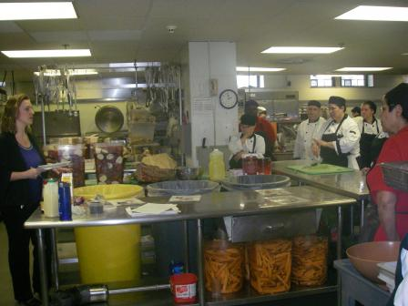
2015 NATIONAL FRC Awardee: Clark University Narrative Category Honorable Mention, Source Reduction
Notes:
Clark University’s Dining Services, managed by Sodexo, implements “from scratch” meal preparation starting with un-processed foods that are prepared fresh every day and creatively reuse trimmings for stocks, soups and sauces, to greatly reduce waste. Employees are encouraged to develop and share ideas to reduce waste further, including monitoring for recyclable and compostable waste in color-coded buckets. Their LeanPath Food Waste Prevention Tracking System recorded source reduction of 12,019 pounds in a year period.

Slide 11
2015 NATIONAL FRC Awardee: Keene State College Narrative Category Winner, Education and Outreach
Notes:
Keene State College Dining Services is committed to helping students recognize the far reaching impact of wasted food by implementing outreach initiatives including: table top announcements, waste buffets, waste demonstrations and a presentation by food waste advocate Jonathan Bloom. Their campaign evolved from and revolves around our spokes-vegetable “The Carrot” who represents the journey every vegetable makes from garden to plate to compost. “The Carrot” makes appearances in the Dining Commons several times every year (both in human form and in the student commissioned sculpture), including freshmen orientation, as a gentle reminder to be thoughtful about food choices.

Slide 12
2015 FRC Awardee: Massachusetts Department of Environmental Protection
Notes:
Narrative Category Winner, Endorser
“The Massachusetts Department of Environmental Protection is proud to receive U.S. EPA’s National Food Recovery Challenge Endorser Award for our program to reuse, recycle and compost food waste from commercial entities across the Commonwealth. We also are pleased to see so many Massachusetts institutions recognized as national leaders for their efforts to divert food waste from disposal.” -- MassDEP Commissioner Martin Suuberg
2014 was a pivotal year for Massachusetts in the area of sustainable food management. In October, on the heels of a multi-year outreach, education, assistance, and market development plan, MassDEP enacted a ban on disposal of commercial organic materialsExit by Massachusetts businesses and institutions that dispose of one ton or more of these materials per week. Recognizing that wasted food comprises 15 percent, or nearly one million tons, of municipal solid waste disposed in Massachusetts per year, MassDEP proposed the ban as a major component of ambitious waste diversion goals outlined in its 2020 Solid Waste Master Plan. In the period leading up to the ban, MassDEP (and RecyclingWorks in Massachusetts, a recycling assistance program funded by MassDEP to help businesses maximize recycling, reuse, and wasted food diversion opportunities) met with representatives from the various sectors affected by the ban, including, but not limited to, colleges and universities, hospitals, venues, supermarkets, public health officials, solid waste facilities, and food banks. These efforts resulted in increased awareness of the need to manage food materials more responsibly and led to an open dialogue about how to manage it, which continued through regular Organics Subcommittee meetings at MassDEP’s Boston office. MassDEP partnered in research concerning effective on-site management of organic waste, and MassDEP and RecyclingWorks compiled helpful resources on their websites to provide information on the scope of wasted food services available and the best management practices available for using them.

Slide 13
2015 REGIONAL FRC Awardees:
MASSACHUSETTS College and Universities
Lesley University
UMass Lowell
Wellesley College
Massachusetts Institute of Technology Northeastern University
Massachusetts Maritime Academy

